Slide 1

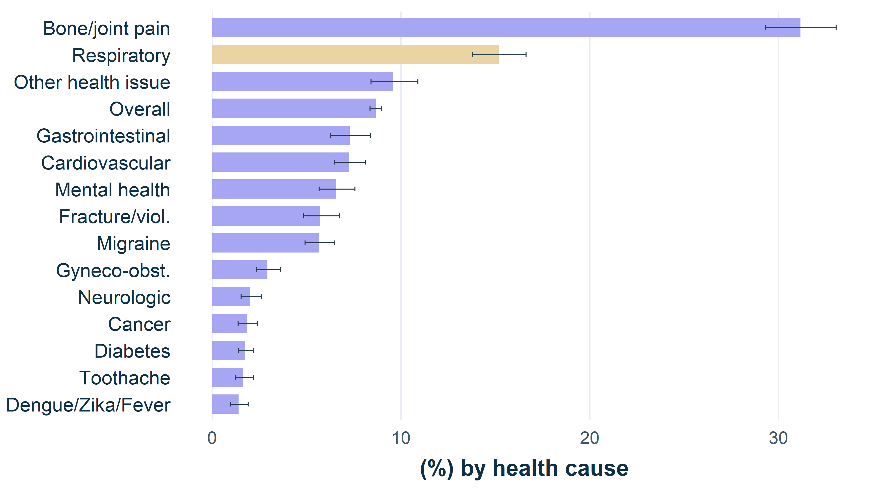
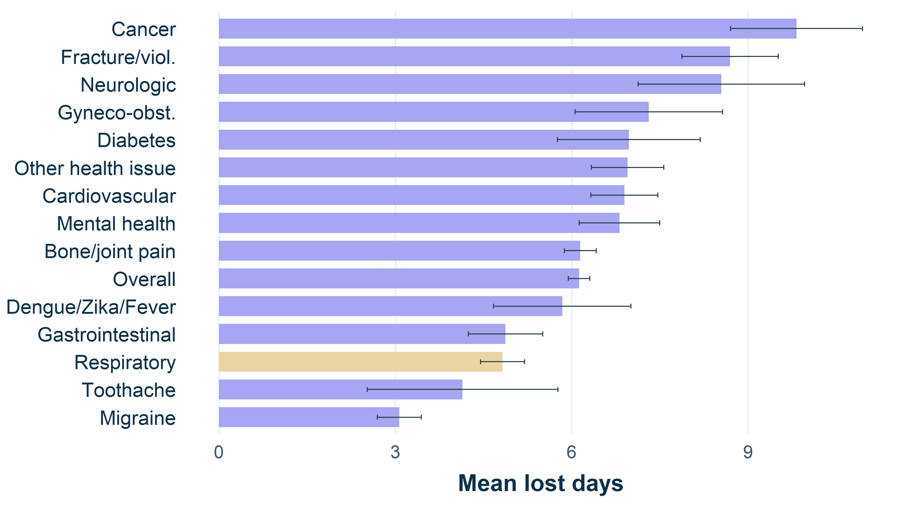
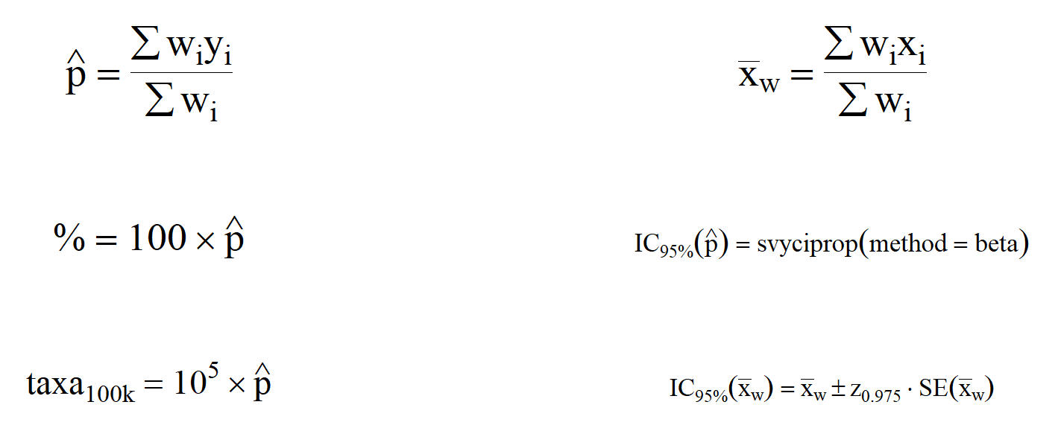


Implementing the Brazilian National Health Survey sampling design in R: a case study on asthma in Brazil.
Asthma diagnosis increased; control, medication access and functional burden must be interpreted through the PNS sampling design.
Discussion and Implications
APPLIED DISCUSSION
• Increased diagnosis may reflect higher occurrence, better diagnostic access, or both.
• Stable recent attacks indicate that broader detection does not automatically mean better clinical control.
• Lower medication use among diagnosed people requires caution: denominator, case mix and 95% CIs affect interpretation.
• Functional burden matters economically: attacks and respiratory symptoms can increase absences, lost workdays, productivity loss and pressure on families and services.
BETA CI AND INFERENCE
• State and subgroup proportions may involve few events and limits near 0 or 1.
• Wald intervals can have unstable coverage and impossible limits.
• Beta CIs respect the 0-1 scale and were used for proportions estimated with survey::svyciprop(method = "beta").
• Year/state comparisons combine magnitude and 95% CI overlap.
ETL, OMOP AND ECONOMY
• The workflow documents extraction, indicator treatment, sampling design and reproducible visualization.
• PNS is not a longitudinal clinical database, but can serve as a population reference layer for OMOP/OHDSI.
• Harmonized indicators support interoperability, comparison with care databases and policy prioritization.
PRESENTED BY: I. Dube; M. E. L. Silva
INTRO
Diagnosis in Brazil
Medication in Brazil
Functional burden
• Epidemiological indicators convert individual survey answers into evidence for surveillance, planning and public policy.
• Asthma combines diagnosis, attacks, medication use, risk factors and functional limitation.
• PNS supports Brazil/state comparisons when weights, strata and clusters are incorporated.
4.41% → 5.40%
81.5% → 64.4%
15.2% and 4.8 days
Physician-diagnosed asthma prevalence; non-overlapping 95% CIs.
Oral medication or inhaler use among people with asthma; read with denominator and CI.
Respiratory absenteeism and mean lost days in 2019.
Table 1: Physician-diagnosed asthma prevalence by state, PNS 2013 and 2019.
Table 2: Oral medication or inhaler use among people with asthma by state.
UF
2013
2019
UF
2013
2019
METHODS
RO
4.20 [3.02-5.67]
3.43 [2.70-4.30]
RO
79.94 [58.68-93.34]
79.76 [56.69-93.92]
AC
4.07 [2.95-5.45]
3.87 [2.99-4.91]
AC
74.66 [43.93-93.83]
54.47 [31.58-76.05]
• 2013/2019 PNS microdata from the selected resident.
• Variables: Q074 asthma; Q076 recent attack; Q07701/Q07704/Q07708 medication; P050 smoking; J002/J003/J00402 absenteeism and lost days.
• Complex design via PNSIBGE::pns_design(), with PSU, strata and calibrated weights; estimation with survey.
AM
5.65 [4.47-7.03]
4.86 [3.86-6.02]
AM
86.72 [70.34-95.98]
46.70 [23.74-70.73]
RR
4.57 [3.35-6.06]
5.85 [4.03-8.16]
RR
81.69 [56.61-95.67]
74.36 [52.38-89.91]
PA
4.29 [3.28-5.50]
4.83 [3.90-5.89]
PA
82.30 [47.71-98.05]
63.73 [41.71-82.21]
AP
4.02 [2.82-5.52]
6.63 [5.27-8.21]
AP
82.76 [56.11-96.62]
67.30 [31.93-92.16]
TO
4.96 [3.55-6.72]
4.36 [3.27-5.70]
TO
66.97 [36.61-89.49]
49.52 [25.39-73.81]
MA
2.64 [1.59-4.12]
3.84 [3.14-4.64]
MA
53.24 [22.96-81.84]
61.26 [42.46-77.89]
PI
4.41 [3.07-6.12]
4.61 [3.66-5.72]
PI
68.25 [37.26-90.53]
53.03 [31.04-74.19]
CE
3.22 [2.53-4.03]
5.01 [4.20-5.93]
CE
78.81 [58.75-92.11]
44.49 [30.19-59.49]
RN
3.65 [2.65-4.88]
5.02 [4.08-6.11]
RN
68.53 [38.21-90.35]
61.69 [41.26-79.48]
PB
2.83 [2.05-3.82]
3.57 [2.86-4.39]
PB
77.50 [58.84-90.53]
56.03 [37.07-73.79]
PE
4.93 [4.03-5.97]
4.75 [4.00-5.60]
PE
68.46 [49.08-84.06]
60.93 [44.32-75.86]
ETL FLOW
AL
2.63 [1.75-3.79]
3.99 [3.17-4.94]
AL
85.95 [58.87-98.07]
62.04 [43.17-78.58]
SE
2.87 [2.03-3.93]
4.64 [3.62-5.84]
SE
87.58 [59.92-98.72]
80.23 [60.76-92.82]
BA
2.35 [1.51-3.46]
3.56 [2.62-4.71]
BA
84.22 [55.45-97.71]
74.04 [42.37-93.86]
Extract PNS
2013/2019 data
MG
4.39 [3.28-5.75]
6.03 [5.11-7.05]
MG
71.82 [43.99-91.07]
64.00 [50.05-76.42]
ES
4.76 [3.10-6.94]
6.71 [5.66-7.87]
ES
64.90 [32.88-89.27]
76.46 [63.42-86.65]
RJ
5.01 [4.04-6.13]
4.60 [3.77-5.56]
RJ
91.98 [82.45-97.29]
54.29 [35.89-71.87]
↓
SP
4.89 [4.12-5.75]
6.40 [5.54-7.35]
SP
88.46 [80.12-94.17]
69.34 [56.38-80.39]
Treat indicator
variables
PR
4.55 [3.40-5.96]
5.18 [4.32-6.16]
PR
85.31 [70.59-94.46]
74.79 [60.28-86.14]
SC
4.33 [3.09-5.87]
5.08 [4.18-6.12]
SC
67.01 [30.86-92.39]
65.68 [45.89-82.15]
RS
6.79 [5.56-8.19]
8.55 [7.24-10.01]
RS
83.19 [64.65-94.43]
61.33 [45.42-75.65]
↓
MS
4.24 [3.28-5.40]
4.96 [4.15-5.87]
MS
80.53 [61.07-93.02]
69.40 [51.51-83.83]
Implement the
sampling design
MT
3.94 [2.76-5.44]
2.91 [1.95-4.18]
MT
86.59 [61.99-97.89]
71.01 [37.48-93.10]
GO
3.61 [2.72-4.68]
5.91 [4.67-7.35]
GO
80.41 [63.61-91.80]
60.59 [43.81-75.73]
DF
5.91 [4.62-7.44]
4.93 [3.78-6.30]
DF
77.45 [49.84-94.19]
52.79 [32.84-72.12]
↙ ↓ ↘
UF abbreviations. Values in %; beta 95% CIs in brackets. Brazil in cards.
UF abbreviations. Values in %; beta 95% CIs in brackets. Brazil in cards.
REFERENCES
Figure 1: Health-related absenteeism in Brazil, highlighting respiratory causes, PNS 2019.
Figure 2: Mean lost days by health cause in Brazil, highlighting respiratory causes, PNS 2019.
[1] GLOBAL ASTHMA NETWORK. Global Asthma Report 2022. Auckland, New Zealand: Global Asthma Network, 2022. Disponível em: https://globalasthmareport.org/resources/Global_Asthma_Report_2022.pdf. Acesso em: 19 set. 2025.
[2] SOUZA-JÚNIOR, Paulo Roberto Borges de et al. Desenho da amostra da Pesquisa Nacional de Saúde 2013. Epidemiologia e Serviços de Saúde, v. 24, p. 207-216, 2015.
[3] DUBE, I.; SILVA, M. E. L. PNS_2013_2019. GitHub, 2026. Disponível em: https://github.com/ingodube/PNS_2013_2019. Acesso em: 28 mai. 2026.
[4] MENEZES, A. M. B. et al. Prevalência de diagnóstico médico de asma em adultos brasileiros: Pesquisa Nacional de Saúde, 2013. Revista Brasileira de Epidemiologia, São Paulo, v. 18, supl. 2, p. 204-213, 2015.
[5] SEVERE ASTHMA. Non-Pharmacological Interventions for Asthma. Disponível em: https://www.severeasthma.org.au/non-pharmacological-interventions-asthma/. Acesso em: 19 set. 2025.
[6] SANTOS, Felipe Moraes dos et al. Tendência da prevalência de asma autorreferida no Brasil de 2003 a 2013 em adultos e fatores associados à prevalência. Jornal Brasileiro de Pneumologia, v. 44, n. 6, p. 491-497, 2018. doi:10.1590/S1806-37562017000000328.
[7] TO, T. et al. Global asthma prevalence in adults: findings from the cross-sectional world health survey. BMC Public Health, v. 12, art. 204, 2012. doi:10.1186/1471-2458-12-204.
[8] OHDSI. Standardized Data: The OMOP Common Data Model. Disponível em: https://www.ohdsi.org/data-standardization/.
[9] OHDSI. OMOP Common Data Model. Disponível em: https://ohdsi.github.io/CommonDataModel/.
[10] OHDSI. ETL Creation Best Practices. Disponível em: https://www.ohdsi.org/web/wiki/doku.php?id=documentation:etl_best_practices.
[11] LUMLEY, Thomas. Complex Surveys: A Guide to Analysis Using R. Hoboken: Wiley, 2010.
[12] BROWN, Lawrence D.; CAI, T. Tony; DASGUPTA, Anirban. Interval estimation for a binomial proportion. Statistical Science, v. 16, n. 2, p. 101-133, 2001. doi:10.1214/ss/1009213286.
[13] KORN, Edward L.; GRAUBARD, Barry I. Confidence intervals for proportions with small expected number of positive counts estimated from survey data. Survey Methodology, v. 24, n. 2, p. 193-201, 1998.
Means
Proportions
Totals/rates
Scan to access the complete methodological report
↓
↓
↓
Normal
95% CI
Beta
95% CI
95% CI by
estimator
ESTIMATORS
I. Dube; M. E. L. Silva
PNS 2013-2019 | Brazil
Normal 95% CI: survey::svymean(~x, design) + confint()
wᵢ = sampling weight; yᵢ = binary indicator; xᵢ = continuous variable.

