Slide 1


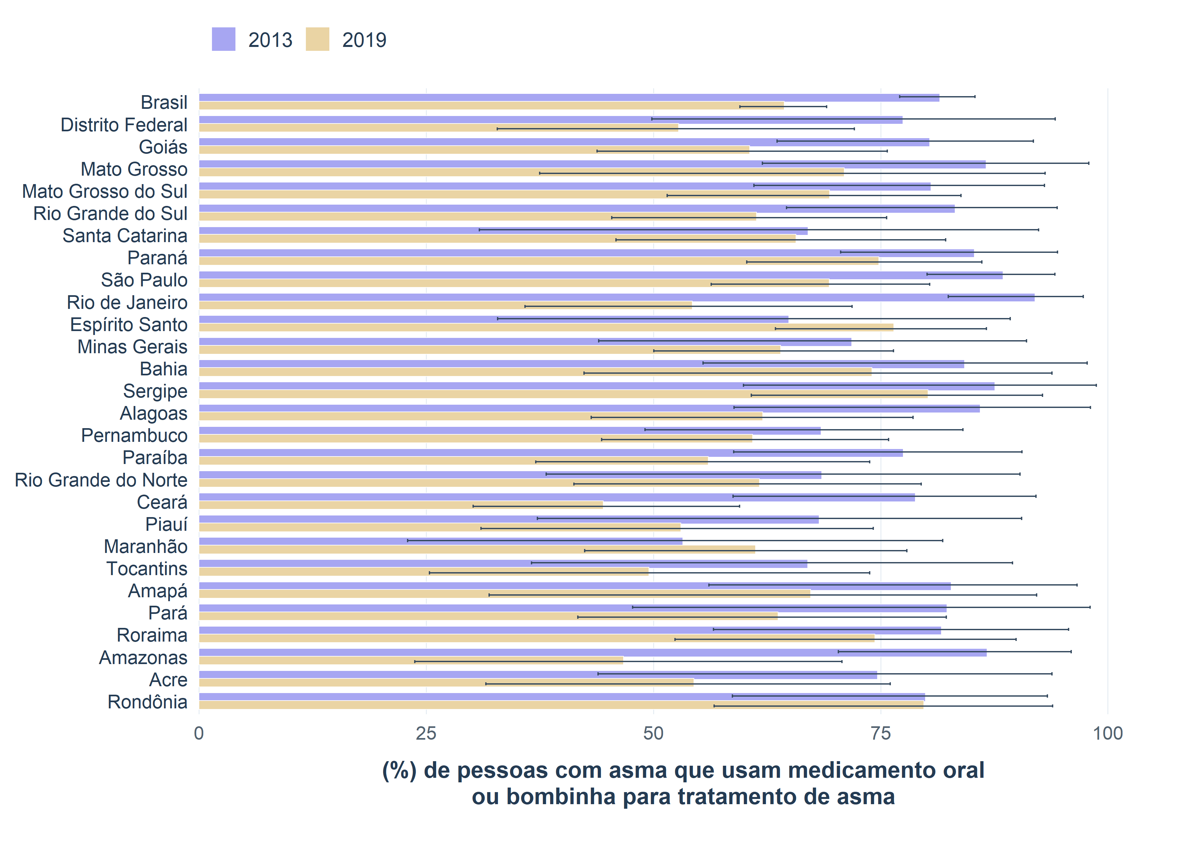
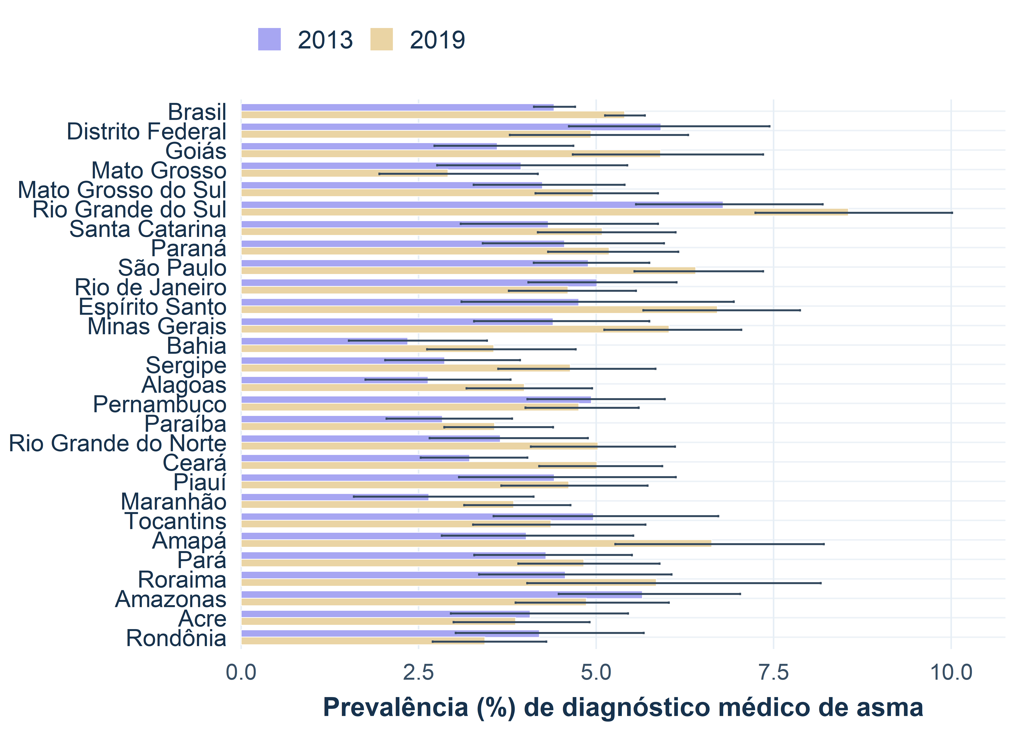
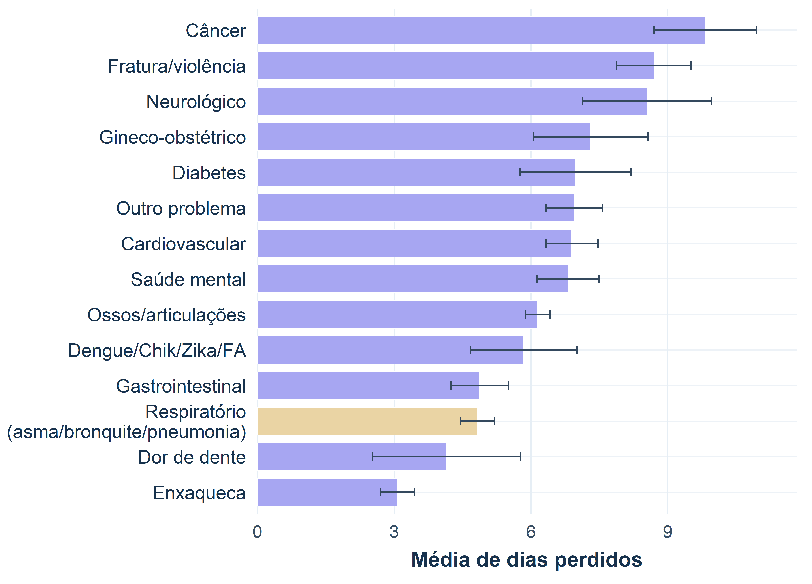
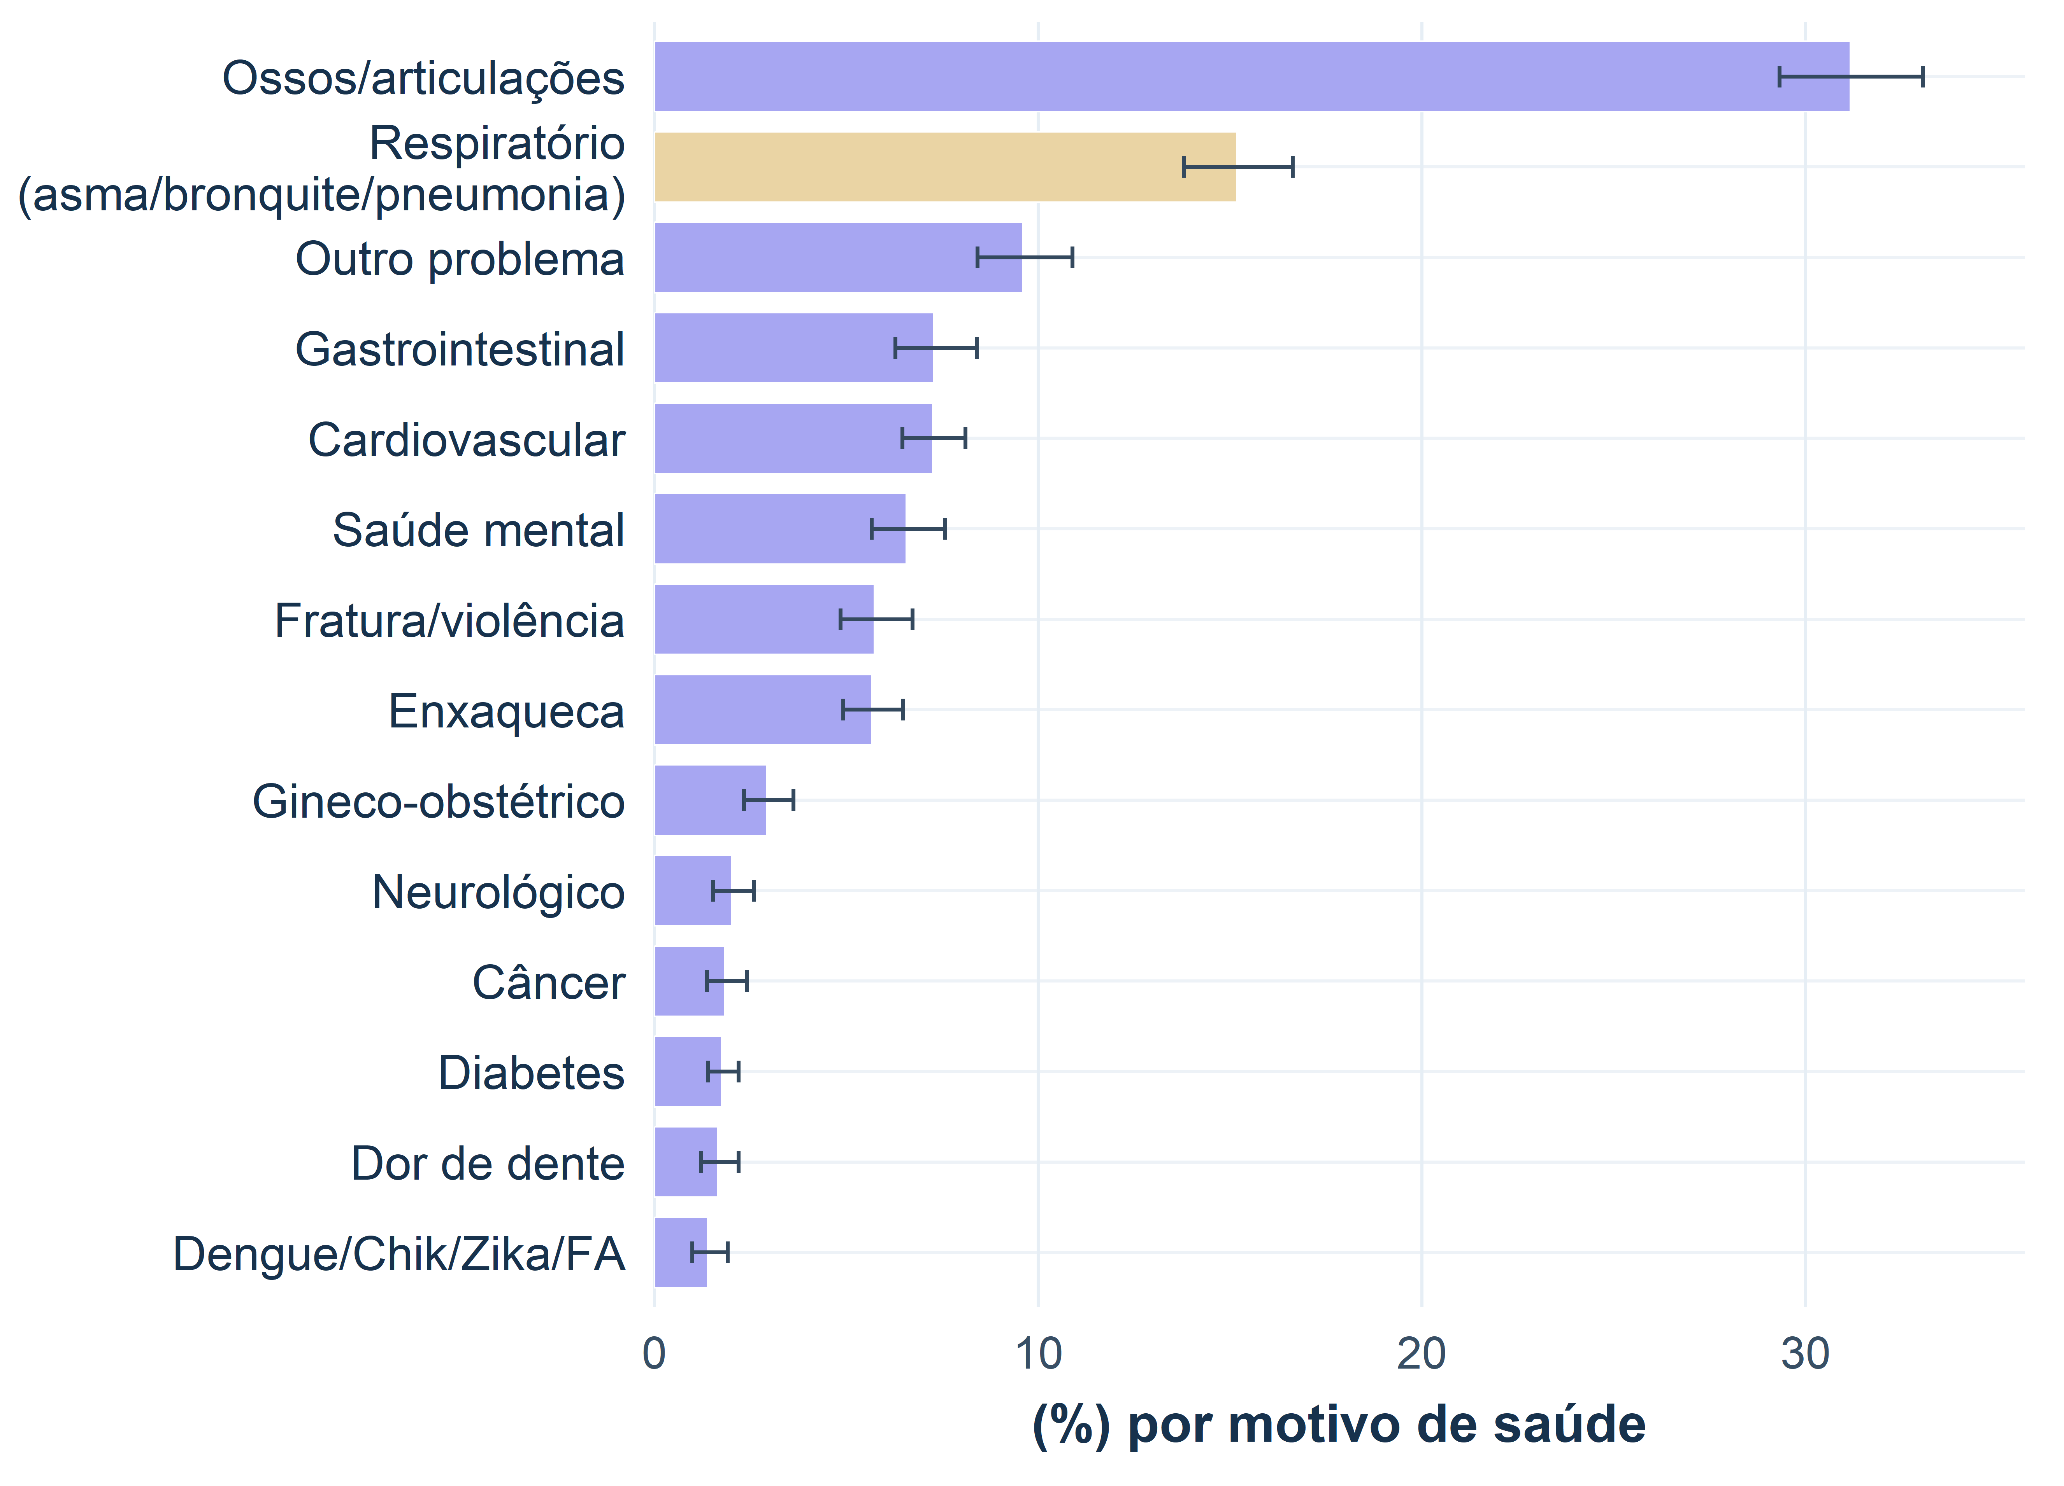

Implementing the National Health Survey Sampling Design in R: a case study on asthma in Brazil
I. Dube; M. E. L. Silva | Observational data management
1. Introduction
Brazil: diagnosis
Brazil: medication
• Epidemiological indicators summarize frequency, distribution and change in health events.
• In asthma, prevalence, medication use, absenteeism and lost days help separate clinical burden, management and effects on work.
• PNS is a population-based household survey with a complex sampling design; valid estimates require weights, strata and clusters.
4.41%→5.40%
81.5%→64.4%
Physician-diagnosed asthma increased, with non-overlapping 95% CIs.
Lower use among people with asthma; read with 95% CIs and the diagnosed-group profile.
Brazil: work
Figure 3: Oral medication or inhaler use among people with physician-diagnosed asthma by state and Brazil.
15.2%; 4.8 days
2. Objectives
Respiratory causes: absenteeism and average lost workdays.
• Implement the 2013 and 2019 PNS sampling design in R.
• Estimate physician-diagnosed asthma, attacks in the previous 12 months, oral/inhaler medication use, smoking, out-of-pocket payment, absenteeism, lost days and income.
• Compare Brazil and states using point estimates, beta 95% CIs, magnitude and interval overlap.
Figure 1: Physician-diagnosed asthma prevalence (%) by state and Brazil, PNS 2013 and 2019.
3. Data and indicators
Figure 4: Mean lost days by health reason in Brazil, highlighting respiratory causes, PNS 2019.
• Analytical unit: selected resident from PNS.
• Core variables: Q074 physician-diagnosed asthma; Q076 recent attack; Q07701/Q07704/Q07708 medication use; P050 smoking.
• Denominators vary by indicator: general population, people with asthma, people with asthma and attack, or valid responses.
Figure 2: Health-related absenteeism in Brazil, highlighting respiratory causes, PNS 2019.
4. Sampling design
• The design was built with PNSIBGE::pns_design(), preserving PSU, strata and calibrated selected-resident weights.
• Estimation uses the survey package for proportions, means, totals and rates.
• Rates per 100,000 rescale weighted proportions while preserving uncertainty from the complex design.
• Lonely PSUs and small domains require explicit inferential choices.
6. Beta CI and chart reading
• Wald intervals can have unstable coverage for low/high proportions or domains with few events.
• The beta CI from survey::svyciprop(method = "beta") respects the 0-1 scale and reduces impossible limits.
• Year/state comparisons were interpreted through magnitude and 95% CI overlap, not bar height alone.
Estimators and formulas
p̂ = Σᵢ wᵢyᵢ / Σᵢ wᵢ
wᵢ = sampling weight; yᵢ = binary indicator
% = 100 × p̂
rate₁₀₀k = 100000 × p̂
CI₉₅%(p̂) = survey::svyciprop(method = "beta")
5. Discussion
• Asthma diagnosis increased in Brazil; respiratory causes account for 15.2% of health-related absenteeism.
• Respiratory causes averaged 4.8 lost days, signaling potential productivity and income costs.
• Better control may reduce absences, lost days and acute-care demand.
7. Economic impact
• Poorly controlled asthma can reduce productivity through absences, functional limitation and demand for acute care.
• The economic reading supports diagnosis, medication access and clinical follow-up policies.
8. ETL, OMOP and OHDSI
• The analytical workflow follows ETL logic: extract microdata, transform variables and load reproducible analytical tables.
• PNS is not a longitudinal clinical database, but it can act as a population reference layer.
• OMOP/OHDSI offers principles for standardization, vocabularies and reproducibility for future comparison with health-care databases.
9. Conclusions
• Correct implementation of the sampling design is required for valid estimates.
• Asthma should be treated as both a clinical and economic issue because it can affect productivity, income and the labor force.
• Absenteeism results are aggregated respiratory estimates; they should not be read as asthma-only estimates.
References
[1] GLOBAL ASTHMA NETWORK. Global Asthma Report 2022. Auckland, New Zealand: Global Asthma Network, 2022. Disponível em: https://globalasthmareport.org/resources/Global_Asthma_Report_2022.pdf. Acesso em: 19 set. 2025.
[2] SOUZA-JÚNIOR, Paulo Roberto Borges de et al. Desenho da amostra da Pesquisa Nacional de Saúde 2013. Epidemiologia e Serviços de Saúde, v. 24, p. 207-216, 2015.
[3] DUBE, I.; SILVA, M. E. L. PNS_2013_2019. GitHub, 2026. Disponível em: https://github.com/ingodube/PNS_2013_2019. Acesso em: 28 mai. 2026.
[4] MENEZES, A. M. B. et al. Prevalência de diagnóstico médico de asma em adultos brasileiros: Pesquisa Nacional de Saúde, 2013. Revista Brasileira de Epidemiologia, São Paulo, v. 18, supl. 2, p. 204-213, 2015.
[5] SEVERE ASTHMA. Non-Pharmacological Interventions for Asthma. Disponível em: https://www.severeasthma.org.au/non-pharmacological-interventions-asthma/. Acesso em: 19 set. 2025.
[6] SANTOS, Felipe Moraes dos et al. Tendência da prevalência de asma autorreferida no Brasil de 2003 a 2013 em adultos e fatores associados à prevalência. Jornal Brasileiro de Pneumologia, v. 44, n. 6, p. 491-497, 2018. doi:10.1590/S1806-37562017000000328.
[7] TO, T. et al. Global asthma prevalence in adults: findings from the cross-sectional world health survey. BMC Public Health, v. 12, art. 204, 2012. doi:10.1186/1471-2458-12-204.
[8] OHDSI. Standardized Data: The OMOP Common Data Model. Disponível em: https://www.ohdsi.org/data-standardization/.
[9] OHDSI. OMOP Common Data Model. Disponível em: https://ohdsi.github.io/CommonDataModel/.
[10] OHDSI. ETL Creation Best Practices. Disponível em: https://www.ohdsi.org/web/wiki/doku.php?id=documentation:etl_best_practices.
[11] LUMLEY, Thomas. Complex Surveys: A Guide to Analysis Using R. Hoboken: Wiley, 2010.
[12] BROWN, Lawrence D.; CAI, T. Tony; DASGUPTA, Anirban. Interval estimation for a binomial proportion. Statistical Science, v. 16, n. 2, p. 101-133, 2001. doi:10.1214/ss/1009213286.
[13] KORN, Edward L.; GRAUBARD, Barry I. Confidence intervals for proportions with small expected number of positive counts estimated from survey data. Survey Methodology, v. 24, n. 2, p. 193-201, 1998.
Methodological report, reproducible code and figures
https://ingodube.github.io/PNS_2013_2019/metodologia.html

