Slide 1
Behavior-Driven Design
Acceptance Testing and SpecFlow

Slide 2
Red, Green, Refactor
Write and run tests before you write code
Encourages small steps and improves the design
Refactoring becomes easier and faster
Living Documentation
Notes:
The idea is that you have to write only enough code to get your tests to pass. Having all the tests pass could be a measure of the done criteria (dev-done) and also increases confidence in the quality of the code
Because you are writing small tests at a time, it forces your code to be more modular TDD helps you learn, understand, and internalize the key principles of good modular design. TDD also forces good architecture. In order to make your code unit-testable, it must be properly modularized. Writing the tests first, various architectural problems tend to surface earlier.
Refactoring code written two years ago is hard. If that code is backed up by a set of good unit tests, the process is made so much easier.
It doesn’t go out of date since you’re running it all the time. It also has to be updated as the behavior changes.

Slide 3
Red, Green, Refactor
Where to start?
What to test and what not to test?
How much to test?
How to name tests?
What does it mean when a test fails?
Notes:
1. Where to start? How much groundwork do you need before you can start writing tests?
2. What to test and what not to test? (repository tests)
3. How much to test? (50%? 80%? 90%?)
4. How to name tests?
5. What does it mean when a test fails?

Slide 4
Adding Structure to TDD
Dan North
Outside-in point of view
Focus on the application’s behavior, not its implementation
Straight to the good stuff
Notes:
1. In 2006, Dan North wrote an article defining BDD as development methodology in which we focus on the behavior of an application from an outside-in point of view (user).
2.
3. ? Implementation details may change in the future. We may change or upgrade systems, like we’re planning to do with Prowess. Our integration points will change. Data contracts may also change. Let’s also consider our parties domain and the introduction to caching. Any of these changes could render our entire suite of unit tests useless, but the application’s behavior has not changed.
4. Present TDD in a way that gets straight to the good stuff and avoids all the pitfalls

Slide 5
Adding Structure to TDD
Where to start?
What to test and what not to test?
How much to test?
How to name tests?
What does it mean when a test fails?
Notes:
1. Where to start? How much groundwork do you need before you can start writing tests?
2. What to test and what not to test? (repository tests)
3. How much to test? (50%? 80%? 90%?)
4. How to name tests?
5. What does it mean when a test fails?

Slide 6
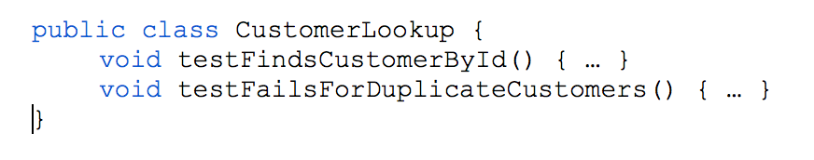
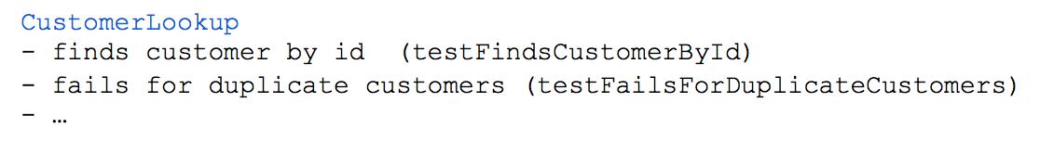
Naming Test Methods
AgileDox

Slide 7
Naming Test Methods
A simple sentence template keeps test methods focused
Beginning with Should helps limit the scope of your tests
Expressive names are helpful when tests fail
A bug was introduced
The behavior moved
The behavior is no longer correct
Should allows you to challenge the premise
Notes:
1. Beginning test methods with should mean you can only define a test for the given class.
- Class should do something (testShouldFailForMissingSurname)
- If your test name doesn’t fit this pattern, the behavior may belong elsewhere
2. Failed tests have 3 causes
- A bug was introduced. Solution: fix the bug
- The intended behavior was still relevant, but moved. Solution: move test and (maybe) change it
- The behavior was no longer correct. Solution: delete the test
3. Should implicitly allows you to challenge the premise of the test. “Should it? Really?”
- makes it easier to decide if a test is failing due to a bug, or because previous assumptions are not incorrect

Slide 8
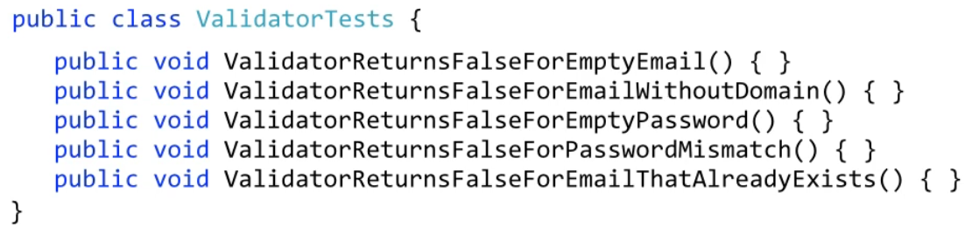
Naming Test Methods

Slide 9
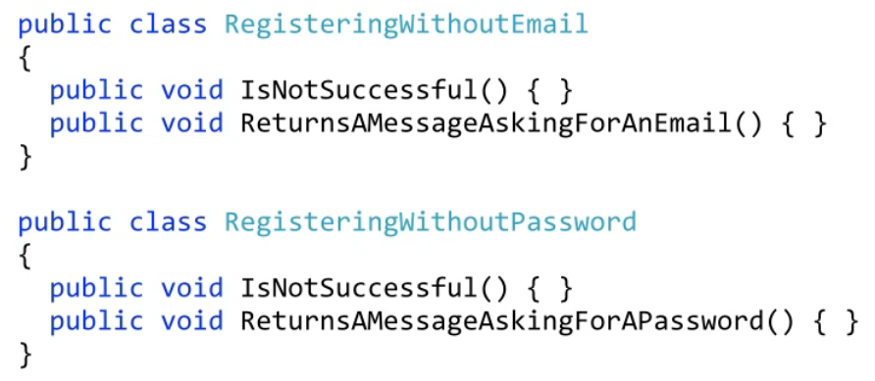
Naming Test Methods

Slide 10
“Behavior” is a more useful word
BDD helps to drive TDD
Why do we write software?
Business value
Better Mindset
“what is the next most important thing the system should do?”
The system doesn’t do X and X is important
shouldDoX
Notes:
Testing in TDD is is an effective way of ensuring your code works. However, if the methods don’t describe the behavior of the system then they are lulling you into a false sense of security.
The test is a sentence that describes the next behavior you are interested in. You can only describe so much behavior in one sentence, so how much to test becomes moot.
In order to answer this question, we must identify the value of the features and prioritize them. This too helps with naming. The system doesn’t do X and X is important, which means it should do X.
shouldDoX

Slide 11
Requirements are Behavior, Too
Ubiquitous Language
Analyst, developers, testers, and the business
Story Language As a [x] – person or role I want [y] – some feature So that [z] – the benefit or value of the feature
Can’t specify so that? Probably isn’t important.
Notes:
BDD plays into our ubiquitous language, dveloping a constant vocabulary for analysts, developers, tester, and the business.

Slide 12
Executable Criteria
Different tests for different stakeholders
Feature tests for product owner
Technical tests for architect
Negative tests for unusual or invalid uses
Notes:
Description of behavior in natural language, but with a defined structure Translate criteria understood by business into testable code
- Business gains more confidence system is working correctly.
Feature tests for product owner
End-to-end black box tests (scrape websites / simulate users)
Technical tests for architect
Performance criteria (executes in 1 second)
Architectural (POSTs to some web service)
Negative tests for unusual or invalid uses
error conditions and checking for logs/messages

Slide 13
DSL of BDD
Given:
The purpose of Given is to put the system in a known state before the user starts interacting with the system.
When:
The purpose of When steps is to describe the key action the user performs.
Then:
The purpose of Then steps is to observe outcomes.
Notes:
Scenarios should contain no implementation details. If the acceptance criteria is defined, then it doesn't matter how it is satisfied.SQL or NoSQL, .net or Java, app or web page, etc.

Slide 14
User Stories
As a former Consultant, I want to pay a fee to re-enroll, So that I don't have to buy more stock
Notes:
What is the behavior here?
How do we capture the behavior in the story?
A story’s behavior is simply its acceptance criteria. If a feature fulfills the acceptance criteria, then it is behaving correctly.

Slide 15
Scenarios
Given some initial context When an event occurs Then ensure some outcomes
Given a customer is a former Consultant And they have been inactive less than 6 months When presented with business opportunities Then they should be able to pay the re-enrollment fee
Notes:
Let’s describe acceptance criteria in terms of scenarios.

Slide 16
Scenarios
Given some initial context When an event occurs Then ensure some outcomes
Given a customer has never been a Consultant When presented with business opportunities Then they should not be able to pay the re-enrollment fee

Slide 17
Future Project Planning
Large user stories are created as epics
Epic is broken down into smaller user stories (no larger than 8 pts)
Document scenarios, both positive and negative, for stories
Break stories into subtasks

Slide 18

Specflow
That’s right Bryan
Terrible Animations
!!!!

Slide 19
Specflow
Member of the Cucumber family and uses Gherkin parser
Write in DSL and map to executable code
Features, Scenarios, Steps
One feature, many scenarios
Notes:
1. BDD testing framework that is part of Cucumber family and uses Gherkin parser
2. Allows us to write our acceptance criteria using DSL and map to executable code
3. Feature files and step definitions
4. One feature (user story), Many scenarios (acceptance criteria)

Slide 20
Specflow Features
Given, When, Then steps allow regular expressions
Scenario Tags - @myTag
Hooks (BeforeFeature, AfterFeature)
Notes:
Regex in Given-When-Then
allow reuse with minimal effort
tags (@myTag)
used to filter scenarios and control execution (BeforeScenario)
SpecFlow generates categories from the tags.
SpecFlow treats the @ignore tag as a special tag
Hooks
same type of setup/tear-down as other testing frameworks

Slide 21
Exercise
As a former Consultant, I want to pay a fee to re-enroll, So that I don't have to buy more stock
Given a customer is a former Consultant And they have been inactive less than 6 months When presented with business opportunities Then they should be able to pay the re-enrollment fee
Given a customer has never been a Consultant When presented with business opportunities Then they should not be able to pay the re-enrollment fee

Slide 22
Key Takeaways
Focuses on behavior rather than implementation details
Naturally keeps test scope small
End up with executable requirements
Better prioritization of work
"what's the next most important thing the system should do?"

Slide 23
Questions?

