Slide 1
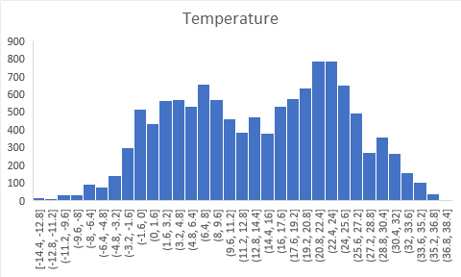
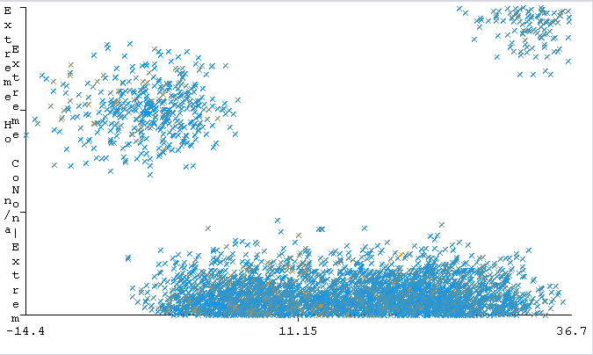
Predicting Baltimore Area Weather
Ethan Lee, Matthew Jensen, Ingrid Nkenlifack, Michael Kelican, Chirag Shah
Group 2 IS 428 Data Mining & Techniques
Introduction
The goal of this project is to assess and analyze weather data in order to accurately predict severe weather for the Baltimore area. This is important as weather can have a significant impact on people, especially severe and hazardous weather conditions. By being able to accurately predict severe weather events, it could help people prepare for natural disasters and even save lives.
Background
Scientists and meteorologists have been predicting the weather and climate changes for a very long time. Data mining has been a very useful tool and increased the accuracy of weather prediction models over the years. Increased accuracy in weather and climate change prediction has allowed for people to plan ahead and be ready for major events. For example, weather prediction in the agricultural industry has helped farmers save produce from harmful conditions. The most popular techniques for forecasting using data mining include regression, neural networks, and decision tree algorithms.
Data​
The dataset was sourced from NOAA's National Centers for Environmental Information (NCEI). It contains weather data captured from their weather station at Baltimore Washington International (BWI) Airport from January 2019 - January 2020. Its main attributes include wind, sky condition, visibility, air temperature, dew point, and sea level pressure.
​Pre-Processing
The dataset had several attributes that were repetitive or redundant which were removed along with instances with missing data. We also simplified the wind speed and temperature attributes into numerical values. Temperature was simplified into Celsius and wind speed values to meters per second. In addition to this we added the extreme_wind and extreme_temp attributes, which were decided based off existing NWS rules such as heat advisory (≥32.2℃), freeze warning(≤0℃), and high wind warning (≥17.8 m/s).
Methods​
Classification: Using Weka, we ran several classification algorithms such as 0R, 1R, JRIP, and Naive Bayes Multinomial Text classification.
Regression analysis: Using Weka we ran linear regression on the newly created wind speed and temperature attributes using 10-fold cross validation.
Clustering: Using Weka we ran Simple K-means clustering on wind speed and temperature attributes with a 66% percentage split.
Results
JRIP resulted in the highest accuracy out of the classification algorithms with 87.3813%. 0R and Naive Bayes had an accuracy of 87.3214% and 1R was 86.714% accurate.
After running linear regression, the temperature model had a relative absolute error of 0.3333% and a mean absolute error of 0.0302. The wind model had an relative absolute error of 5.2582% and mean absolute error of 0.0932.
​
Discussion
There were limitations in our dataset as there were no instances of extreme wind as well as limited cases of extreme temperature based off the NWS definition. We determined that it would not be beneficial to lower the threshold as it would not serve much purpose in practical application. While accuracy is a key indicator of the model’s effectiveness, it should not be taken at face value. 0R and the Naive Bayes Multinomial Text classification both resulted in 87.3214% accuracy, which was found by classifying everything as ‘not-extreme’. The high accuracy was likely a result of our dataset having limited instances of extreme weather.
Conclusion
Using the ratio of false negatives to accurate positive classification as a metric for success, the most successful model tested was the Bayes network classifier which correctly classified 14% of the tested cases as being precursors to severe weather. This result is surprisingly low, but likely due in part to the dataset being more limited than expected. We also attempted to analyze the data with a neural network, but the overwhelming amount of typical weather in the dataset caused it to classify everything as non-extreme. If given the opportunity, a better way to refine the results would be to select examples of extreme and not extreme in equal proportion to be used as a training set, then test models generated off of that on the main body of data.
References
National Weather Service. (n.d.). Watch/warning/advisory definitions. National Weather Service. https://w ww.weather.gov/lwx/WarningsDefined
Temperature (℃)
Fig 1. Distribution of temperature values
Temperature (℃)
Fig 2. Visualization of extreme and non-extreme temperatures

