Slide 1



Deploying Moodle on Cloud using Docker with SSL in 21 minutes
Taller
Milton Jesús Vera Contreras miltonjesusvc@ufps.edu.co
Jairo Andrés Castañeda Pachecho jairoandrescp@ufps.edu.co
Carlos Iván Ortega Álvarez carlosivanoa@ufps.edu.co
Semillero SILUX - Grupos GIDIS y GIA
Programa de Ingeniería de Sistemas
Universidad Francisco de Paula Santander Cúcuta

Slide 2

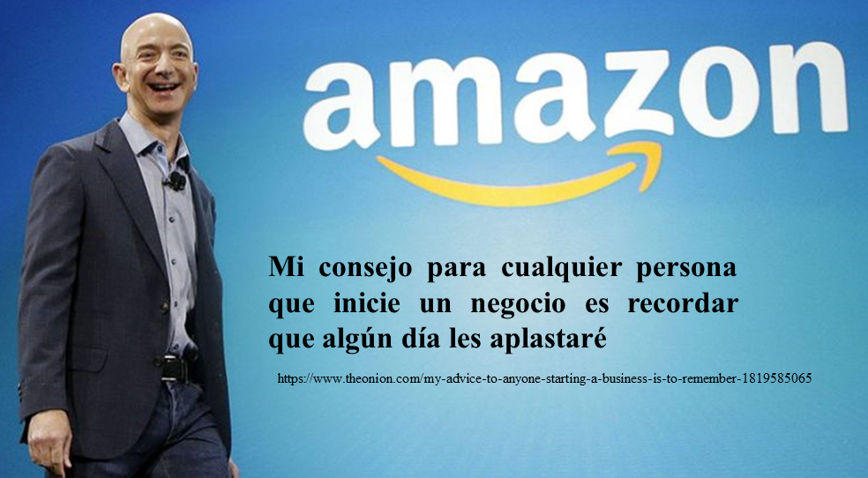
https://www.theonion.com/my-advice-to-anyone-starting-a-business-is-to-remember-1819585065
Deploying Moodle on Cloud using Docker with SSL in 21 minutes Página <número> de 16

Slide 3
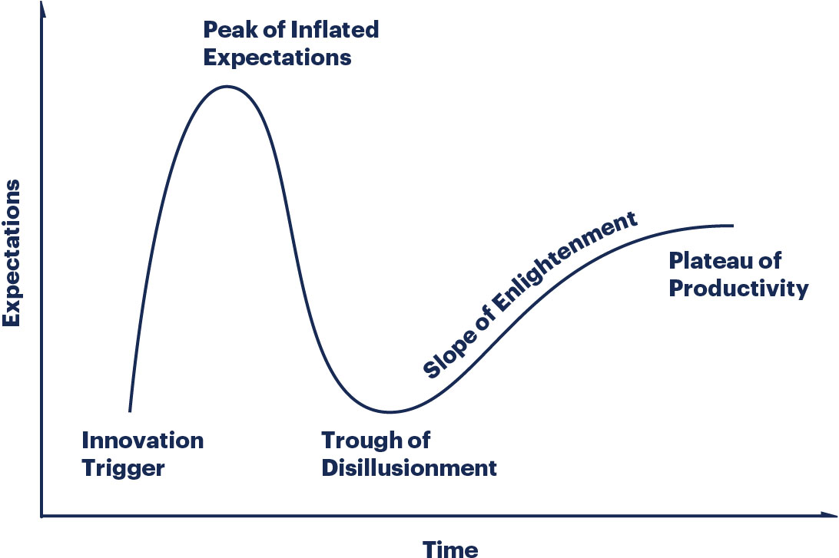
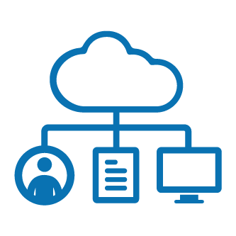
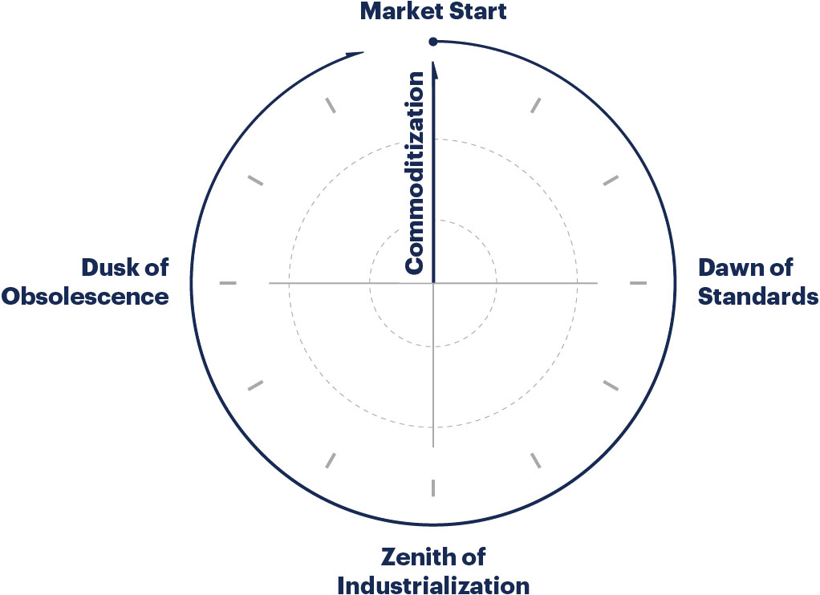

https://www.gartner.com/en/research/methodologies/gartner-hype-cycle
https://www.gartner.com/en/research/methodologies/it-market-clock
Deploying Moodle on Cloud using Docker with SSL in 21 minutes Página <número> de 16

Slide 4
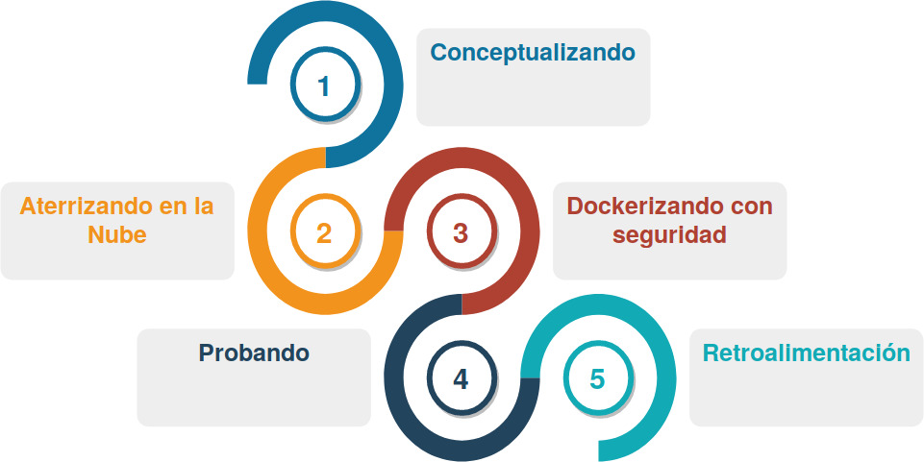

https://st.depositphotos.com/1038855/1433/i/950/depositphotos_14339273-stock-photo-3d-human-with-a-pointer.jpg
Deploying Moodle on Cloud using Docker with SSL in 21 minutes Página <número> de 16

Slide 5
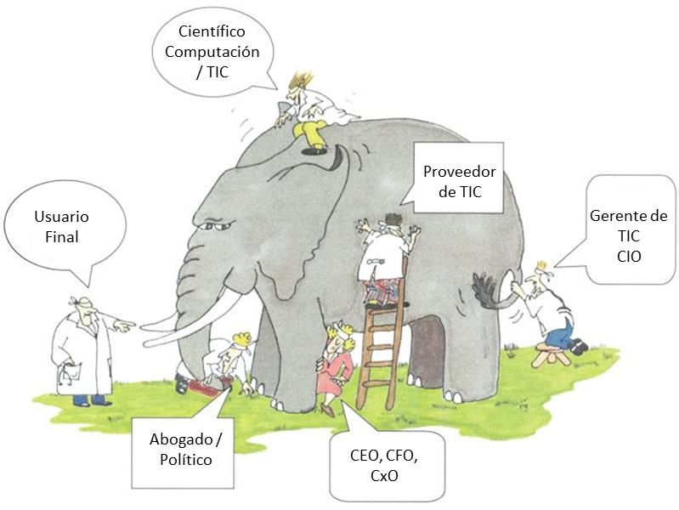
https://st.depositphotos.com/1038855/1433/i/950/depositphotos_14339273-stock-photo-3d-human-with-a-pointer.jpg
Deploying Moodle on Cloud using Docker with SSL in 21 minutes Página <número> de 16

Slide 6
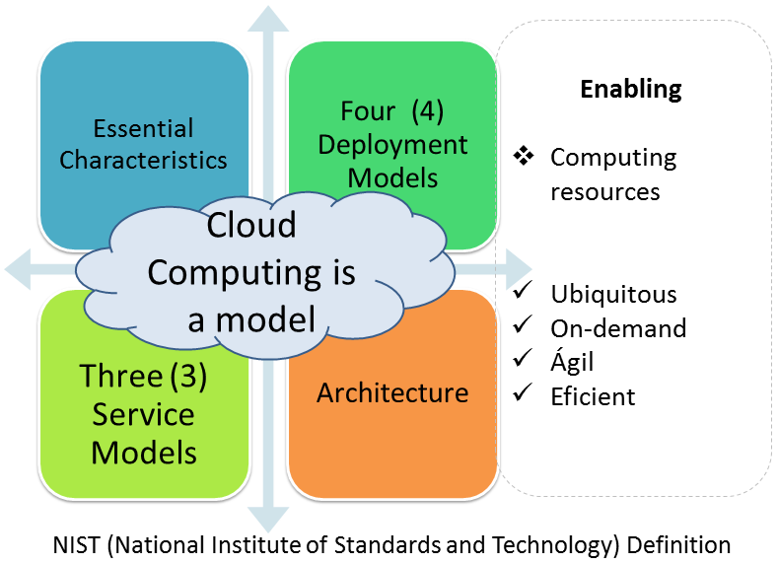
https://st.depositphotos.com/1038855/1433/i/950/depositphotos_14339273-stock-photo-3d-human-with-a-pointer.jpg
Deploying Moodle on Cloud using Docker with SSL in 21 minutes Página <número> de 16

Slide 7
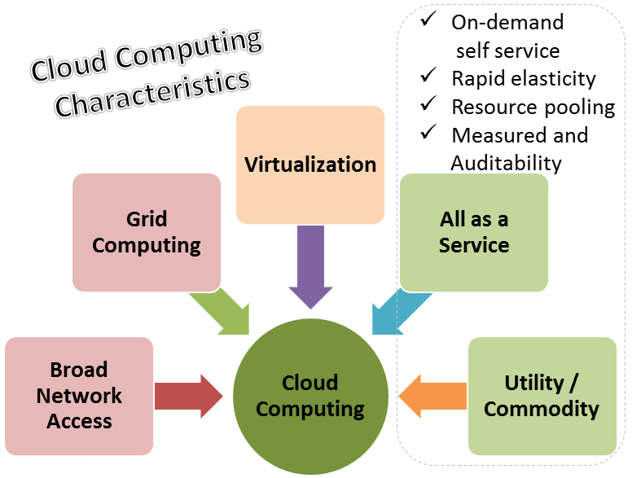
https://st.depositphotos.com/1038855/1433/i/950/depositphotos_14339273-stock-photo-3d-human-with-a-pointer.jpg
Deploying Moodle on Cloud using Docker with SSL in 21 minutes Página <número> de 16

Slide 8
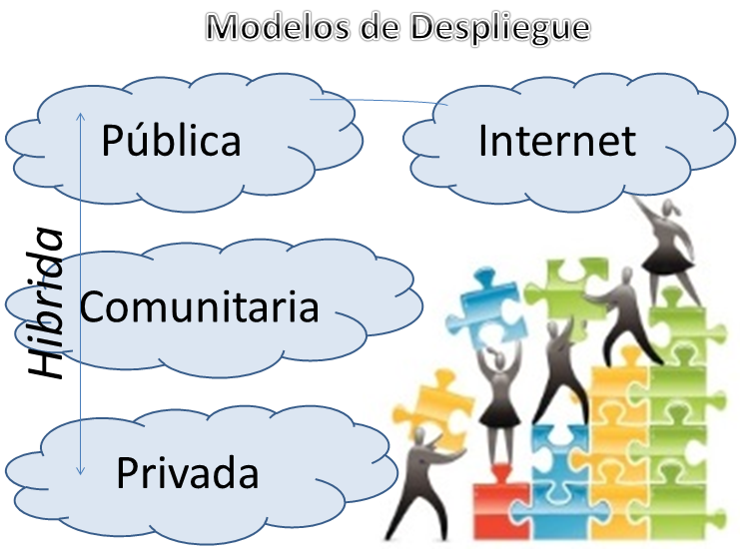
https://st.depositphotos.com/1038855/1433/i/950/depositphotos_14339273-stock-photo-3d-human-with-a-pointer.jpg
Deploying Moodle on Cloud using Docker with SSL in 21 minutes Página <número> de 16

Slide 9
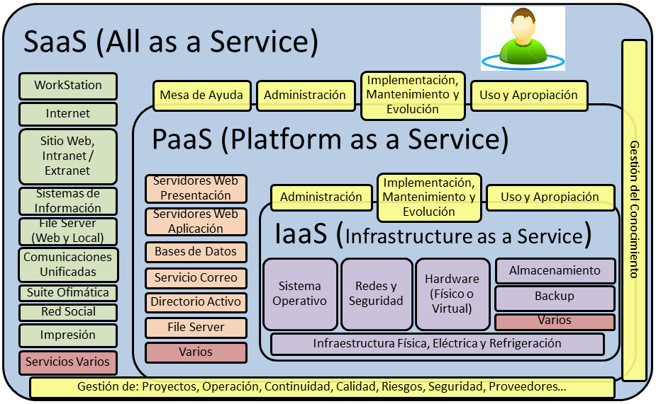
https://st.depositphotos.com/1038855/1433/i/950/depositphotos_14339273-stock-photo-3d-human-with-a-pointer.jpg
Deploying Moodle on Cloud using Docker with SSL in 21 minutes Página <número> de 16

Slide 10
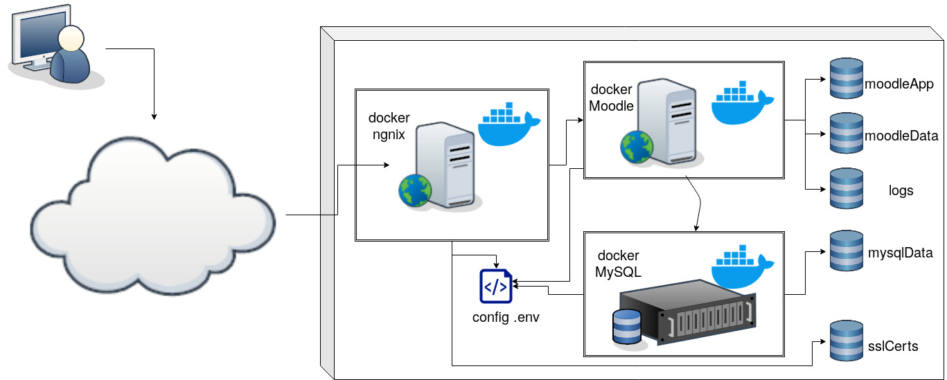
https://st.depositphotos.com/1038855/1433/i/950/depositphotos_14339273-stock-photo-3d-human-with-a-pointer.jpg
Deploying Moodle on Cloud using Docker with SSL in 21 minutes Página <número> de 16

Slide 11
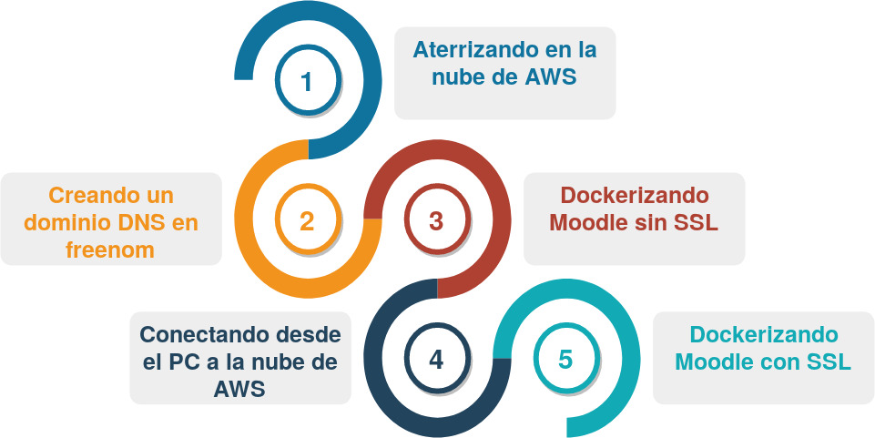
https://st.depositphotos.com/1038855/1433/i/950/depositphotos_14339273-stock-photo-3d-human-with-a-pointer.jpg
Deploying Moodle on Cloud using Docker with SSL in 21 minutes Página <número> de 16

Slide 12





Deploying Moodle on Cloud using Docker with SSL in 21 minutes Página <número> de 16

Slide 13

Manos a la nube
https://st.depositphotos.com/1038855/1433/i/950/depositphotos_14339273-stock-photo-3d-human-with-a-pointer.jpg
Deploying Moodle on Cloud using Docker with SSL in 21 minutes Página <número> de 16

Slide 14
https://st.depositphotos.com/1038855/1433/i/950/depositphotos_14339273-stock-photo-3d-human-with-a-pointer.jpg
Deploying Moodle on Cloud using Docker with SSL in 21 minutes Página <número> de 16

Slide 15
Gracias
Milton Jesús Vera Contreras miltonjesusvc@ufps.edu.co
Jairo Andrés Castañeda Pachecho jairoandrescp@ufps.edu.co
Carlos Iván Ortega Álvarez carlosivanoa@ufps.edu.co
Deploying Moodle on Cloud using Docker with SSL in 21 minutes Página <número> de 16

Slide 16
Referencias
https://www.docker.com/products/docker-hub
https://hub.docker.com/
https://docs.docker.com/develop/
https://github.com/ingsistemascloud/moodlemootcolombia2019sample
Deploying Moodle on Cloud using Docker with SSL in 21 minutes Página <número> de 16

