Slide 1
Dictionary App
Mobile Programming Assignment

Slide 2
Members
01
02
03
04
Akbarov Umarkhon
U1910080
Khasanov Diyor
U1910067
Khamidov Azizbek
U1910057
Mamasoliev Umidjon
U1910080

Slide 3
Overview
Introduction
Features
01
02
- Brief introduction
- Overview of the project
- Word lookup feature - Word Synonym and Antonym
- Voice pronunciation feature
Project Review
Demo
03
04
- Code Review
- API Integration
- Project Demo

Slide 4
II. Features
Main Features:
Word Search
Voiceover Word Pronunciation
Antonym and Synonym
Searched Words History

Slide 5
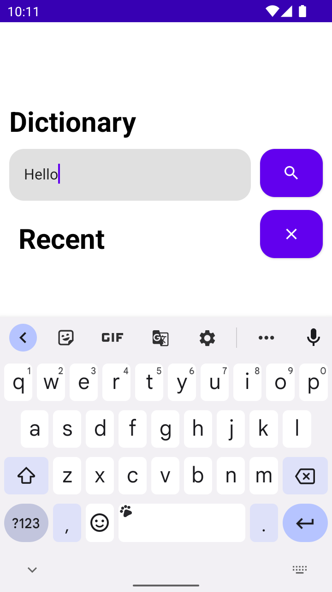
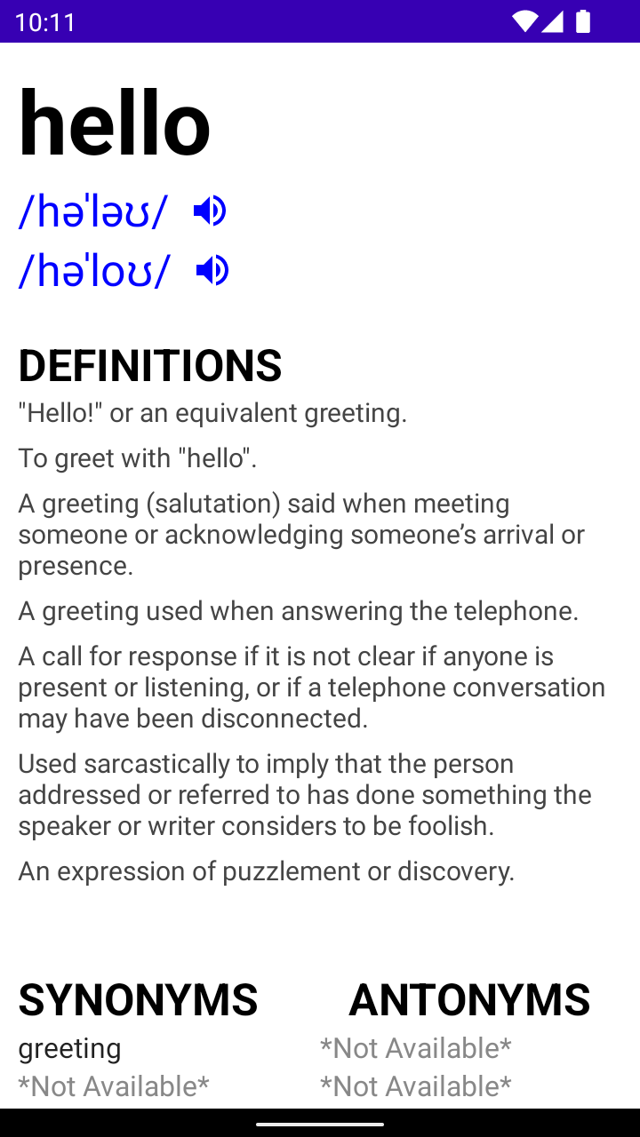
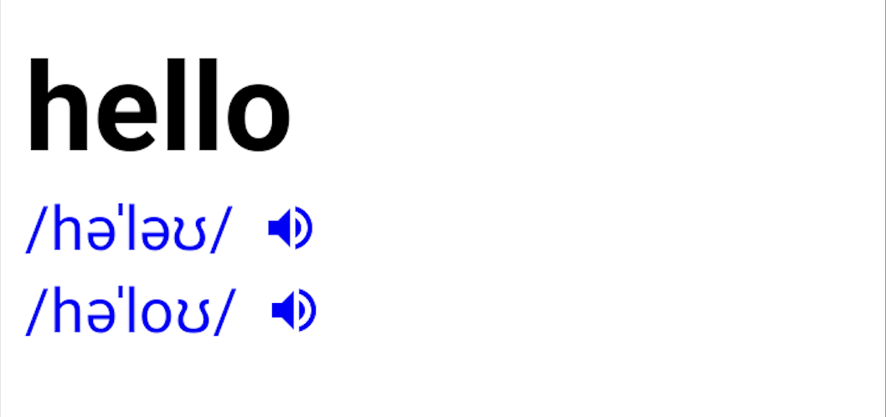
Word Search Activity
2. Word Definition Activity
3. Word Pronunciation

Slide 6
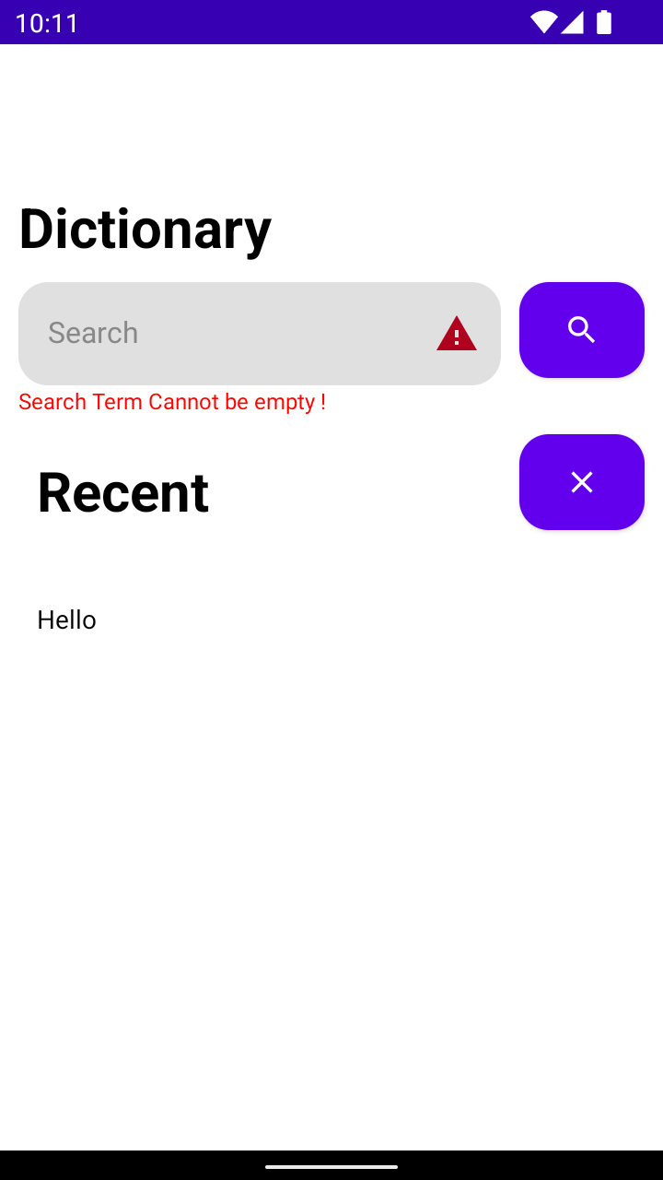
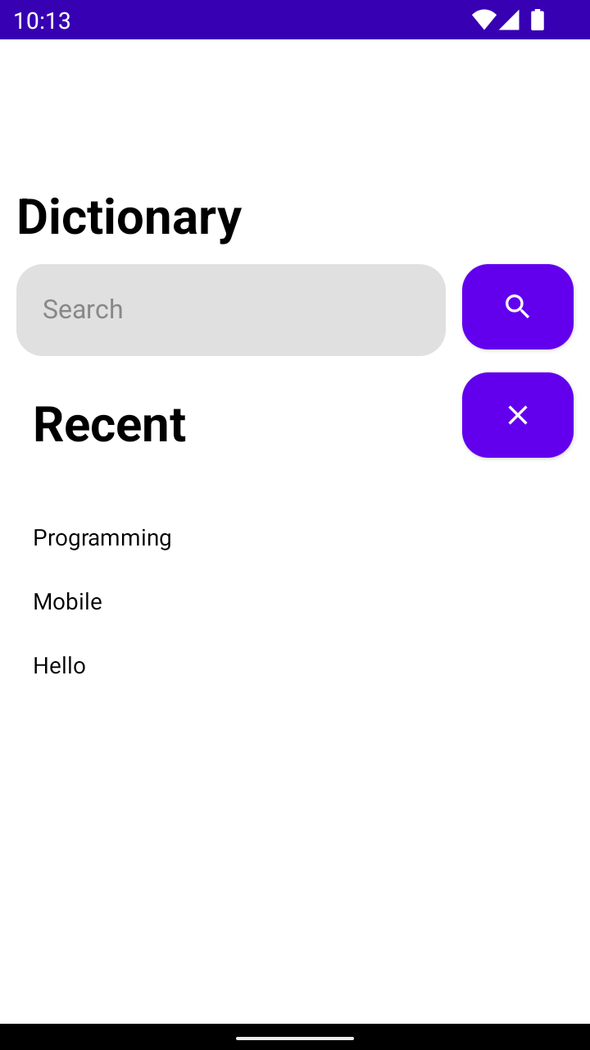
4. Error handling
5. Recent Word History

Slide 7

III. Project Review & Demo
- Kotlin Features
- JetPack Compose Features
- Dictionary API

Slide 8
Thanks!

