Slide 1
Simple RNN

Slide 2

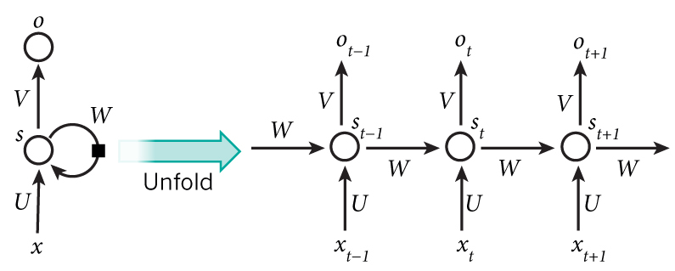
Recurrent Neural Network

Slide 3
How does RNN reduce complexity?
Given function f: h’,y=f(h,x)
h and h’ are vectors with the same dimension
y¹
y²
y³
h⁰
f
h¹
f
h²
f
h³
……
x¹
x²
x³
x^{n}= vector
Only need one function f.

Slide 4
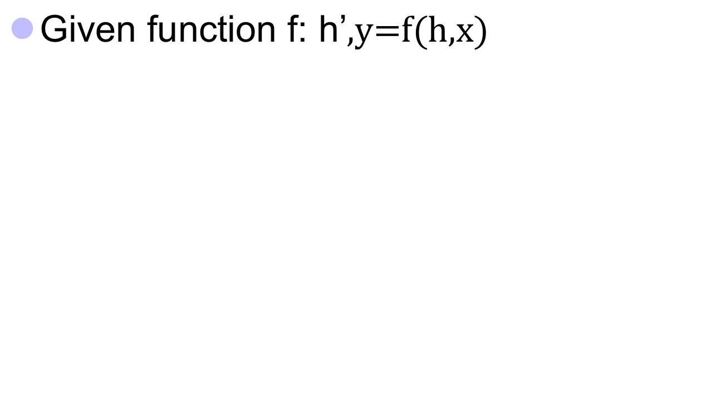



Naïve RNN
y
h'
W^{h}
^{h}
W^{i}
x
h
f
h'
y
Wº
^{h’}
x
Note:y is computed from h’
We have ignored the bias

Slide 5

Deep RNN
h’,y = f₁(h,x), g’,z = f₂(g,y)
…
…
…
z¹
z²
z³
g⁰
f₂
g¹
f₂
g²
f₂
g³
……
y¹
y²
y³
h⁰
f₁
h¹
f₁
h²
f₁
h³
……
x¹
x²
x³

Slide 6
Bidirectional RNN
y,h=f₁(x,h)
z,g = f₂(g,x)
x¹
x²
x³
g⁰
f₂
g¹
f₂
g²
f₂
g³
z¹
z²
z³
p¹
p²
p³
p=f₃(y,z)
f₃
f₃
f₃
y¹
y²
y³
h⁰
f₁
h¹
f₁
h²
f₁
h³
x¹
x²
x³

Slide 7
Problems with naive RNN
“memory” to short.
Gradient vanishing
Gradient exploding

Slide 8
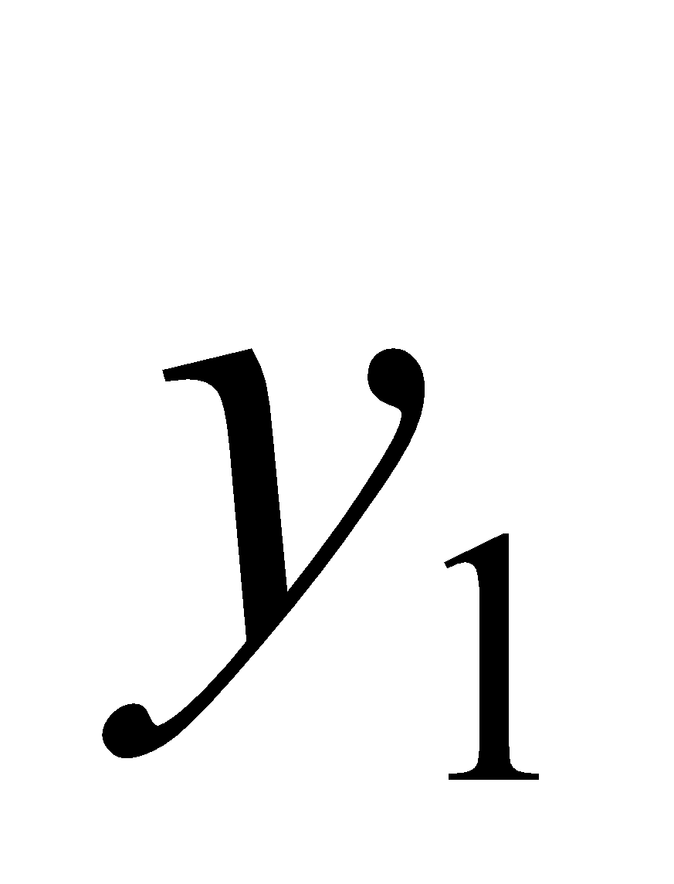
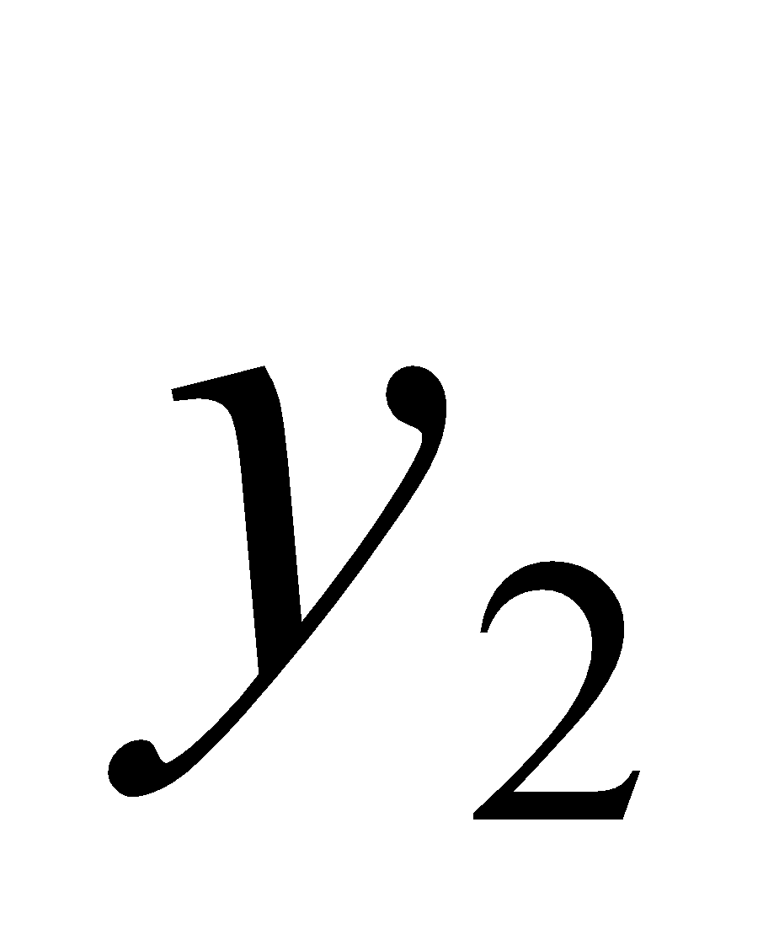
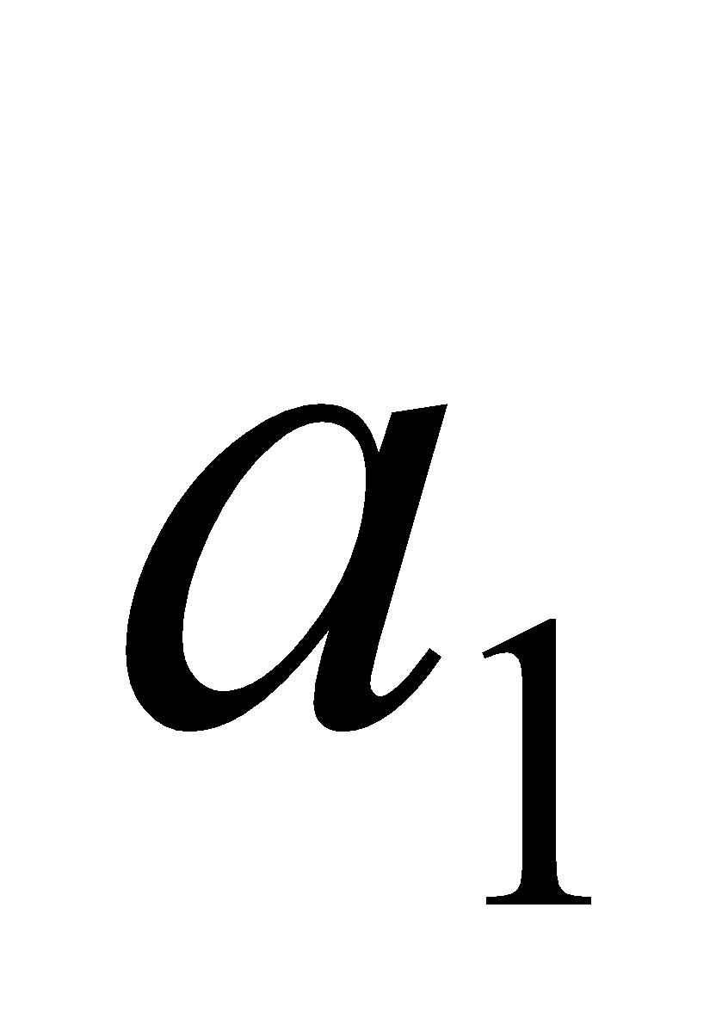
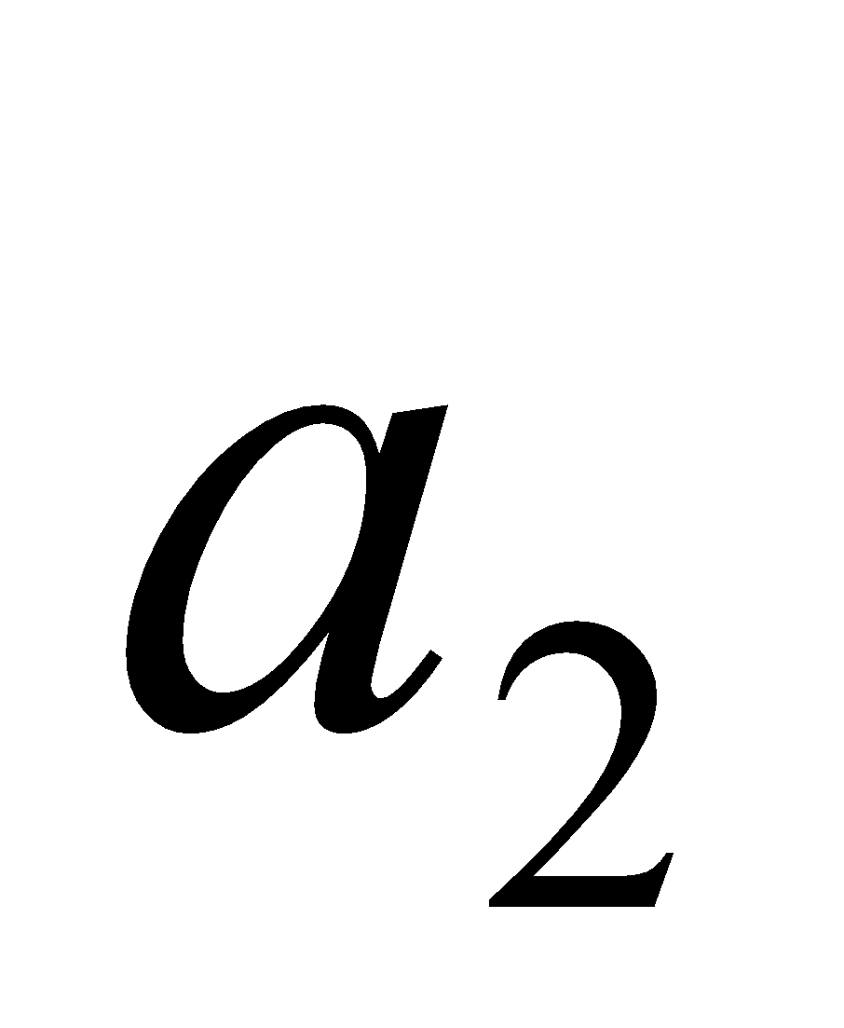


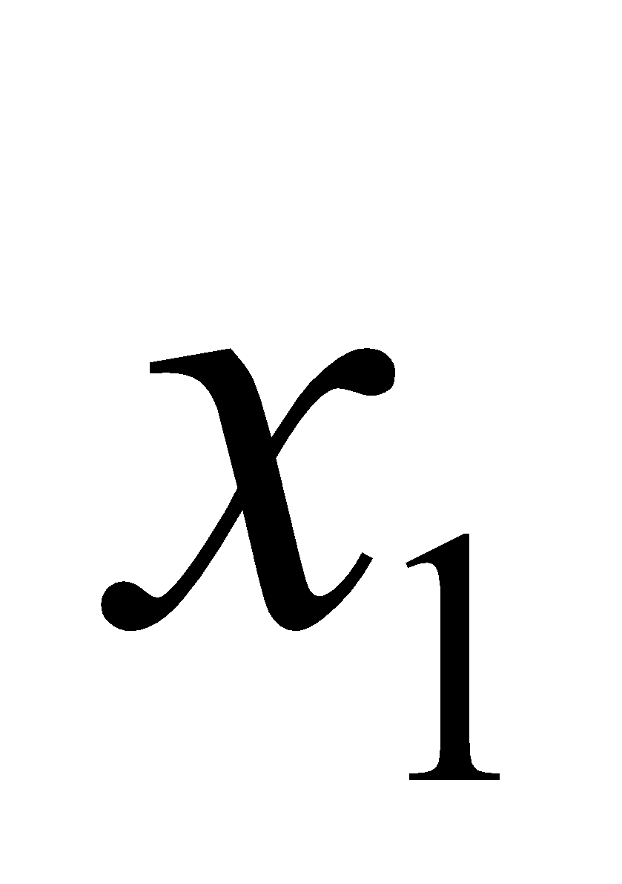
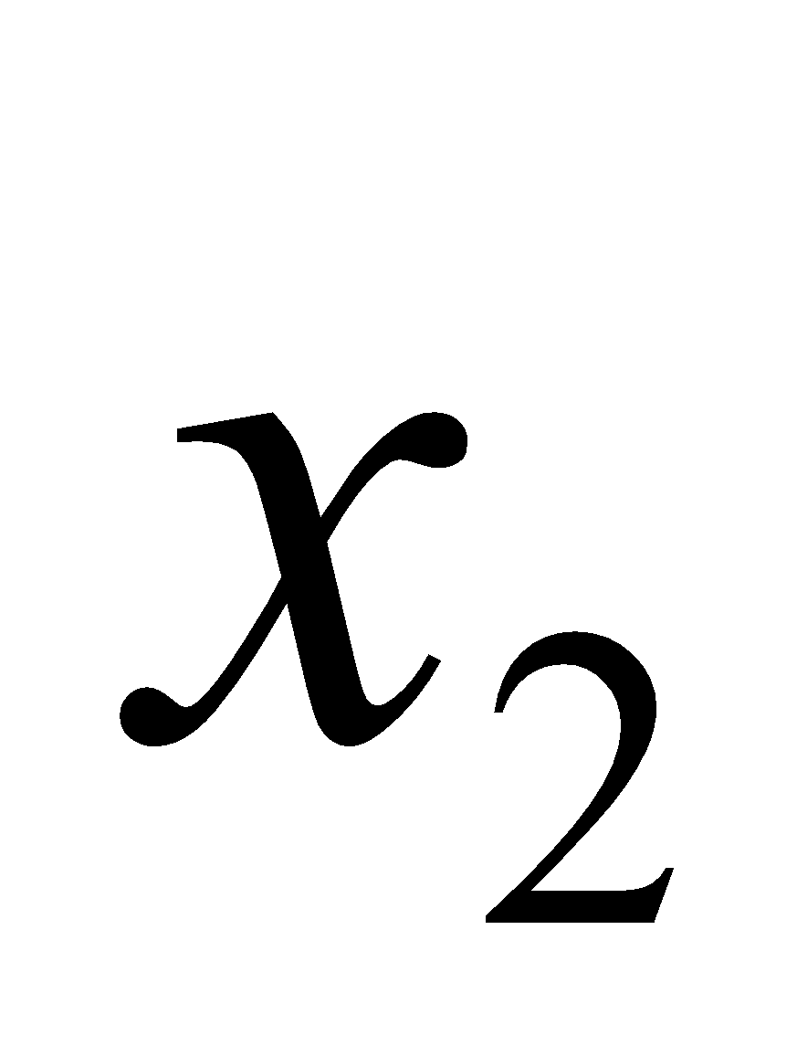
How to Training RNN
Backpropagation through time (BPTT)
copy
Notes:
How to update parameter by BPTT
BPTT will consider time sequence

Slide 9
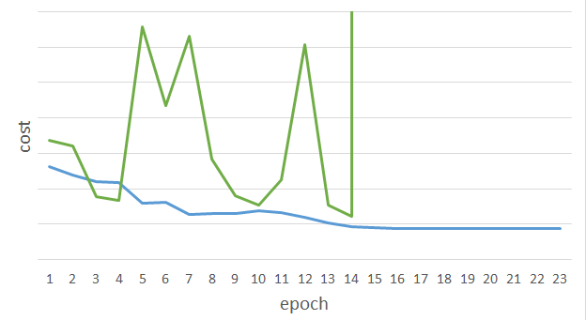
RNN-based network
RNN-based network is not always easy to learn
Real experiments on Language modeling
sometimes
Total Loss
Lucky
Epoch
Notes:
Not because you have bug haha

Slide 10
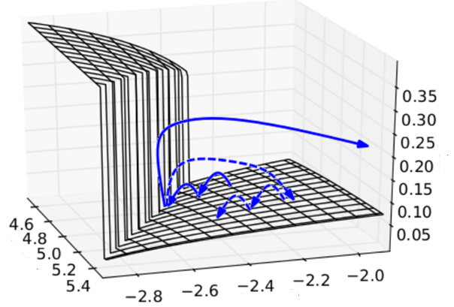
The error surface is rough.
http://proceedings.mlr.press/v28/pascanu13.pdf
figure.6
Cost
Total Loss
w₂
w₁
[Razvan Pascanu, ICML’13]
Notes:
Even adagrad can not handle this problem, maybe RMS prop is better
Source: http://jmlr.org/proceedings/papers/v28/pascanu13.pdf
Large or small is fine. Change quickly is bad

Slide 11


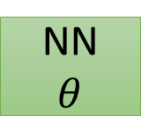







Update Weights
x^{n}
y^{n}
C^{n}
y^{n} = 1 * W^{n-1}
y¹
y²
y³
y^{n}
1
1
1
1
……
w
w
w
1
1
1
1
1
0
0
0
Notes:
Gradient Explode/Gradient Vanishing
Echo state network -> …..

Slide 12

Backpropagation
x^{n}
y^{n}
C^{n}
y¹
y²
y³
y^{n}
1
1
1
1
……
w
w
w
1
1
1
1
1
0
0
0

Slide 13
LSTM

Slide 14
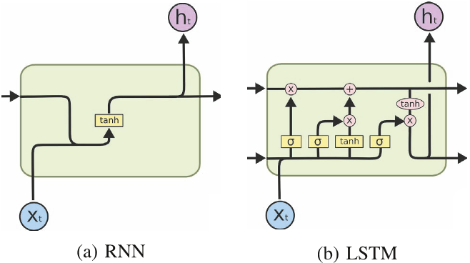
RNN vs LSTM

Slide 15
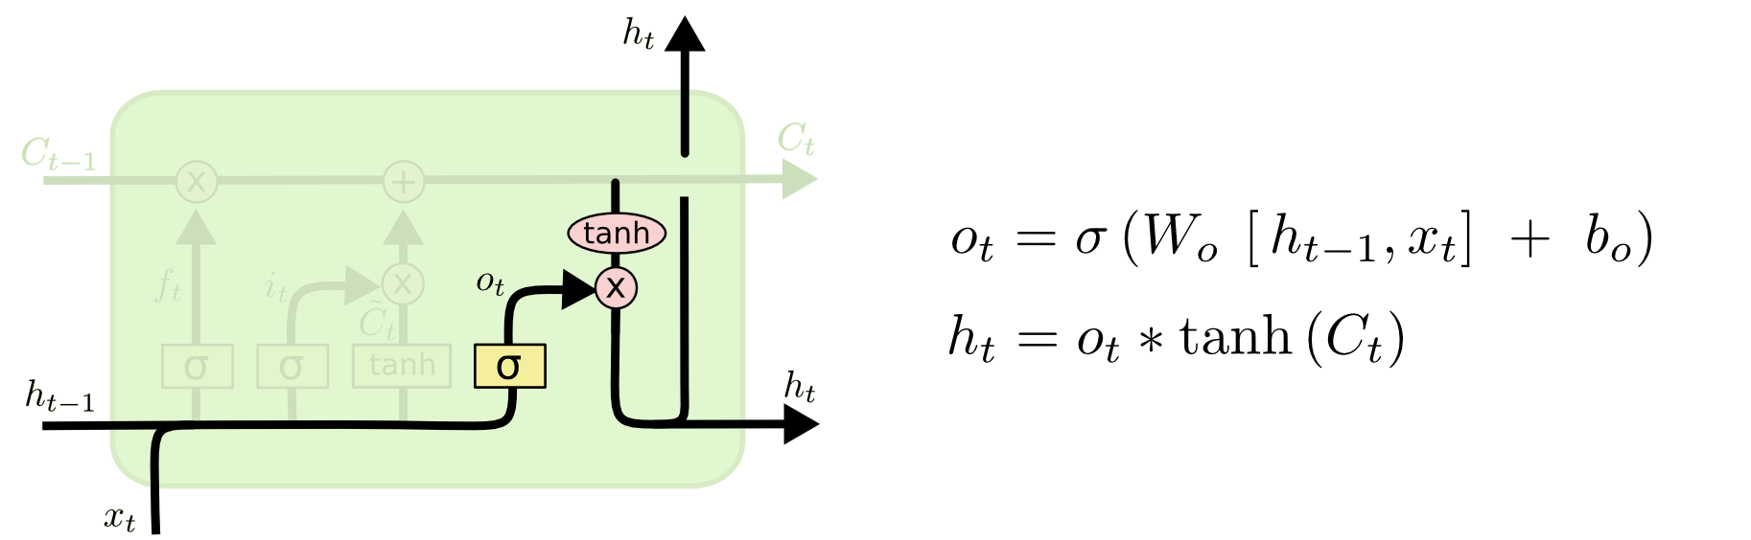
RNN vs LSTM
y^{t}
LSTM
c^{t}
y^{t}
c^{t-1}
Naïve
RNN
h^{t}
h^{t}
h^{t-1}
h^{t-1}
x^{t}
x^{t}
c changes slowly
c^{t} is c^{t-1} added by something
h changes faster
h^{t} and h^{t-1} can be very different

Slide 16
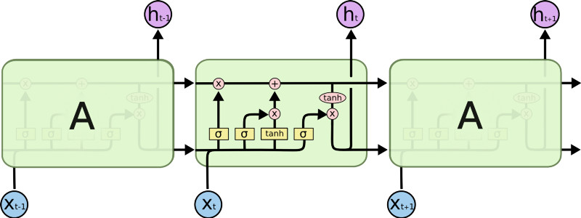
LSTM
Forget Gate
Input Gate
C_{t-1}
h_{t-1}
Output Gate

Slide 17
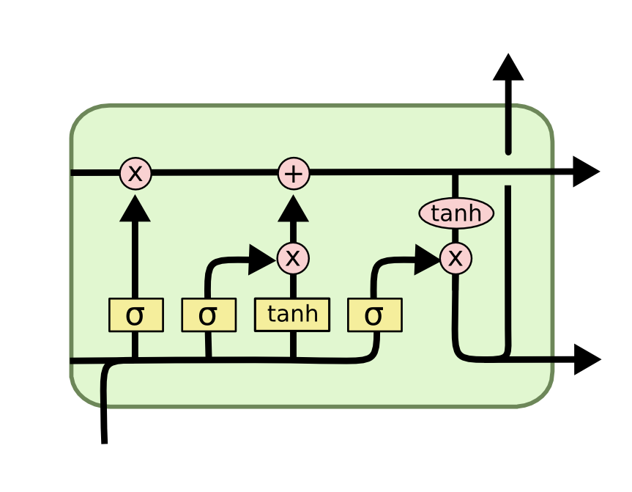
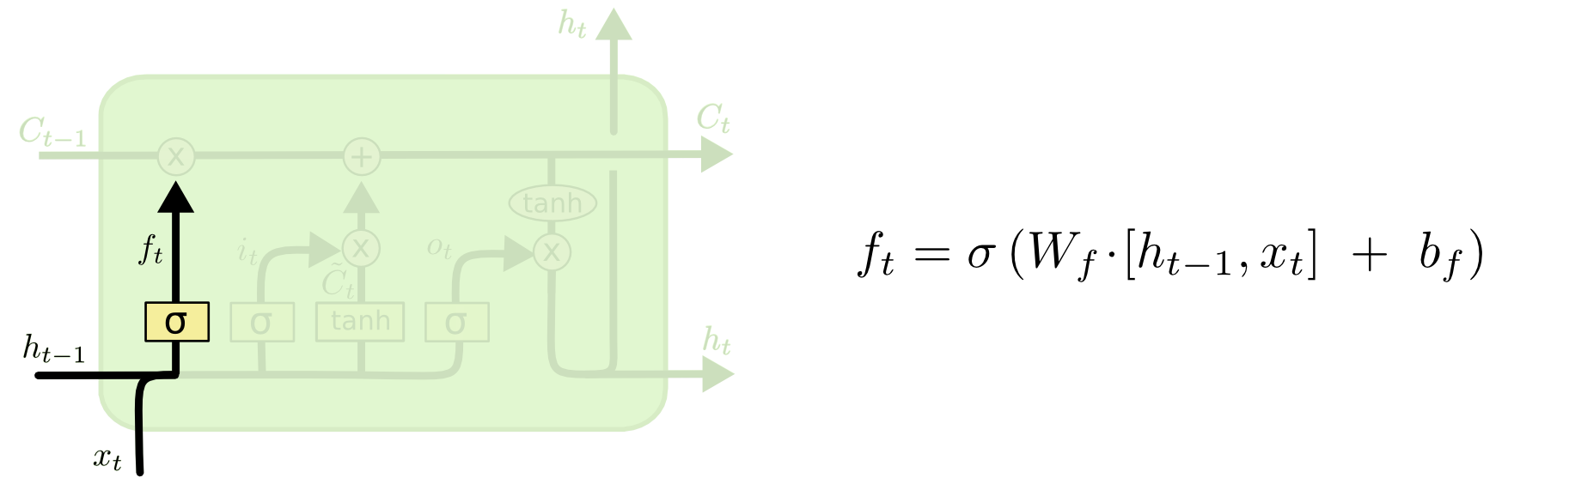
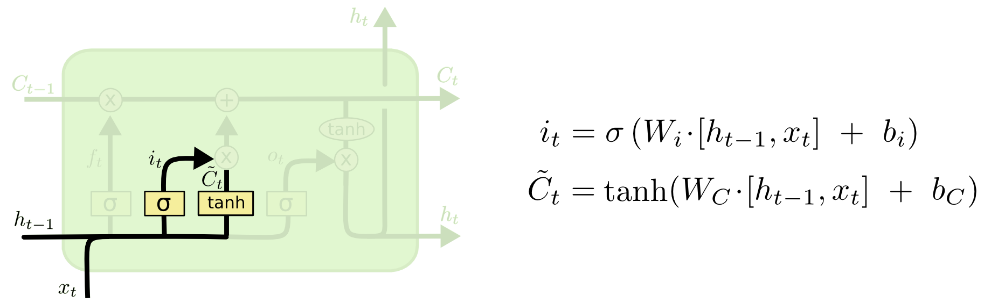
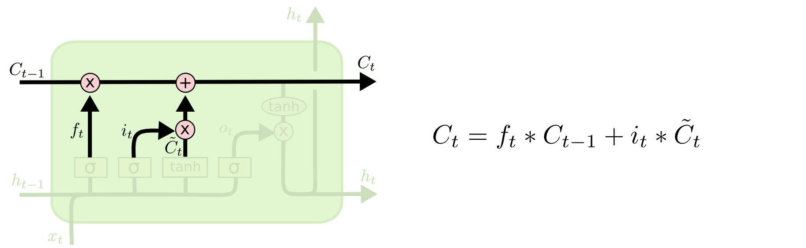
i_{t} decides what component
is to be updated.
C_{t} provides change contents
Updating the cell state
C_{t} : Cell’s memory changed slowly
Decide what part of the cell
state to output

Slide 18

Cell’s memory
Forget Gate
Input Gate
if 1 > sigmoid > 0, remember C^{t-1}
if sigmoid = 0, forget C^{t-1}
if 1 > sigmoid > 0, remember
if sigmoid = 0, forget

Slide 19


y^{t}
c^{t-1}
c^{t}
c^{t} = z^{f} ◉ c^{t-1} + z^{i}◉z
tanh
h^{t} = zº ◉ tanh(c^{t})
y^{t} = σ(W’ h^{t})
Element-wise multiply
z^{f}
z^{i}
z
zº
h^{t-1}
x^{t}
h^{t}

Slide 20
x^{t}
z
Transform
=tanh( )
h^{t-1}
Transform = matrix
zº
z^{f}
z^{i}
obtained by the same way
z^{f}
z^{i}
z
zº
Vector
h^{t-1}
x^{t}

Slide 21

x^{t}
z
W
h^{t-1}
x^{t}
z^{i}
W^{i}
= σ( )
Controls
forget gate
Controls
input gate
Updating
information
Controls
Output gate
h^{t-1}
z^{f}
z^{i}
z
zº
W^{f}
x^{t}
z^{f}
= σ( )
h^{t-1}
h^{t-1}
x^{t}
x^{t}
zº
Wº
= σ( )
h^{t-1}

Slide 22



LSTM information flow
y^{t}
y^{t+1}
c^{t-1}
c^{t}
c^{t+1}
tanh
tanh
z^{f}
z^{i}
z
zº
z^{f}
z^{i}
z
zº
h^{t+1}
h^{t-1}
x^{t}
h^{t}
x^{t+1}

Slide 23
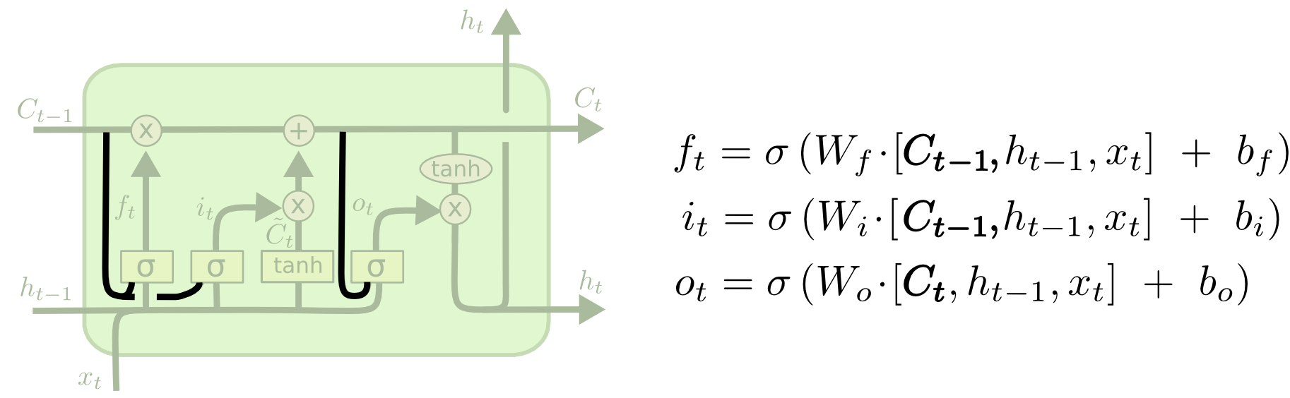
Peephole LSTM
Allows “peeping into the memory”

Slide 24
Constant Error Carousels
Gradient Vanishing / Exploding in RNN
the repeated application of the recurrent weight matrix
Gradients Vanish in LSTM
Only some of them, gradient information local in time will still be present.
Still have a non-zero gradient but it will not contain long term information. Because some gradient is still the same.
δ
δ
δ

Slide 25
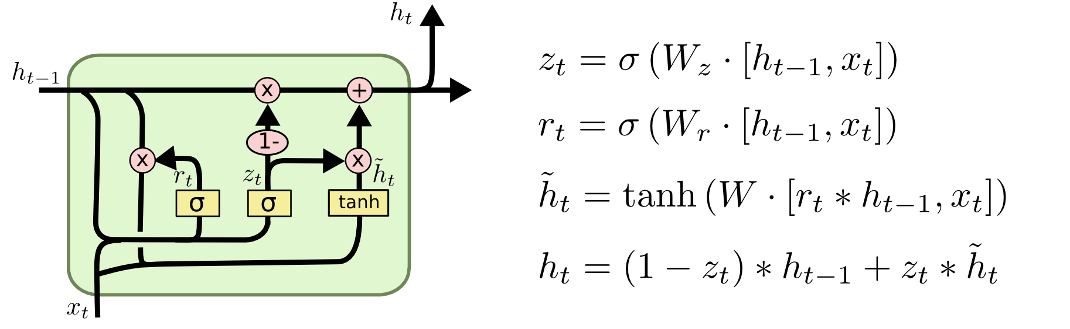
GRU – gated recurrent unit (more compression)
LSTM
reset gate
Update gate
It combines the forget and input into a single update gate.
It also merges the cell state and hidden state. This is simpler
than LSTM. There are many other variants too.
X,*: element-wise multiply

Slide 26
BPTT

Slide 27
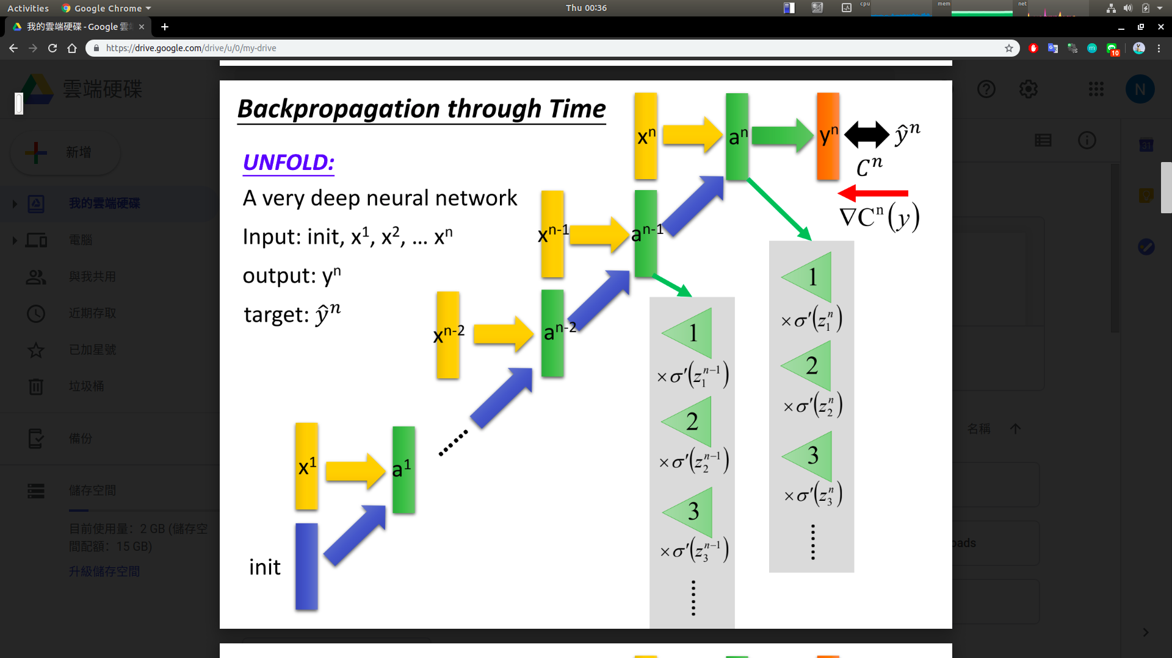
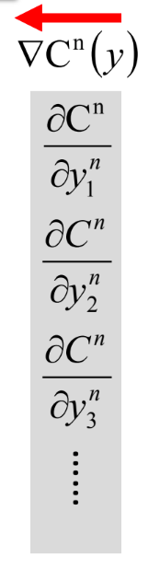
Backpropagation Through Time
(Wº)^{T}
x^{n}
y^{n}
C^{n}
x^{n}
a^{n}
y^{n}
C^{n}
x^{n-1}
a^{n-1}
a^{n-2}
= δ
x¹
a¹
(W^{h})^{T}
i

Slide 28
Gradient Exploding / Vanishing
(Wº)^{T}
x^{n}
y^{n}
C^{n}
x^{n}
a^{n}
y^{n}
C^{n}
δ^{n}
x^{n-1}
a^{n-1}
δ^{n-1}
a^{n-2}
δ^{n-2}
= δ
W=(W^{h})^{T}
x¹
a¹
i
δ¹=W ^{n-1} δ^{n}
δ^{n-1}=W δ^{n}

Slide 29
LSTM BPTT
C_{t-1}
C_{t}

Slide 30
LSTM BPTT flow
δ
a
δ ⊙ b
δ
δ
*
δ
δ ⊙ a
b
y^{t}
y^{t+1}
c^{t-1}
c^{t}
c^{t+1}
tanh
tanh
z^{f}
z^{i}
z
zº
z^{f}
z^{i}
z
zº
W
W
h^{t+1}
h^{t-1}
x^{t}
h^{t}
x^{t+1}

Slide 31



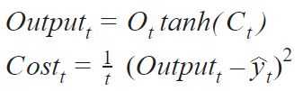
LSTM BPTT

Slide 32
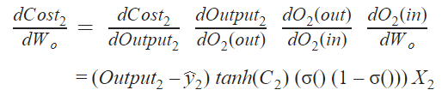
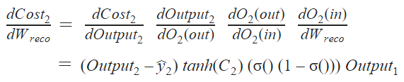
Output Gate Backpropagation ( t = 2 )

Slide 33


Memory Gate Backpropagation ( t = 2 )

Slide 34
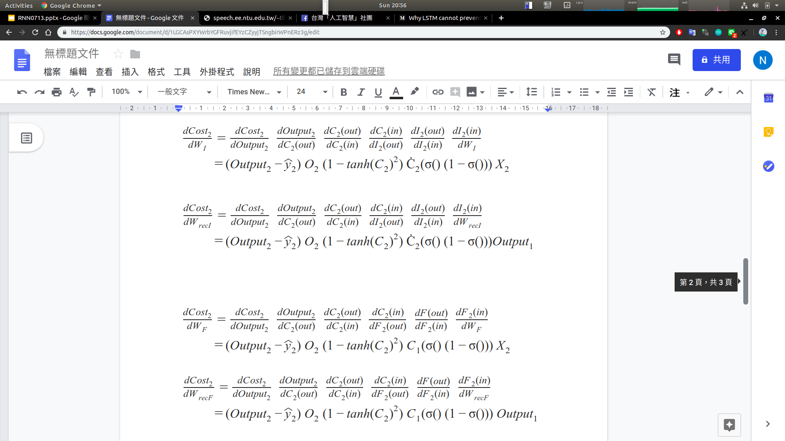
Input Gate Backpropagation ( t = 2 )

Slide 35
Forget Gate Backpropagation ( t = 2 )

Slide 36
Backpropagation to Cell1 ( t = 1 )

Slide 37
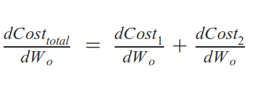
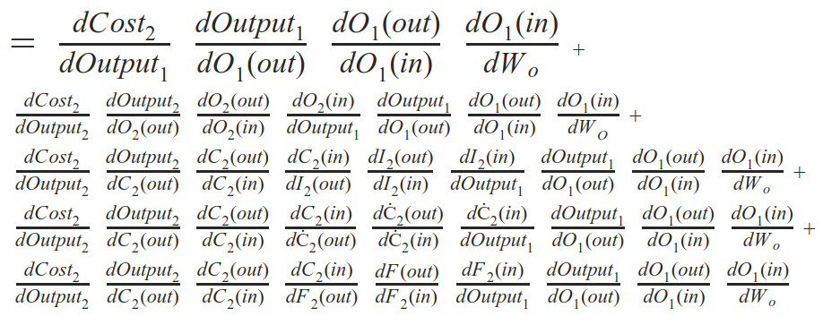
Backpropagation to Cell1 Output Gate( t = 1 )

Slide 38
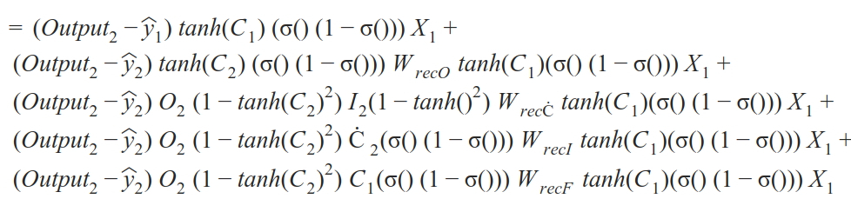
Simplify Backpropagation( t = 1 )

Slide 39
Thank you

