Slide 1
Ambulation Code Progress Meeting
William Xie

Slide 2
What I Did
Time filtering on IData (specific)
241,307488,2017-09-27 17:00:00,2017-10-04 13:00:00
Created segment level information in general code
Automated the categorization and filtering of segment based on speeds
Customizable thresholds on “too fast”, “too slow” filters, and likely walk speeds
Histogram of segments speeds (19 patient dataset that had manual analysis)
Threshold values subject to change

Slide 3
Accuracy of Segments Created
Automated segment calculation compared to manual analysis
Results based on 2 patient data files (consist of 15 ambulation)
Category | Number of Segments | Within 1% Error | Accuracy %
Time | 212 | 202 | 95
Distance | 212 | 202 | 95
Speed | 212 | 203 | 96

Slide 4
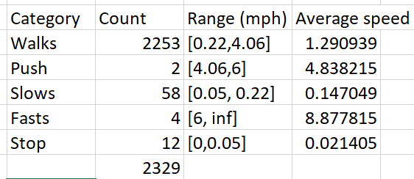
Segment speed thresholding
Categories based off of segment speeds
Fast Noise (6, inf) mph
Remove ambulation
Stop (0,0.05) mph
Normalize segment
Too slow (0.05, 0.22) mph
Normalize segment
Push (4.06, 6) mph
Remove segment
Walk [0.22, 4.06] mph
No change
Ranges of categories modifiable easily
# Patients 19
#Ambulation 158
#Segments 2329

Slide 5
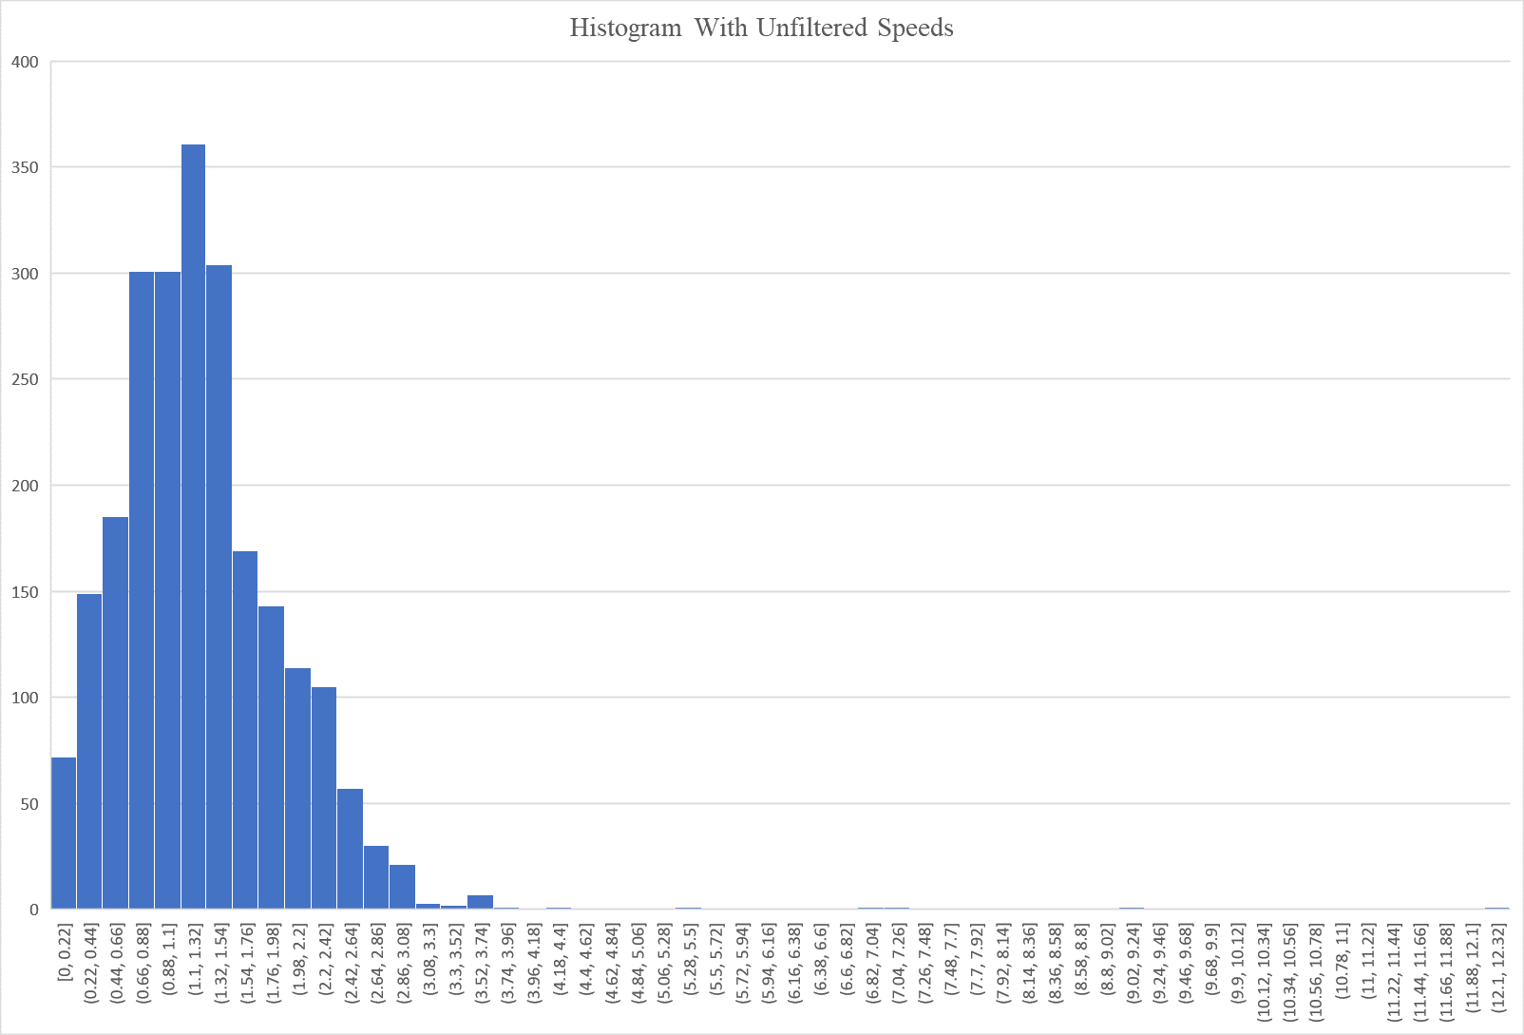
# Patients 19
#Ambulation 158
#Segments 2329

Slide 6
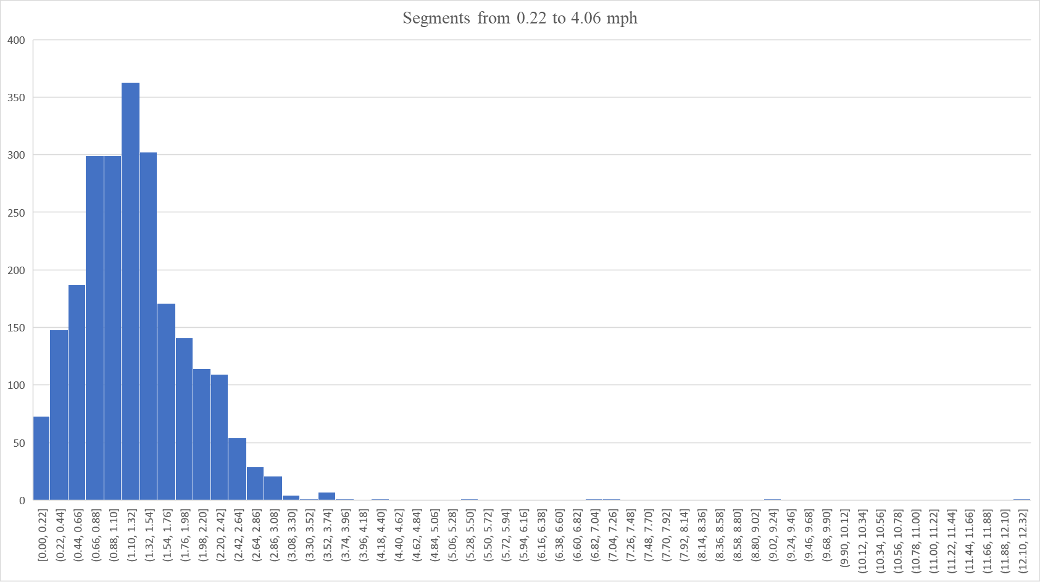

Slide 7
Process of Filtering
Categorize segment
Handle segment
Calculate average and standard deviation of segment speeds
Filter out segments falling outside 1 σ of average

Slide 8
Future Todos
Handling segments
Use segment information to output general results
Currently we sum up incorrect (not +/- 11 normalized) time and distance values and use that as general result
Reasons to Use Segments:
Segment information is +/- 11 normalized
Classification of segments may change general results
For example, a segment that is too fast may be omitted
Inaccuracies in Segment
The only inaccuracies in segment results found in the two patient data files were found at the very first segment
Documentation

