Slide 1
Differences in Regression Methods

Slide 2
General Info
These plots are of distance vs. seconds since admission date.
To be specific, it is not seconds until the specific ambulation, but seconds until the date this ambulation happened. Therefore points only have x axis values that are multiples of 86,400 (24hours*60minutes*60seconds)
My versions of regressions:
v1: We don't 'fake' any data points for days where there were no ambulations.
v2: On days where there are no ambulations, we add a fake ambulation on that day with 0 distance, duration, and speed.

Slide 3
Patients
In choosing patients, I am calling an 'standard case' a case in which the patient ambulates at least once every day, except for possibly the first and last day they are in the unit.
The patients I chose are as follows:
patient 111: Standard case, average length of stay
had 6 days on unit, did ambulations on days 2-5
patient 26: Standard case, longer stay
10 days on unit, did ambulations every day except day 1 and day 10
patient 11: Standard case, shorter stay
3 days on unit, only did ambulations on day 1 and 2
patient 1: No ambulations for the first few days
had 6 days in unit, did ambulations days 4-6
patient 8: Short stay with only one day of ambulations (we can't find a slope for this case currently)
3 days on unit, did 2 ambulations day 2 and no other ambulations
patient 34: Medium/long stay with only a couple days of ambulations
6 days on unit, only did ambulation on day 3 and day 5

Slide 4
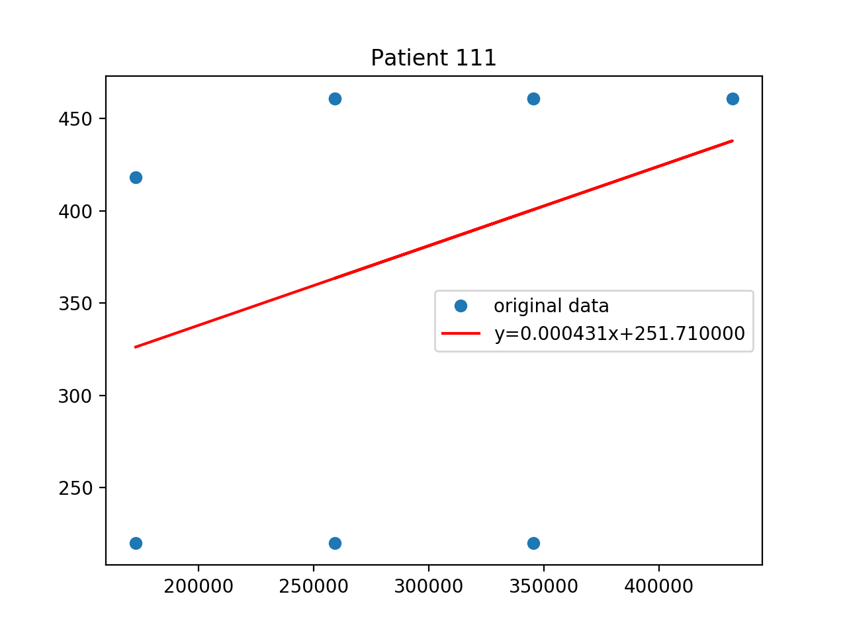
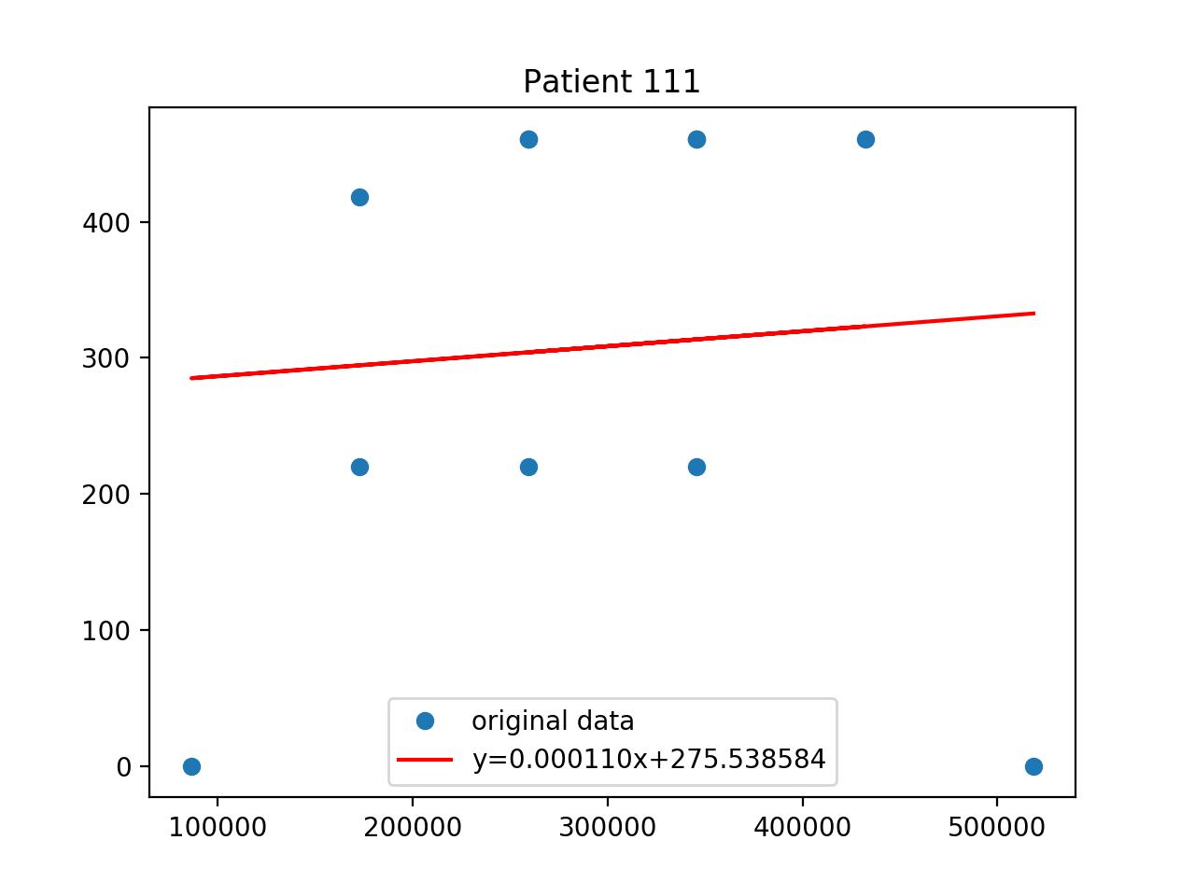
Patient 111
v1
v2

Slide 5
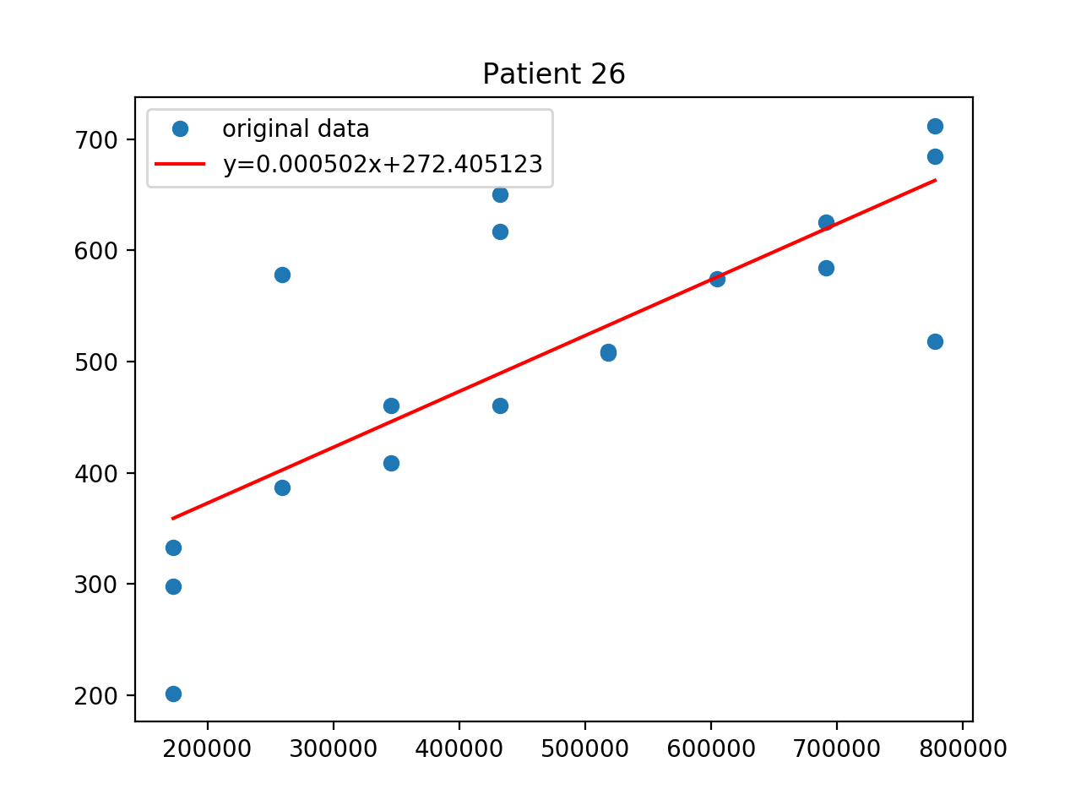
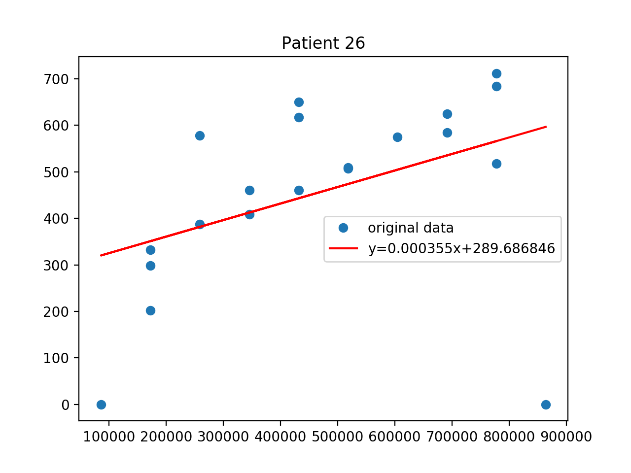
Patient 26
v1
v2

Slide 6
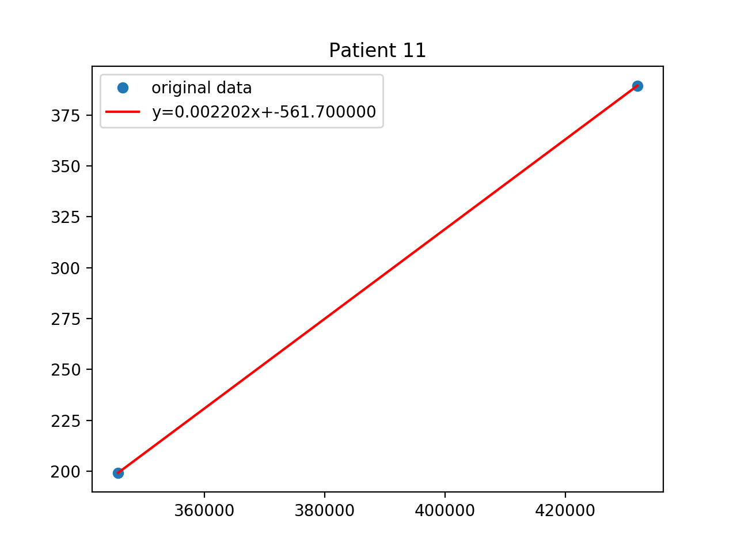
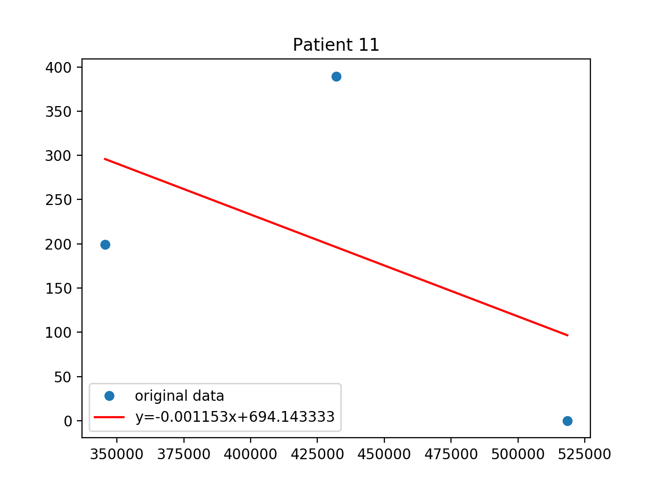
Patient 11
v1
v2

Slide 7
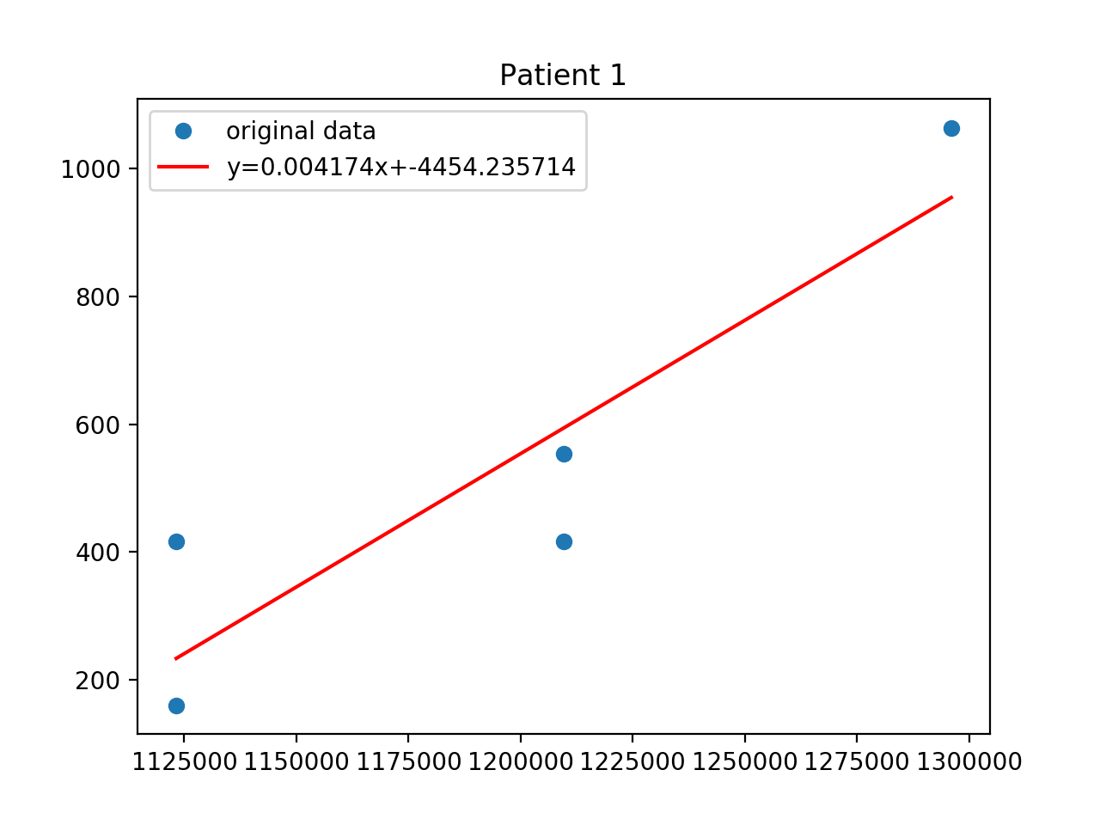
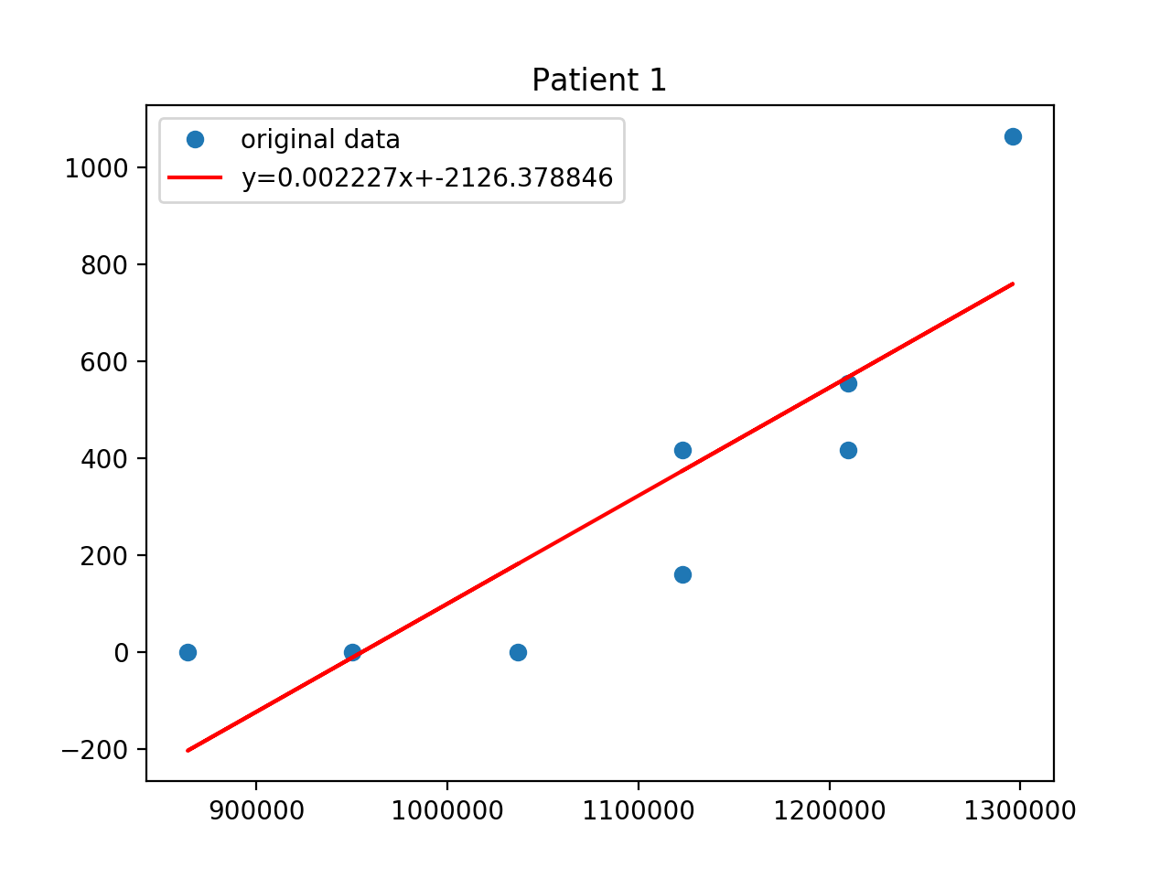
Patient 1
v1
v2

Slide 8
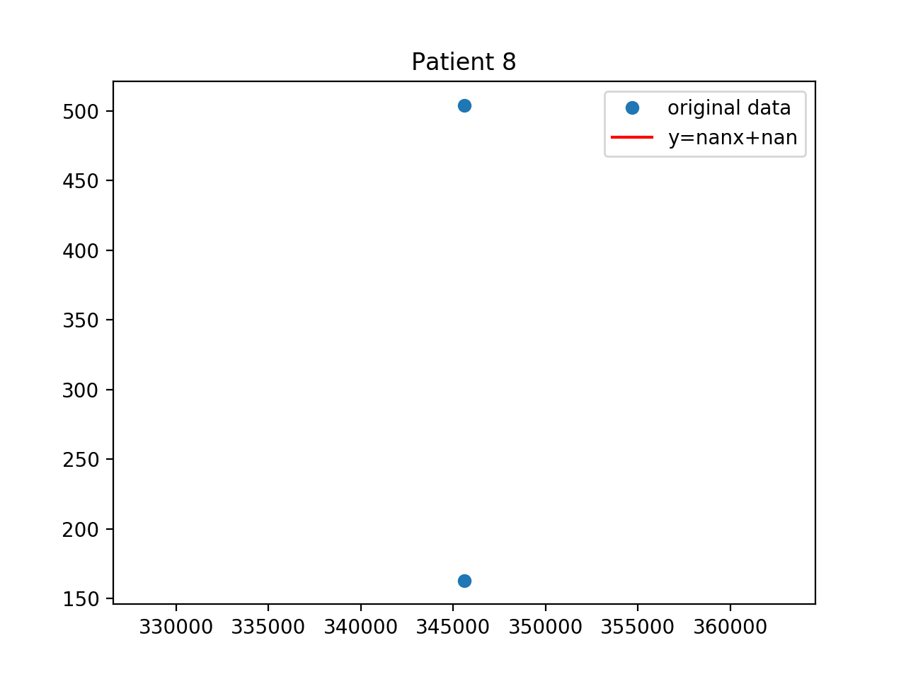
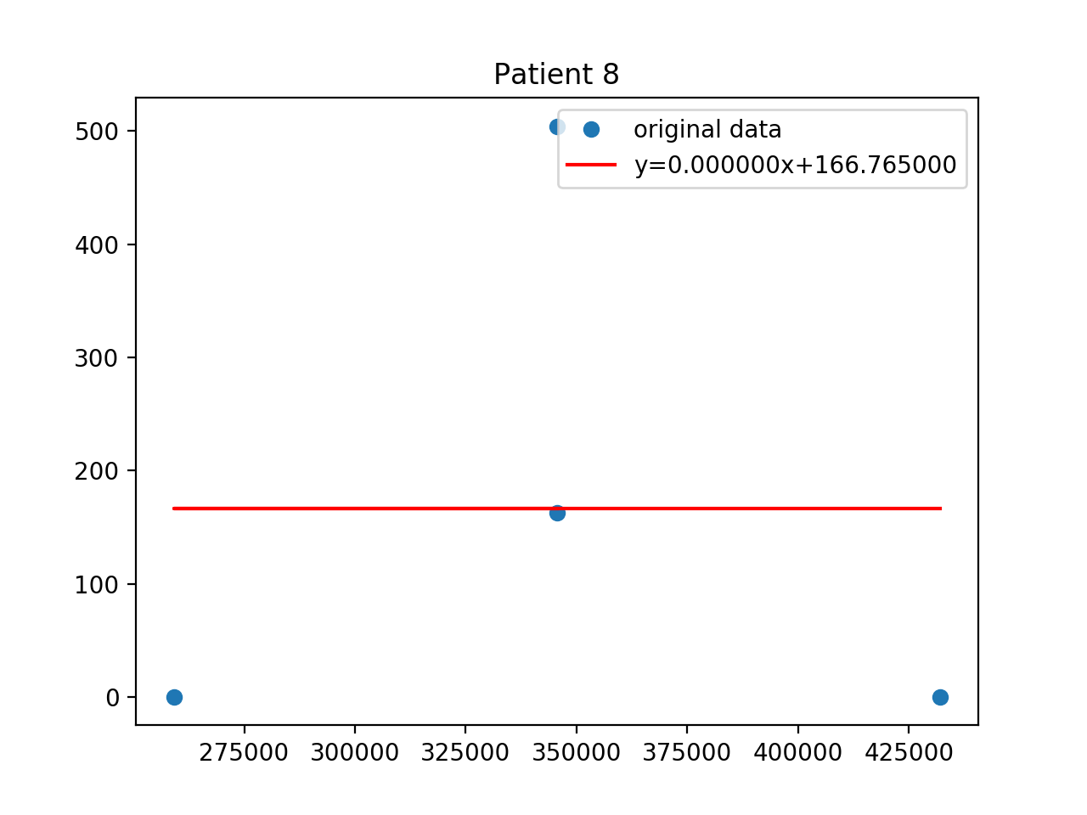
Patient 8
v1
v2

Slide 9
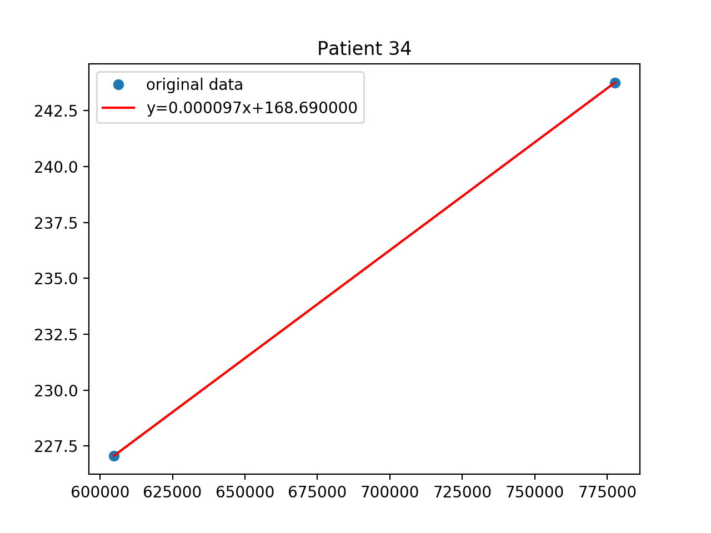
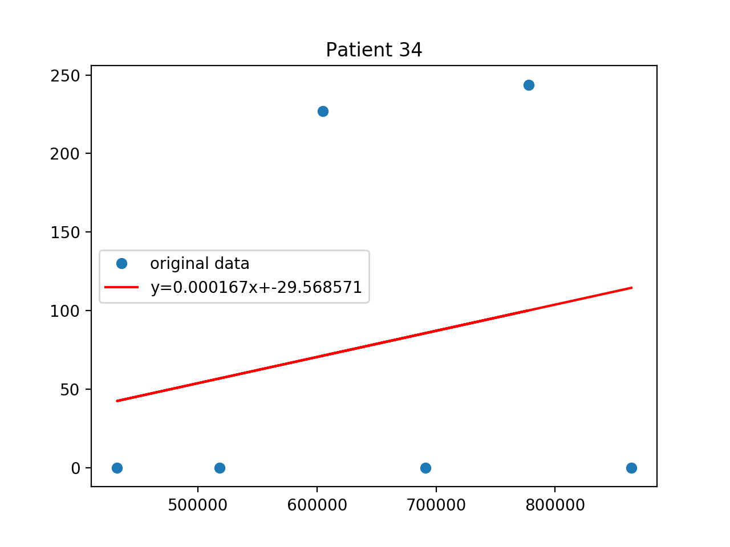
Patient 34
v1
v2

