Slide 1
CHANNEL ea
PROPRIETARY AUTO TRADING PLATFORM

Slide 2
“An investment in knowledge pays the best interest.” - Benjamin Franklin

Slide 3
What is channel ea?
Auto trading platform currently deployed in a live testing environment
One of the most technologically advanced and highly regarded Swiss brokerage
Consistently demonstrates over 200% ROI per month over the past 9 months of extensive testing – every single month
Extensive testing results indicate that it has never sustained a trading loss over a single trading day

Slide 4
The theoretical concept
Fully automated trading platform that works without any human intervention
Highly sophisticated algorithm based on Bayesian math and artificial intelligence
Focuses on market behavior to analyze over 1 million data points
Very fast calculations – analyzes over 1 million data points within 0.5 seconds
Calculates based on algorithmic logic, using fast servers that are much smaller than super computers
Algorithm draws an inference on when to open and when to close a trade

Slide 5
The theoretical concept
Bayesian math – deals with statistical analysis and probability analysis based on refining the sample and experience that is gained from the sample
Artificial intelligence – system that learns from the experience; the longer this system is in market, the more efficient and accurate it becomes

Slide 6
The theoretical concept
Inference helps the system decide when to open and when to close a trade
The system opens one trade and closes one trade at a time
Market exposure never exceeds 30 minutes at any one time
Automatically executes 7 to 15 trades during one trading day
Extensive testing results show that system generates net trading gain of approximately 5% on the amount traded in the equity account at the end of each trading day
System does in a day what most systems cannot do in a whole year

Slide 7
How it works
Algorithm does continuous real-time analysis of very large volumes of live market data consisting of about 1,000,000 data points
Very high computational speeds of approximately 0.5 seconds to achieve each full-scale analysis of present market conditions, without needing to deploy super-computing capability
Constantly monitors market liquidity
Proprietary mathematical logic and code permits valuable casual inferences to be obtained in real time from analysis of large volumes of live market data (the holy grail of so called “big-data computation”)
Based on the inferences, the algorithm determines the right time to open the trade
Opens a trade

Slide 8
How it works
Constantly analyzes data points and determines the right time to close the trade
Extensive testing demonstrates that system executes about 7 to 15 trades in each trading day, providing a net trading gain of about 5% ROI on each trading day
Never sustained a net trading loss in any day of trading during extensive back testing, forward testing, and demo account testing that has been done over large trading periods in 2014 and 2015, to-date
Algorithm has demonstrated consistent profitability at a rate of 5% per day during extensive testing over a period of 9 months

Slide 9
The future plan
System will trade live at one of the most technologically advanced and most reputed Swiss brokerages from March 29, 2015
We firmly believe that live performance of the system will be within ± 10% of the testing results

Slide 10
The future plan
This is Module 1 of 5 additional modules to be developed and added to trading capability of algorithm over the next 12 calendar months
Presently, this system opens and closes one trade at a time
Additional modules will open multiple trades (typically 5-6) and close multiple trades at a time
Another module will open this algorithm to other currency pairs like $ - € , $ - ¥ etc. and large aggregate indices – extraordinary capability
Existing auto trading systems are very specific; this technology is extremely flexible and adaptable with no other system like it in the market

Slide 11
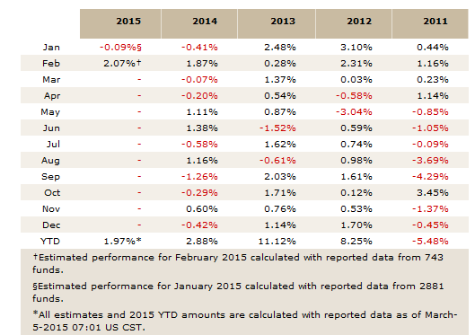
hedge fund performance over the years
Source: http://www.barclayhedge.com/research/indices/ghs/Hedge_Fund_Index.html

Slide 12
WHY IS it UNIQUE?
ABSOLUTELY NOTHING OF THIS KIND EXISTS IN THE MARKET THAT CAN GENERATE EVEN 1% OF THE RETURNS THAT THIS AUTO TRADING PLATFORM GENERATES
NO OTHER PLATFORM HAS NEVER CREATED A LOSS OVER A SINGLE TRADING DAY

Slide 13
OUR challenge
SHOW US ANY OTHER PROGRAM THAT DELIVER EVEN 1%
OF THE PROFIT THAT CHANNEL EA IS GENERATING

Slide 14
UNBELIEVABLE?

Slide 15
CHECK THE RESULTS FROM FORWARD TESTING, BACK TESTING AND DEMO ACCOUNT TESTING AT THE SWISS BROKERAGE WHERE CHANNEL EA IS CURRENTLY DEPLOYED

Slide 16
The system is tested at Lot Size=0 (20% capacity). In real trading, the system will leverage at higher Lot Size (up to 5) so margin will be much higher
Profit: 214.6%

Slide 17
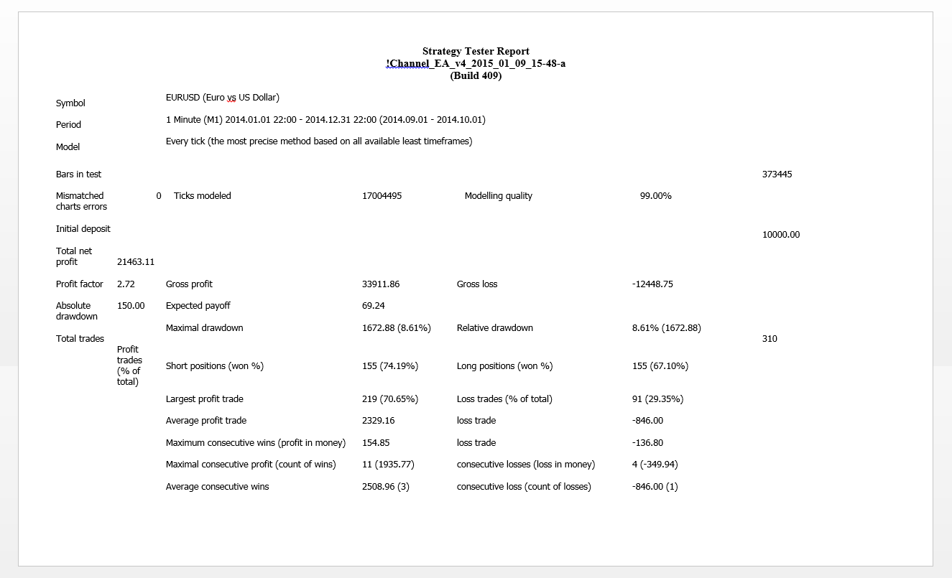

Slide 18
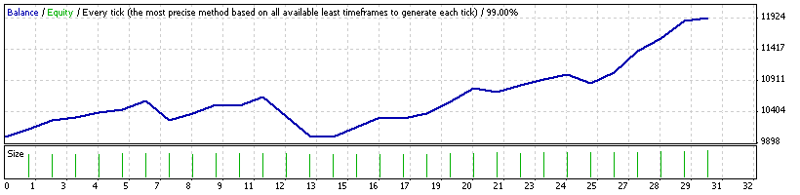
REAL MARKET DATA TESTING RESULT
SEPTEMBER GRAPH
The trend line never touches the baseline, which means that the system never generates a loss during a trading day
Baseline

Slide 19
The system is tested at Lot Size=0 (20% capacity). In real trading, the system will leverage at higher Lot Size (up to 5) so margin will be much higher
Profit: 1747.5%

Slide 20
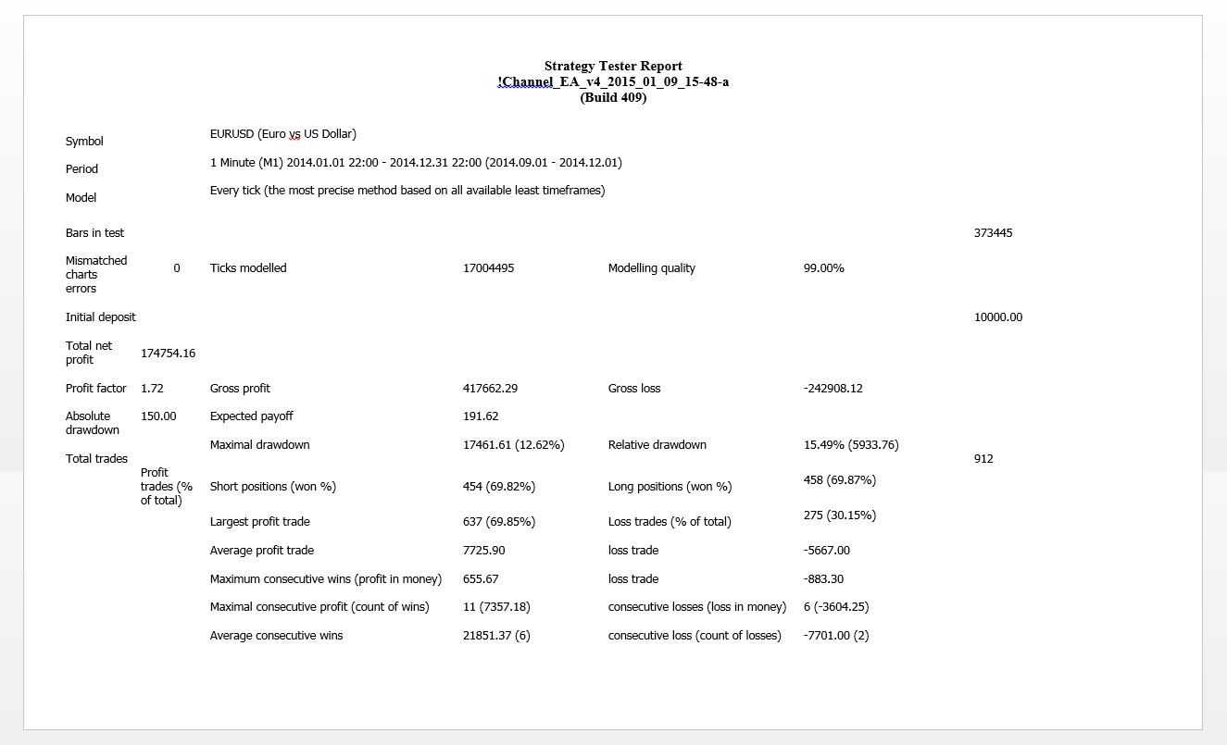

Slide 21
The system is tested at Lot Size=0 (20% capacity). In real trading, the system will leverage at higher Lot Size (up to 5) so margin will be much higher

Slide 22
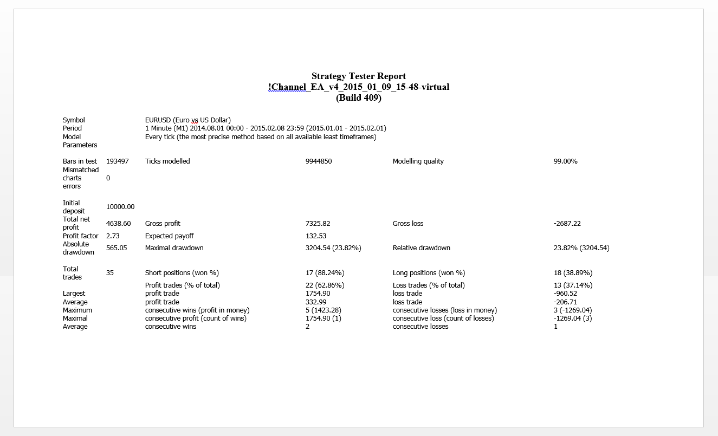

Slide 23
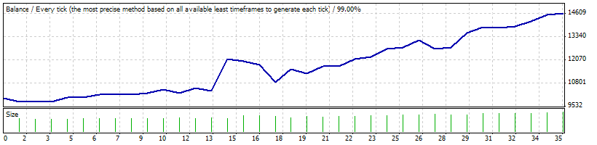
REAL MARKET DATA TESTING RESULT
JANUARY TREND LINE GRAPH
The trend line never touches the baseline, which means that the system never generates a loss during a trading day
Baseline

Slide 24
The system is tested at Lot Size=0 (20% capacity). In real trading, the system will leverage at higher Lot Size (up to 5) so margin will be much higher
Profit: 19.3%

Slide 28
Extraordinary growth
€ 10K will grow to € 3.9 BILLION
in one year

Slide 29
OUR BUSINESS MODEL
Selected eligible non-US (preferably European) hedge funds having highest level of integrity would be invited to trade with us, strictly on invitation basis only
We currently trade only in non-USD currencies on FOREX market in € - $ pair
A Europe-based legal entity (LLC) established by us, but independently controlled by a reputed Swiss Notar (fiduciary) with independent function, will manage and execute the trading using our proprietary platform
Bank automatically distributes profits to all parties involved, as per pre-defined payment instruction

Slide 30
HOW TO trade WITH US
Hedge fund should have investment capability of at least € 100 million in currency market; will deposit trading funds into its trading account
Likely investment schedule:
By 1st week - € 50,000
By 2nd week - € 100,000
By 3rd week - € 1000,000
By 4th week - € 5,000,000
By 8th week - € 50,000,000
By 12th week - € 100,000,000

Slide 31
HOW TO trade WITH US
Funds will go into a designated bank that will act as depository of funds
Hedge fund will transfer funds to its trading account; brokerage account will be tied to a bank
Bank will have standing instructions to distribute funds from trading account automatically
Swiss Notar will access trading account through our secure server to trade in currency market
Swiss Notar will simply supervise the trading account

Slide 32
HOW TO trade WITH US
After a certain time, there will be a sweep on the brokerage account
All trading funds will be transferred into bank account
The bank will automatically distribute the profit as per pre-defined payment instruction
A leading European bank (like Deutsche, Barclays, etc.) will be chosen and accepted by everybody
Will be completely free from human intervention; funds will be automatically distributed by the bank as per payment instructions, rather than come to us

Slide 33
Vital information
About Swess Notar:
Public notaries in Switzerland certify acts of law, they complete notarisations of signatures and copies on the basis of original documents. Swiss notaries provide advice on preparation and certification of transactions and transfers of shares under the corporate law. Public notaries in Switzerland can also consult with foreign authorities if a company transfers overseas. In terms of property selling, a Swiss public notary acts on behalf of both the vendor and the purchaser. Overall, a public notary in Switzerland has the role of providing the highest legal certainty of documents. Source: http://www.bridgewest.eu/article/public-notary-in-switzerland
Swiss fiduciary: « A Fiducie (fiducia means trust in Latin), is a legal instrument through which a person, the Trustee, has the right to manage the trust assets. The latter is limited by various obligations that generally include transferring the right after a certain period of time to the Settler or to a third party. » – By Professor Witz.
Trust operations are based on the trust the Settler has toward the Trustee. Thus, a « Fiducie » is a contract for a temporary transfer of ownership. The Trustee must reconvey the asset(s) of the trust once his/her obligations are finished.

Slide 34
PARNASSUS TRUST, LLC INCORPORATED IN CAYMAN ISLANDS, CONTROLLED BY SWISS NOTAR (FIDUCIARY)
WILL ACCESS THE TRADING ACCOUNT THROUGH CHANNEL EA PROPRIETARY AUTO TRADING PLATFORM
HEDGE FUND
(INVESTOR)
10% PROFIT AUTOMATICALLY DISTRIBUTED BY THE BANK
BANK ACCOUNT IN LEADING BANK LIKE DEUTSCHE BANK, BARCLAYS BANK, ETC. (IT WILL HOLD DEPOSITORY FUNDS DEPOSITED BY HEDGE FUND)
90% PROFIT AUTOMATICALLY DISTRIBUTED BY THE BANK
TRADING ACCOUNT (BANK WILL TRANSFER DEPOSITORY FUNDS TO TRADING ACCOUNT)
FUNDS WILL BE AUTO SWEPT TO BANK ACCOUNT AFTER A CERTAIN TIME
CHANNEL EA
AUTO TRADING PLATFORM

Slide 35
HOW TO trade WITH US
Extensive testing data will be shared with interested fund managers prior to engagement with us
Hedge fund will have its own funds and trading account based on the specs we give them
Fiduciary will not control trading platform or its funds
Swiss fiduciary will be given the ability to access the trading account using our proprietary trading algorithm through our secure server
Only the fiduciary will be allowed to access our server
Fiduciary will have live read-only access of account performance
Fund manager can tell the fiduciary to kill the account any time

Slide 36
HOW TO trade WITH US
Fiduciary will give them trading account balance and 10% of the profit
It will give us 90% of the profit (after deducting all intermediate charges, brokerage charges and its own fees)
Very high level of fiduciary relationship
Hedge fund will not have the ability to access its own trading account after the fiduciary has been appointed
Fiduciary will control the account, but only as a fiduciary
Only fiduciary will have access to our database
Strictly confidential and private nature of investment

Slide 37
Why trade with us?
ROI – over 100,000 times in one year of initial investment
No human intervention required for trading
No other system can provide even 1% of what this system is already generating
Multiple measures to ensure the system never goes into a net trading loss in any single trading day
Transparent dealing via establishment of overseas trust (Parnassus Trust, LLC) incorporated in Cayman Islands, brokerage and Swiss Notar

Slide 38
Why trade with us?
Unrestricted and automatic distribution of invested funds and trading profits directly by the account holder bank
Fiduciary will be provided read-only access to live trading accounts
Automatic daily closing reports for trading account performance evaluation will be generated
Flexibility for partners to discontinue association at any time, no questions asked

Slide 39
contact us
Lisa Collins
Program Manager
program.manager@parnassustrust.com

Slide 40
Let’s Change the Game!!

