Slide 1



Allstate Endorsements UX Review
Issues and Impacts
04.23.2014

Slide 2
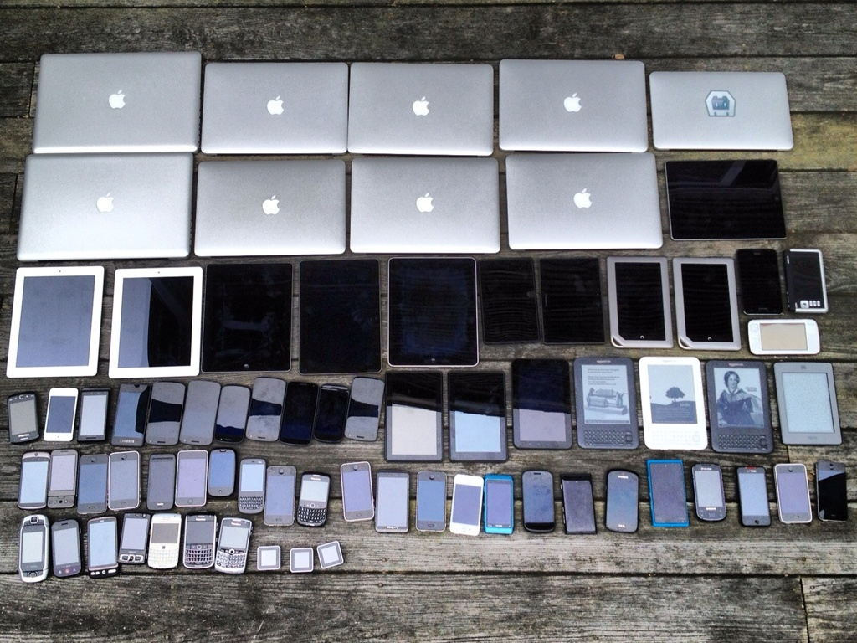
iOS Endorsement Issues

Slide 3

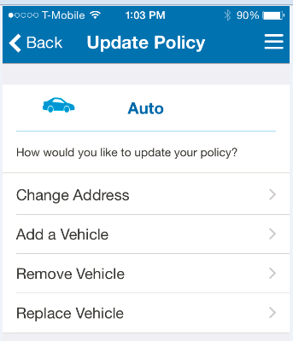
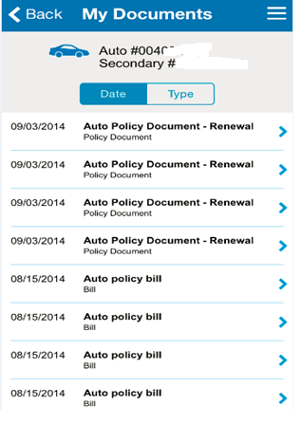
iOS Issues Log
Screen Title: Update Policy
Issue Description: Auto policy number does not appear at top of screen as in other screens.
Proposed Solution: We will add the policy number to this design to match payments.
DELIVERABLE UPDATES
ENHANCEMENT TYPE | WIREFRAMES | CONTENT MATRIX | VISUAL DESIGN
UX | X | X | X

Slide 4
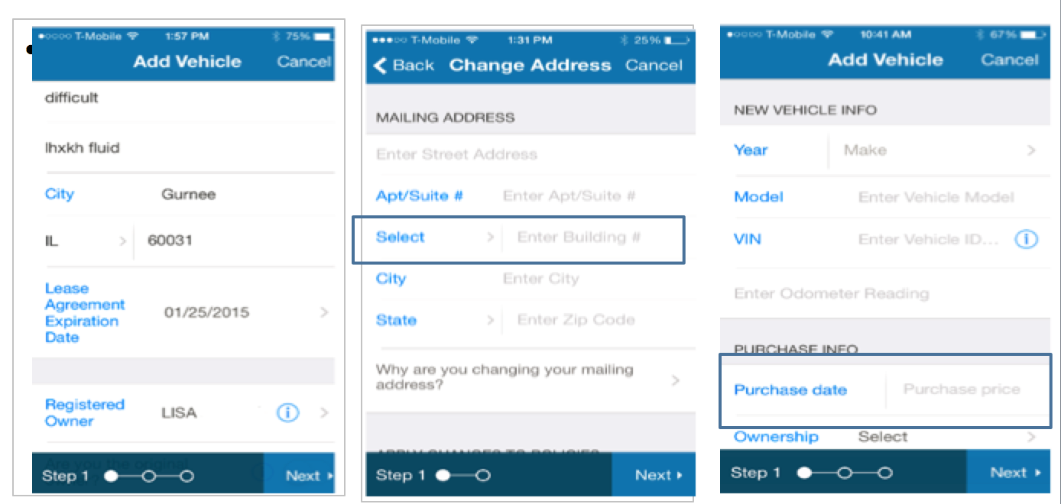
iOS Issues Log
Screen Title: Multiple Screens
Issue Description: iOS multi-fields may cause user confusion
Proposed Solution: Although Apple frequently uses multi-fields in its designs, we have decided to avoid the risk and not use side-by-side fields in iOS (this does not affect Android)
ENHANCEMENT TYPE | WIREFRAMES | CONTENT MATRIX | VISUAL DESIGN
UX | X |  | X

Slide 5
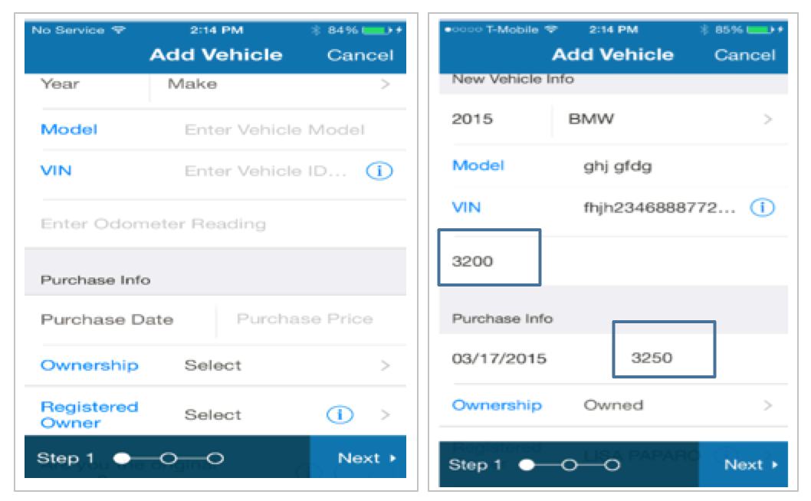
iOS Issues Log
Screen Title: Add Vehicle
Issue Description: Odometer and Purchase Price are missing field labels.
Proposed Solution: We will add labels to the fields.
ENHANCEMENT TYPE | WIREFRAMES | CONTENT MATRIX | VISUAL DESIGN
UX | X | X | X

Slide 6
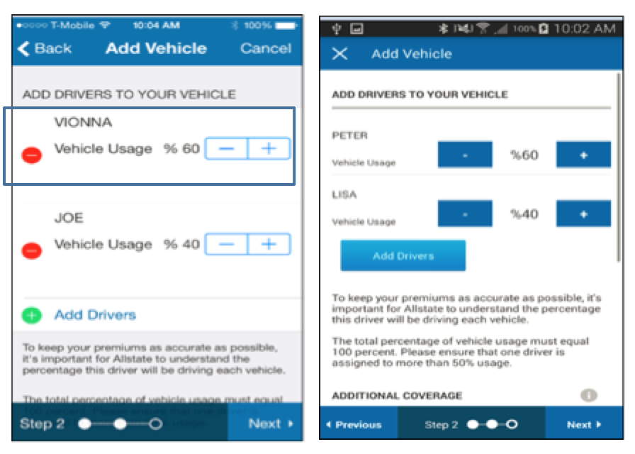
iOS Issues Log
Screen Title: Add Vehicle
Issue Description: Percentage is in front of the number.
Proposed Solution: We will change the percentage to be after the number
ENHANCEMENT TYPE | WIREFRAMES | CONTENT MATRIX | VISUAL DESIGN
UX | X | X

Slide 7
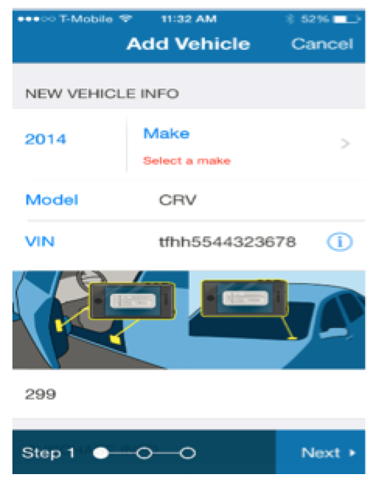
iOS Issues Log
Screen Title: Add Vehicle
Issue Description: Image doesn't tell anything about the VIN number.
Proposed Solution: Image is only used as a general reference to where to find a VIN on any vehicle. Images should have white space between them.
ENHANCEMENT TYPE | WIREFRAMES | CONTENT MATRIX | VISUAL DESIGN
Visual |  |  | X

Slide 8
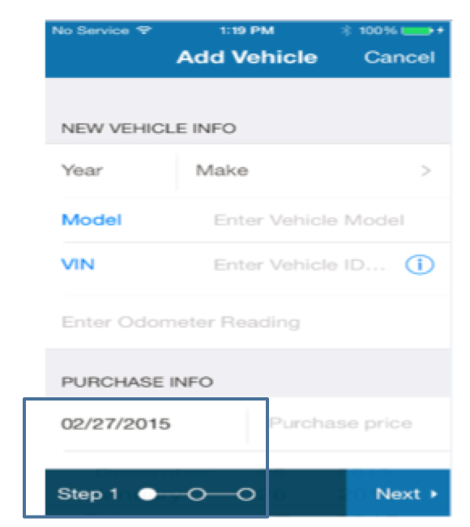
iOS Issues Log
Screen Title: Add Vehicle
Issue Description: Purchase date picker is hidden under the scroll when triggered
Proposed Solution: Screen should be automatically scrolled so the picker is visible on the screen
ENHANCEMENT TYPE | WIREFRAMES | CONTENT MATRIX | VISUAL DESIGN
Development

Slide 9
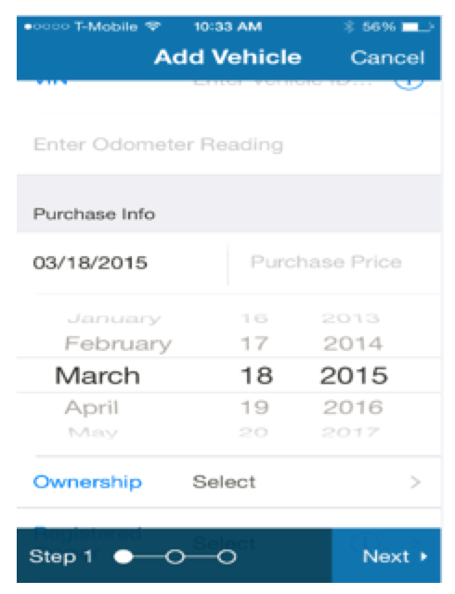
iOS Issues Log
Screen Title: Add Vehicle
Issue Description: Calendar implementation is not intuitive.
Proposed Solution: When customer taps off of the picker, the picker should be dismissed. UX will simplify fields by removing side-by-side fields
ENHANCEMENT TYPE | WIREFRAMES | CONTENT MATRIX | VISUAL DESIGN
Development

Slide 10
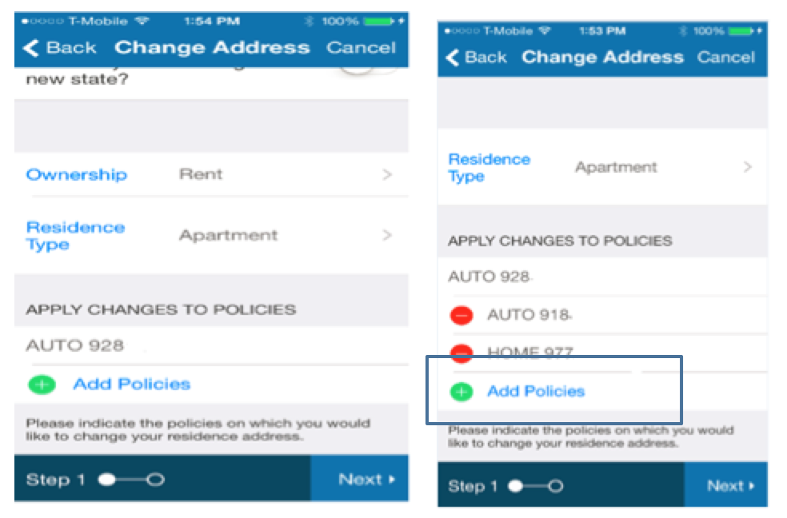
iOS Issues Log
Screen Title: Change Address
Issue Description: iOS Add Policies button continues to display when there are no more policies to add
Proposed Solution: Once all policies have been added, remove button. Button will reappear if a user removes a policy
ENHANCEMENT TYPE | WIREFRAMES | CONTENT MATRIX | VISUAL DESIGN
Development

Slide 11
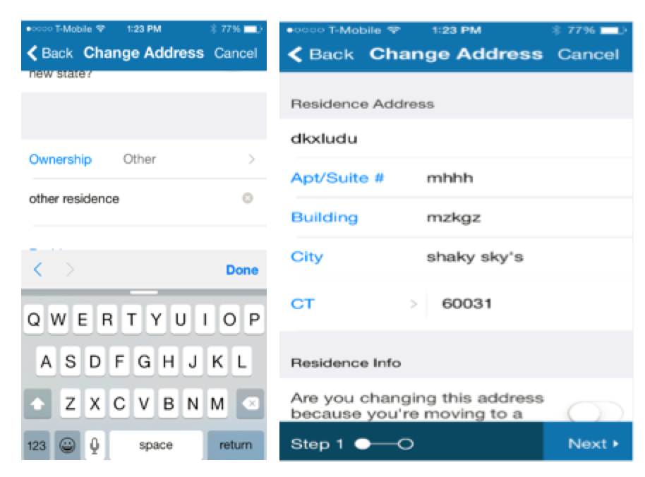
iOS Issues Log
Screen Title: Change Address
Issue Description: When filling in a field with the keyboard, pressing the done button navigates to top of screen.
Proposed Solution: Dev should make the screen maintain it’s current place in the input process.
ENHANCEMENT TYPE | WIREFRAMES | CONTENT MATRIX | VISUAL DESIGN
Development

Slide 12
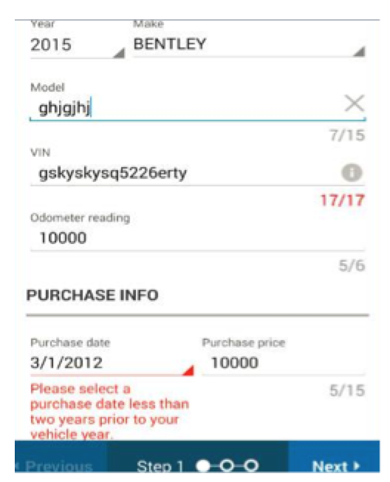
iOS Issues Log
Screen Title: Add Vehicle
Issue Description: Purchase Date validation messaging is unclear.
Proposed Solution: We will update the messaging in the content matrix
ENHANCEMENT TYPE | WIREFRAMES | CONTENT MATRIX | VISUAL DESIGN
UX | X | X

Slide 13
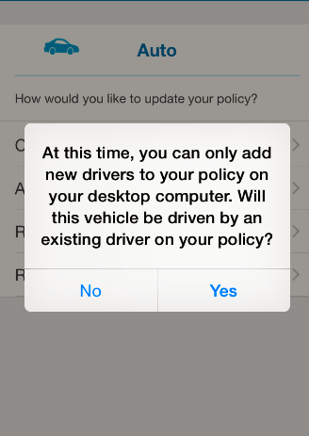
iOS Issues Log
Screen Title: Add Vehicle Modal
Issue Description: Content formatting for add vehicle alert modal is confusing.
Proposed Solution: Manifest will review the content and amend the content matrix to clarify the messaging.
ENHANCEMENT TYPE | WIREFRAMES | CONTENT MATRIX | VISUAL DESIGN
Content |  | X

Slide 14
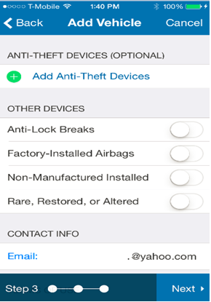
iOS Issues Log
Screen Title: Add Vehicle
Issue Description: Anti Theft Devices include “Rare Restored or Altered.”
Proposed Solution: “Rare, Restored, or Altered” should be broken off into it's own area.
ENHANCEMENT TYPE | WIREFRAMES | CONTENT MATRIX | VISUAL DESIGN
UX | X |  | X

Slide 15
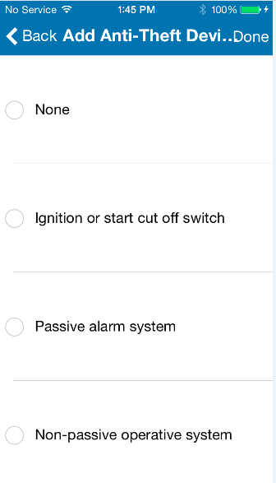
Who Needs to Fix? Dev, UX, Content, VD | Requires Wire Changes? | Requires Content Changes? | Requires VD Changes? | Requires Code Changes?
Dev |  |  |  | X
iOS Issues Log
Screen Title: Add Anti-Theft Devices
Issue Description: None and other devices can be selected simultaneously.
Proposed Solution: This should be updated by Dev so that if None is selected, all other devices are deselected, and if other devices are selected, none is deselected.
ENHANCEMENT TYPE | WIREFRAMES | CONTENT MATRIX | VISUAL DESIGN
Development

Slide 16
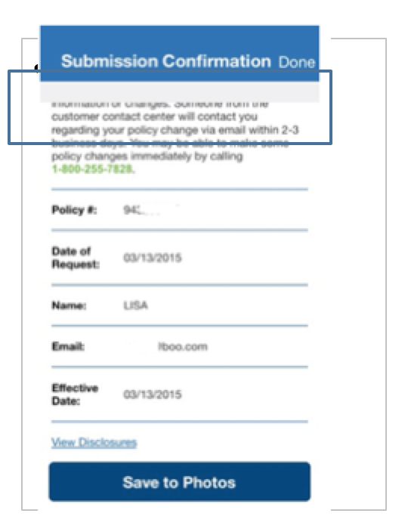
iOS Issues Log
Screen Title: Submission Confirmation
Issue Description: Grey section is on the submit screen.
Proposed Solution: Dev should remove the gray boxes.
ENHANCEMENT TYPE | WIREFRAMES | CONTENT MATRIX | VISUAL DESIGN
Development

Slide 17
Android Endorsement Issues

Slide 18
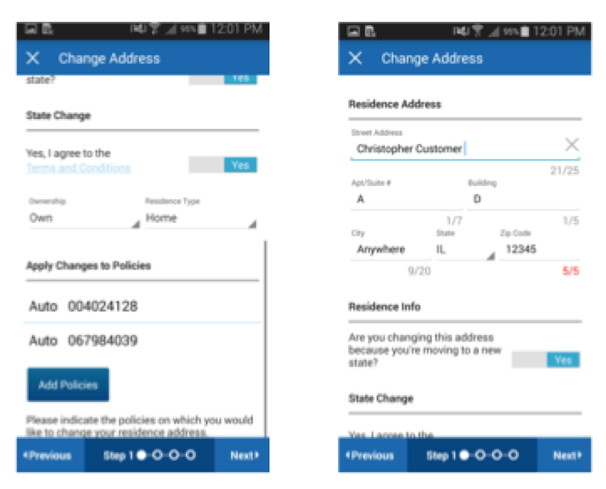
iOS Issues Log
Screen Title: Terms and Conditions
Issue Description: Residence info - Terms and Conditions navigates to top of page after pressing back.
Proposed Solution: Dev should return to screen in the same position as before. Text displayed on screen should reflect text in the content matrix.
ENHANCEMENT TYPE | WIREFRAMES | CONTENT MATRIX | VISUAL DESIGN
Development

Slide 19
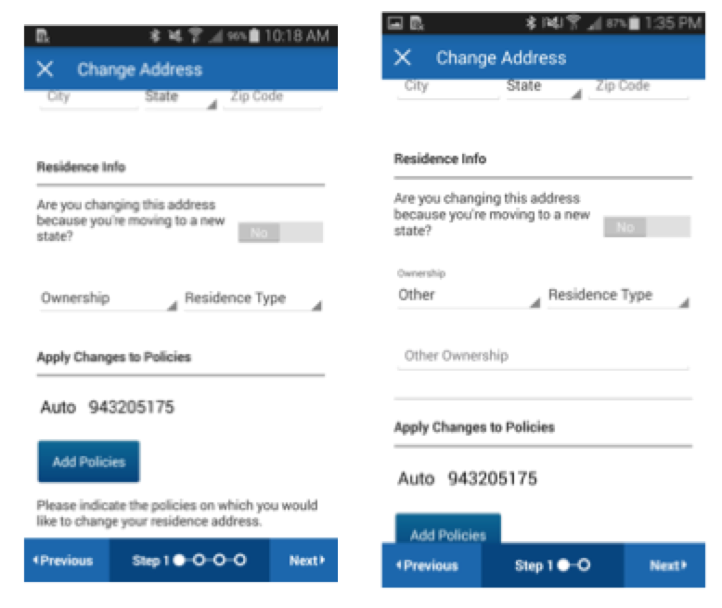
iOS Issues Log
Screen Title: Change Address
Issue Description: When ownership type of Other is selected, the generated input field is not grouped with “Other.”
Proposed Solution: UX will update the field display to break Ownership and Residence Type onto separate lines and provide examples of how the “Other” fields should behave.
ENHANCEMENT TYPE | WIREFRAMES | CONTENT MATRIX | VISUAL DESIGN
UX | X

Slide 20
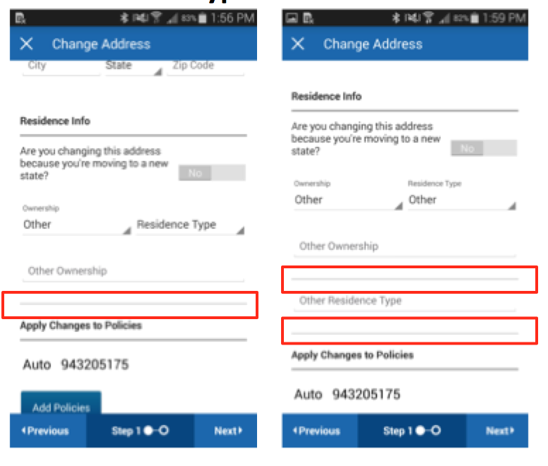
iOS Issues Log
Screen Title: Change Address
Issue Description: Additional Gray lines exist and make interface confusing.
Proposed Solution: Lines should be removed by Dev.
ENHANCEMENT TYPE | WIREFRAMES | CONTENT MATRIX | VISUAL DESIGN
Development

Slide 21
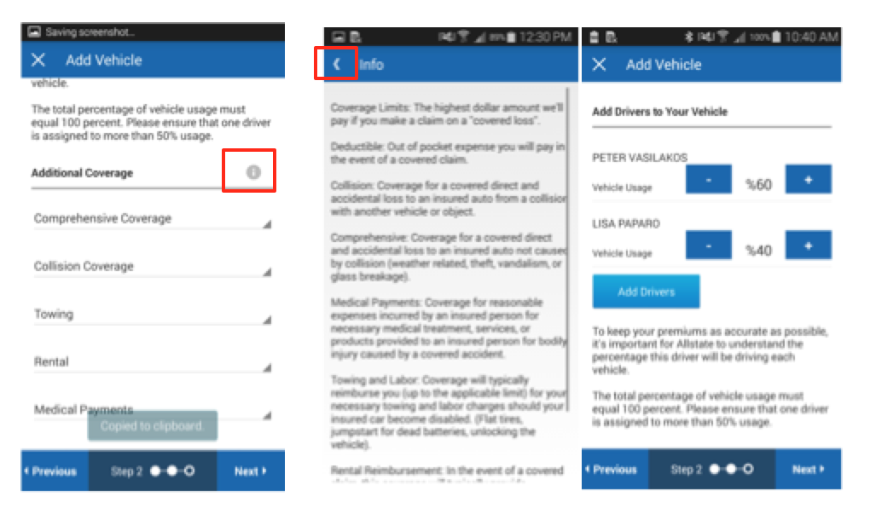
iOS Issues Log
Screen Title: Add Vehicle
Issue Description: Back button on Info screen takes customer to top of screen
Proposed Solution: Dev should return to screen in the same position.
ENHANCEMENT TYPE | WIREFRAMES | CONTENT MATRIX | VISUAL DESIGN
Development

Slide 22
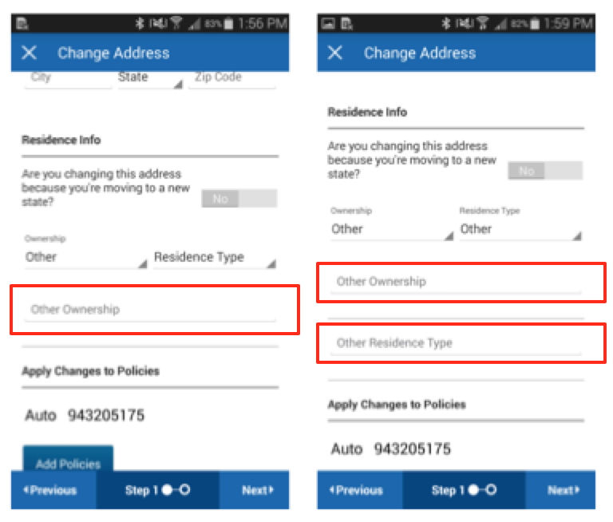
iOS Issues Log
Screen Title: Change Address
Issue Description: Text fields for Other Ownership and Other Residence Type display incorrectly, they should be grouped.
Proposed Solution: We will add the correct grouping to the fields and ungroup the Ownership and Residence Type fields.
ENHANCEMENT TYPE | WIREFRAMES | CONTENT MATRIX | VISUAL DESIGN
UX | X

Slide 23
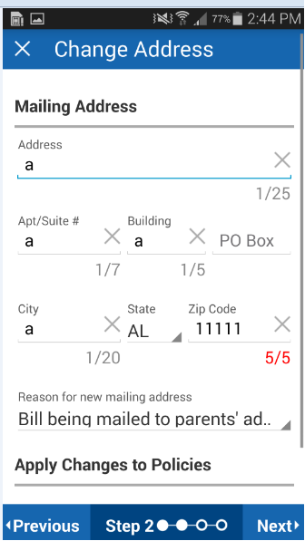
iOS Issues Log
Screen Title: Change Address
Issue Description: Text clear X is too large.
Proposed Solution: Dev should refer to style guide for visual sizing.
ENHANCEMENT TYPE | WIREFRAMES | CONTENT MATRIX | VISUAL DESIGN
Development |  |  | X

Slide 24
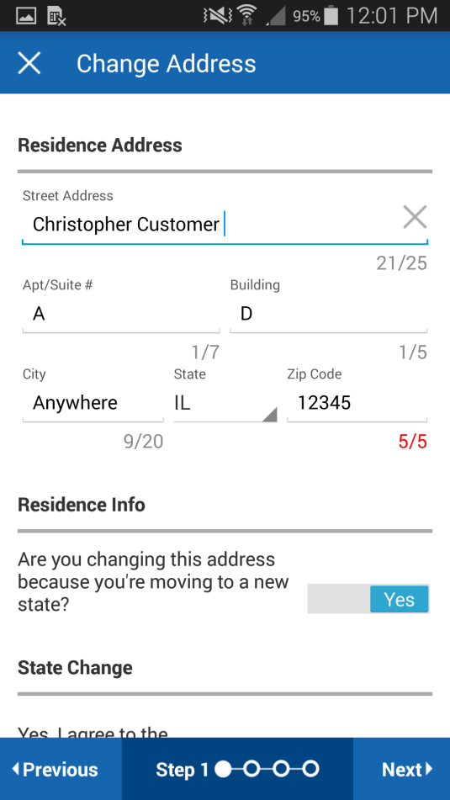
iOS Issues Log
Screen Title: Change Address
Issue Description: Text field max character count always displays
Proposed Solution: Character counter should only be displayed for overages / excessive text
ENHANCEMENT TYPE | WIREFRAMES | CONTENT MATRIX | VISUAL DESIGN
Development

Slide 25
iOS Issues Log
Screen Title: Add Vehicle
Issue Description: Purchase Date validation messaging is unclear.
Proposed Solution: We will update the messaging in the content matrix
ENHANCEMENT TYPE | WIREFRAMES | CONTENT MATRIX | VISUAL DESIGN
Content |  | X

Slide 26
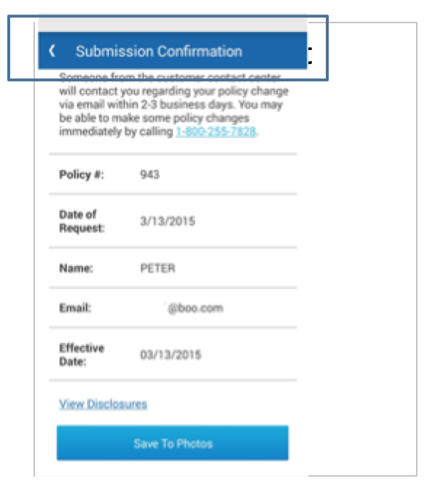
Android Issues Log
Screen Title: Submission Confirmation
Issue Description: Grey section is on the submit screen.
Proposed Solution: Dev should remove the gray boxes.
ENHANCEMENT TYPE | WIREFRAMES | CONTENT MATRIX | VISUAL DESIGN
Development

Slide 27
Additional Screens

Slide 28
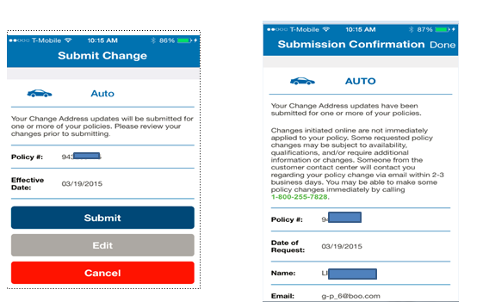
iOS Issues Log
Screen Title: Confirmation Screen
Issue Description: It would be helpful to have a confirmation screen at the end of the process.
Proposed Solution: UX will create a confirmation screen
ENHANCEMENT TYPE | WIREFRAMES | CONTENT MATRIX | VISUAL DESIGN
UX | X | X | X

Slide 29
Who Needs to Fix? Dev, UX, Content, VD | Requires Wire Changes? | Requires Content Changes? | Requires VD Changes? | Requires Code Changes?
UX | X |  |  | X
iOS Issues Log
Screen Title: None
Issue Description: Development is having difficulty understanding how transitions should be implemented.
Proposed Solution: UX will create a guide for screen transitions.
ENHANCEMENT TYPE | WIREFRAMES | CONTENT MATRIX | VISUAL DESIGN
UX | X

