Slide 1





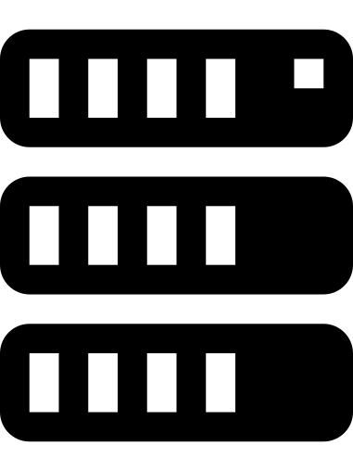

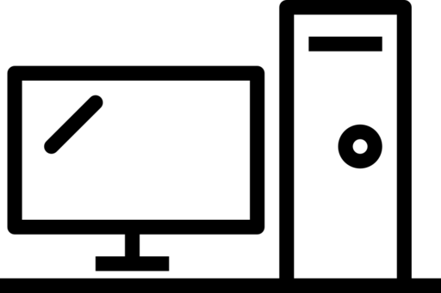

Sensor Data Monitoring System
Sensor
Edge-device
SaaS Server

Slide 2
