Slide 1
Practical Message-passing Framework for Large-scale Combinatorial Optimization
2015 IEEE International Conference on Big Data
Inho Cho, Soya Park, Sejun Park, Dongsu Han, and Jinwoo Shin
KAIST

Slide 2
Large-scale Real-time Optimizations Are Becoming More Important for Processing Big Data
Introduction
Virtual Machine Placement in Data Centers ^{[1]}
Multi-path Network Routing in SDN ^{[2]}
Resource Allocation on Cloud ^{[3]}
Virtual Network Resource Assignment ^{[4]}
Problem size is becoming large.
Decision needs to be made in real time.
[1] Meng, et al. Improving the scalability of data center networks with traffic-aware virtual machine placement. INFOCOM 2010.
[2] Kotronis, et al. Outsourcing the routing control logic: Better Internet routing based on SDN principles. Hot Topics in Networks 2012.
[3] Rai, et al. "Generalized resource allocation for the cloud." ACM Symposium on Cloud Computing 2012.
[4] Zhu, et al. "Algorithms for Assigning Substrate Network Resources to Virtual Network Components." INFOCOM 2006.

Slide 3
Traditional Attempts to Solve Combinatorial Optimization
Introduction
General Algorithm
Problem-specific Algorithm
GOAL
Exact
Algorithm
Integer
Programming
high
Accuracy
Approximation
Algorithm
poor
Greedy
low
high
Time Complexity
There is a trade-off among accuracy, time complexity and generality.
Our goal is to develop the parallelizable framework to solve large-scale combinatorial optimization with low time complexity and high accuracy.

Slide 4


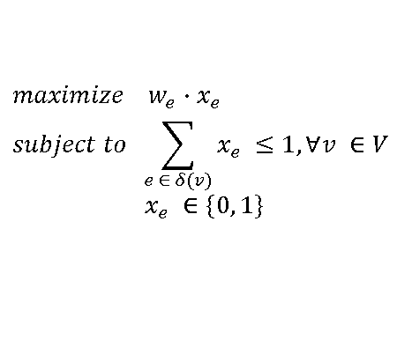


Our Approach
Our Contribution
Many combinatorial optimizations can be expressed as Integer Programming (IP) formulation.
We are going to solve the optimization problem using Belief Propagation algorithm.
Problem
Maximum Weight Matching
edge
$$maximize w_{e}∙x_{e}$$
$$subject to \sum_{e ∈ δ(v)}{x_{e} ≤1, ∀v ∈V}$$
$$x_{e} ∈\{0, 1\}$$
IP formulation
BP formulation
Message Update Rule:
Decision Rule:
$$m_{i→j}^{t+1} ←\max_{k∈δ(i)\backslash \{j\}}{\{\max{\{}w_{ik}−m_{k→i}^{t}, 0\}\}}$$
$$z_{e}= \left\{\begin{aligned}1 if \left(m_{i→j}+m_{j→i}\right)< w_{e} \\ ? if \left(m_{i→j}+m_{j→i}\right)= w_{e} \\ 0 if \left(m_{i→j}+m_{j→i}\right)> w_{e}\end{aligned}\right.$$
(selected)
(undecided)
vertex
(unselected)

Slide 5
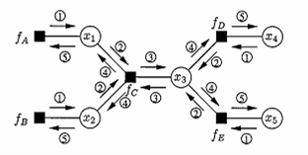
Belief Propagation (BP)
Our Contribution
BP algorithm is message-passing based algorithm.
Easy to parallelize ^{[5]}, easy to implement.
BP is widely used due to its empirical success in various fields, e.g., error-correcting codes, computer vision, language processing, statistical physics.
Previous works on BP for combinatorial optimization
Analytic studies are too theoretic, i.e. not practical ^{[6-7]}.
Empirical studies are problem-specific ^{[8-9]}.
[5] Gonzalez, et al. "Residual splash for optimally parallelizing belief propagation.” Aistats 2009. [6] S. Sanghavi, et al., “Belief propagation and lp relaxation for weighted matching in general graphs,” Information Theory 2011. [7] N. Ruozzi and S. Tatikonda, “st paths using the min-sum algorithm,” ALLERTON 2008.
[8] S. Ravanbakhsh, et al., “Augmentative message passing for traveling salesman problem and graph partitioning,” NIPS 2014.
[9] M. Bayati, et al., “Statistical mechanics of steiner trees,” Physical review letters, vol. 101, no. 3, p. 037208, 2008.

Slide 6
Challenges of BP & Our solution
Our Contribution
BP’s convergence is too slow for practical instances.
Fixed number of BP iterations.
Solution may not produce feasible solution.
Introduce generic “rounding” scheme enforcing the feasibility via weight transformation and post-processing.
Solution produce poor accuracy.
Careful message initialization, hybrid damping and asynchronous message updates

Slide 7
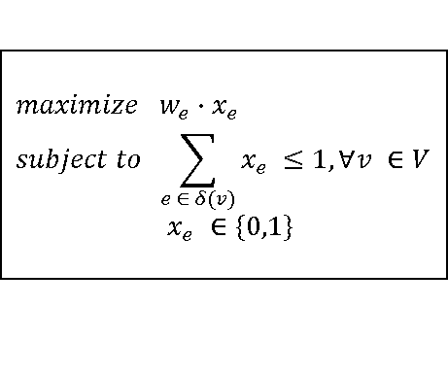
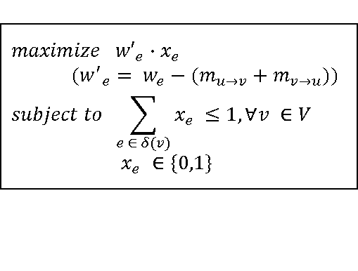
Overview of our generic BP-based framework
Algorithm Design
Input
Message
Initialization
Noise Addition
Damping
Heuristic Algorithm
Output
Asynchronous Message Update
Transformed
weight
BP Iterations
(1) BP Weight Transforming
(2) Post-Processing
Original Weight
Transformed Weight
$$maximize w_{e}∙x_{e}$$
$$subject to \sum_{e ∈ δ(v)}{x_{e}} ≤1, ∀v ∈V$$
$$x_{e} ∈\{0,1\}$$
$$maximize {w′}_{e}∙x_{e}$$
$$({w^{′}}_{e}= w_{e}−(m_{u→v}+m_{v→u}))$$
$$subject to \sum_{e ∈ δ(v)}{x_{e}} ≤1, ∀v ∈V$$
$$x_{e} ∈\{0,1\}$$
Feasible Solution
After running a fixed number of BP iterations, weights are transformed so that BP messages are considered. Using transformed weight post-processing is responsible for producing feasible solution.

Slide 8
Message Initialization & Hybrid Damping
Algorithm Design
Input
Message
Initialization
Noise Addition
Damping
Heuristic Algorithm
Output
Asynchronous Message Update
Transformed
weight
BP Iterations
(1) BP Weight Transforming
(2) Post-Processing
BP convergence speed can be significantly improved by careful message initialization and hybrid damping.

Slide 9
Evaluation Setup
Evaluation
Combinatorial Optimization Problems
Maximum Weight Matching, Minimum Weight Vertex Cover, Maximum Weight Independent Set, and Travelling Salesman Problem.
Data Sets
Benchmark data sets ^{[10]}, Real-world data sets^{[11]}, and synthetic data sets with Erdos-Rényi random graphs.
Number of Samples
Synthetic Data Sets: 100 samples for up to 100k vertices, 10 samples for up to 500k vertices, and 1 sample for up to 50M vertices.
Benchmark Data Sets: 5 samples per each data set.
Metrics
Running time, accuracy (approximation ratio), and scalability over large-scale input.
[10] bhoslib benchmark set. http://iridia.ulb.ac.be/~fmascia/maximum_clique/BHOSLIB-benchmark
[11] Davis, et al. "The University of Florida sparse matrix collection." TOMS 2011

Slide 10
Running Time
Evaluation
<Maximum Weight Matching>
Experiment Environment
Two Intel Xeon E5 CPUs (16 cores)
Language: c++
Pthread for parallelization
Post-processing: Greedy
Randomly generated data set
Accuracy
Blossom | BP
100% | >99.9%
71x
Our framework achieves more than 70 times faster running time compared with Blossom V, one of exact algorithm on Maximum Weight Matching with randomly generated data set.

Slide 11
Accuracy
Evaluation
<Minimum Weight Vertex Cover>
Experiment Environment
Two Intel Xeon E5 CPUs (16 cores)
Language: c++
Pthread for parallelization
Benchmark data set
-43%
Our framework reduces more than 40% of error ratio compared with existing heuristic algorithms on Minimum Weight Vertex Cover with benchmark data of frb-series from BHOSLIB ^{[12]} .
[10] bhoslib benchmark set. http://iridia.ulb.ac.be/~fmascia/maximum_clique/BHOSLIB-benchmark

Slide 12
Scalability over large-scale input
Evaluation
<Maximum Weight Matching>
Experiment Environments
i7 CPU (4 cores) and 24GB memeory
Language : c++
GraphChi Implementation
>2.5B
(158h)
300M
(102h)
50M
(>200h)
Our framework can handle more than 2.5 billion of variables (50M vertices) while existing schemes can handle up to 300 million of variables under the same machine.
[12] A. Kyrola, et al., Graphchi: Large-scale graph computation on just a pc. OSDI 2012.
[13] V. Kolmogorov, “Blossom v: a new implementation of a minimum cost perfect matching algorithm,” Mathematical Programming Computation 2009.
[14] Gurobi Optimizer 5.0. http://www. gurobi. com (2012).

Slide 13
Conclusion
We proposed the first practical and general BP-based framework which achieves above 99.9% of accuracy and more than 70x faster running time than existing algorithms by allowing parallel implementation on synthetic data with 20M vertices of Maximum Weight Matching.
Our framework can reduce up to more than 40% of error rate on benchmark data of Maximum Weight Vertex Cover.
Our framework is applicable for any large-scale combinatorial optimization tasks.
Code is available on https://github.com/kaist-ina/bp_solver

