Slide 1
/* Socket Programming */
컴퓨터 네트워크 22년 1학기
이상범 교수님
2022. 03.
Presentation by Inho, Song
mearrong123@gmail.com
or Inhoinno@dankook.ac.kr

Slide 2



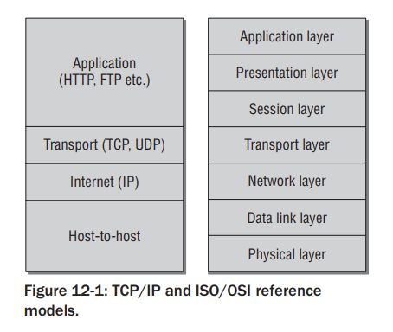


Socket Programming : Overview
Application layer
Application
(HTTP, FTP, Websocket)
Presentation layer
Session layer
Transport layer
Transport (TCP, UDP)
Network layer
Internet (IP)
Data link layer
ISP
Host-to-Host
(MAC, UART)
Physical layer
OSI model
TCP/IP model

Slide 3
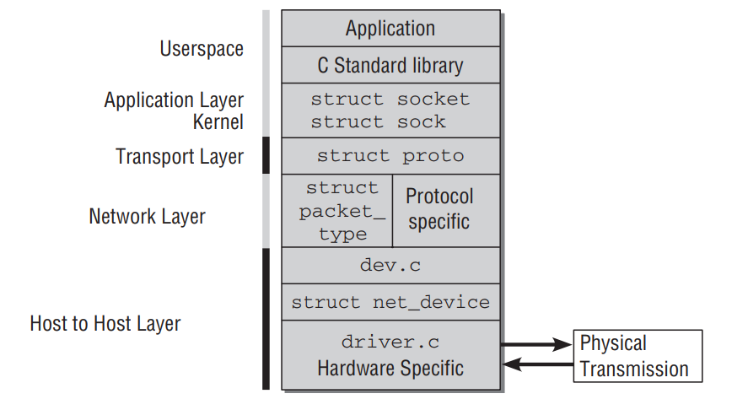
Socket Programming : Introduction
Socket Programming in C/C++
SERVER
(220.149.xxx.xxx)
Client
connection
….
User-level
Application layer
Presentation layer
Session layer
Transport layer
Network layer
Data link layer
Physical layer
OSI model
Source : Wolfgang Mauerer, Professional Linux Kernel Architecture:Ch12 Network, O WILEY

Slide 4
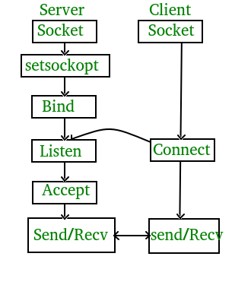
In, Server
#include <sys/socket.h>
int socket(int domain, int type, int protocol)
Source : https://man7.org/linux/man-pages/man2/socket.2.html
#include <sys/socket.h>
int bind(int sockfd, const struct sockaddr *addr, socklen_t addrlen)
Source : https://man7.org/linux/man-pages/man2/bind.2.html
#include <sys/socket.h>
int listen(int sockfd, int backlog)
Source : https://man7.org/linux/man-pages/man2/listen.2.html
#include <sys/socket.h>
int accept(int sockfd, const struct sockaddr *addr, socklen_t addrlen)
Source : https://man7.org/linux/man-pages/man2/accept.2.html
#include <sys/socket.h>
ssize_t send(int sockfd, const void *buf, size_t len, int flags);
Source : https://www.geeksforgeeks.org/soc
Source : https://man7.org/linux/man-pages/man2/send.2.html

Slide 5
In, Client
#include <sys/socket.h>
int socket(int domain, int type, int protocol)
Source : https://man7.org/linux/man-pages/man2/socket.2.html
#include <sys/socket.h>
int connect(int sockfd, const struct sockaddr *addr, socklen_t addrlen)
https://man7.org/linux/man-pages/man2/connect.2.html
#include <sys/socket.h>
int listen(int sockfd, int backlog)
Source : https://man7.org/linux/man-pages/man2/listen.2.html
#include <sys/socket.h>
int accept(int sockfd, const struct sockaddr *addr, socklen_t addrlen)
Source : https://man7.org/linux/man-pages/man2/accept.2.html
#include <sys/socket.h>
ssize_t send(int sockfd, const void *buf, size_t len, int flags);
Source : https://www.geeksforgeeks.org/soc
Source : https://man7.org/linux/man-pages/man2/send.2.html

Slide 6
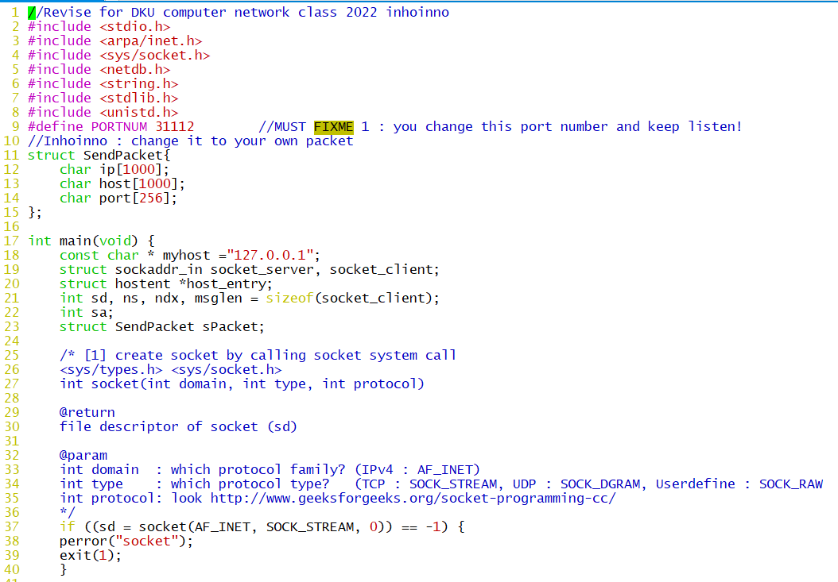
Socket programming 실습 : server.c
Code in https://github.com/inhoinno/socket_proggraming
you need to revise

Slide 7
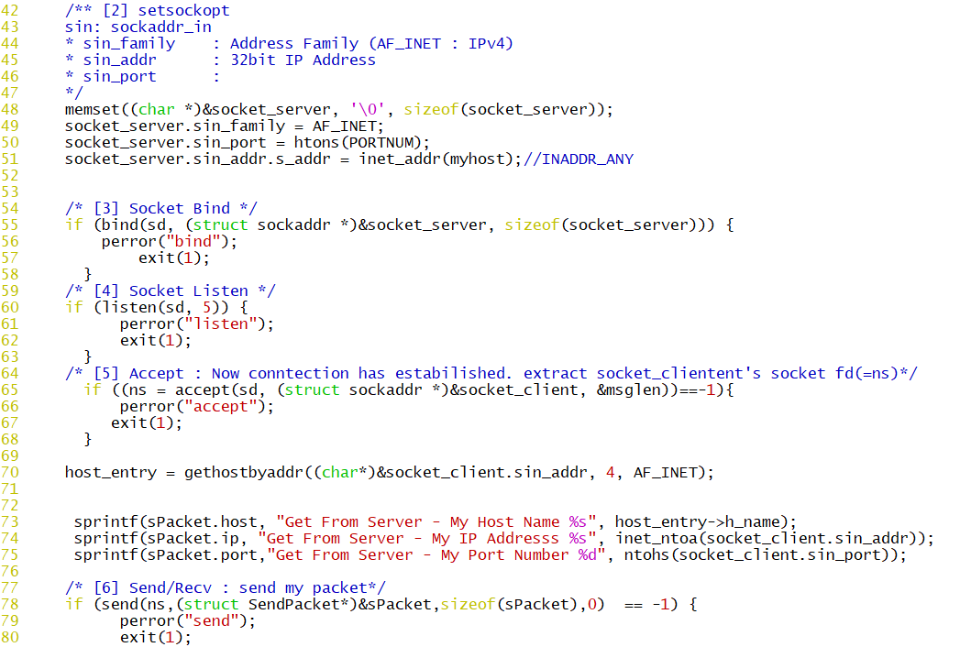
Socket programming 실습 : server.c
Code in https://github.com/inhoinno/socket_proggraming

Slide 8
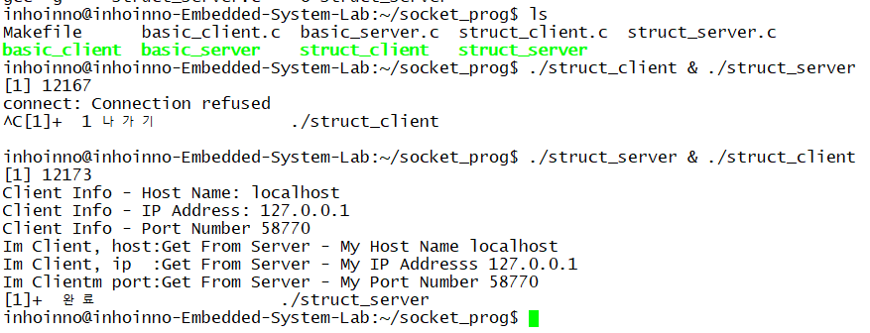
수행결과 화면(./struct_server & ./struct_client)
Server
Client
https://github.com/inhoinno/socket_proggraming

Slide 9
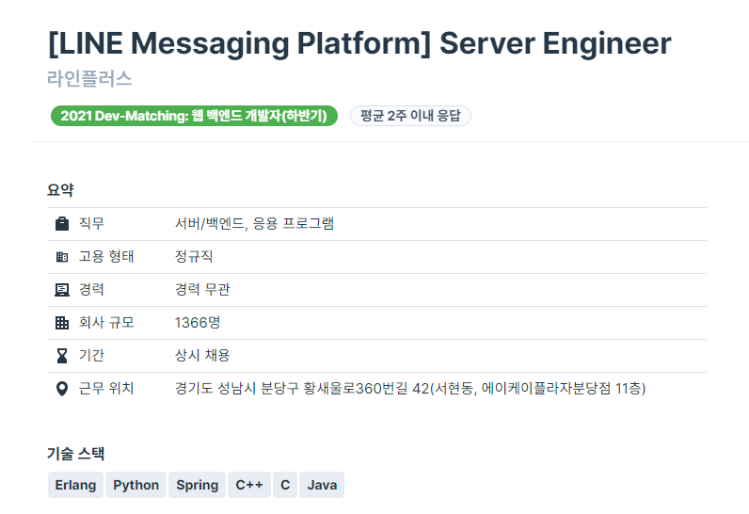
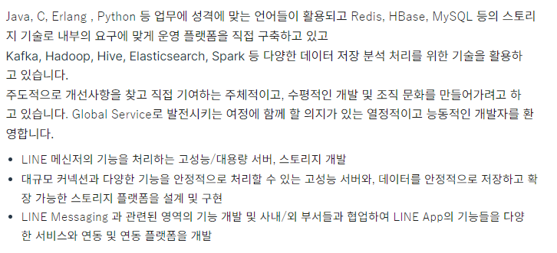
Messaging Platform
Source : https://programmers.co.kr/job_positions/7311

Slide 10
Reference
Wolfgang Mauerer, Professional Linux Kernel Architecture

Slide 11
/* Socket Programming */
컴퓨터 네트워크 22년 1학기
이상범 교수님
Thank you
2022. 03.
Presentation by Inho, Song
mearrong123@gmail.com
or Inhoinno@dankook.ac.kr

