Slide 1
OWASP for Free
Romek Szczesniak

Slide 2

What Do Most Think of OWASP?
Open Web Application Security Project (OWASP)
Owasp.org
Owasp Top Ten
Web Application Testing

Slide 3
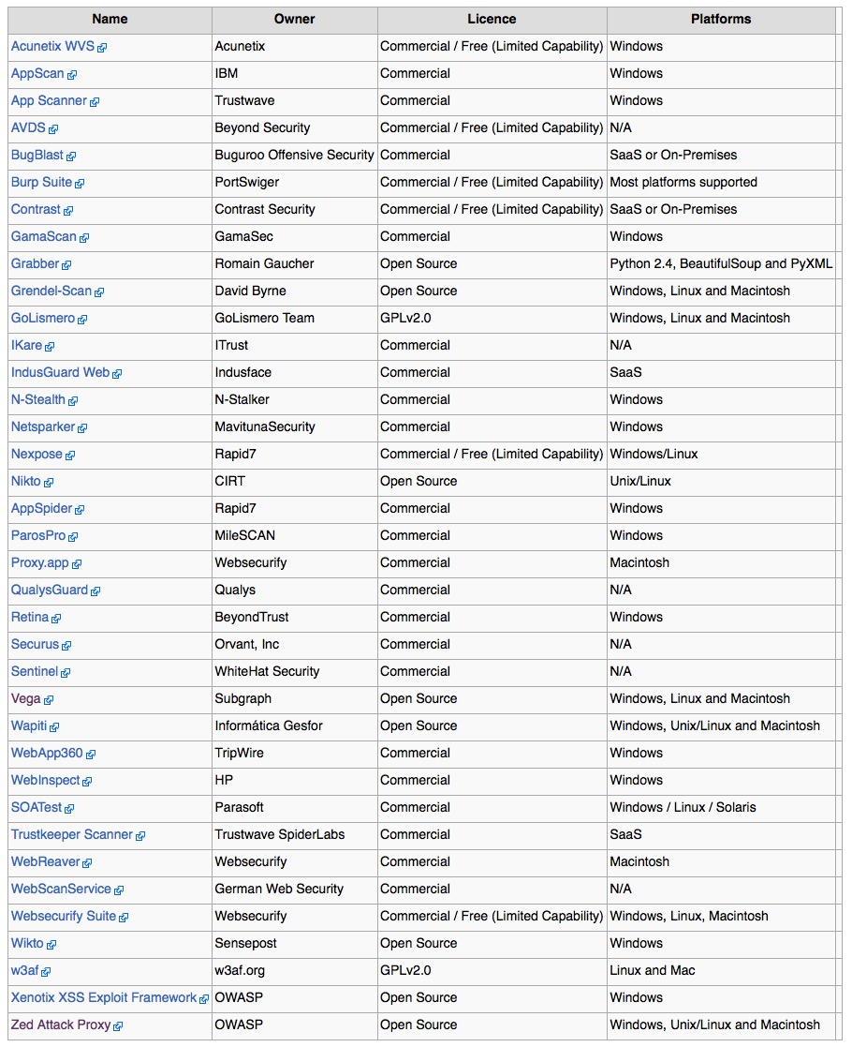
Commercial Tools to do OWASP

Slide 4
Open Source OWASP
OWASP ZAP
Arachni
Skipfish
Subgraph Vega
Netsparker
Wapiti
...

Slide 5
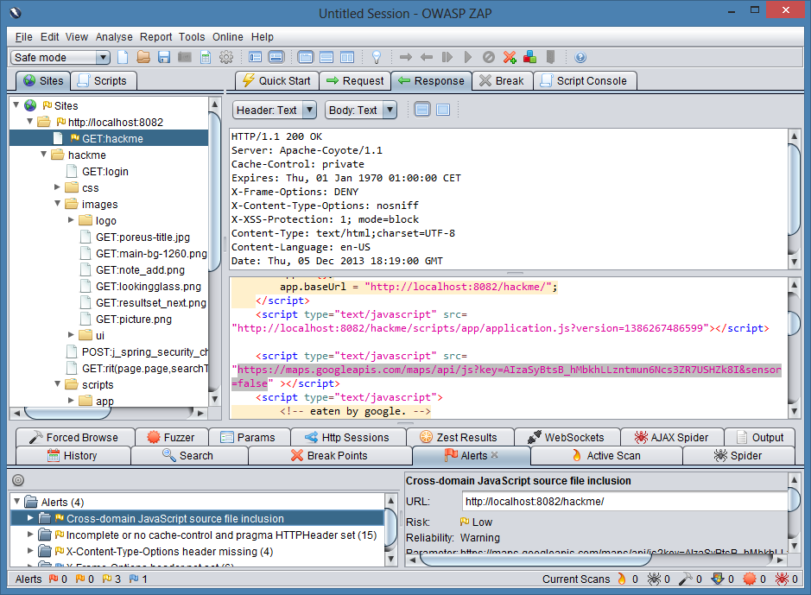
OWASP ZAP

Slide 6
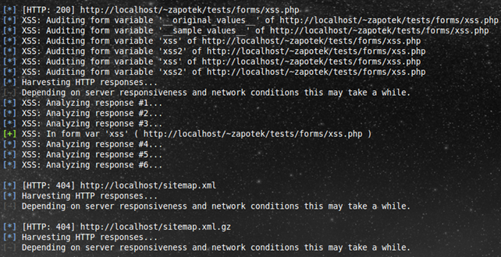
Arachni

Slide 7
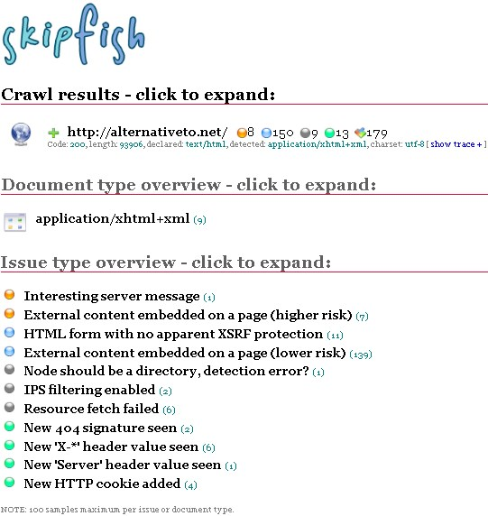
Skipfish

Slide 8
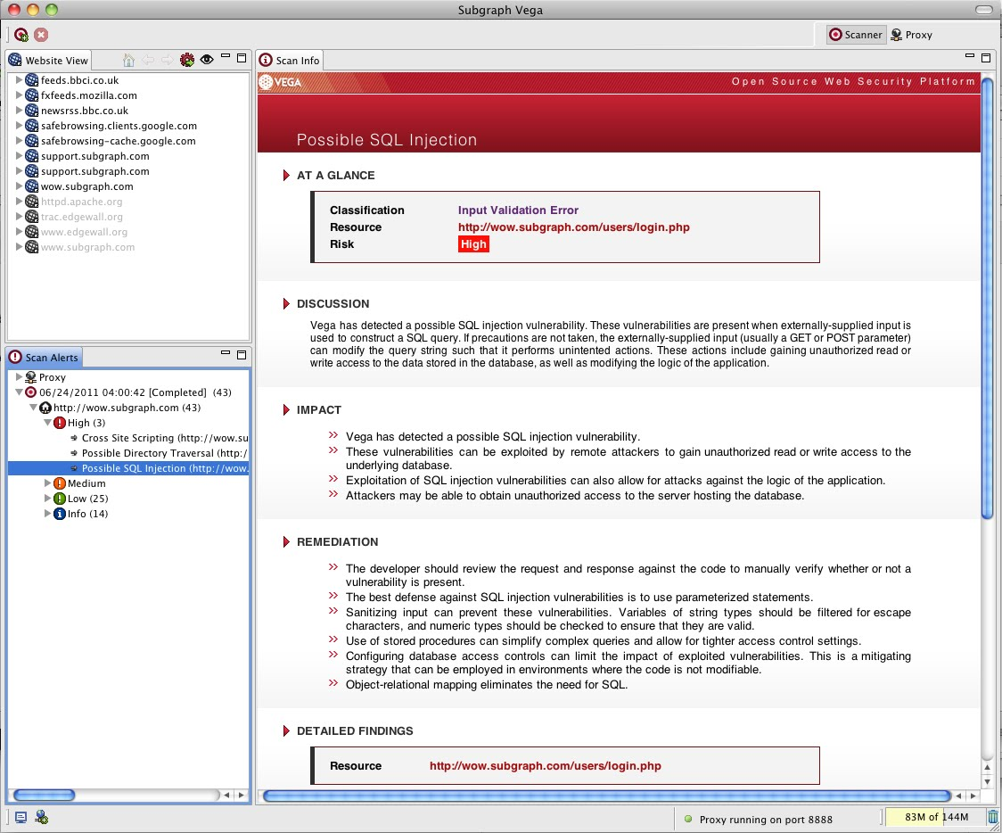
Subgraph Vega

Slide 9
Put These Together!
No one answer to “do” OWASP
Finding problems is done from using many tools
Here are a few that do work
There are many others... (but I cannot guarantee they will work too!)
I recommend using at least one commercial tool too to back your results up

Slide 10
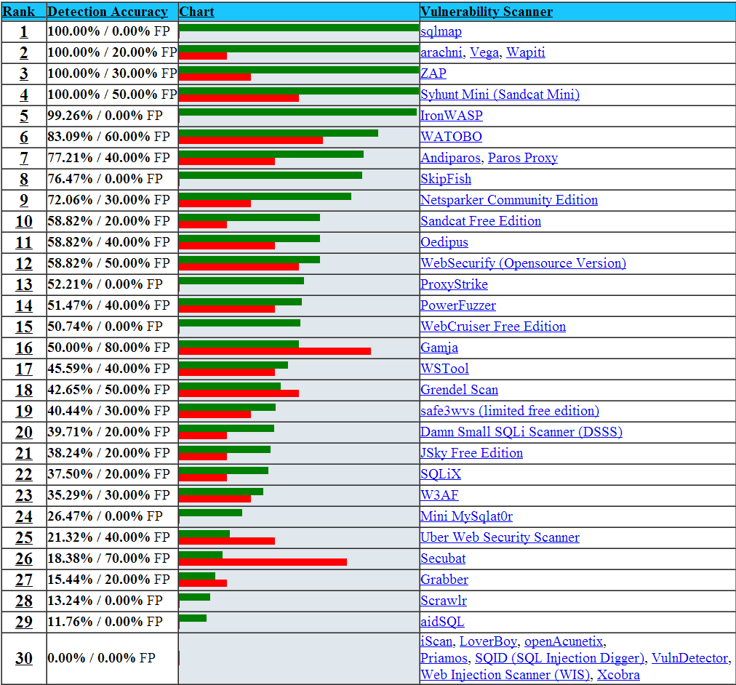
Current open source tools

