Slide 1
Tailoring Identity to You
Romek Szczesniak

Slide 2
All or Nothing Identity Systems
Thou shalt use our new unproven system
If you don't use ALL our identity system, you cannot be identified
You cannot interoperate with anyone else
Our never heard of before system is amazing!
You should only need our identity system
Why should I throw away my years of experience of doing identity just because you say so?
Why can you not merge with my systems?

Slide 3
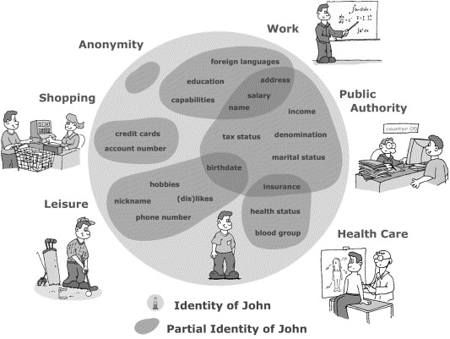
One Identity Does Not Fit All Functions

Slide 4
Identity Does Not Live on the Device
iPhone
Android
Windows Phone
Blackberry OS
All are insecure and cannot be trusted.

Slide 5
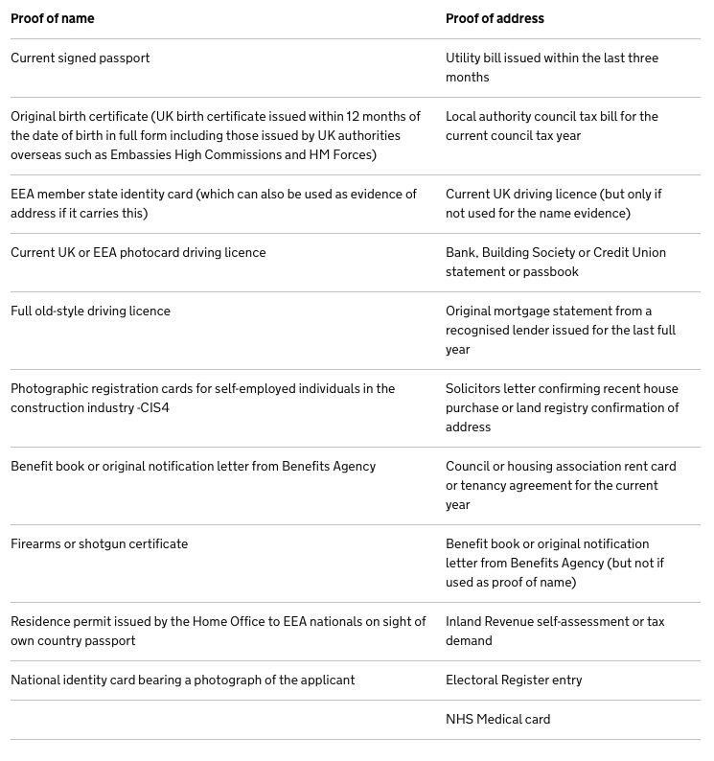
Proving Who I am in the UK

Slide 6
Identity in Practice – A Patchwork Quilt
Document reading
Document scanning and verification
Biometrics – Face, Fingerprint, Iris, Retina, etc.
Identity system registration and validation
Network security
Internal and External Audit
Insurance
Application

