Slide 1

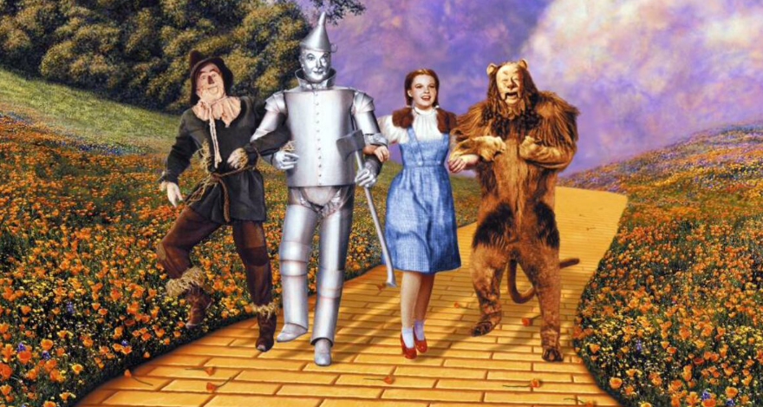
Home-lab-2-prod-ai-golden-path
Aug-Sep 2025

Slide 2




1- Objective
Play with AI with easy entry level concepts from SRE - Platform or Data Engineer – Architect – DevOps eyes.
Create a POC to play like a backbone that can be enhanced little by little.
Create a technological golden path, opinionated shortcut, that can be reused from home lab to PROD.
Mini state of the art: from ML towards MCP agents

Slide 3
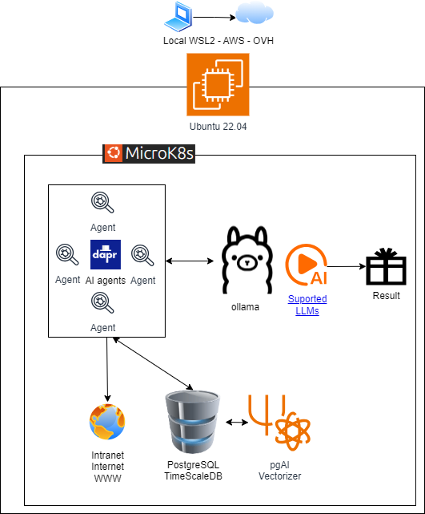


1- Objective: golden path
Select and integrate OSS projects curated by CNCF to respect vendor neutrality
Privacy: local AI and data
Technological independence, Europe first
Source glamour.com
15 %

Slide 4



1- Objective: create a 1st POC
Broad definition of AI agents + RAG : AI Agents (hands, gets data) - LLM (brain, process data and answers) – RAG database (authoritative knowledge base).
Python program scraper reads web content and save into PostgreSQL DB .
Pg AI chunks and vectorizes inserted data automatically, this is our RAG database where semantic search is done. Pg AI can vectorize sources from S3 or PostgreSQL and can integrate with Ollama or OpenAI.
Ollama allows you to run large language models (LLMs) locally on your own computer.
Python Flask user web where user can write prompt and receive and answer based on local RAG database and local Ollama LLM, optionally configured with OpenAI as well.
1
4
3
4
1
2
2
3
1
1
2
4

Slide 5
2- Demo time
LLM (Large Language Model) vs SLM (Small): trained with less parameters so we need less hardware resources to run it. Demo running in a laptop WSL2 Ubuntu with 10GB RAM & 4 cores assigned.
TimescaleDB/PostgreSQL RAG database vectorizer encoding is setup to all-minilm which is OSS and maps sentences & paragraphs to a dimensional dense vector space and can be used for semantic search.
Ollama LLM selection: llama3.2:1b which is OSS & SLM & supports all-minilm encoding & honesty temperature parameter / prompt & uses RAG (authoritative knowledge base) & different language support (original RAG data language matters).
Dapr microservices building blocks – maximizes standardization and code reuse changing configuration only.
Dapr eases Open Telemetry monitoring Zipkin tracing – Prometheus metrics.
Tilt deploy directly into K8S – mini demo small change.

Slide 6
2- Demo time: project structure
Github – MIT license
Detailed explanations in README.md in each folder
1-IaC: shell script to install in WSL2 and OpenTofu IaC for AWS or OVH (U know, Europe first). OpenTofu supports many providers like Hetzner or more.
2-mandatory-k8s-services: PostgreSQL database + pg AI vectorizer + Ollama + Dapr
3-dapr-microservices-agents: User-web and web-injection-agent

Slide 7

3- Next steps
SLM are ideal for specific domains knowledge. Install and play, have your own internal RAG database filled with your web/intranet or documents and expose it to your own users – Performance: pg db chunk size, original data language - save contexts and metrics (tokens, time …) Prometheus
This POC could work in Raspberry Pi industrial environments on the edge
This POC is suitable for DEV environments & Educational environments to have a hands on experience
You can play with Machine Learning installing MLFlow or Kubeflow or both(MLFlow better for tracking experiments VS Kubeflow better with pipelines) on K8S
Depending on your data type can work better with semantic (understand meaning of natural language)) vs pgvectorscale vector search (image similarity & anomaly detection sensor data)
Mini state of the art : AI agents: rapidly evolving trend - Agents MCP vs Google A2A – Dapr MCP approach – Dapr workflows

Slide 8
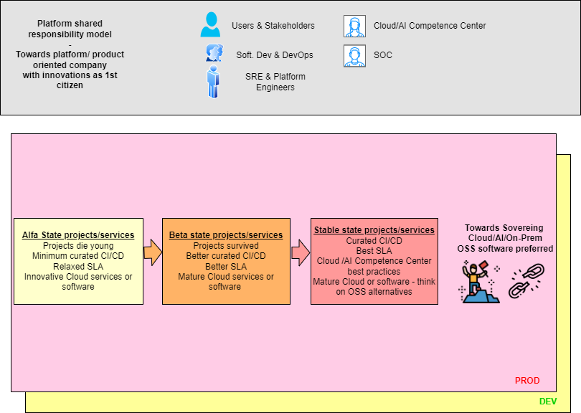

3- Next steps
Too much entropy management:
From lab to PROD – Technological change management personal view - <image>
Data quality is the most important and still may be undervalued factor in AI – There is a huge Diogenes syndrome on companies data. Do you want to be a data engineer hero?
Impostor syndrome / mental health & cognitive overload / crazy recruitment processes /Luck the force: hear forget, see remember, do understand, explain understand +. Fail fast to learn
Public data not free anymore / AI paid service / synthetic data trouble/ Tecno feudalism

Slide 9


4- Q&A - Contribute
Share your experience or thoughts
Tell me if you need any help with your lab
If something is wrong or there is an error, comment it but do not be a hater ;) - This project is a learning by doing experience
Feedback points: YouTube or GitHub or LinkedIn

Slide 10
5- Some references
Most of the icons in this presentation are from flaticom.com, flaticom license (Free for personal and commercial purpose with attribution)
Wizard of Oz 1st slide image link
Use the force Luke link

