Slide 3

Presentation Outline
Project Summary
Tools & Technologies
Project Modules
Resource Requirement
Diagrams (Use Case, Sequence, Activity, Class)
Screenshots ( Web App & Mobile App)
Limitations & Future Enhancements
References

Slide 4

Project Summary
The idea behind the project title is to develop a mobile & web application where seller can sell and customer can buy medicines online.
Customers are only allowed to pay via Cash on Delivery.

Slide 5
Tools & Technologies
Front-end Tools HTML/HTML5 CSS/CSS3 jQuery NetBeans Design Tools Photoshop CS6 Illustrator CS6 | Back-end Tools PHP 5.5 MySQL 4.3.12 Apache 2.0 Libraries jQuery 3.1 Normalize.css FontAwesome

Slide 6
Project Modules
Admin
Login
Dashboard
Manage Orders
Manage Users
Manage Companies & Categories
Feedback Listing
Logout

Slide 7
Project Modules
Sellers
Login
Dashboard
Manage Orders
Manage Companies & Categories
Logout

Slide 8
Resource Requirement
Any HTML5 Supported Web Browser.

Slide 9
D I A G R A M S

Slide 10
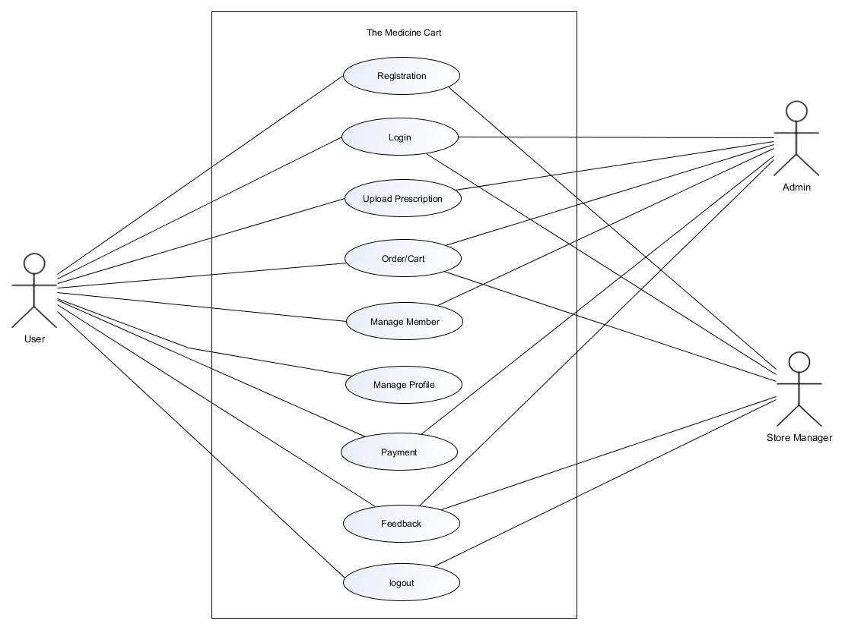
Use Case Admin, User & Seller

Slide 11
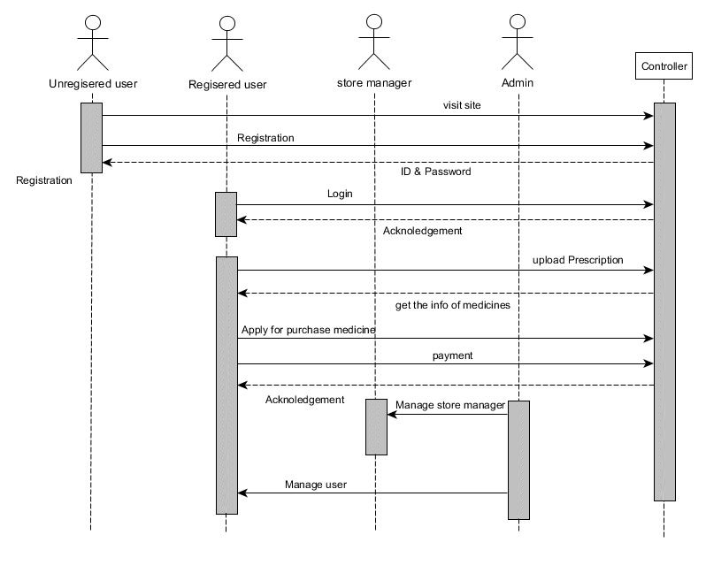
Sequence Diagram Medicine Cart

Slide 12
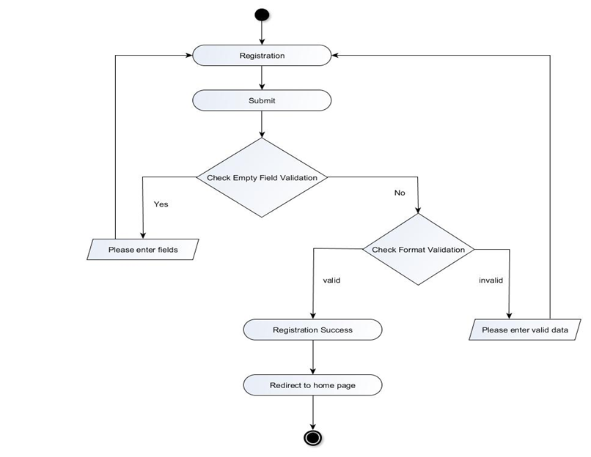
Activity Diagram User Registration

Slide 13
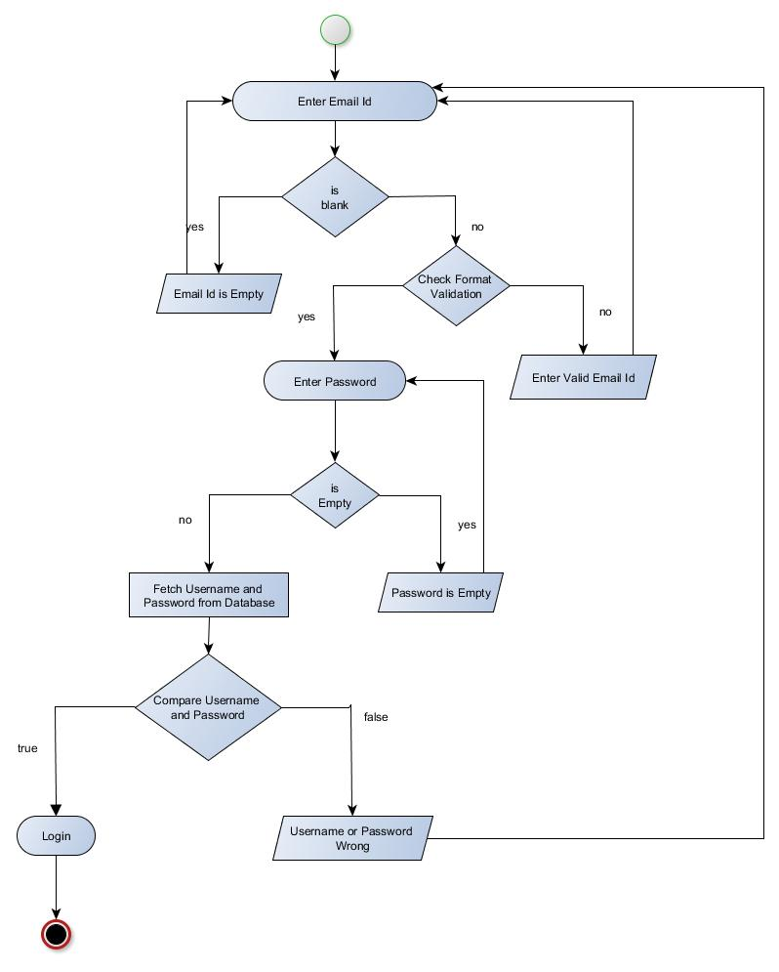
Activity Diagram Login

Slide 14
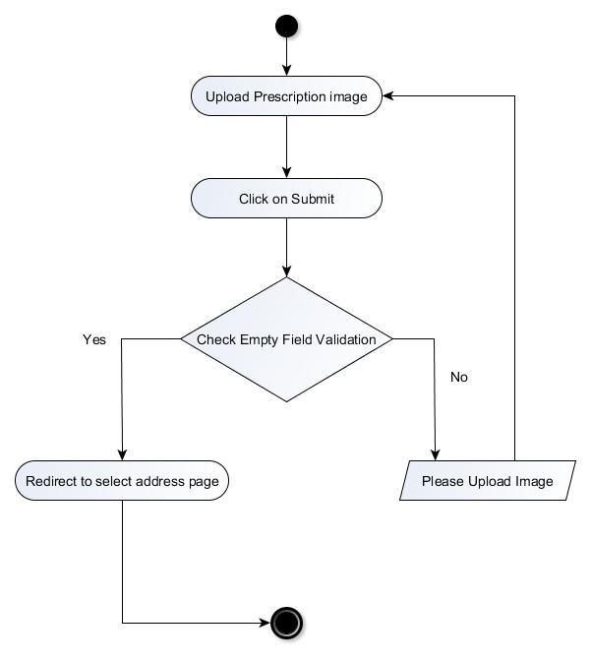
Activity Diagram Place Order

Slide 15
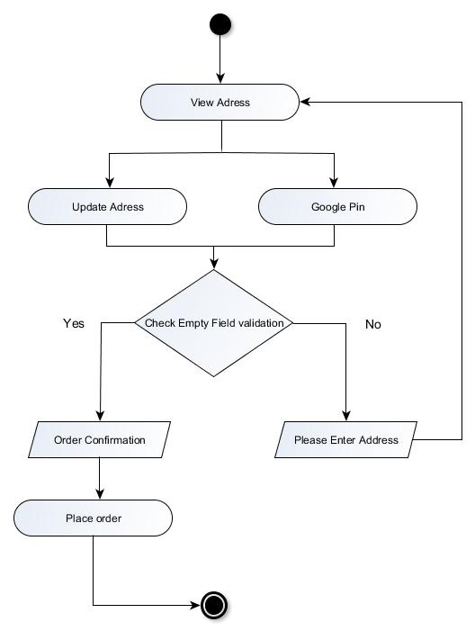
Activity Diagram Select Delivery Address

Slide 16
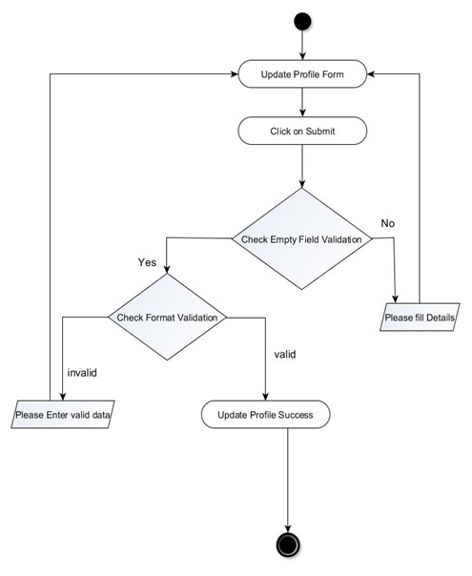
Activity Diagram Edit User Profile

Slide 17
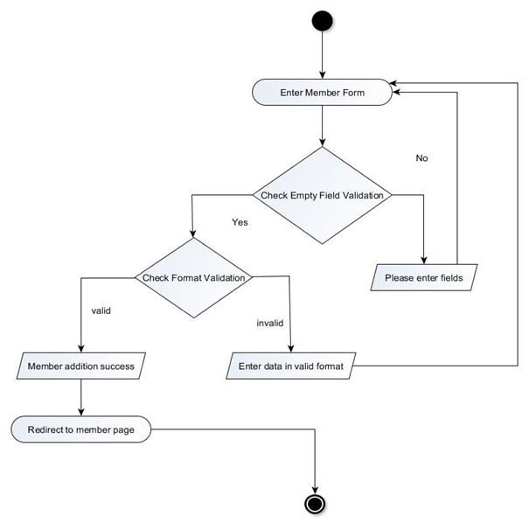
Activity Diagram New Member (not an user)

Slide 18
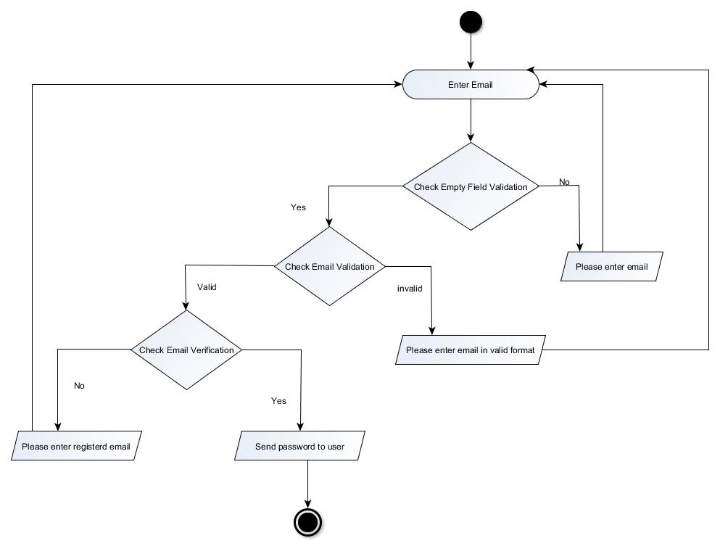
Activity Diagram Account Recovery

Slide 19
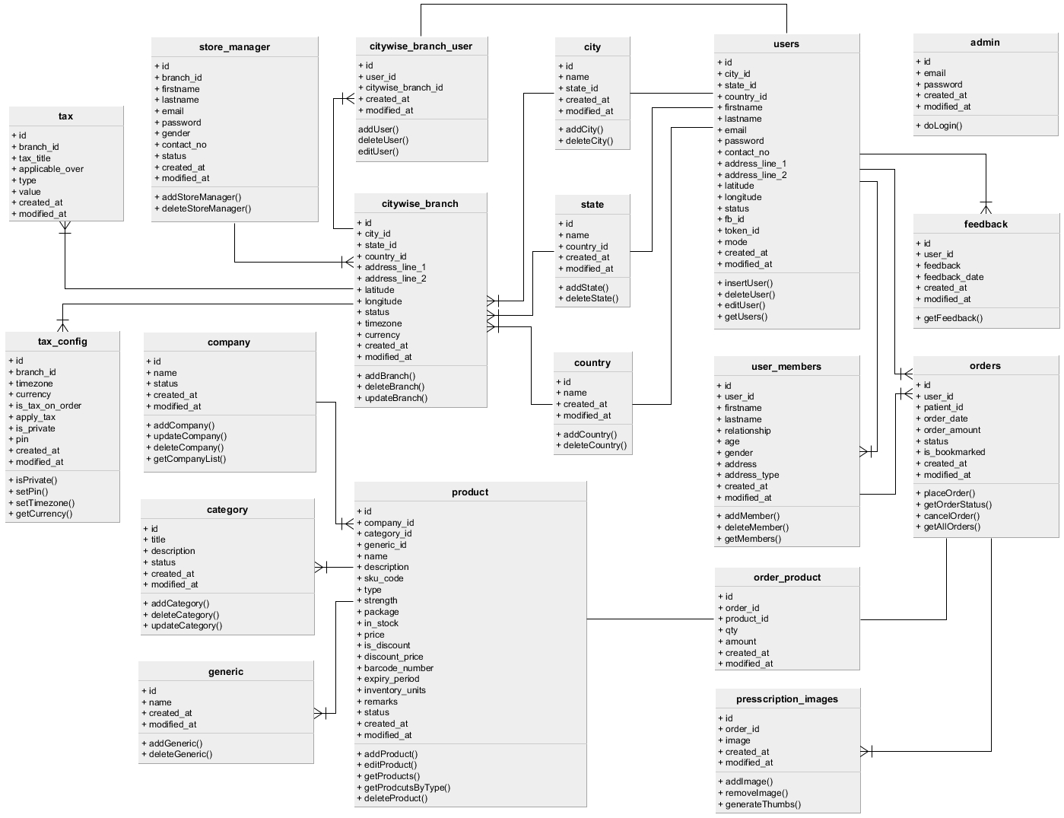
Class Diagram Medicine Cart

Slide 20
S C R E E N S H O T S

Slide 21
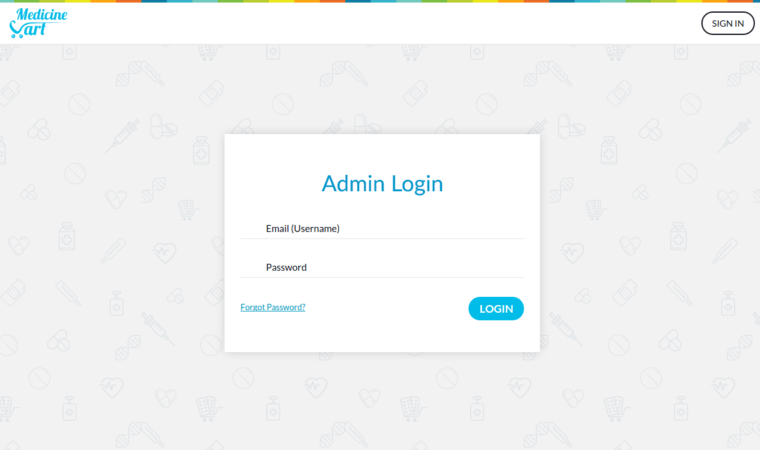
Admin Login

Slide 22
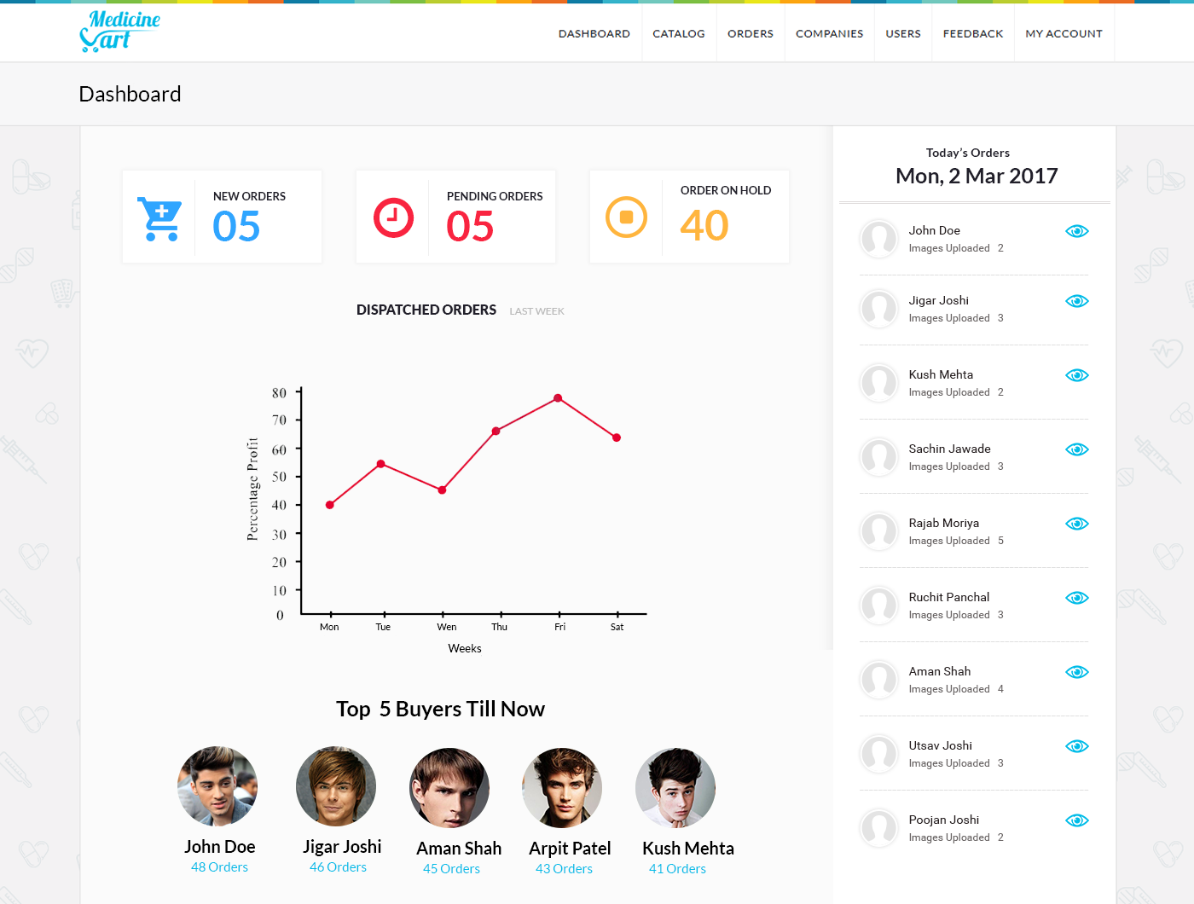
Seller / Admin Dashboard

Slide 23
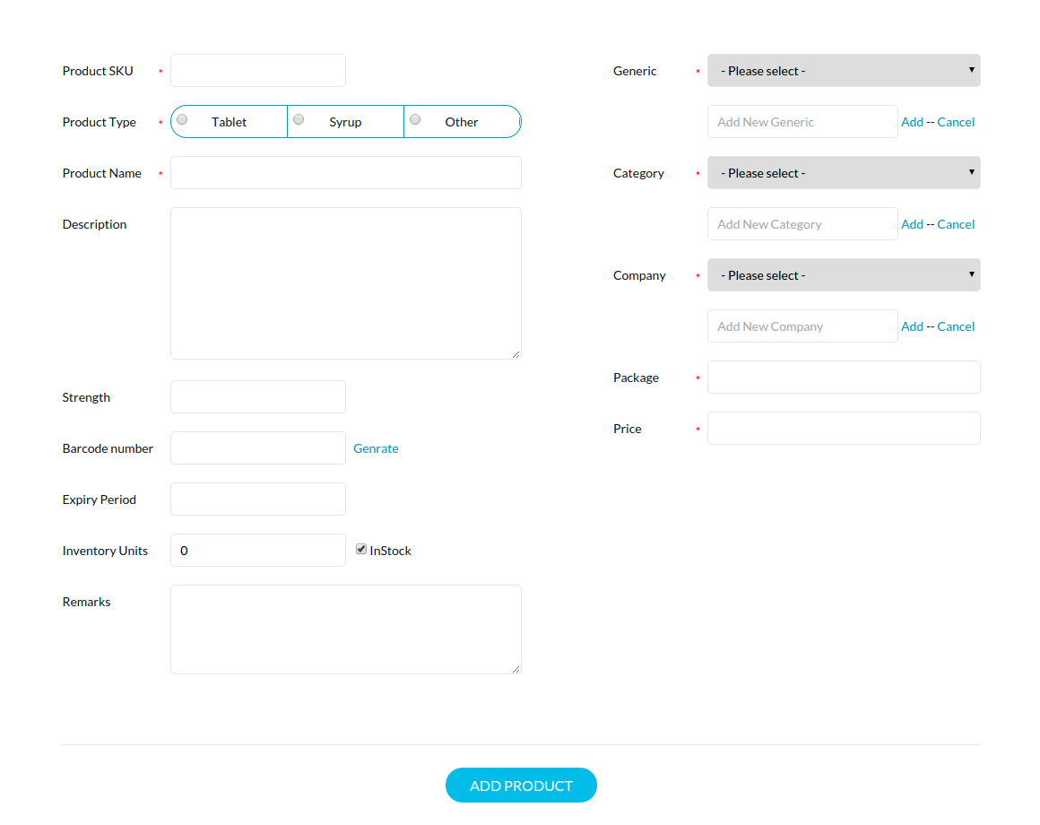
Seller / Admin Add New Product

Slide 24
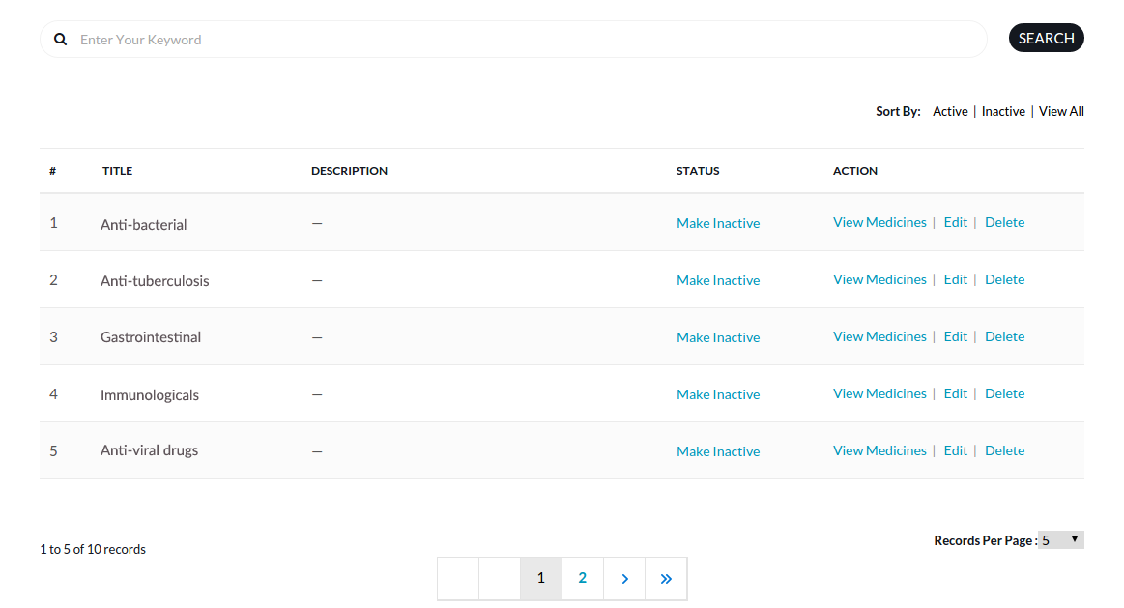
Seller / Admin Category Listings

Slide 25
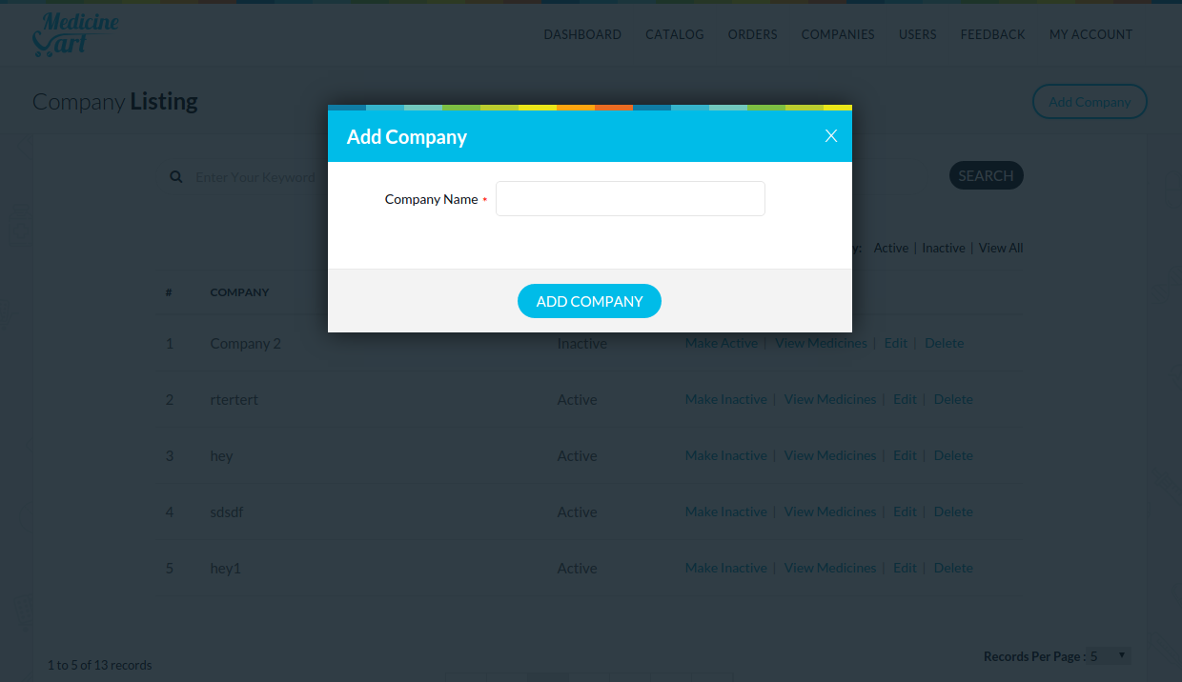
Seller / Admin Add New Company

Slide 26
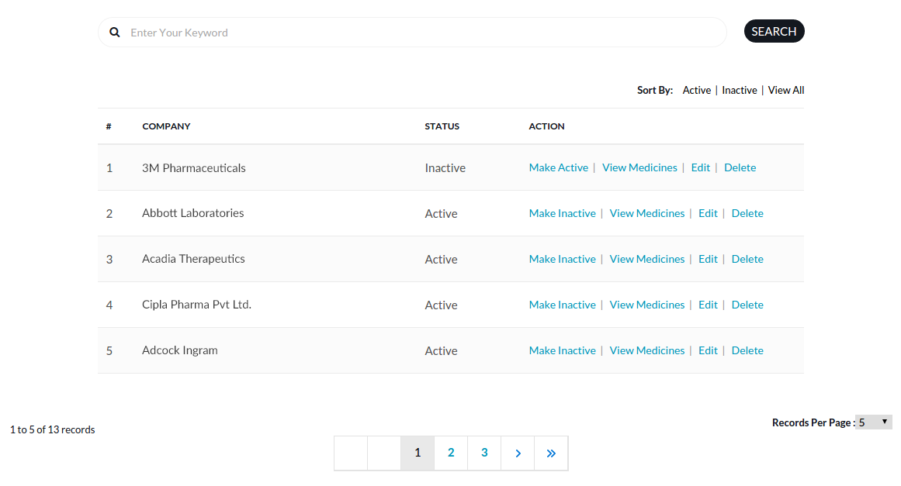
Seller / Admin Pharma. Company Listings

Slide 27
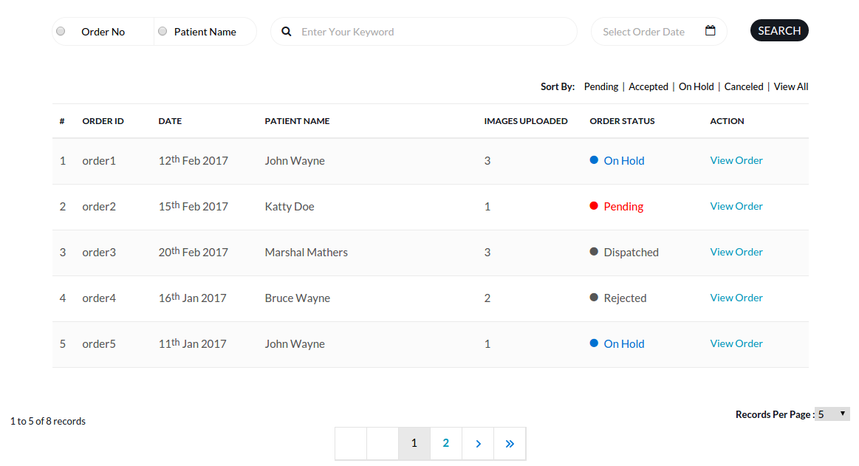
Seller / Admin Order Listings

Slide 28
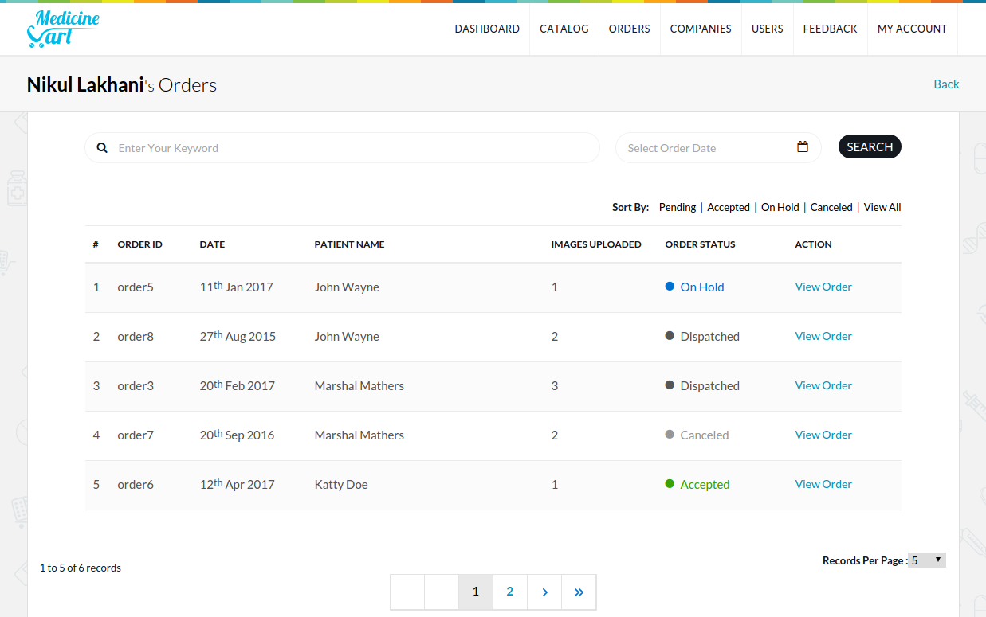
Seller / Admin Order listings for an user

Slide 29
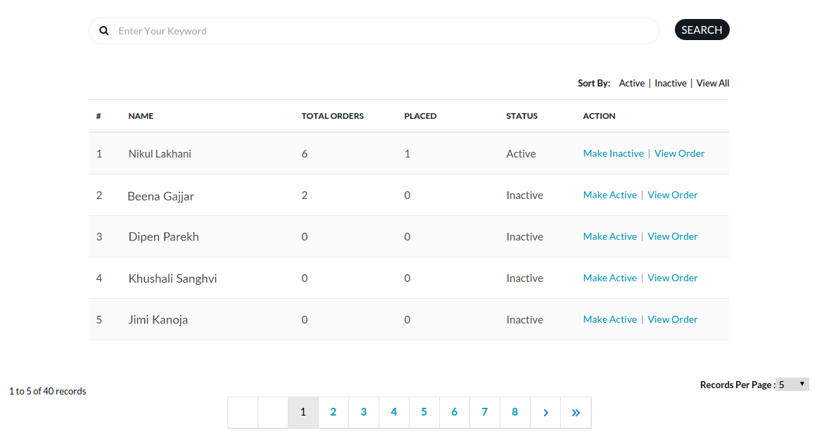
Admin User Listings

Slide 30
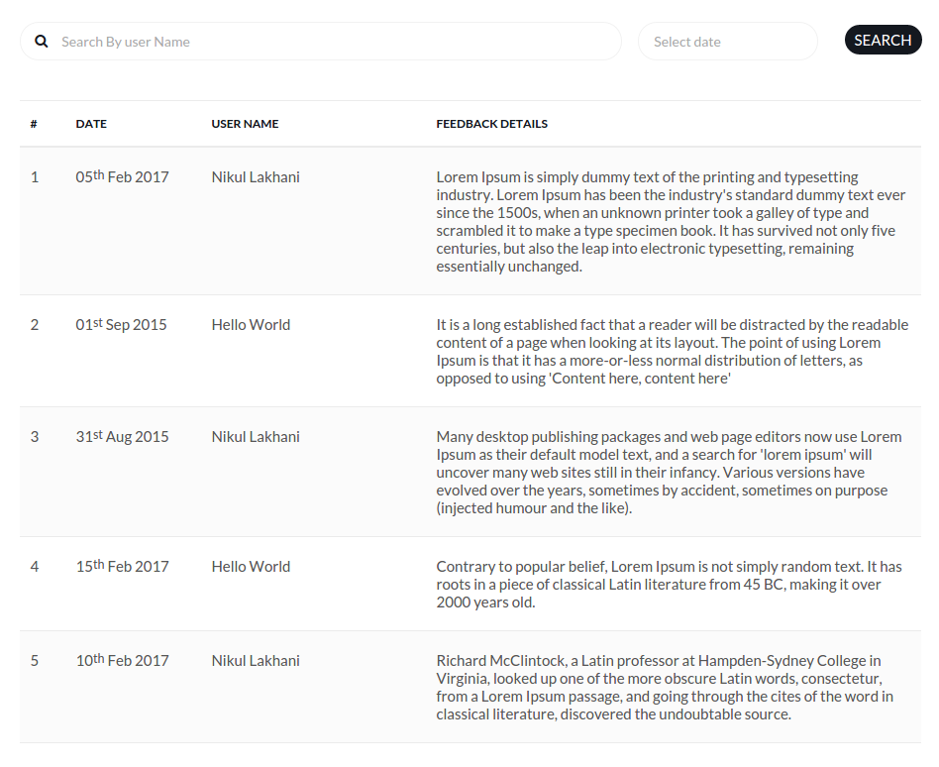
Admin Feedback Listings

Slide 31
M O B I L E A P P G U I

Slide 32


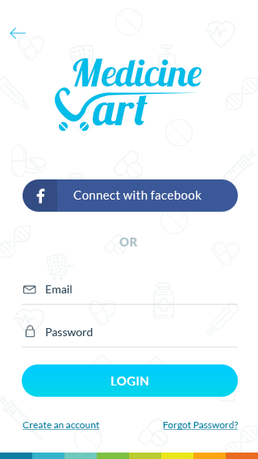
Mobile App Android & iPhone

Slide 33
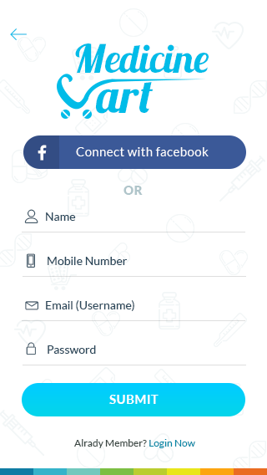
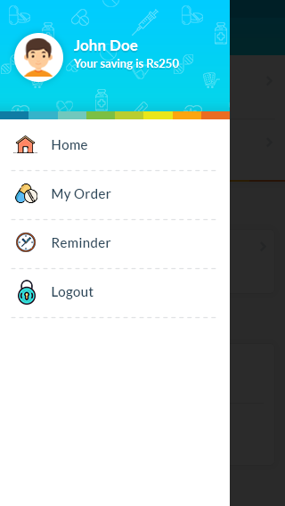
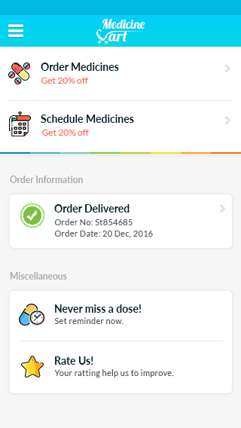
Mobile App Android & iPhone

Slide 34
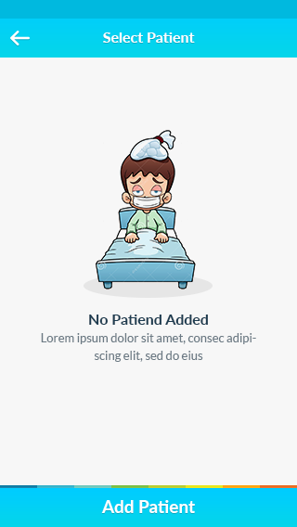
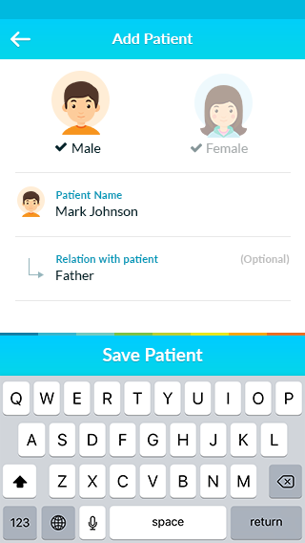
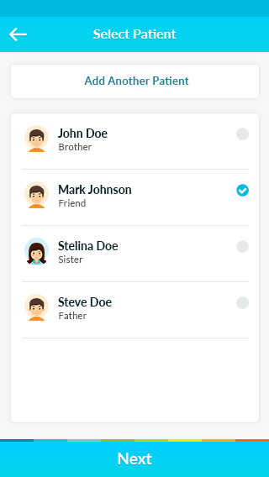
Mobile App Android & iPhone

Slide 35
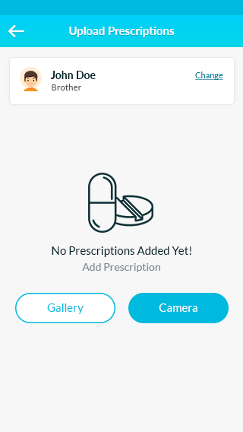
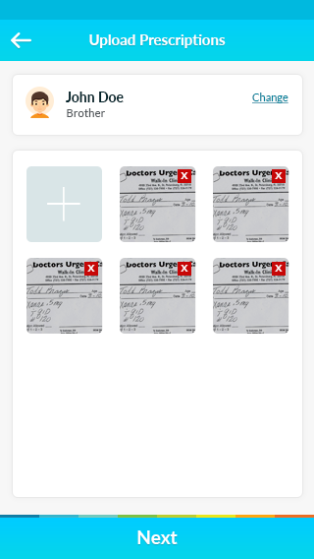
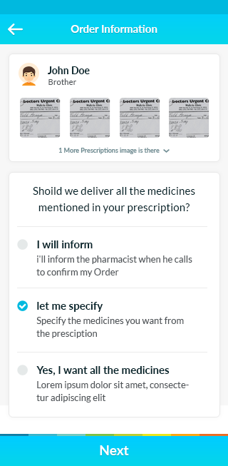
Mobile App Android & iPhone

Slide 36
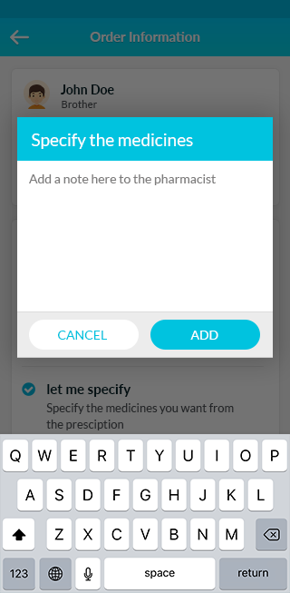
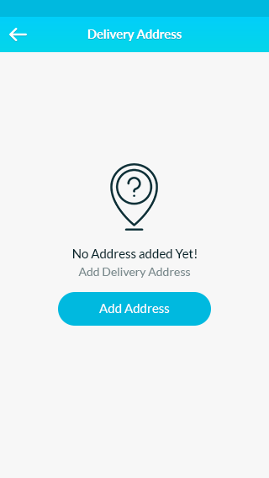
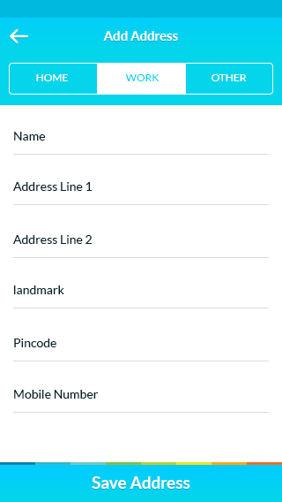
Mobile App Android & iPhone

Slide 37
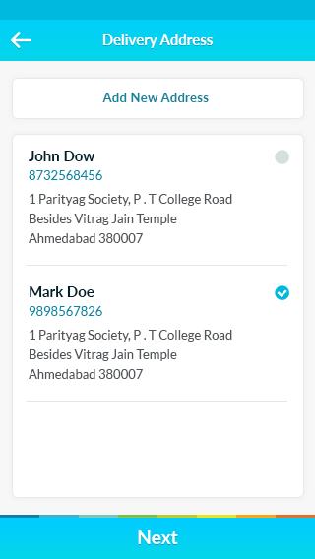
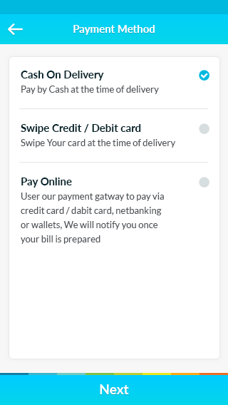
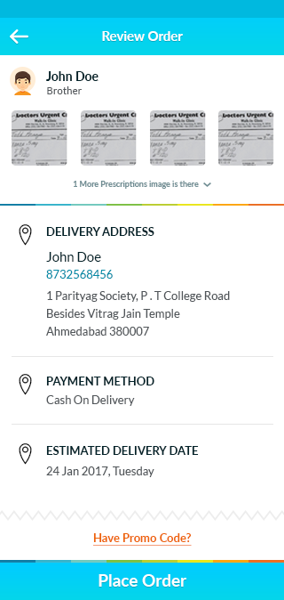
Mobile App Android & iPhone

Slide 38
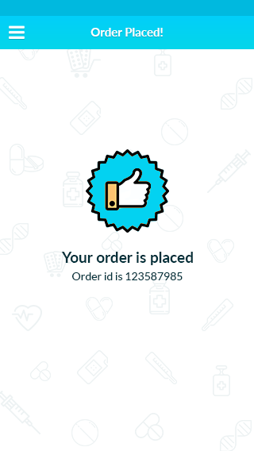
Mobile App Android & iPhone

Slide 39
Limitations
Only Cash on Delivery
Web Portal is not available
SMS Alert is not available

Slide 40
Future Enhancements
More payment options
Web Application
SMS Alerts
Recurring Delivery

Slide 41
References
http://www.netmeds.com/
http://www.medidart.com/
http://www.medplusmart.com/
http://www.mchemist.com/
http://slideshare.net/

