Slide 1
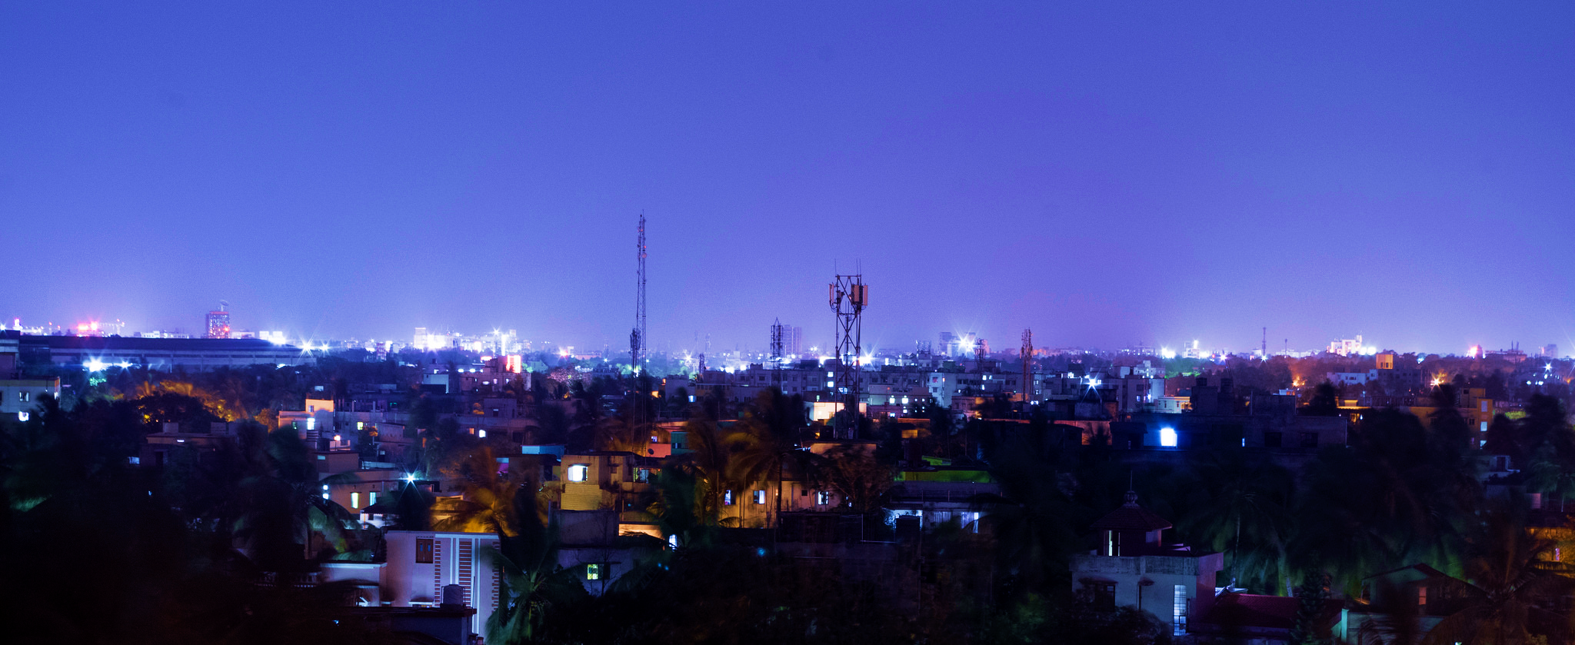
15th International Conference on Information Technology
ICIT 2016
Bhubaneswar, India
December 22-24 2016
www.oits-icit.org

