Slide 1
Django Intro.
phodal

Slide 2











Who use Django?

Slide 3
History
Born 2003
用于管理劳伦斯出版集团旗下新闻内容为主的网站
Release 2005 (BSD License)
音乐家Django Reinhardt
Django于2008年6月17日正式成立基金会
Django 1.8 LTS
Notes:
Spring 2002.10
RoR 2004
Django 2005

Slide 4
Django
MTV(MVC, Model-View-Template)
ORM
URL and Vies
Templates
Forms
Authentication
Admin
Internationalization
Security
Notes:
Spring 2002.10
RoR 2004
Django 2005

Slide 5
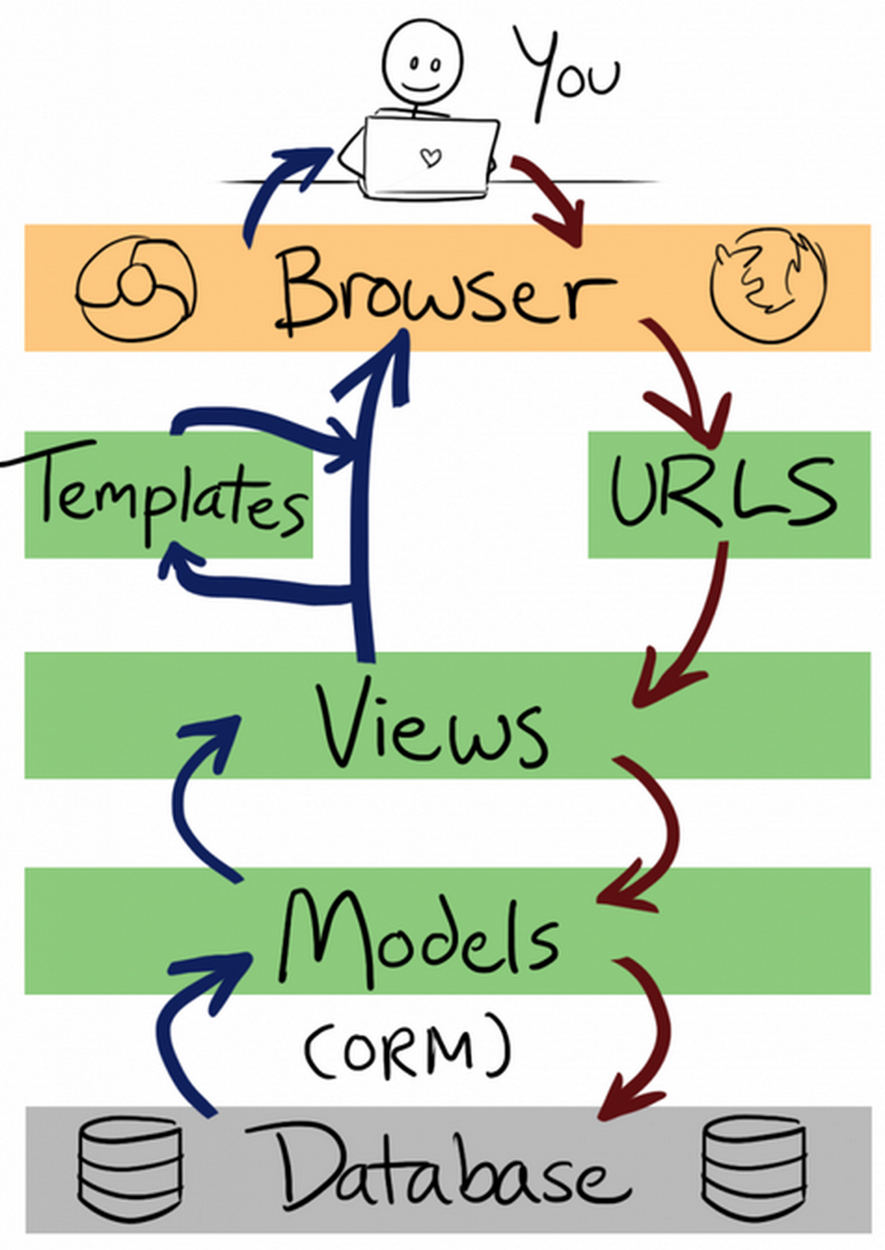
MTV

Slide 6
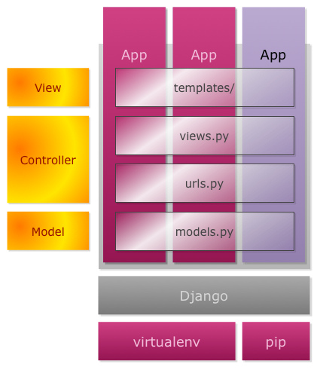
Django Project Architecture

Slide 7
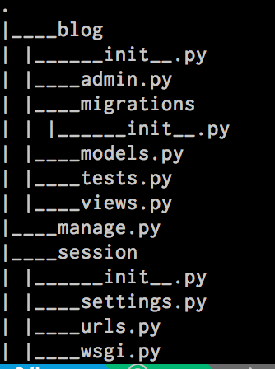
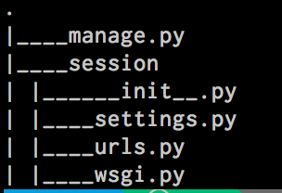
Django Project
django-admin startproject session
django-admin startapp blog

Slide 8
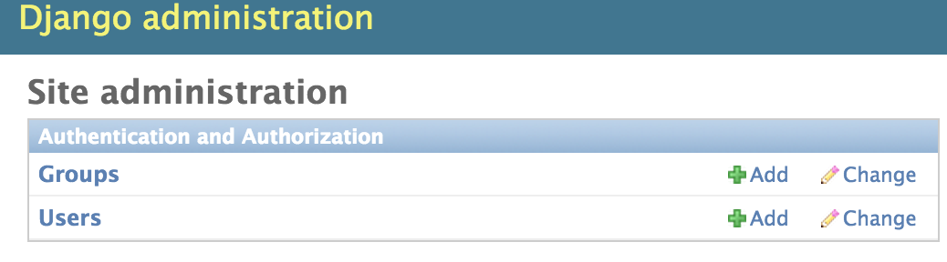
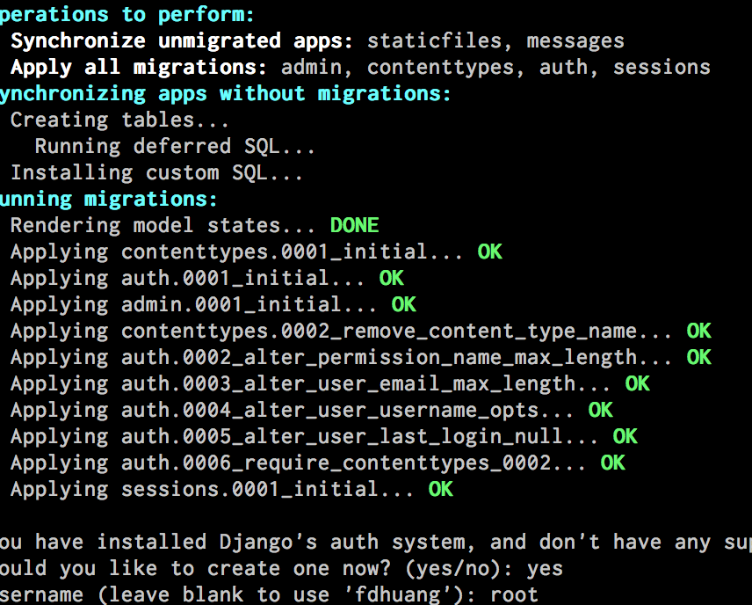
Admin

Slide 9
Django Model
CHOICES(select)
Help_text
Validators
Error_Messages
…

Slide 10
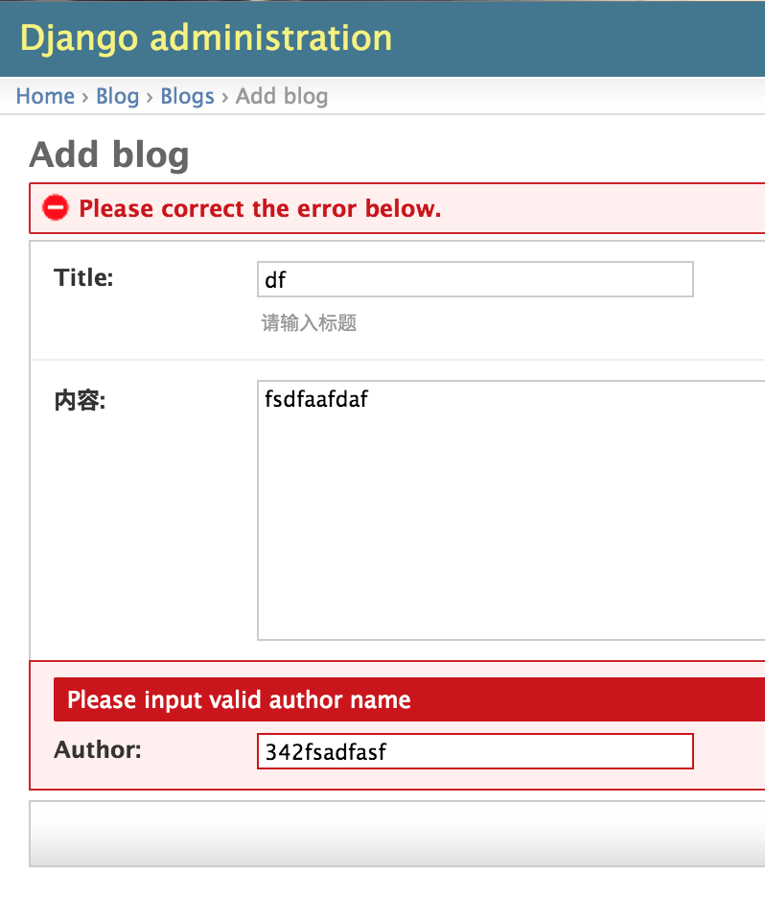
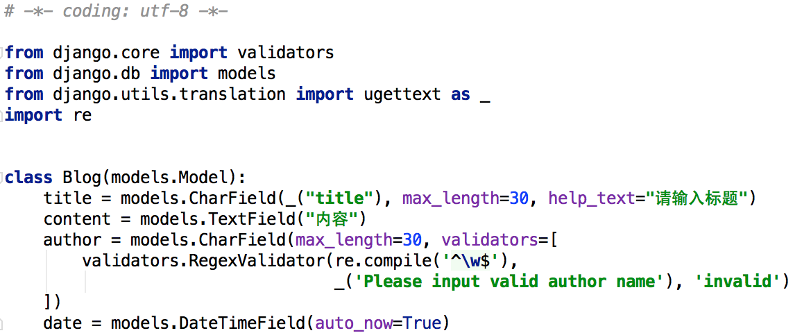
Django Model

Slide 11
QuerySet API
order_by
filter
all
get
delete
create

Slide 12
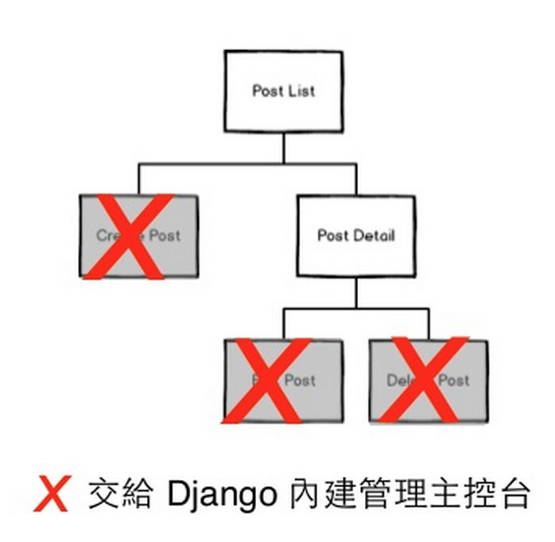
Admin
Editing
Publishing
Separation

Slide 13
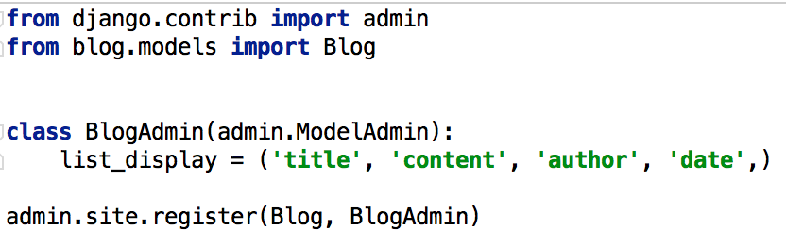
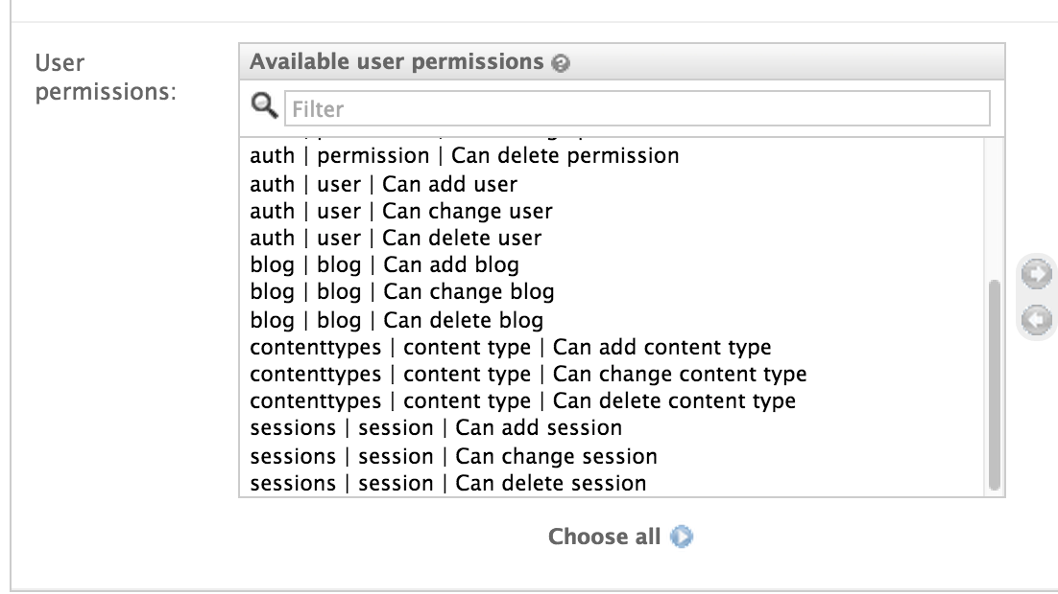
Admin

Slide 14
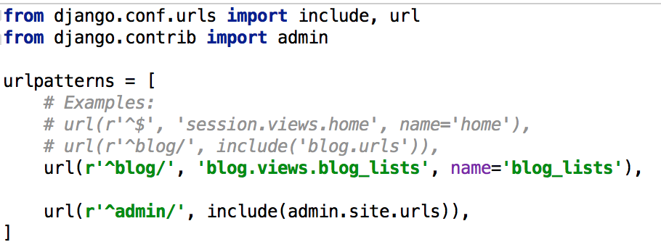
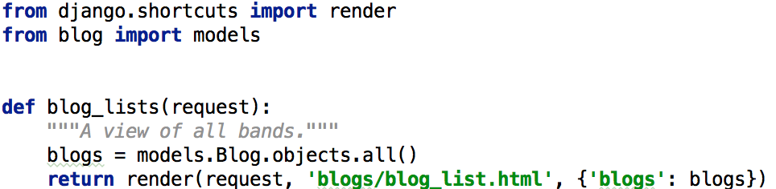
URL & Views

Slide 15
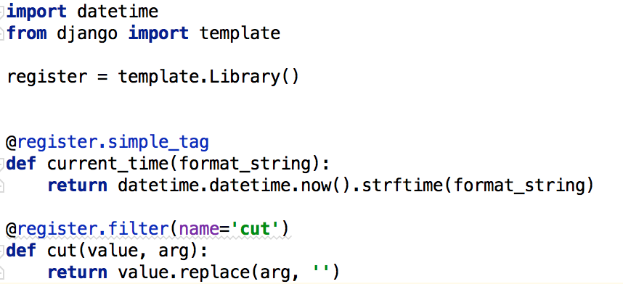
Templates
filter
tag

Slide 16
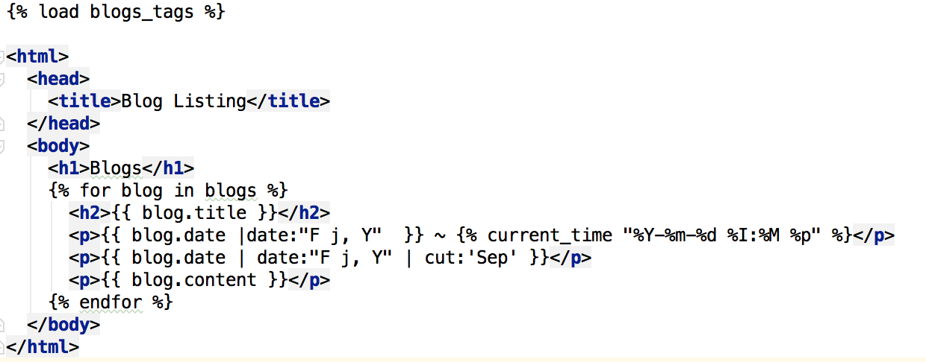
TemplateTags

Slide 17
Others
MIDDLEWARE
CACHE
CONTEXT_PROCESSOR
Migrations

Slide 18
Deploy & Local
VirtualEnv (rvm, rbenv)
Requirements.txt (pip install –r requirements.txt)
Gunicorn (gunicorn session.wsgi –worker=4)
Nginx (StaicFiles)
Fabricq
Settings.py (local, prod, staging)

