Slide 1

Movie Recommender
System
Collaborative Filtering · SVD · Content-Based · Hybrid
MovieLens 1M · 5 Algorithms · Web Demo

Slide 2

What is a Recommender System?
Introduction
An information filtering system that predicts user preferences
Solves the "information overload" problem
YouTube: 800M+ videos — how to find the right one?
Spotify: 100M+ songs — what should you listen next?
Goal: Predict which items a user will like
Used by Netflix, Amazon, TikTok, Shopee — everywhere
Core: Analyze past behavior → Find patterns → Predict → Recommend
2

Slide 3

Why Movies? Why MovieLens?
Introduction
MovieLens: Gold standard for RecSys research
3 versions: 100K / 1M / 25M ratings
We chose MovieLens 1M — large enough, fast enough
Criteria | Movies | Books | Products | Music
Free dataset | ✅ MovieLens | ⏳ | ❌ | ⏳
Clear features | ✅ Genres | ✅ | ❌ | ✅
Easy to demo | ✅ Universal | ⏳ | ⏳ | ✅
Research papers | ✅ Most popular | ⏳ | ❌ | ⏳
3

Slide 4

MovieLens 1M — Dataset Overview
Dataset
1,000,209 ratings from 6,040 users on 3,706 movies
Rating scale: 1–5 stars (avg 3.58)
Sparsity: 95.5% — most user-movie pairs unknown
Collected 2000–2003 by GroupLens Research
Three data files: ratings.dat · movies.dat · users.dat
6,040
3,706
1,000,209
95.5%
Users
Movies
Ratings
Sparsity
4

Slide 5
Dataset Details — What's Inside Each File?
Dataset
File | Columns | Rows | Used For
ratings.dat | userId, movieId, rating, timestamp | 1,000,209 | CF, SVD, Evaluation
movies.dat | movieId, title, genres (18 types) | 3,883 | Content-Based, Hybrid
users.dat | userId, gender, age, occupation, zip | 6,040 | Context Analysis
Rating 4★ is most common (~34%) — positive bias
18 genres: Action, Drama, Comedy, Sci-Fi, Romance, ...
7 age groups: Under 18, 18-24, 25-34, 35-44, 45-49, 50-55, 56+
21 occupations: student, programmer, engineer, doctor, ...
Timestamp → extractable temporal features (year, hour, weekday)
5

Slide 6
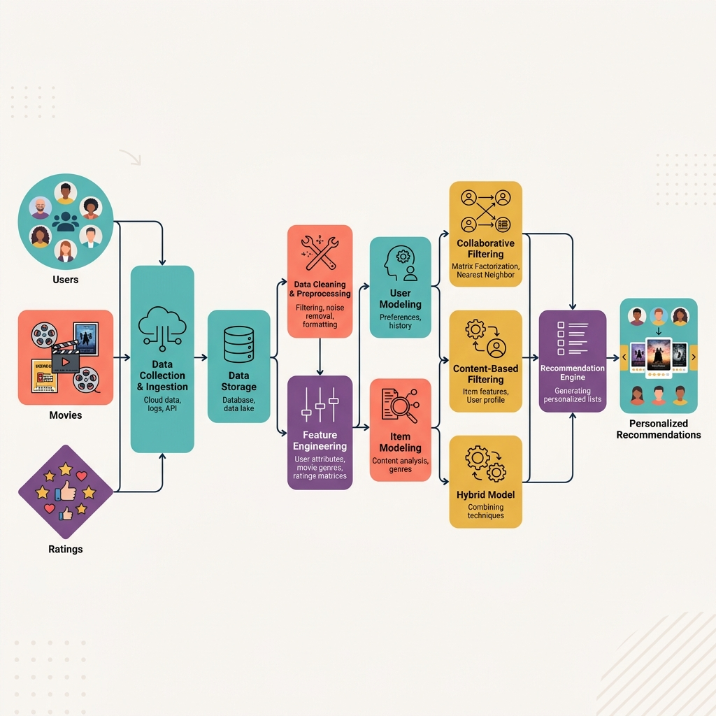
Data Flow — Which File Feeds Which Algorithm?
Dataset
ratings.dat → CF, SVD, Evaluation
movies.dat → Content-Based, Hybrid
users.dat → Context Features
6

Slide 7

Setup & Exploratory Data Analysis
EDA
Environment: Google Colab (free GPU/CPU)
Libraries: pandas, numpy, matplotlib, scikit-surprise
Load data: pd.read_csv(sep="::", engine="python")
Basic stats:
Avg rating: 3.58 ★
Ratings per user: min 20, median ~96
Most rated: "American Beauty" (3,428 ratings)
Notebook: 01_setup_eda.ipynb → Load, clean, visualize, export stats
7

Slide 8
EDA — Key Findings
EDA
Rating Distribution: 4★ most frequent (34%), 1★ rarest (6%)
→ Users tend to rate positively (positive bias)
Power-law in movie popularity — a few movies get most ratings
Genre distribution: Drama > Comedy > Action dominate
Each movie has 1.6 genres on avg (multi-label)
Temporal span: 2000–2003 (3 years of data)
Rating Distribution
4★ = 34% | 3★ = 27%
5★ = 21% | 2★ = 11%
1★ = 6% (positive bias)
Top Genres
Drama: 1,500+ movies
Comedy: 1,200+ movies
Action: 900+ movies
User Activity
Mean: 166 ratings/user
Min: 20 | Max: 2,314
Median: ~96 ratings
8

Slide 9

Algorithm Taxonomy — 5 Approaches
Algorithms
┌─ Collaborative Filtering (CF)
│ ├─ 1. User-Based CF (find similar users)
│ ├─ 2. Item-Based CF (find similar items)
│ └─ 3. SVD (latent factors)
│
├─ 4. Content-Based (TF-IDF on genres)
│
└─ 5. Hybrid (SVD + Content-Based)
Learning order: User-CF → Item-CF → SVD → Content-Based → Hybrid
9

Slide 10
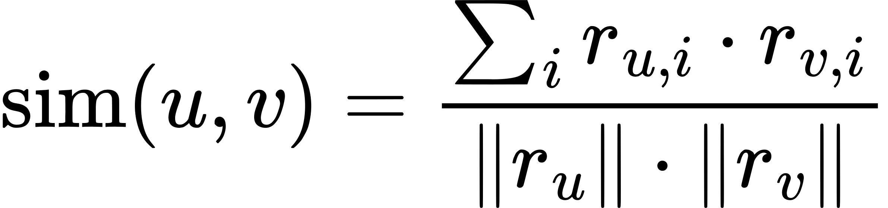
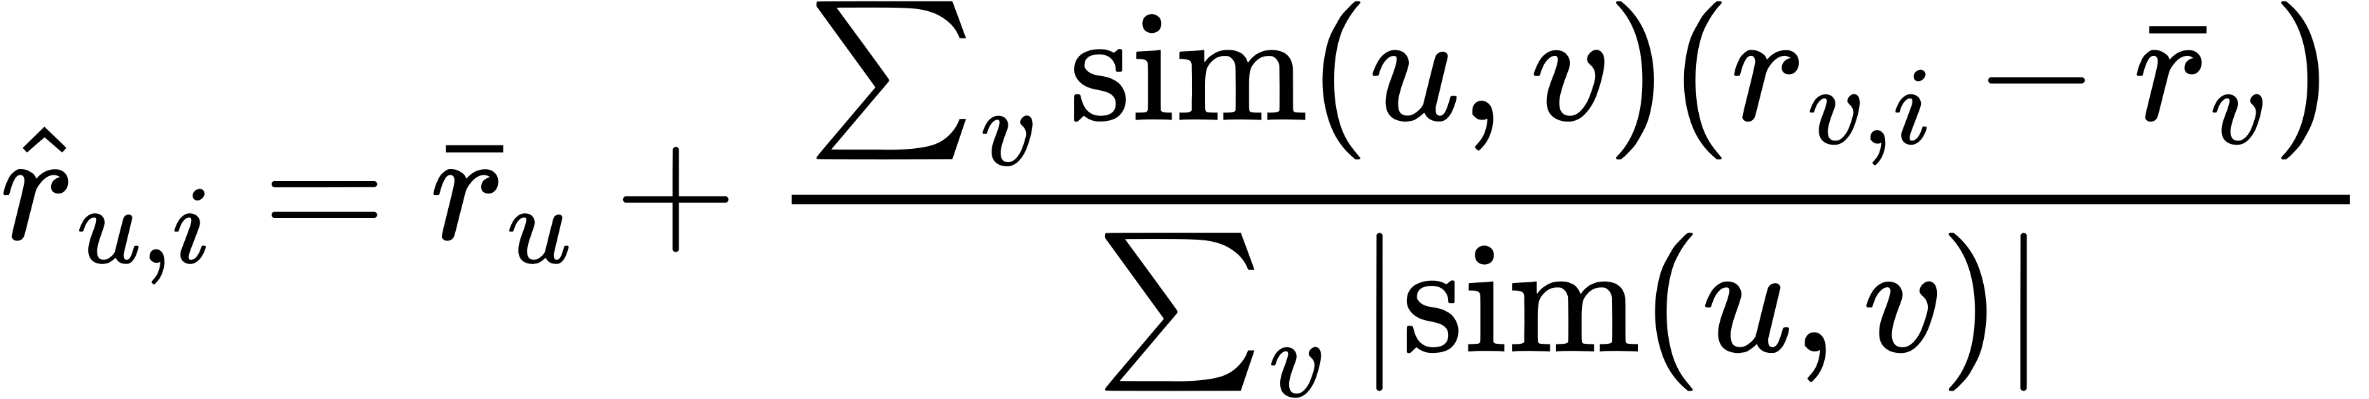
Algorithm 1 — User-Based Collaborative Filtering
Algorithms
Idea: "Users with similar tastes like similar movies"
Step 1: Represent each user as a rating vector
Step 2: Compute Cosine Similarity between user pairs
Step 3: Find K=20 nearest neighbors (KNN)
Step 4: Predict rating via weighted average
✅ No content knowledge needed
✅ Pure behavior-based
❌ Slow for large user sets
❌ Cold-start problem
Cosine Similarity:
Prediction Formula:
RMSE: 0.9293
10

Slide 11
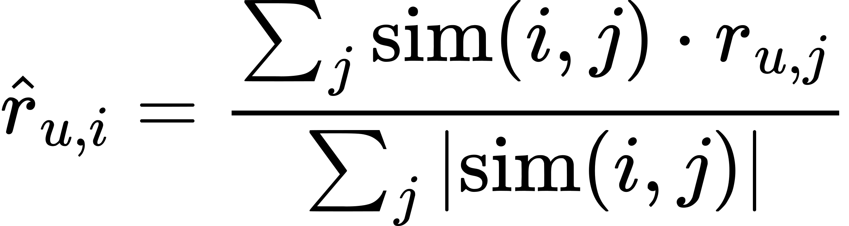
Algorithm 2 — Item-Based Collaborative Filtering
Algorithms
Idea: "Movies rated similarly by many users are similar"
Compare items instead of users — more stable
Netflix and Amazon use Item-Based CF in production
Same KNN approach, but sim(item_i, item_j)
Aspect | User-Based CF | Item-Based CF
Compares | Users | Items
Stability | Low (users change) | High (items stable)
Speed | Slower | Faster
RMSE | 0.9293 | 0.9293
Prediction Formula:
RMSE: 0.9293
11

Slide 12
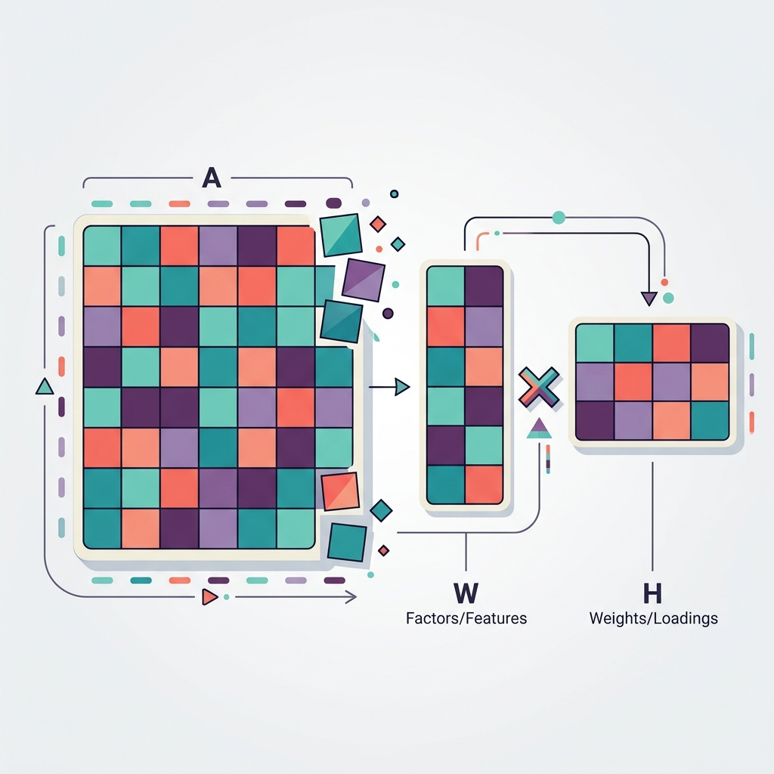
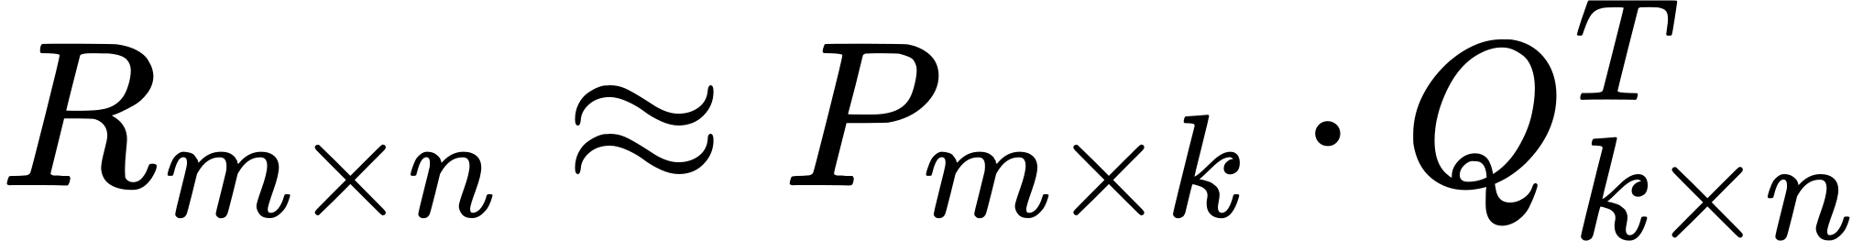
Algorithm 3 — SVD (Matrix Factorization)
Algorithms
Problem: Rating matrix is 95.5% empty (sparse)
Idea: Decompose R into P × Qᵀ (latent factors)
Each user & movie → vector of k hidden features
Model learns features automatically from data
Trained via Stochastic Gradient Descent (SGD)
Decomposition:
Prediction:
n_factors=50 · n_epochs=20 · μ=3.58 · b_u, b_i = bias terms
Best RMSE: 0.8706
12

Slide 13
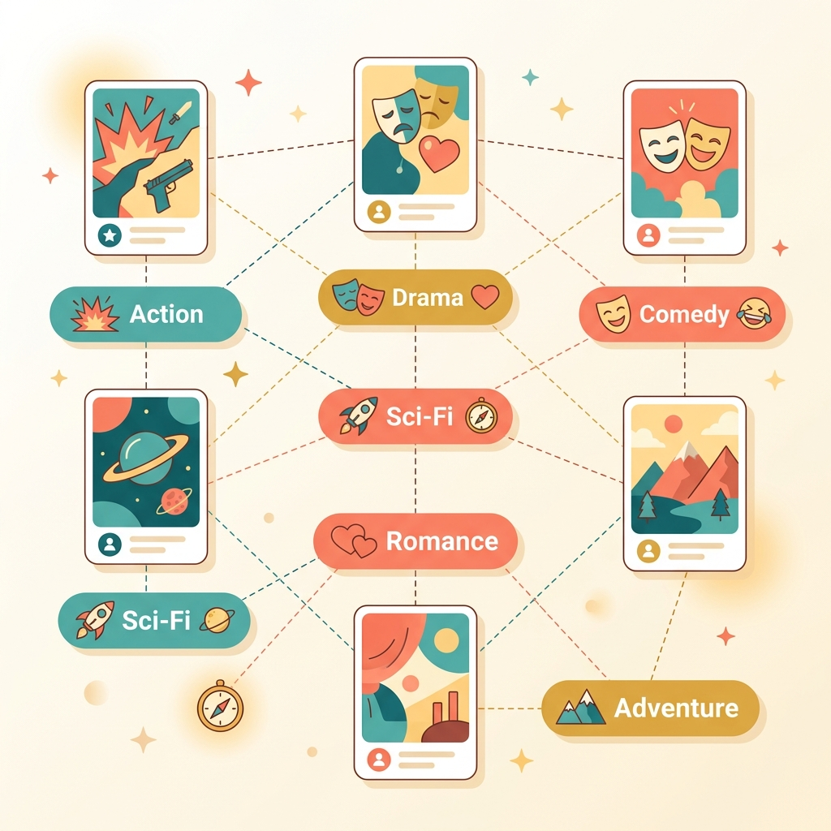
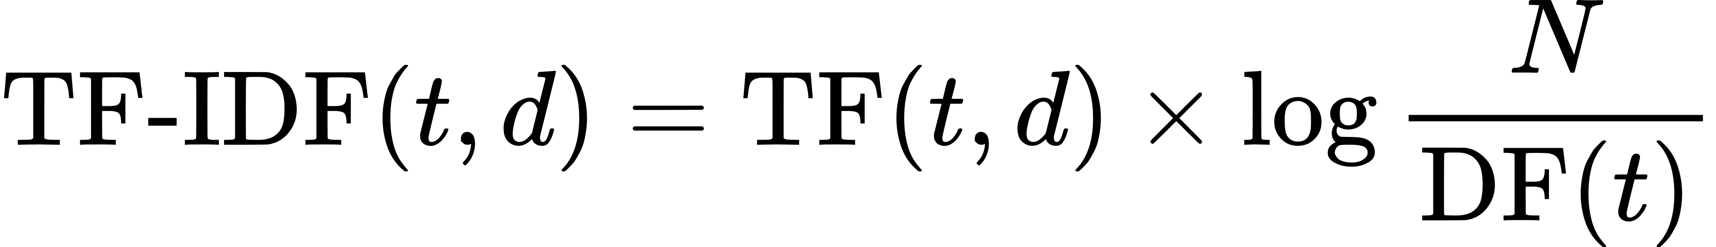
Algorithm 4 — Content-Based Filtering
Algorithms
Idea: "If you liked Action movies, try more Action"
Based on movie CONTENT (genres), not on other users
Step 1: Convert genres → TF-IDF vectors
Step 2: Compute Cosine Similarity (movie × movie)
Step 3: Recommend movies similar to user's top-rated
Solves Cold-Start — works even for new users!
TF-IDF Formula:
✅ No need for other users' data
✅ Solves cold-start problem
✅ Explainable recommendations
❌ Limited diversity (filter bubble)
❌ Depends on metadata quality
Precision@10: 0.1163
13

Slide 14
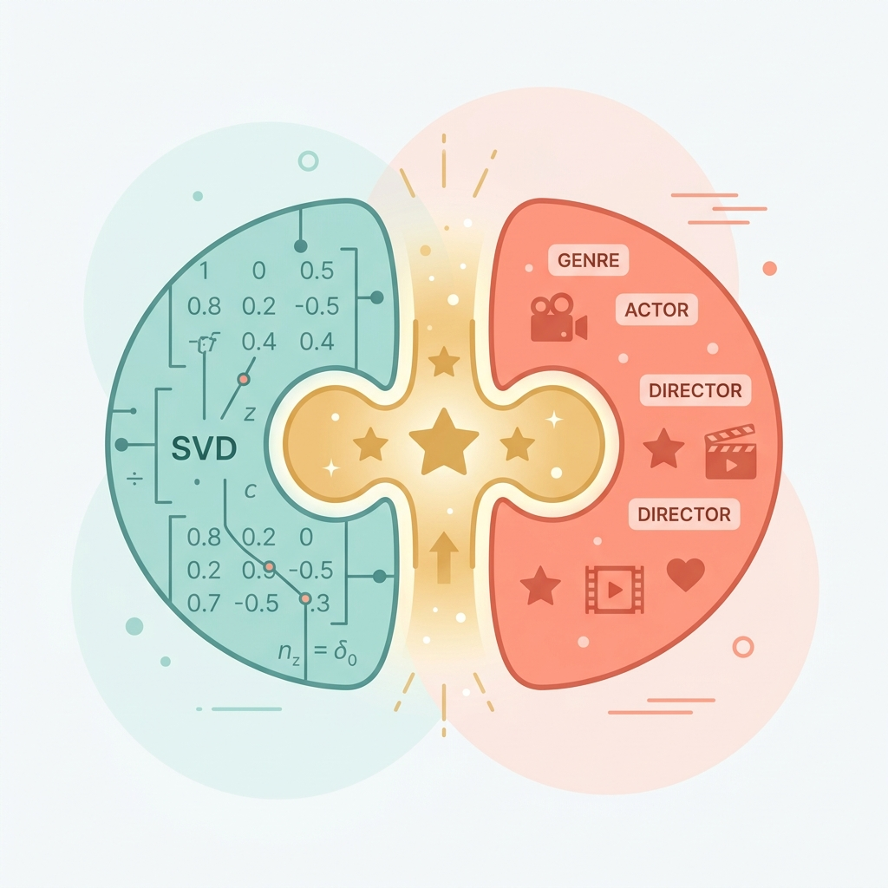
Algorithm 5 — Hybrid (SVD + Content-Based)
Algorithms
SVD: Accurate predictions, but has cold-start problem
Content-Based: Handles cold-start, but limited diversity
Hybrid = Best of both worlds!
Weighted combination: α=0.6 (60% SVD + 40% CB)
Hybrid Score:
Strategy | How it Works | When to Use
Weighted | α×SVD + (1-α)×CB | Simple, default approach
Switching | CF if enough data, else CB | Handle cold-start gracefully
Cascade | SVD→100, CB→30, Rank→10 | Multi-layer filtering
14

Slide 15
Why Do We Need Evaluation Metrics?
Evaluation
Without metrics — "which algorithm is better?" is subjective
Need concrete numbers to compare algorithms objectively
Two types of evaluation:
Prediction Metrics: How accurate is the rating prediction?
Ranking Metrics: How good is the recommendation list?
Train/Test Split: 80% train, 20% test (random or temporal)
PREDICTION METRICS
→ RMSE, MAE
→ "How far off is the predicted rating?"
→ Lower = Better
RANKING METRICS
→ Precision@K, Recall@K, MAP, NDCG
→ "How relevant is the top-K list?"
→ Higher = Better
Must evaluate on UNSEEN data (test set) — not training data!
15

Slide 16
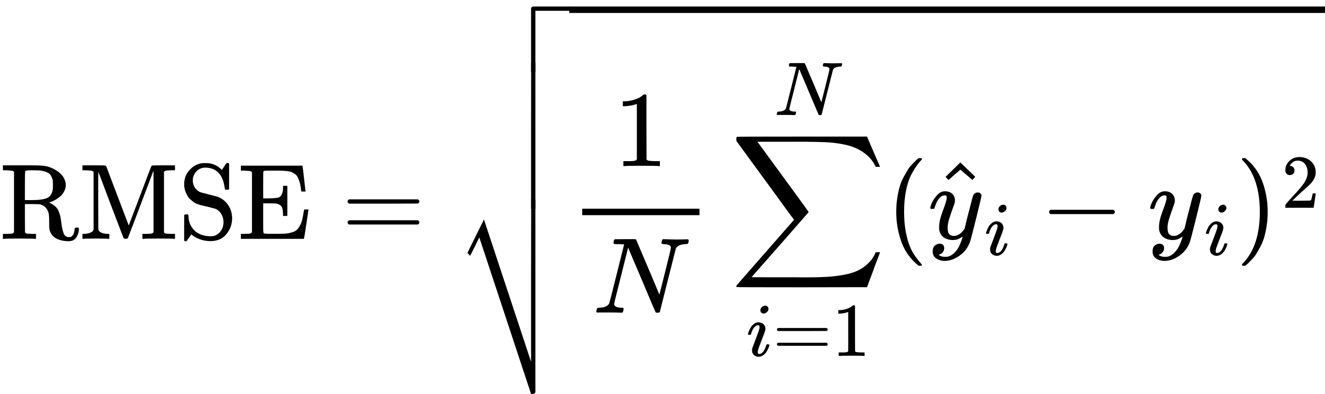
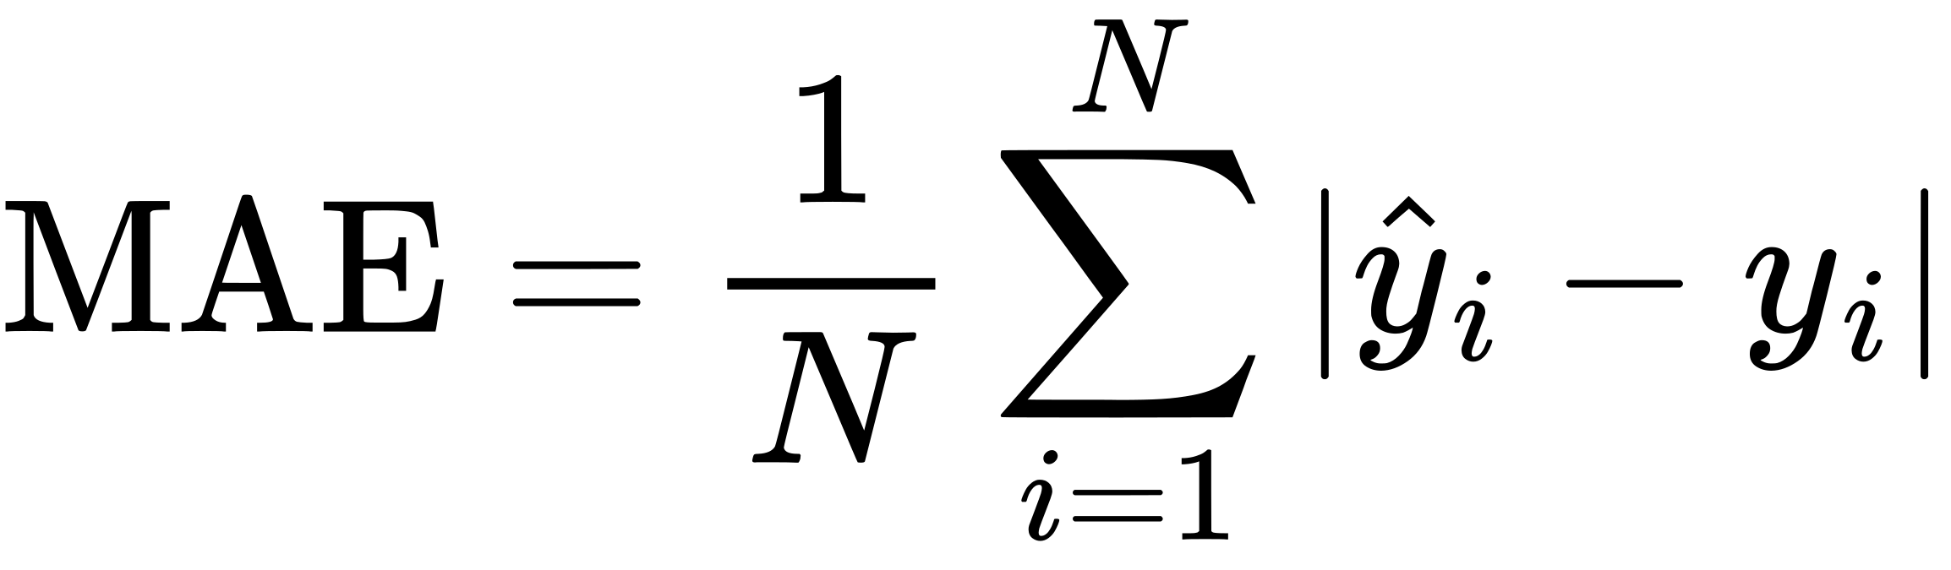
Prediction Metrics — RMSE & MAE
Evaluation
RMSE — Root Mean Square Error:
Worked Example:
Predicted: [4.5, 3.0, 2.0, 5.0]
Actual: [4.0, 3.5, 1.5, 4.5]
Errors: [0.5,-0.5, 0.5, 0.5]
SSE = 0.25+0.25+0.25+0.25 = 1.0
MSE = 1.0 / 4 = 0.25
RMSE = √0.25 = 0.50 ★
Penalizes large errors more → sensitive to outliers
MAE — Mean Absolute Error:
Treats all errors equally → more robust
< 0.8
Excellent
0.8–1.0
Good
1.0–1.5
Fair
> 1.5
Poor
Our best model (SVD): RMSE = 0.8706 → avg error of ~0.87 stars on a 1-5 scale
16

Slide 17
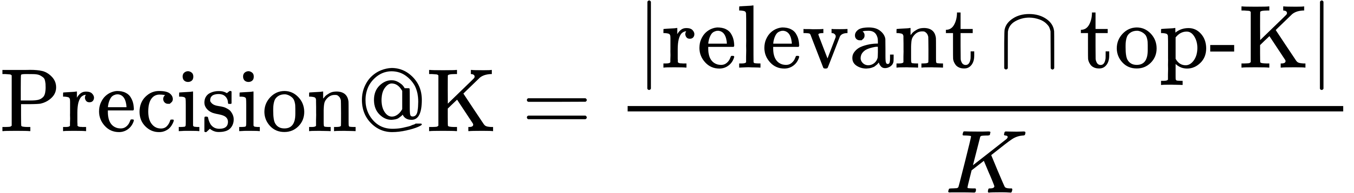
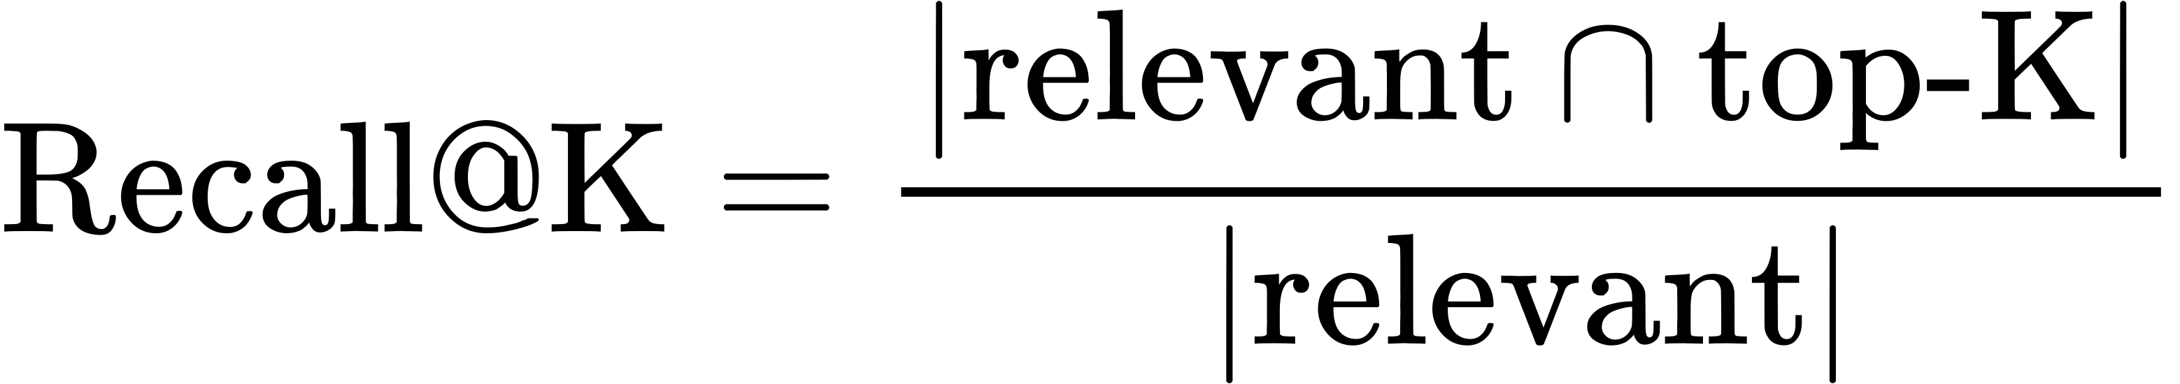
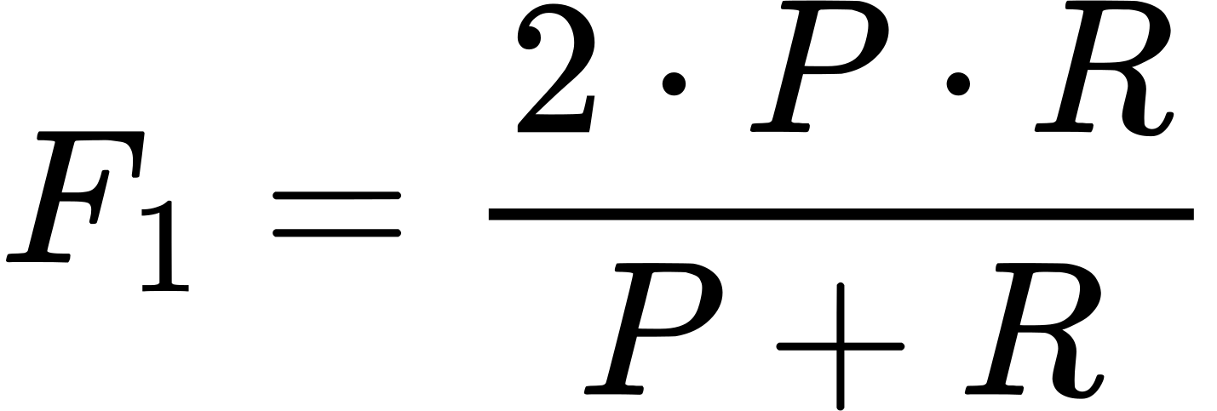
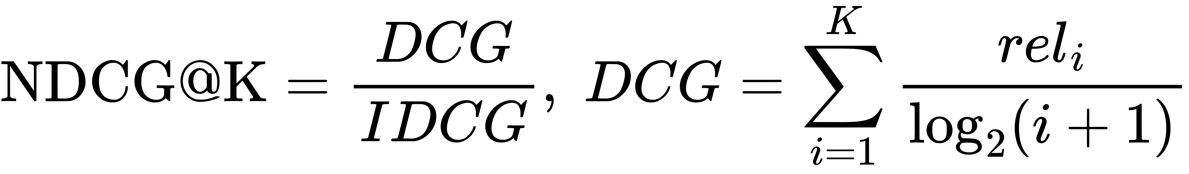
Ranking Metrics — Precision, Recall, MAP, NDCG
Evaluation
Precision@K:
Recall@K:
F1-Score:
NDCG@K:
Algorithm | RMSE | MAE | P@10 | MAP@10 | NDCG@10
User-Based CF | 0.9293 | 0.7383 | — | — | —
Item-Based CF | 0.9293 | 0.7383 | — | — | —
SVD (k=50) | 0.8706 | 0.6839 | — | — | —
Content-Based | — | — | 0.1163 | 0.0571 | 0.1248
SVD wins on prediction accuracy · Content-Based provides ranking-based evaluation
17

Slide 18
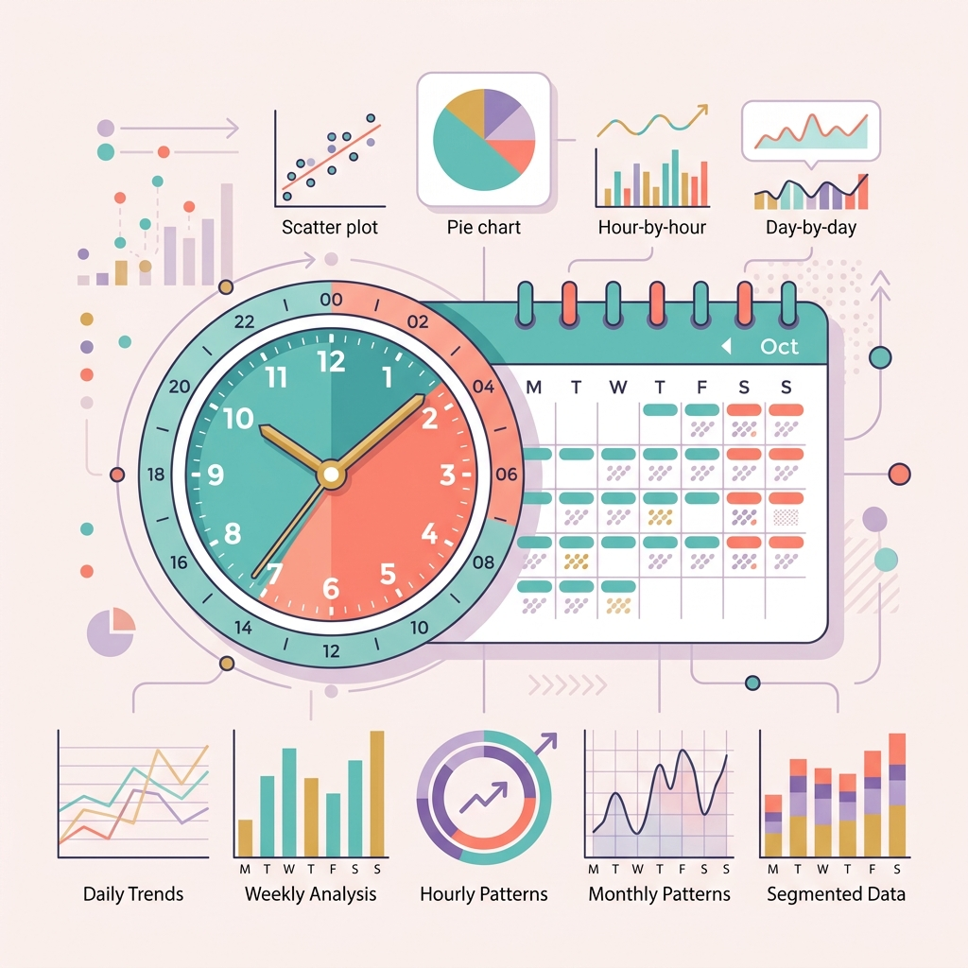
Context Features — Temporal Analysis
Context Features
Extract from timestamp: year, month, day, hour
Key Findings:
Weekends → slightly higher ratings (+0.07)
Late night (9–11PM) → higher ratings
Slight decline in avg rating 2000→2003
Why it matters:
Time-aware recommendations possible
User mood varies by time of day & week
Notebook: 07_context_features.ipynb → temporal feature extraction & visualization
18

Slide 19
Context Features — Demographics Analysis
Context Features
Gender: Female rates +0.06 higher than Male on average
Age: Under 18 rates highest (~3.68), 25-34 lowest (~3.50)
Genre preferences differ significantly:
♀ Female → Romance, Drama, Musical
♂ Male → Action, War, Horror, Sci-Fi
Group | Avg Rating | Top Genre | # Users
Male | 3.56 | Action | ~4,200
Female | 3.62 | Romance | ~1,840
Under 18 | 3.68 | Animation | ~220
25-34 | 3.50 | Drama | ~2,100
56+ | 3.55 | War | ~230
Application: Cold-start fallback — recommend by demographics when no history exists
19

Slide 20
Project Structure — Clean & Modular
Architecture
recommend-system/
├── docs/ ← 8 documentation files
├── notebooks/ ← 9 Colab notebooks
│ ├── 01_setup_eda.ipynb
│ ├── 02–06 (algorithms)
│ ├── 07_context · 08_evaluation
│ └── 00_full_pipeline.ipynb ← API
├── src/ ← 5 Python modules (~620 LOC)
│ ├── constants.py · data_loader.py
│ ├── models.py (5 algorithms)
│ ├── evaluation.py · context.py
├── frontend/ ← HTML/JS (Zen UI)
├── data/raw/ml-1m/ ← Dataset
└── results/ ← Charts + JSON reports
Module Dependency Flow:
constants.py
↓
data_loader.py
↓
models.py
↓
evaluation.py
↓
context.py
20

Slide 21
System Architecture — Colab + Cloudflare Pages
Architecture
☁️ Google Colab (Backend)
🌐 Cloudflare Pages (Frontend)
• Load MovieLens 1M dataset
• Train 5 recommendation models
• FastAPI server (port 8000)
• Serve predictions via REST API
• Endpoint: /api/recommend
• Static HTML/CSS/JS (Zen UI)
• JS fetch() → API calls to backend
• Display movie recommendations
• Algorithm selector dropdown
• Prediction scores shown
ngrok tunnel
1. Open web → 2. Paste ngrok URL → 3. Select user & algorithm → 4. Get predictions with scores
21

Slide 22

Live Demo
& Future Work
Try it now:
1. Open Colab notebook → Run All
2. Copy ngrok URL
3. Visit the web frontend
4. Paste URL → Select algorithm → See results!
Future Improvements:
Thank You! 🎬🍿
• Neural CF (deep learning) • Implicit feedback (ALS)
• Docker deployment • Richer metadata
Questions?

