Slide 1

Automatic Colorization
数学科学学院
--张鸿铭，张希

Slide 2
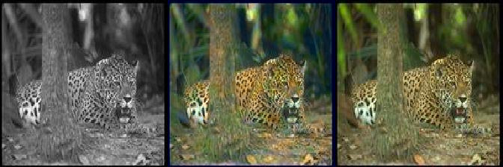
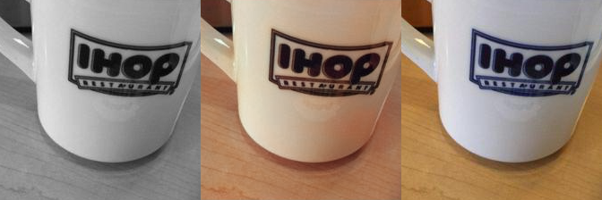
Some results of
our predictions

Slide 3
Image Color Space
an additive color model which added red, green and blue light
for the sensing, representation and display of images in electronic systems
used in conventional photography.
RGB
a color space typically used as part of a color image pipeline
luma component already existed as the black and white signal
the UV signal is able to add color
YUV

Slide 4
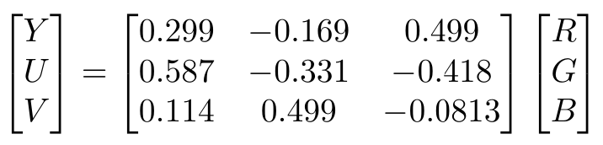
RGB to YUV

Slide 5
Transfer Learning
Transfer learning or inductive transfer is a research problem in machine learning that focuses on storing knowledge gained while solving one problem and applying it to a different but related problem. For example, knowledge gained while learning to recognize cars could apply when trying to recognize trucks. This area of research bears some relation to the long history of psychological literature on transfer of learning, although formal ties between the two fields are limited.

Slide 6
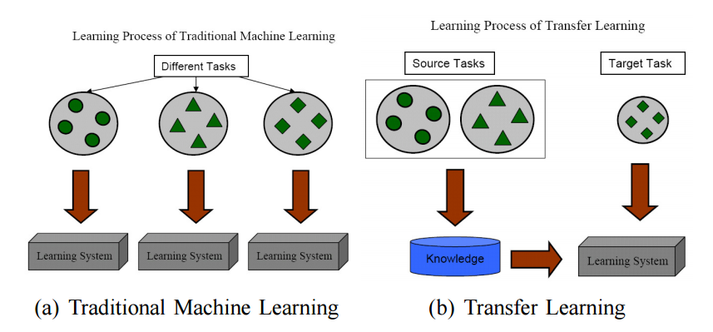
Transfer Learning

Slide 7
In CNN classification models, more information can be extracted than just the final classification. It turns out that objects like car wheels and people already start becoming identifiable by layer three. Intermediate layers in classification models can provide useful color information.
Here we use a pre-trained image classification model to extract features for colorization. We choose the VGG-16 model because it has a simple architecture yet still competitive.

Slide 8
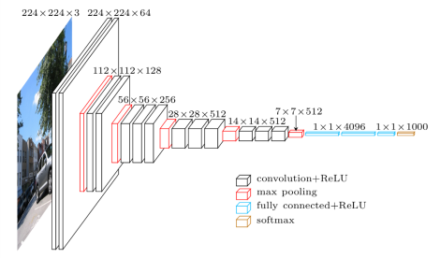
Structure of Vgg16

Slide 9
Hyper Columns
A hyper column for a pixel in the input image is a vector of all the activations above that pixel. The way I implemented this was by forwarding an image thru the VGG network and then extracting a few layers, upscaling them to the original image size, and concatenating them all together.

Slide 10
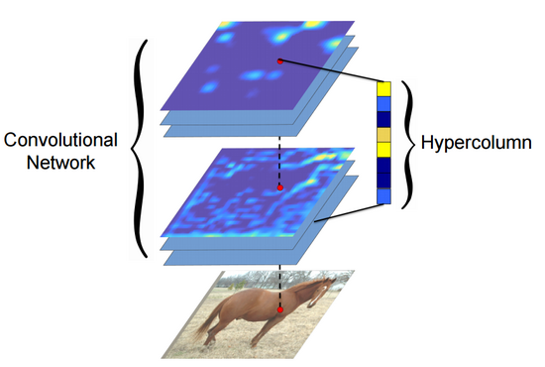
Hyper Columns

Slide 11
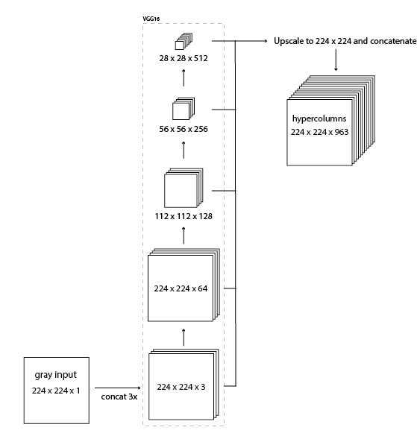
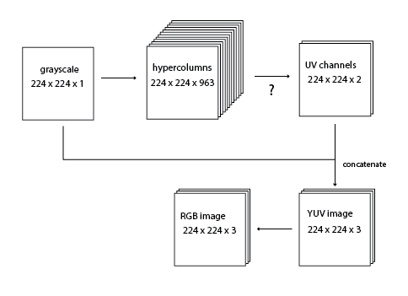
Structure of Our Model
--Hyper Columns

Slide 12
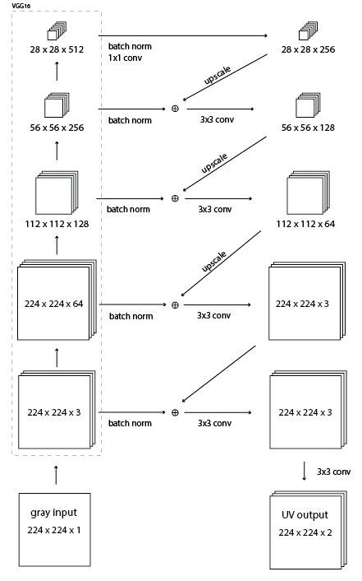
Structure of Our Model
--residual encoder

Slide 13
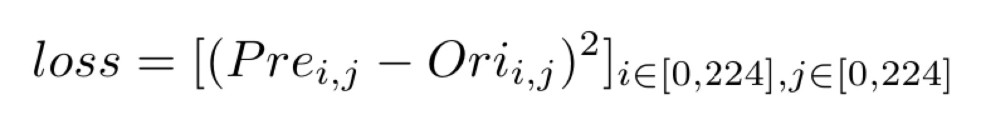
Loss Function

Slide 14
Image Data Set
Pictures of objects belonging to 101 categories. About 40 to 800 images per category. Most categories have about 50 images. Collected in September 2003 by Fei-Fei Li, Marco Andreetto, and Marc 'Aurelio Ranzato. The size of each image is roughly 300 x 200 pixels.
Tom and Jerry 166

Slide 15
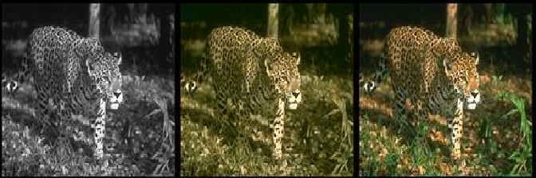
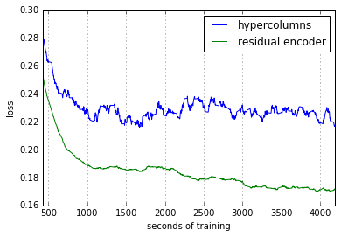
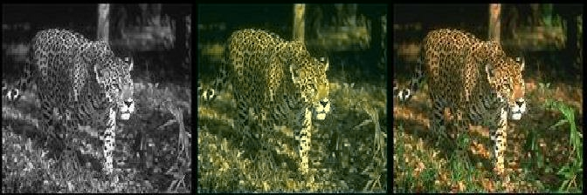
Training Loss
Predictions
Hyper Columns
Residual Encode

Slide 16
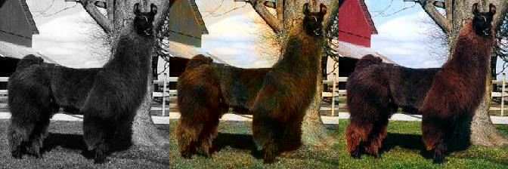
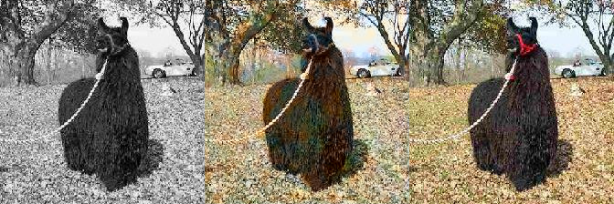
Our Predictions
psnr: 39.492
ssim: 0.915
psnr:39.708
ssim: 0.969

Slide 17
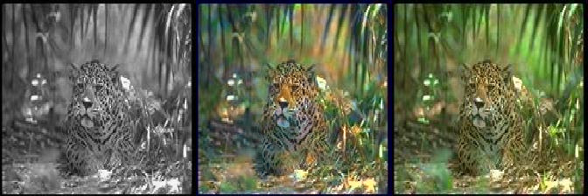
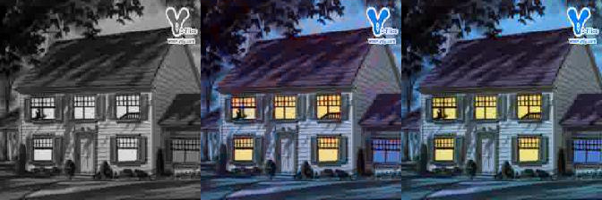
Our Predictions
psnr: 39.899
ssim: 0.976
psnr：40.053
ssim：0.994

Slide 18

Let’s enjoy a movie
Model: VGG-19，ResNet
Loss Function: 1/psnr, others
Picture: picture size
Outlook

Slide 19
THANKS
Notes:
模板来自于 http://docer.wps.cn

