Slide 1

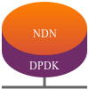



Named Data Networking on FABRIC
Can we achieve NDN Forwarding at 100 Gbps on FABRIC?
Arizona State University
School of Computing and Augmented Intelligence
Ashwin Nair, Toby Sinkinson, Jason Womack, Yingquiang Yuan

Slide 2
NDN Motivation
Information-Centric Networks account for half of the world's internet traffic, e.g., YouTube, Netflix, Amazon
The Internet is mostly mobile devices
ICN-over-IP is very inefficient
NDN is an architecture developed to better meet that usage and offer better security
NDN can be run over IP, which means it can be realized incrementally and relatively painlessly.
Notes:
IP infrastructure services that have taken decades to evolve, such as DNS naming conventions and namespace administration or inter-domain routing policies and conventions, can be readily used by NDN.
Indeed, because NDN’s hierarchically structured names are semantically compatible with IP’s hierarchically structured addresses, the core IP routing protocols, BGP, IS-IS and OSPF, can be used as-is to deploy NDN in parallel with and over IP.
Thus NDN’s advantages in content distribution, application-friendly communication, robust security, and mobility support can be realized incrementally and relatively painlessly.

Slide 3
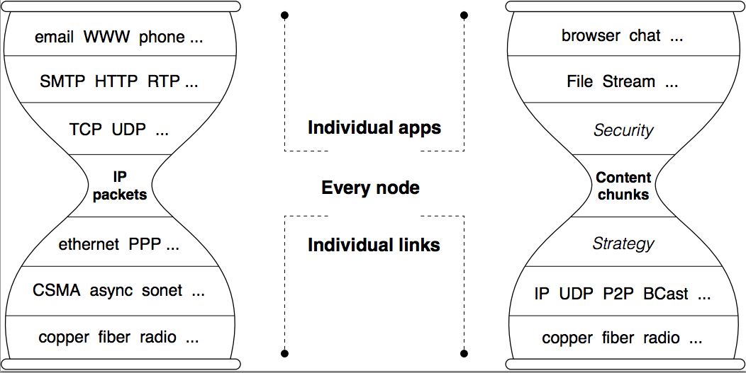
IP vs NDN Architecture
Both share hourglass shape
Both send datagrams
Both use their own namespace
NDN includes a security primitive at the narrow waist
IP has a stateless dataplane, NDN has a stateful dataplane
Notes:
Its been while since we looked at NDN, so a quick review of the high level concepts
IP sends packets to destination addresses, NDN uses Interest packets to fetch Data packets
Hourglass shape is what made the Internet elegant and powerful- the centerpiece is IP Packets , NDN uses data names as it thin waist
IP (by definition) has a stateless data plane. NDN has a stateful data plane. Together with the forwarding strategy, this stateful data plane offers NDN networks a variety of desired functions

Slide 4
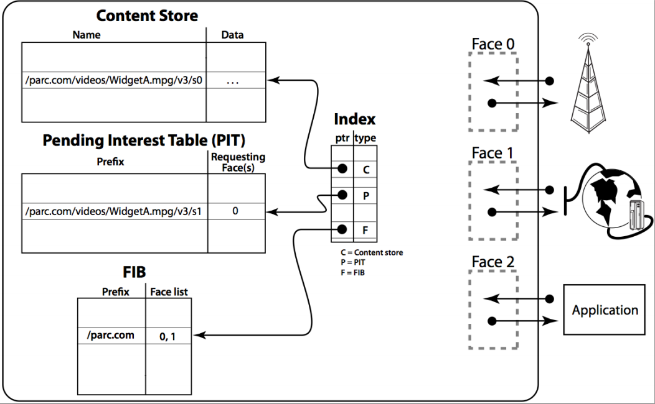
NDN routers have 3 data structures:
FIB (Forwarding Information Base)
PIT (Pending Interest Table)
ContentStore (data cache)
Notes:
Communication is driven the by receiver/ consumer when is sends an Interest packet which carries a name that identifies the desired data.
Router remembers interface the interest arrived on, and forwards according to name lookup in the FIB.
Once the Interest reaches the node that has the requested data, a Data packet is sent back following the path in reverse and carries the name, the content, and a signature by the producer's key.
The router stores all the Interests its sees in a Pending Interest Table. When multiple Interests for the same data are received, only the first one is sent upstream.
When the data arrives, the router finds the matching FIB entry and forwards to all interfaces listed there. The router removes the corresponding PIR entry, and caches the data in the Content Store.
The PIT holds every Interest that has been forwarded but still waiting for Data to come back in response.
Of note, neither Interest nor Data packets carry IP addresses.

Slide 5
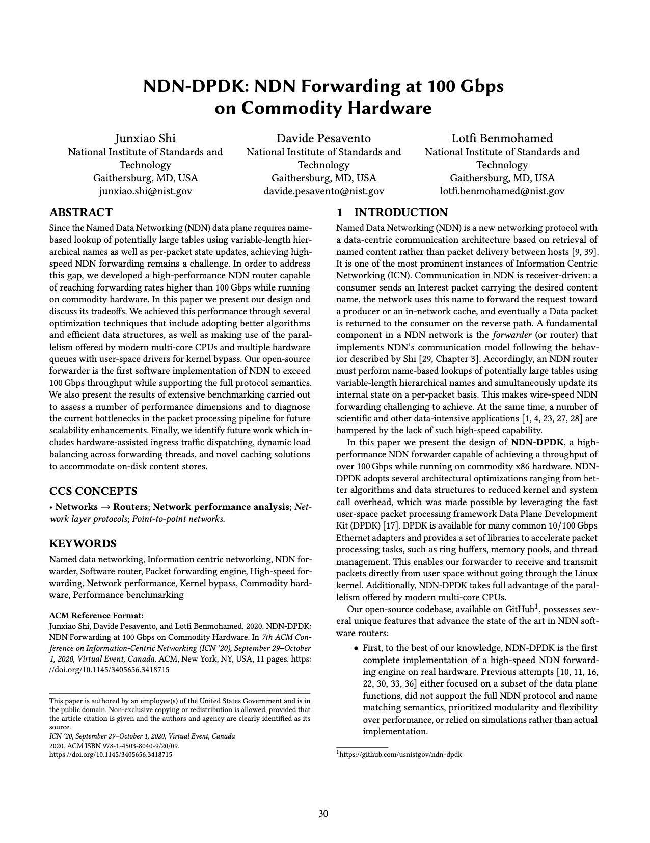
NDN-DPDK Motivation
NDN can be overlaid on existing architecture, but there is a bottleneck when forwarding
The NDN data plane requires name-based lookups in potentially large tables (and variable length hierarchical names)
Achieving high speed forwarding is a challenge
Notes:
We saw this in the DNS Does Not Suffice paper- hierarchical naming introduces larger latency for lookups.
Challenge to implement on x86 commodity hardware

Slide 6
Achieving 100 Gbps
Take advantage of parallelism from multi-core CPU's
Share NDN tables as much as possible
PIT and CS do not require thread safety mechanisms (mostly read only)
FIB (gets updated by control plane) but can employ low-overhead RCU synchronization
Place all three in NUMA-based memory to minimize access latency
Notes:
To move beyond that bottleneck

Slide 7
Hugepages, Memory Pools and NUMA Sockets
NDN-DPDK uses DPDK's mempool library to preallocate most of its data structures in 1 GB hugepages.
This eliminates the unpredictable latency of calling malloc() on the packet processing hot path and reduces complexity of handling runtime memory allocation.
Each CPU, memory DIMM and PCIe belong to one NUMA socket.
Notes:
DPDK is an open source project that provides a more generic data plane development
It also includes a ring buffer queue to transfer packets between threads.

Slide 8
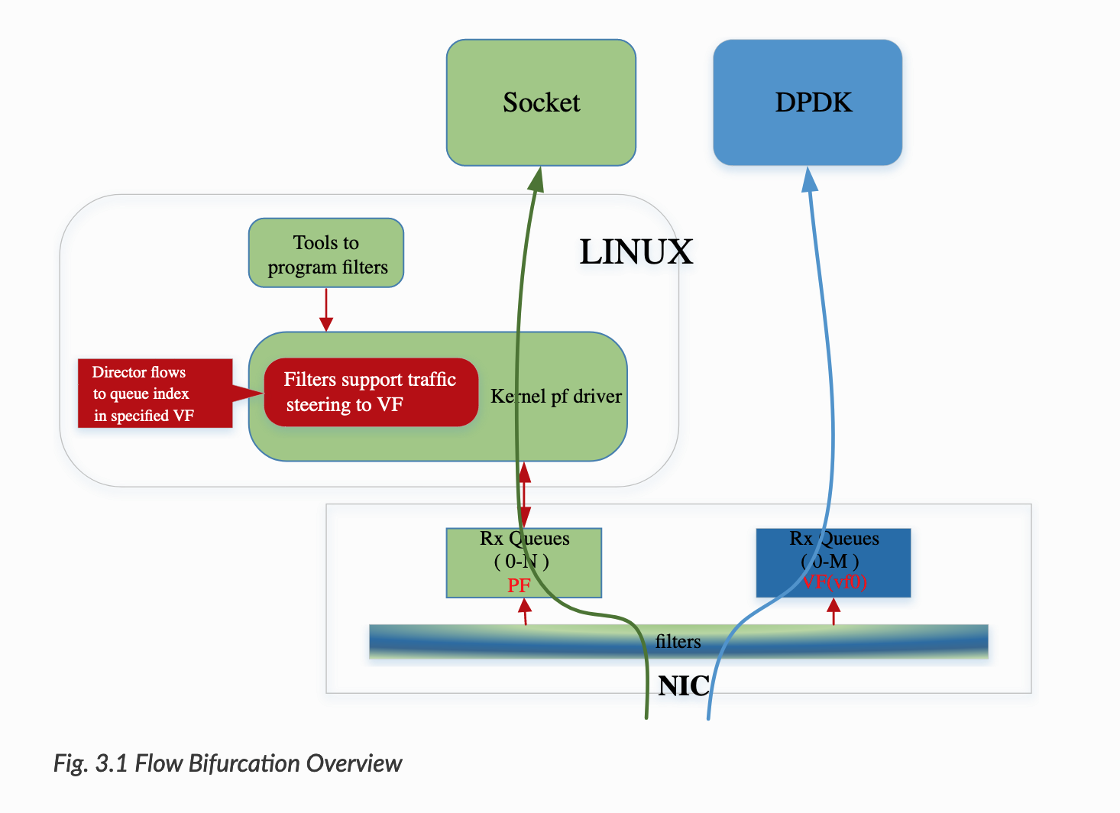
NVIDIA Mellanox ConnectX Flow Bifurcation
NDN-DPDK is optimized for 10/100 Gbps Ethernet adapters attached to a PCIe bus
NDN-DPDK uses DPDK’s poll mode drivers to split traffic between user and kernel space
This significantly improves performance by eliminating the overhead of system calls and interrupt handling

Slide 9
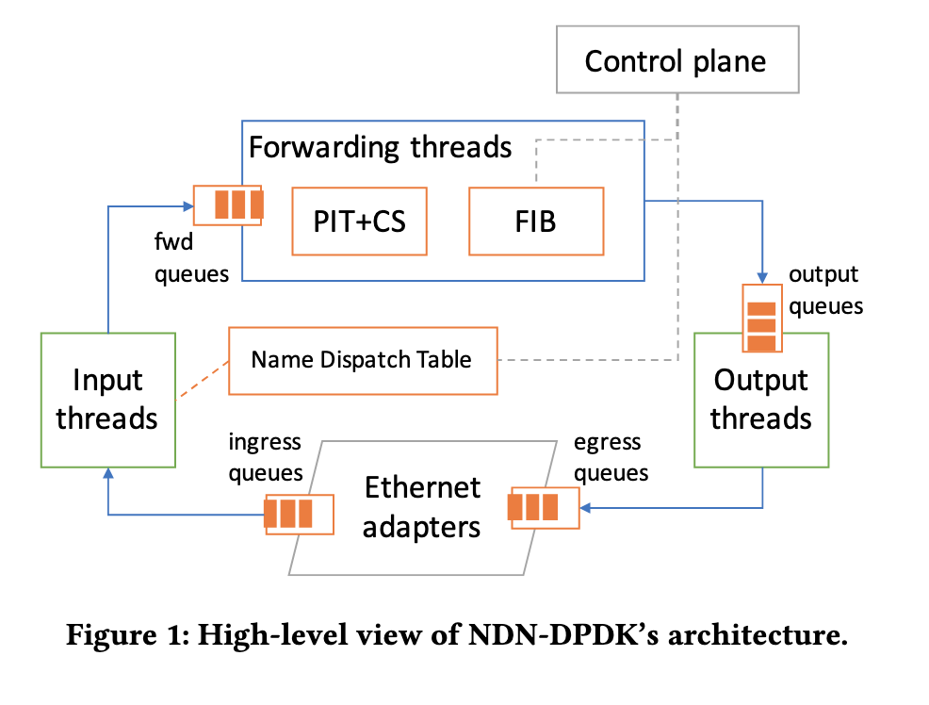
Three Stages for Multi-Threaded Architecture
The input stage receives a packet from a network interface, decodes it, and dispatches it to a forwarding thread according to a Name Dispatch Table (NDT).
The forwarding stage applies the NDN forwarding rules to the packet; this stage includes the traditional FIB, PIT and CS.
The output stage prepares outgoing packets and passes them to a network interface for transmission.
Notes:
One of the innovative strategies was to introduce a Name Dispatch Table and SipHash to make sure Interests were sent to the right thread. If threads share common interest prefix they should also be sent to the same thread. finally, returning data and nacks needed to be sent to the same thread when they returned downstream. NDN-DPDK introduced a PIT token (8byte hop by hop field) this allows neighboring routers to agree on a hash function before they communicate.

Slide 10
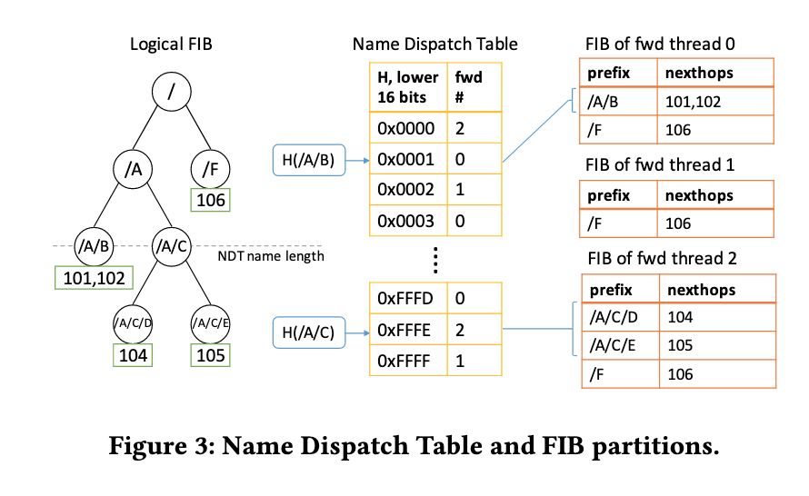
NDN-DPDK FIB Design
The FIB entries are stored in a hash table keyed by the name prefixes
2-stage LPM lookup algorithm
Multi-threaded architecture requires thread safety
Uses the Userspace RCU (Read-Copy-Update) library to allow FIB queries from the forwarding thread and FIB updates from the management thread to take place simultaneously
Each forwarding thread is given its private FIB instance.

Slide 11
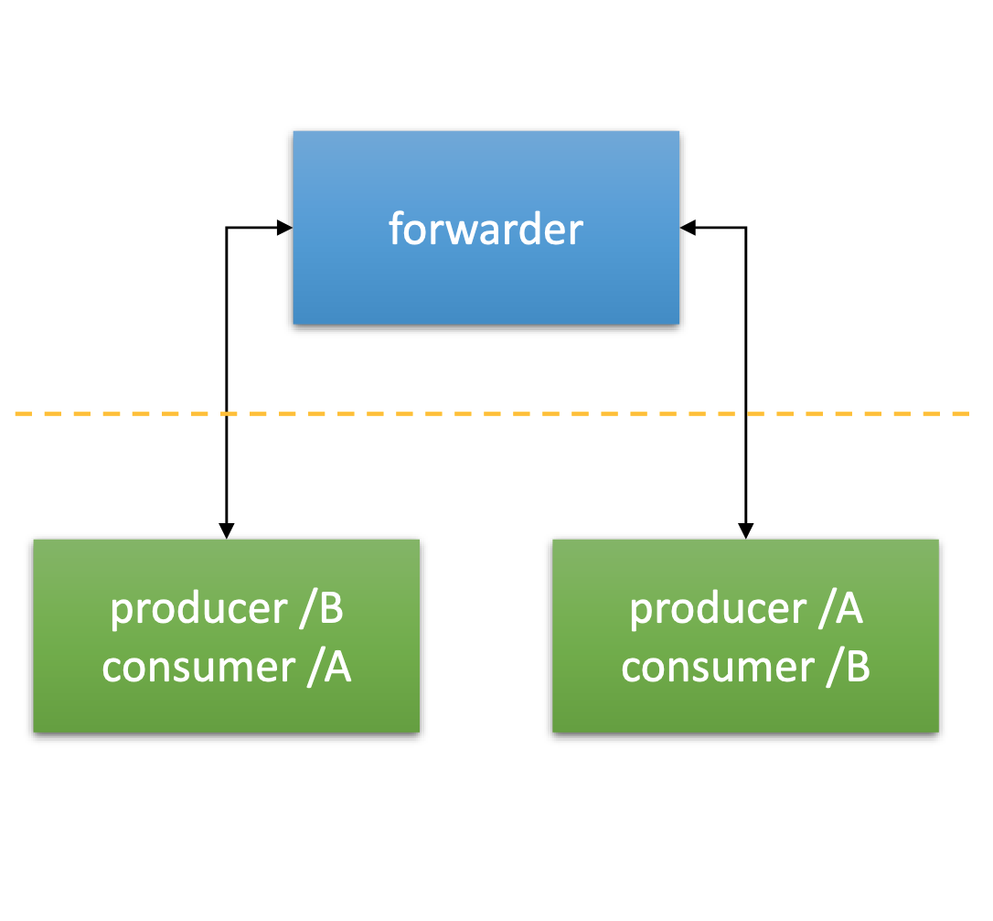
NDN-DPDK Topology
Two physical machines (connected over copper cables):
Forwarder
Traffic Generators (fetch data from each other, using CUBIC-like congestion control)
CPU: dual Intel Xeon Gold 6240
18 cores at 2.6 GHz, hyper-threading disabled
Memory: 256 GB, 2933 MHz (4 channels)
64 x 1 GB hugepages per NUMA socket
NIC: Mellanox ConnectX-5 100 Gbps

Slide 12
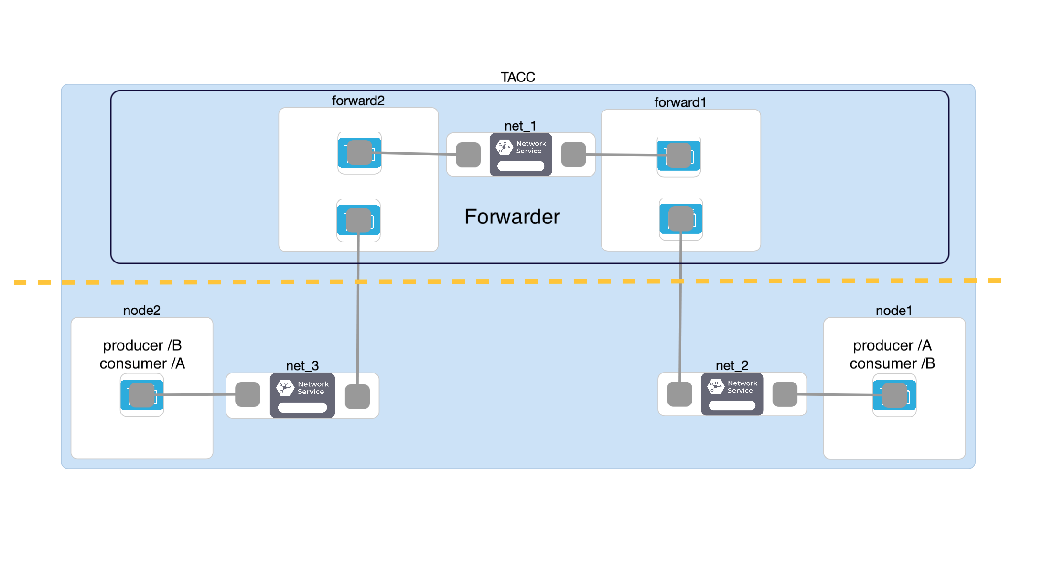
FABRIC Topology
Initially Consumers/Producers and Forwarder contained on 1 site: TACC
Notes:
4 CPU's
6 Core Multiprocessor
80 Gb RAM,
60 GB disk
4 NVIDIA ConnectX-6 NICs
3 Network Services: L2Bridge

Slide 13
Experimental Design

Slide 14
Installing NDN-DPDK on FABRIC
Reserve resources in a FABRIC slice
Install dependencies – NVIDIA drivers, hugepages
Clone DPDK and NDN repos

Slide 15
Activating the Forwarder
Configure hugepages – 1GB x 64
Configure PCI driver bindings
Set up interfaces and activate forwarder
NDNping to test

Slide 16
Activate the Traffic Generator
Can configure traffic patterns – names, packet losses, etc
Traffic can be generated for consumer and producer
Feed in a pre-determined JSON document for producer and consumer
Create FIB (Forwarding Information Base) entries on the forwarders

Slide 17
Activate the File Server
File server which serves content at one of the hosts
More sophisticated than simple producer
Use "ndncat" to test

Slide 18
Experiment on the network
NDN vs IP
Multiple sites and hosts
Stability and congestion response

Slide 19
IP vs NDN Experiment
Multiple runs using same traffic (a large file, for example)
Total time for data transfer
Compare response to congestion

Slide 20
Hurdles solved and unsolved
Installing Mellanox – was not obvious right away
FABRIC instability – haven't been able to test on multiple sites
Some sites assigned IPv6 by default – initially could not connect to Github
Hugepages do not work with 64GB RAM – had to scale to 128GB
Measure forwarder latency.

Slide 21
Results

Slide 22
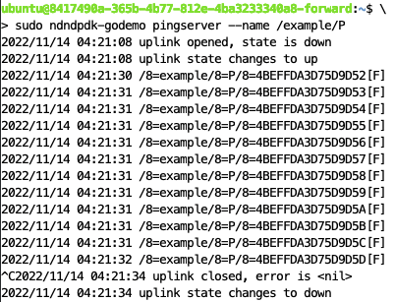
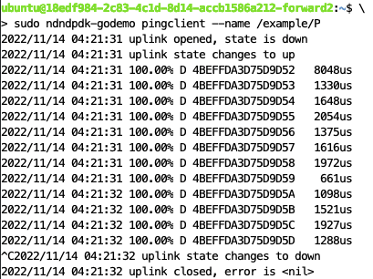
NDN-DPDK Installation and Forwarder Activation
Successful implementation of NIST’s NDN-DPDK on FABRIC
Special NVIDIA driver configuration for ConnectX-6
Extra script to use IPv6 based sites
Using this, we were able to create NDN forwarders
We were able to send an NDNping across two forwarding nodes
One as the server with the data in the FIB
One as the client pinging that data

Slide 23
Traffic Generator and File Server
Implementation of the traffic generator and file server are still ongoing
Traffic generator watch module tries to use a GraphQL query on a missing field
To solve this, we are trying to rewrite some of the backend of the NIST NDN-DPDK package (written in Go) to remove the field

Slide 24
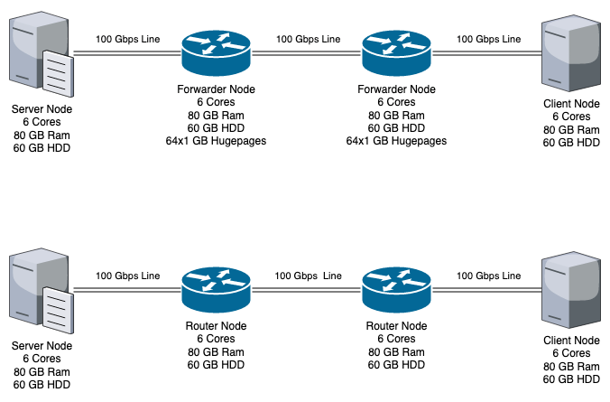
IP vs NDN Expected Results
Both expected to perform the same on first run
Empty cache on routers
Interest packet/IP packet will go the same route (to server node)
NDN expected to transfer files faster after first run
All chunks of the data stored in cache in both forwarders
NDN interest should be fulfilled by closest forwarder
IP packet will still have to reach server node

Slide 25
Future Work
We aim to prove that NDN provides higher throughput and quicker data transfers when compared to the standard IP network.
Once we have the full experimental setup with all proposed components working on our Jupyter notebooks, we aim to scale out the implementation across the testbed to include multiple hosts, producers and forwarders across different sites.
If time permits, we might also attempt to modify and implement parts of the NDN protocol. One idea is to implement a predictive algorithm that will automatically supply data packets ahead based on the interest packets that came before it.

Slide 26
Conclusion
We used the NIST NDN-DPDK package and install this onto a set of FABRIC nodes which act as different NDN components (forwarder, consumer, provider) to accomplish the goal of sending namespace-based traffic across the FABRIC network at high speeds.
FABRIC Jupyter notebook brought the replicability and programmability and opens a lot of possibilities for the other future work.

Slide 27
Thank you

