Slide 1
PowerPointLabs Test Cases
General instructions:
DO NOT SAVE these slides after testing. Keep this file in its original form.
If your result is different from the expected output, please submit a bug report (attach slides/screenshots as necessary).

Slide 2
Spotlight
Additional instructions:
Select the BLUE color shape(s).
Click “Create Spotlight” button in the ribbon or right click and then select “Add spotlight” in the context menu.
Compare the result with the expected output.
Also try tweaking these:
transparency setting
Soft edges setting

Slide 3
Spotlight:: normal shape
Spotlight Transparency 1%
Soft Edges 50 pts
Spotlight Color: #00FF00 (Green)

Slide 4
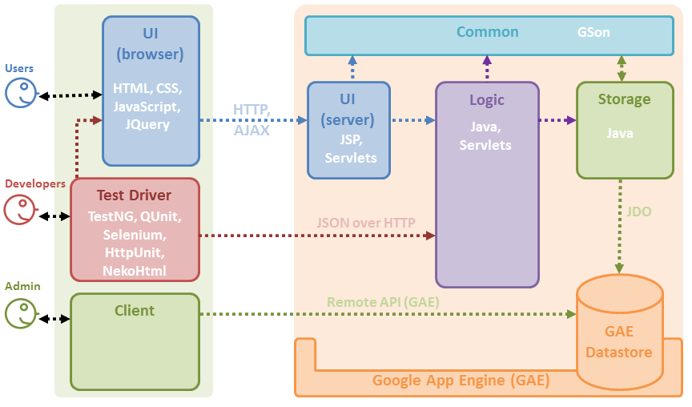
BLUE TEXT

Slide 5
BLUE TEXT

Slide 6

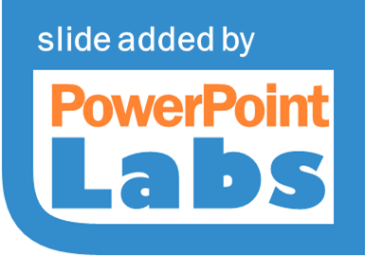

BLUE TEXT

Slide 7
Spotlight:: various multiple shapes
Select all blue shapes together.
Spotlight currently does not support 3D rotated shapes.

Slide 8
TS: Custom Shape
Shape beyond edge
Complex shape with same name. Do not select this.
Overlapping shapes
Overlapping shapes
Custom shape
Grouped
Complex shape
This shape should remain in the slide
A duplicate of the shape behind this.
Shape wider than slide

Slide 9
TS: Custom Shape
Shape beyond edge
Complex shape with same name. Do not select this.
Overlapping shapes
Overlapping shapes
Custom shape
Grouped
Complex shape
This shape should remain in the slide
A duplicate of the shape behind this.
Shape wider than slide
Expected Output

Slide 10







TS: Custom Shape
Complex shape with same name. Do not select this.
Complex shape
This shape should remain in the slide
Expected Output

Slide 11
Spotlight
Additional instructions:
Select the BLUE color shape(s).
Click “Create Spotlight” button in the ribbon or right click and then select “Add spotlight” in the context menu.
Compare the result with the expected output.
Also try tweaking these:
transparency setting
Soft edges setting

Slide 12
Spotlight:: normal shape

Slide 13
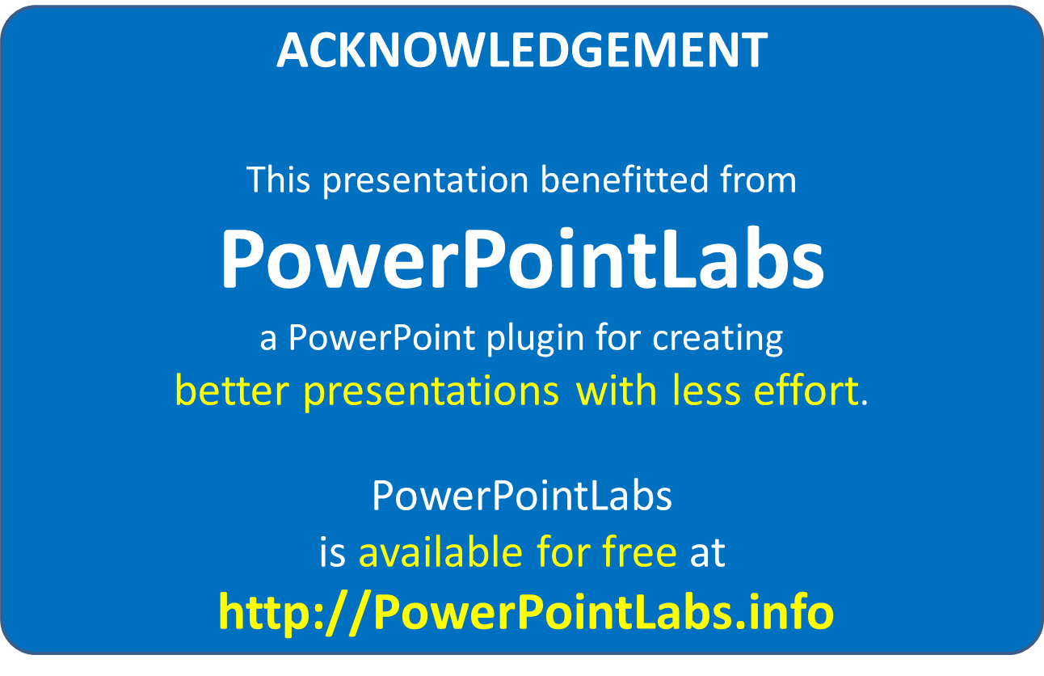

Slide 14


