Slide 1
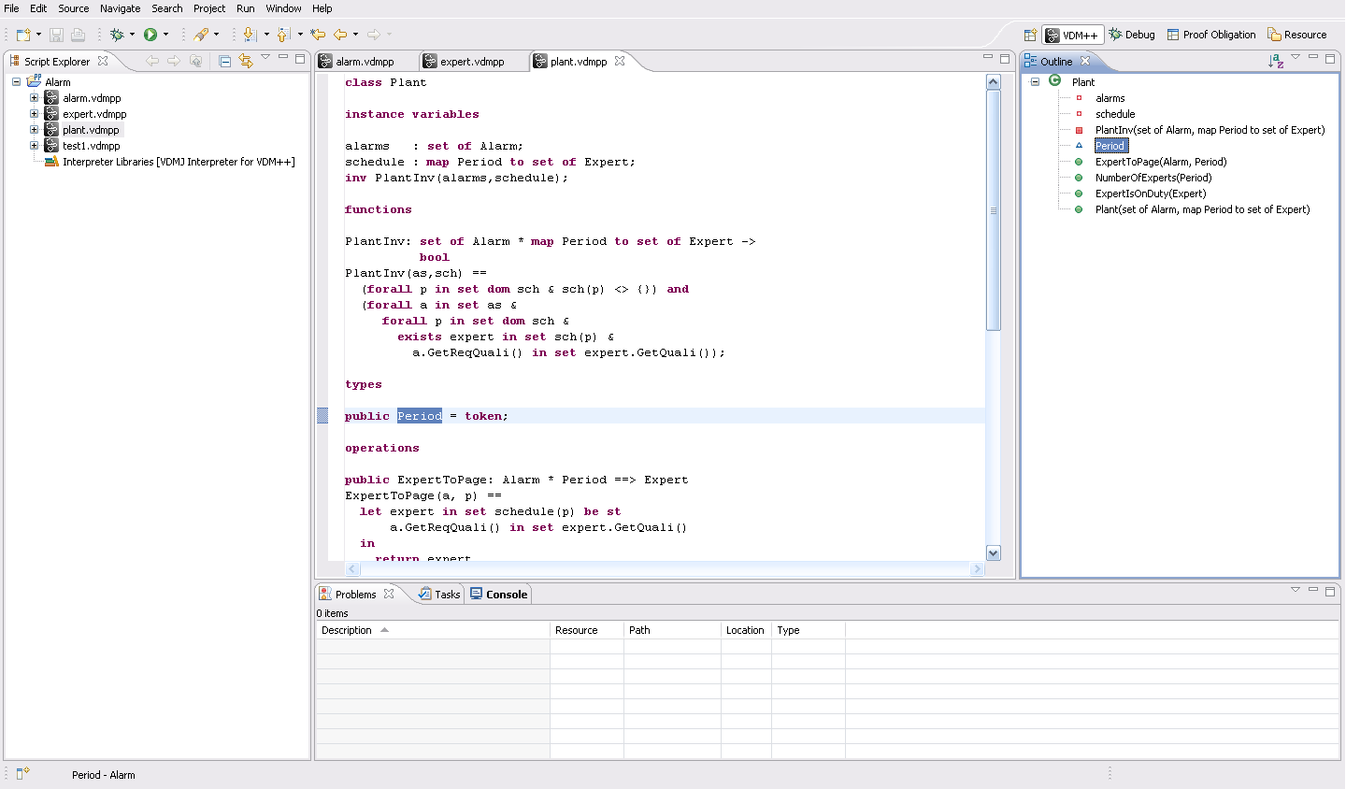
Switch perspective
Project
Editor
Model files
Outline view
Problem view

Slide 2
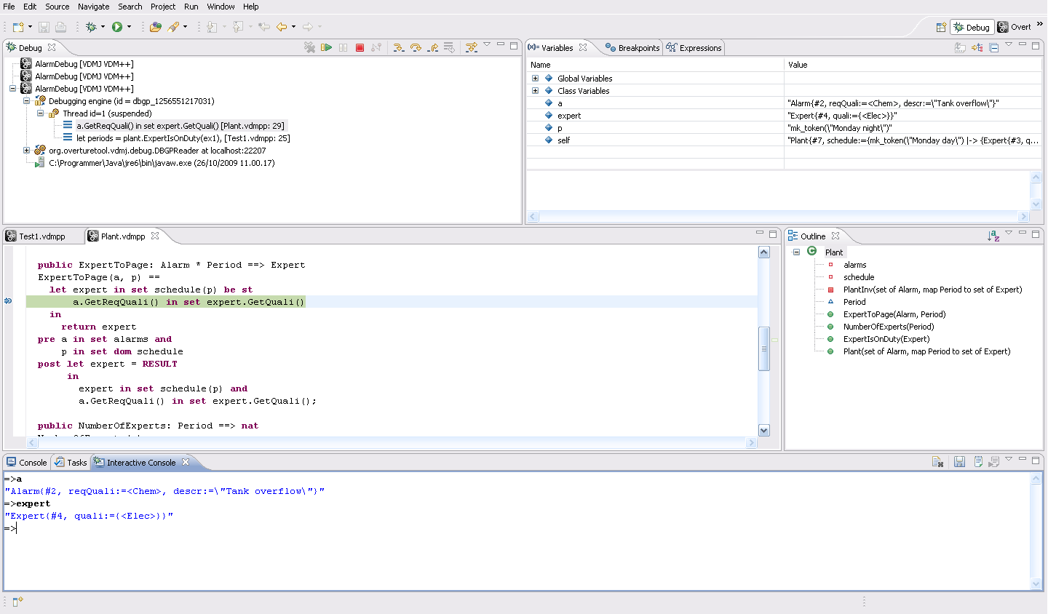
Call traces in debug
Inspecting variables
Editor
Outline
Interactive console

Slide 3
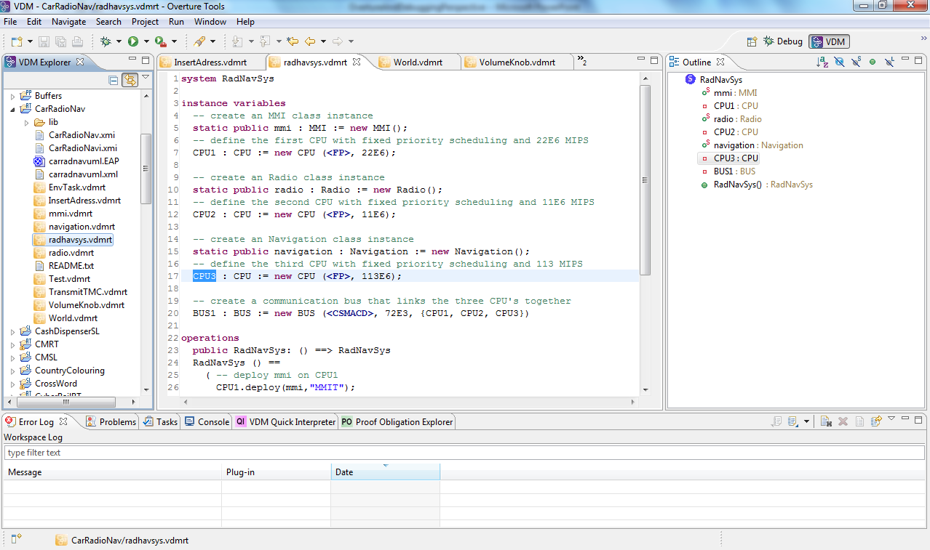
Switch perspective
Project
Outline view
Editor
Model files
Problem view

Slide 4
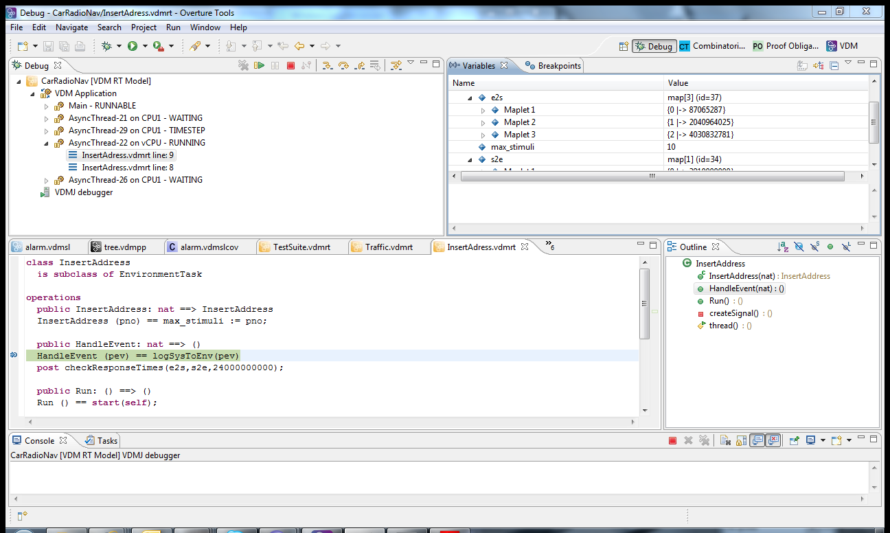
Call traces in debug
Inspecting variables
Editor
Outline
Interactive console

