Slide 2

dragonflow简介
肖宏辉 华为技术有限公司
IRC： xiaohhui

Slide 3
What is dragonflow?
Integral part of OpenStack Neutron
Fully Open Source
https://launchpad.net/dragonflow
Lightweight Distributed SDN Controller with pluggable database

Slide 4
What is dragonflow?
Dragonflow architecture consists of Neutron plugins which maps the Neutron models to new logical topology models
Dragonflow synchronizes this with local Dragonflow controllers which are distributed at each of the compute nodes using a pluggable distributed DB solution.

Slide 5
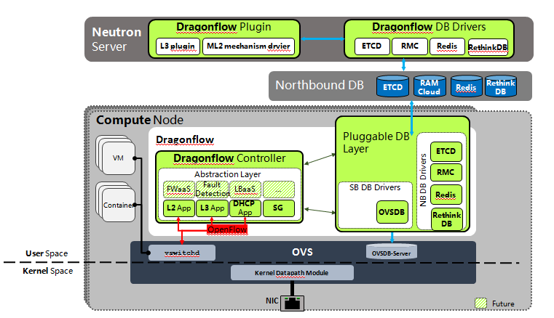
Dragonflow architecture

Slide 6
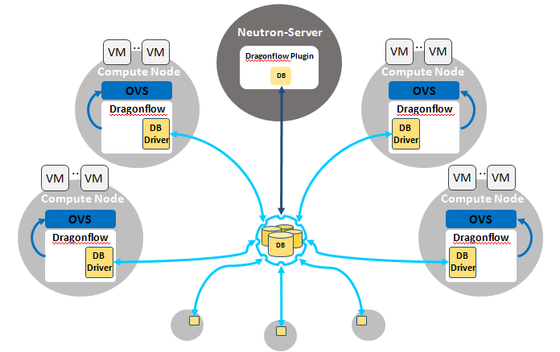
Data synchronization in Dragonflow

Slide 7
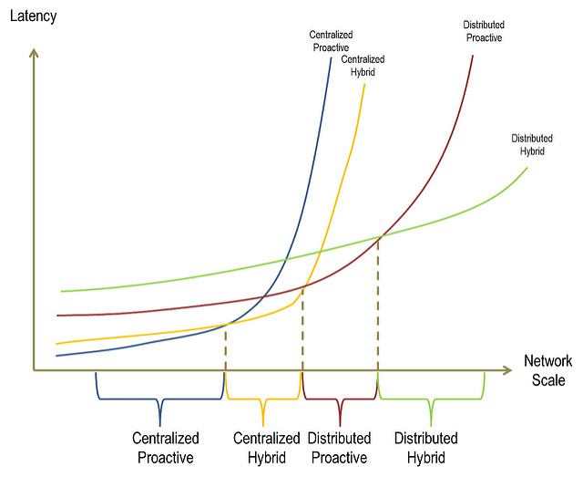
Dragonflow VS Neutron legacy
Eliminate neutron agents
Use pub/sub Mechanism to notify compute node about the change
Distribute the control plane to compute nodes

Slide 8
DHCP

Slide 9
Neutron DHCP Implementation
Example
100 Tenants
3 vNet / tenant
= 300 DHCP Servers
Neutron Server
Message Queue
Network Node
DHCP Agent
DHCP
namespace
DHCP
namespace
DHCP
namespace
DHCP
namespace
DHCP
namespace
dnsmasq

Slide 10
Dragonflow Distributed DHCP
Compute Node
1
VM
DHCP SERVER
VM
VM
4
7
1
DHCP DISCOVER
1
2
OVS
DHCP OFFER
3
qvoXXX
qvoXXX
4
br-int
DHCPREQUEST
2
6
DHCPACK
5
7
OpenFlow
Dragonflow
1 | VM Send DHCP_DISCOVER
2 | Classify Flow as DHCP, Forward to Controller
3 | DHCP App sends DHCP_OFFER back to VM
4 | VM Send DHCP_REQUEST
5 | Classify Flow as DHCP, Forward to Controller
6 | DHCP App populates DHCP_OPTIONS from DB/CFG and send DHCP_ACK
Dragonflow Controller
Pluggable DB
Layer
Abstraction Layer
L2 App
L3 App
DHCP App
SG
DB
6
3

Slide 11
Security Group

Slide 12
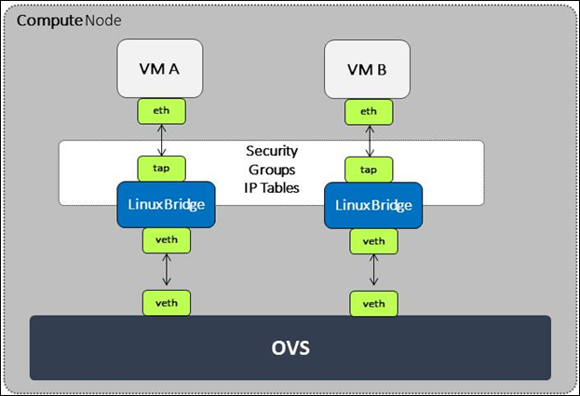
Security Groups in Neutron
Data plane performance
Additional Linux Bridge on the Path
Iptables
Control plane performance
Rules needs to be re-compiled on port changes
Many rules due to security group capabilities
Iptable commands issued by CLI process
RPC bulks
Notes:
<voice note: Here we'd explain the part about them being vendor specific makes that each Neutron vendor would have to make its own implementation of libnetwork or cni reinventing the wheel and without the ability to share the common parts./>

Slide 13
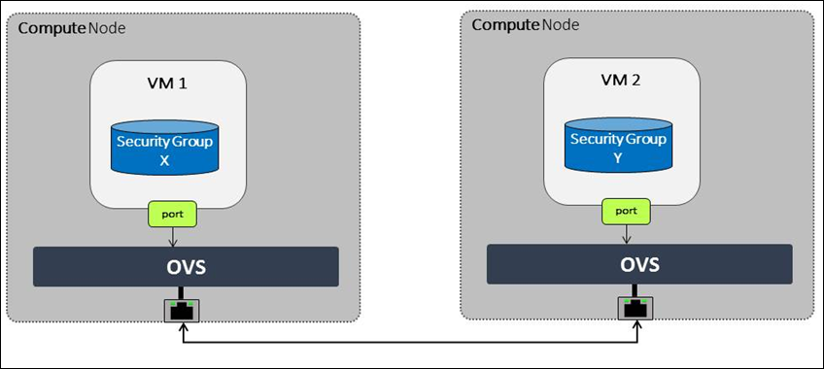
Security Groups in Dragonflow
Linux Bridge
Iptables
Openflow
Notes:
<voice note: Here we'd explain the part about them being vendor specific makes that each Neutron vendor would have to make its own implementation of libnetwork or cni reinventing the wheel and without the ability to share the common parts./>

Slide 14
Security Groups Translations
Direction:Egress
Type:IPv4, IP Protocol:TCP, Port Range:Any, Remote IP Prefix:0.0.0.0/0 match:ct_state=+new+trk,tcp,reg6=X actions=ct(commit,zone=network),resubmit(,<next_table>)
Direction:Ingress
Type:IPv4, IP Protocol:TCP, Port:22, Remote Security Group: Y
match:ct_state=+new+trk,tcp,reg6=X,reg7=Y, tp_dst=22
actions=ct(commit,zone=network),resubmit(,<next_table>)
Openvswitch:
CT（connection tracking）
Conjunction
Notes:
<voice note: Here we'd explain the part about them being vendor specific makes that each Neutron vendor would have to make its own implementation of libnetwork or cni reinventing the wheel and without the ability to share the common parts./>

Slide 15
Distributed Virtual Router

Slide 16
East to West
Neutron(DVR)
Dragonflow
Compute Node
Compute Node
Compute Node
Compute Node
VM
Router
Namespace
VM
VM
VM
Router
Namespace
OpenFlow
OpenFlow
OVS
OVS
OVS
OVS
namespace
openflow
Notes:
<voice note: Here we'd explain the part about them being vendor specific makes that each Neutron vendor would have to make its own implementation of libnetwork or cni reinventing the wheel and without the ability to share the common parts./>

Slide 17
Floating IP
Neutron(DVR)
Dragonflow
Public
network
Public
network
Compute Node
Compute Node
br-ex
br-ex
Fip
Namespace
VM
VM
Router
Namespace
br-int
br-int
namespace
openflow
Notes:
<voice note: Here we'd explain the part about them being vendor specific makes that each Neutron vendor would have to make its own implementation of libnetwork or cni reinventing the wheel and without the ability to share the common parts./>

Slide 18
Dragonflow Roadmap
Additional DBs Drivers…
Pluggable Pub/Sub Mechanism
DB Consistency
Multi-segments support
Distributed SNAT
Advanced services

Slide 19
Join the project Dragonflow
Documentation
https://wiki.openstack.org/wiki/Dragonflow
Bugs & blueprints
https://launchpad.net/dragonflow
DF IRC channel
#openstack-dragonflow
Weekly on Monday at 0900 UTC in #openstack-meeting-4 (IRC)

