Slide 2
Linux性能分析工具的现状和我们的优化
Barry Song & Bob Liu & Xining Xu

Slide 3
Runtime resources profiling
A variety of tools such as top, iotop, iostat, vmstat, sar oprofile, perf etc exist in Linux system; however, it is extremely difficult for people to address the problems from the raw data printed by these tools
LEP(Linux Easy Profiling) is a web-based open-source tool suite to make them be all-in-one and visualized, and its key developers, for this moment, include
Baohua Song
Bob Liu
Xining Xu
More developers are coming(eg, Ping Liu….)

Slide 4

Problems in existing tools
RAW data, it is difficult for non-experts to understand
e.g. load average…

Slide 5
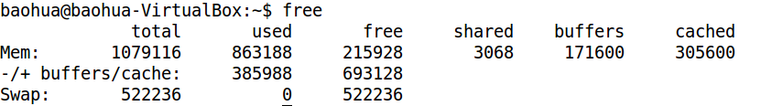
Problems in existing tools(cont.)
Not visualized
e.g. how many memory used in Linux?

Slide 6
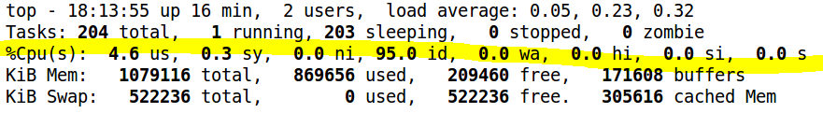
Problems in existing tools(cont.)
Lack of the description for changing…
e.g. how the cpu usage is changing during a period?

Slide 7
What we need?
CURVED LINE
PIE diagram
BIN diagram
COLORED

Slide 8








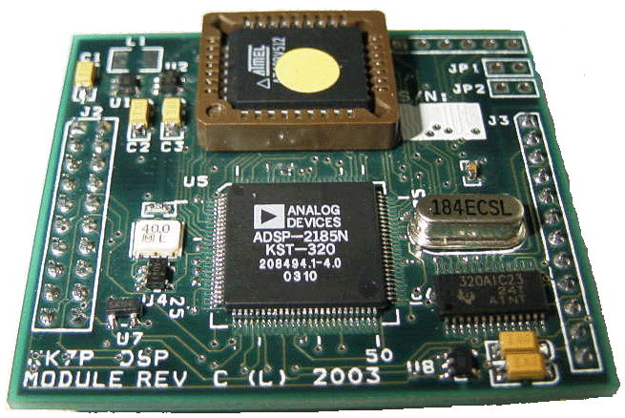


LEP architecture diagram
JSON-RPC
Restful API
LEPD
LEPD
LEPV
LEPD
LEPD

Slide 9
LEP Summary
C/S
PC / Embedded Board
JSONRPC
Web App
Restful API -> Extensibility

Slide 10
LEPD implementation
cJSON & jsonrpc-c
RPC provided
Read proc entries / Execute a command

Slide 11
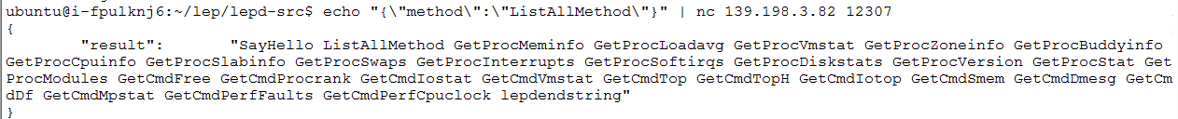
RPC - methods
Get lepd response by command lines

Slide 12
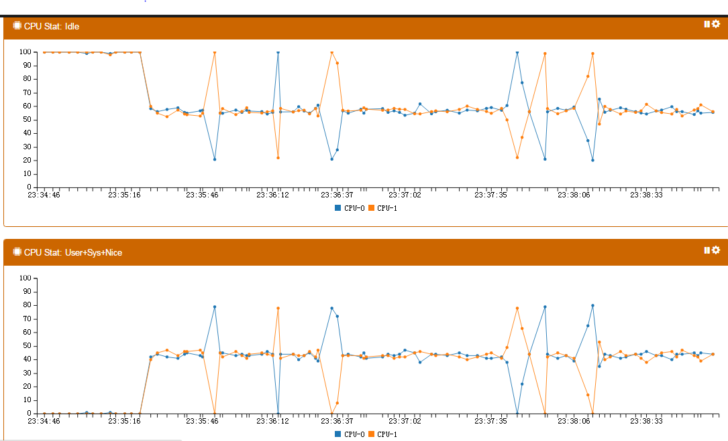
Load balance view

Slide 13
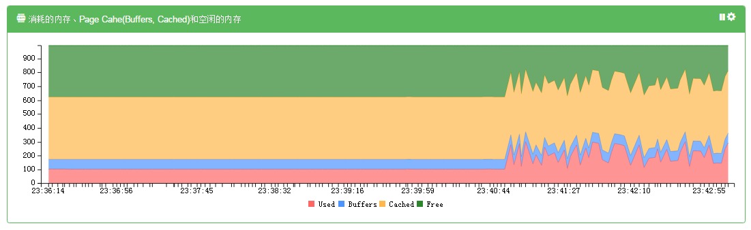
Memory consumption view

Slide 14
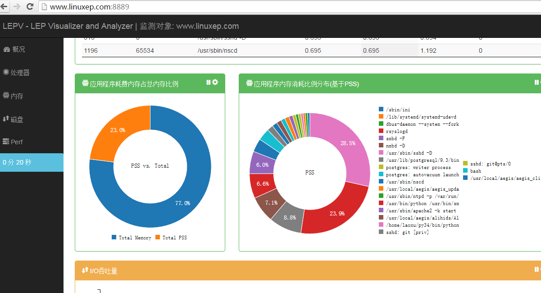
App memory usage view

Slide 15
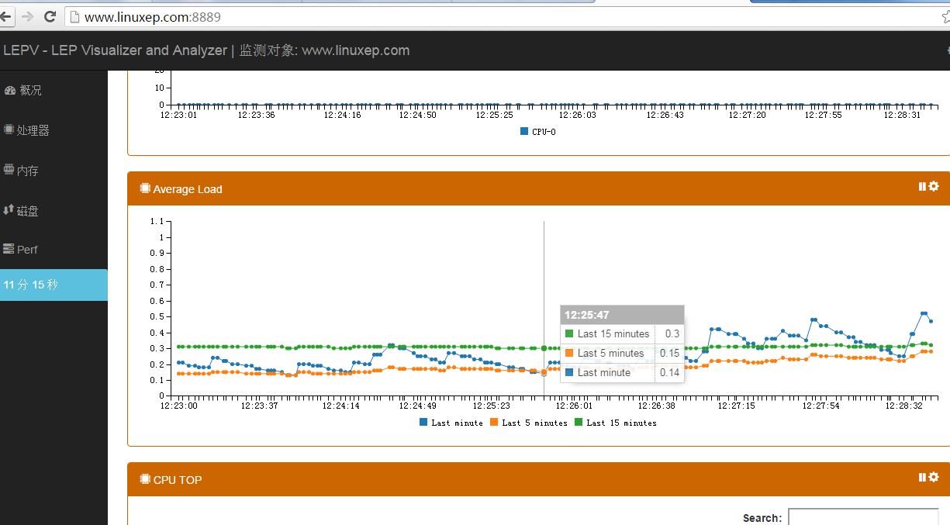
LEP: average load view

Slide 16
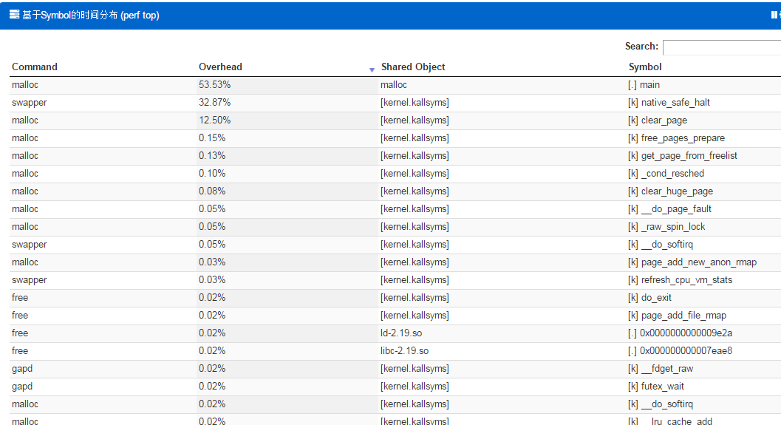
LEP: symbol level view

Slide 17
Next steps
More features in LEPD
More documentations
Push codes to github
Docker based LEPV

Slide 18
Coming more features in LEP
ARM support
Predict memory leak for an application and kernel
Analyze cache miss
Analyze time consumption for one native/Java processes
Benchmark integration
I/O queues
Kernel memory details such as buddy, slab, CMA etc.
Runtime scheduler(CPU/IO)
Boot procedure
….

Slide 19
Please join LEP
LEPD git:
LEPV git:
LEP documentations git:
Project website: www.linuxep.com/trac

Slide 20
Plans - LE series
Easy Build
Easy Test
Easy Profiling…
LEB
LET
LEP

