Slide 2
hand-on: Docker-image-based Java App CI
Tang feixiong <fxtang@qingyuanos.com>

Slide 3






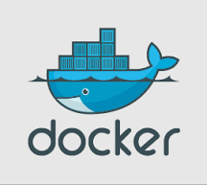
PaaS:
- Tenant
- CI/CD
- DevOps
- ...
Container Orchestration
Container Provisioning

Slide 4
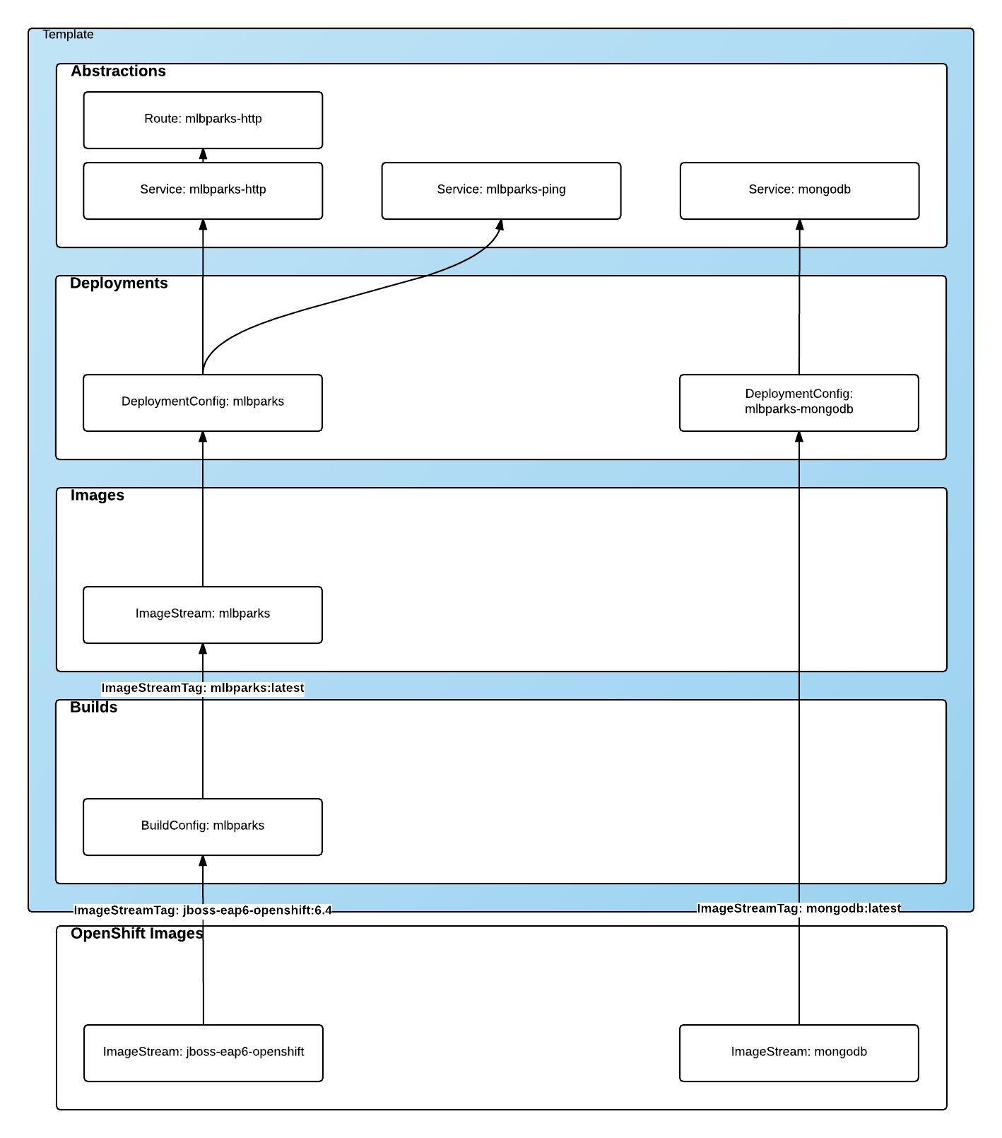
Openshift Application template:
Build:
- BuildConfig:
Source: git-hosted, local-workspace-archive
Docker-build-context: git-hosted, local-archive
Hook: git-hooked
Output: Docker image, CD-ready ImageStream
- Build:
Continuously
Deploy:
- DeploymentConfig
Kubernetes deployment
ImageStream trigger
- Deploy
Continuously
Staging/Production
- Service: Kuberentes service
- Router: Kubernetes ingress
https://blog.openshift.com/part-2-creating-a-template-a-technical-walkthrough/

Slide 5
Layer 1: Builds
{ "kind": "BuildConfig", "apiVersion": "v1", "metadata": { "name": "mlbparks", (1) "labels": { "application": "mlbparks" (2) } }, "spec": { "source": { (3) "type": "Git", (4) "git": { "uri": "https://github.com/jorgemoralespou/openshift3mlbparks.git", (5) "ref": "master" (6) }, "contextDir":"" (7) }, "strategy": { (8) "type": "Source", (9) "sourceStrategy": { "from": { (10) "kind": "ImageStreamTag", "namespace": "openshift", "name": "jboss-eap6-openshift:6.4" } } },
"output": { (11) "to": { "kind": "ImageStreamTag", "name": "mlbparks:latest" } }, "triggers": [ { "type": "GitHub", (12) "generic": { "secret": "secret" } }, { "type": "Generic", (13) "github": { "secret": "secret" } }, { "type": "ImageChange", (14) "imageChange": {} } ] } }

Slide 6
Layer 2: Images
Layer 3: Deployments
{ "kind": "ImageStream", "apiVersion": "v1", "metadata": { "name": "mlbparks", (1) "labels": { "application": "mlbparks" (2) } }, "spec": { (3) "dockerImageRepository": "", (4) "tags": [ (5) { "name": "latest" } ] } }
{ "kind": "DeploymentConfig", "apiVersion": "v1", "metadata": { "name": "mlbparks", (1) "labels": { (2) "deploymentConfig": "mlbparks", "application": "mlbparks" } }, "spec": { (3) "replicas": 1, (4) "selector": { "deploymentConfig": "mlbparks" (5) }, "strategy": { "type": "Recreate" (6) }, "template": { (7) "metadata": { "labels": { (8) "deploymentConfig": "mlbparks", "application": "mlbparks" }, "name": "mlbparks" (9) }, "spec": { (10) "containers": [ {

Slide 7
Layer 3: Deployments - 1
"name": "mlbparks", (11) "image": "mlbparks", (12) "imagePullPolicy": "Always", (13) "env": [ (14) { "name": "OPENSHIFT_DNS_PING_SERVICE_NAME", "value": "mlbparks-ping" }, { "name": "OPENSHIFT_DNS_PING_SERVICE_PORT", "value": "8888" }, { "name": "MONGODB_USER", "value": "user" }, { "name": "MONGODB_PASSWORD", "value": "password" }, { "name": "MONGODB_DATABASE", "value": "database" } ], "ports": [ (15) { "name": "mlbparks-http", "containerPort": 8080, "protocol": "TCP"
}, { "name": "mlbparks-ping", "containerPort": 8888, "protocol": "TCP" } ], "readinessProbe": { (16) "exec": { "command": [ "/bin/bash", "-c", "/opt/eap/bin/readinessProbe.sh" ] } }, "resources": {}, "terminationMessagePath": "/dev/termination-log", "securityContext": { (17) "capabilities": {}, "privileged": false } } ], "restartPolicy": "Always", "dnsPolicy": "ClusterFirst" } }, "triggers": [ (18) {

Slide 8
Layer 3: Deployments - 2
Layer 4: Abstractions - Service
"type": "ImageChange", (19) "imageChangeParams": { "automatic": true, "containerNames": [ "mlbparks" ], "from": { "kind": "ImageStreamTag", "name": "mlbparks:latest" } } }, { (20) "type": "ConfigChange" } ] } }
{ "kind": "Service", "apiVersion": "v1", "metadata": { "name": "mlbparks-ping", (1) "labels": { "application": "mlbparks" (2) }, "annotations": { "description": "Ping service for clustered applications" } }, "spec": { "ports": [ { "port": 8888, (3) "targetPort": 8888 (4) } ], "selector": { "deploymentConfig": "mlbparks" (5) } } }

Slide 9
Layer 4: Abstractions - Route
Kubernetes Ingress
{ "kind": "Route", "apiVersion": "v1", "metadata": { "name": "mlbparks-http-route", (1) "labels": { "application": "mlbparks" (2) }, "annotations": { "description": "Route for application's http service" } }, "spec": { "host": "mlbparks.cloudapps.example.com", (3) "to": { (4) "kind": "Service", "name": "mlbparks-http" } } }
apiVersion: extensions/v1beta1 kind: Ingress metadata: name: test spec: rules: - host: foo.bar.com http: paths: - path: /foo backend: serviceName: fooSvc servicePort: 80 - host: bar.baz.com http: paths: - path: /bar backend: serviceName: barSvc servicePort: 80

Slide 10
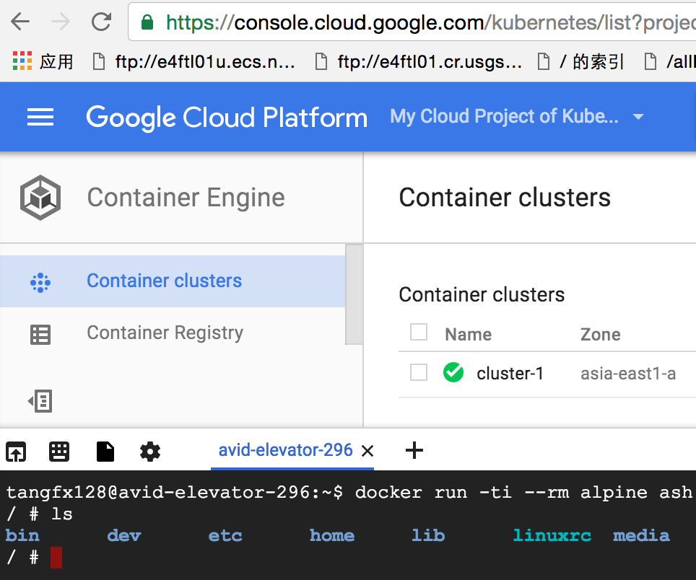
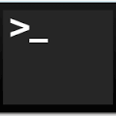




Slide 11

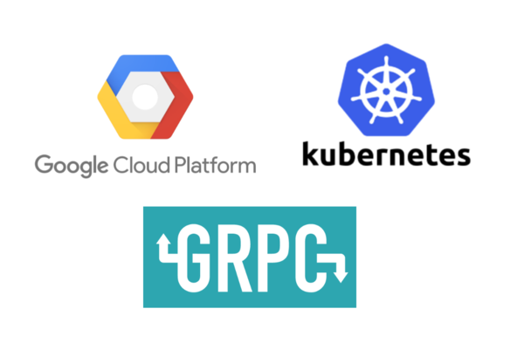

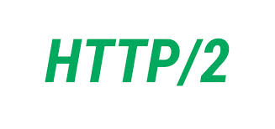
Kubernetes/Openshift orchestration
gRPC: https://github.com/grpc/grpc-go
protobuf: https://github.com/golang/protobuf
gRPC for Golang: https://github.com/grpc/grpc-go
Protobuf for Golang: https://github.com/golang/protobuf
protobuf
except kube-APIServer
JSON Gateway

Slide 12
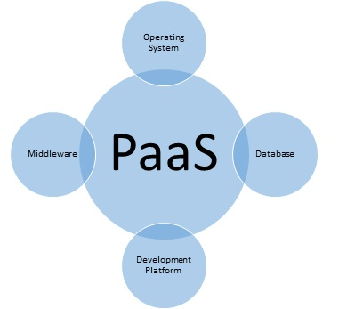

Using Kubernetes Charts to catalog application CI/CD template
Templated Micro-service Store
Continuous Integration/Distribution
charts:
- spec: https://github.com/kubernetes/helm/blob/master/docs/charts.md
- architect: > https://github.com/kubernetes/helm/blob/master/docs/architecture.md#components

Slide 13


This demonstration
Container Orchestration
Container Provisioning

Slide 14

fxtang@qingyuanos.com
https://github.com/tangfeixiong/go-to-cloud-1
Content:
- spring-boot app CI template
- gPRC charts template server
- build and ship
Feature:
- Golang 1.6
- based on more Kubernetes/Openshift community source code
- import “k8s.io/kubernetes/pkg/api”
- import “k8s.io/kubernetes/pkg/client/unversioned”
- import “k8s.io/kubernetes/pkg/runtime”
- import “github.com/openshift/origin/pkg/build/api”
- import “github.com/openshift/origin/pkg/cmd/cli/cmd”
- github project
- API/gRPC protobuf
- Golang gRPC server stub
- Java gRPC client stub
Follow up in future:
- complete CI/CD
- canary distribution
- co-op with Openshift template
- rolling update
- blue-green deployment

