Slide 1
An introduction of SLED11-SP2
David Liang
dliang@suse.com

Slide 2
SLED overview
SUSE Linux Enterprise Desktop is an enterprise-quality Linux desktop ready for routine business use.
－ interoperability with existing IT systems
－ dozens of essential applications
－ depoly on wide range devices

Slide 3
Base enviornment
GNOME 2.28 (gtk2-2.18)
GNOME was updated to version 2.28 with SP1, only selected packages got an update for SP2.
KDE 4.3
X.org 7.4

Slide 4
Linux kernel 3.0.10
Direct successor of the Linux kernel 2.6 series, all applications run without change.
Potential issue.
some broken applications or installation programs may check for "2.6" literally.

Slide 5
New features

Slide 6
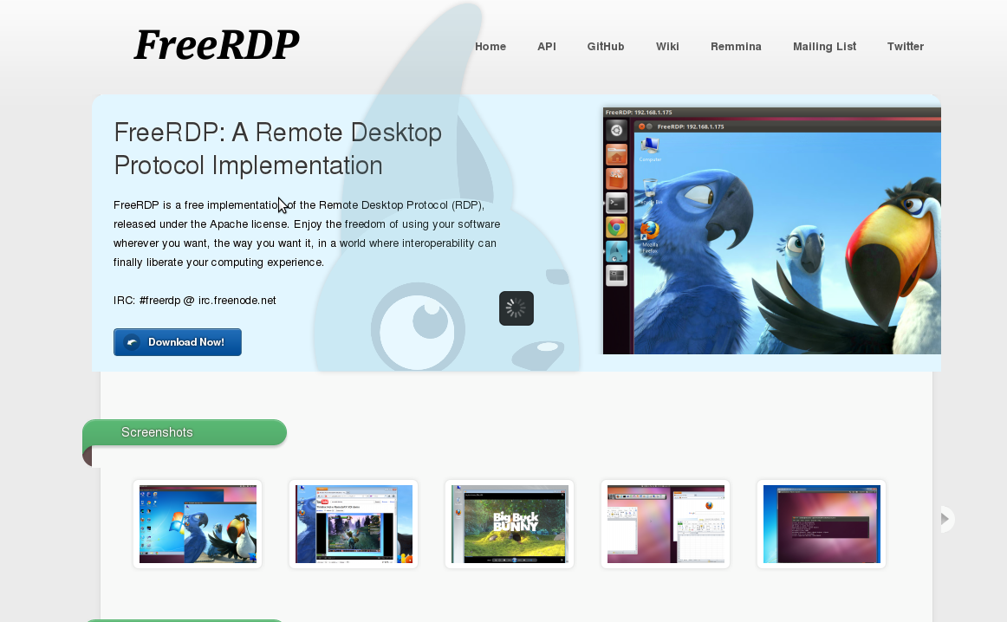

Slide 7
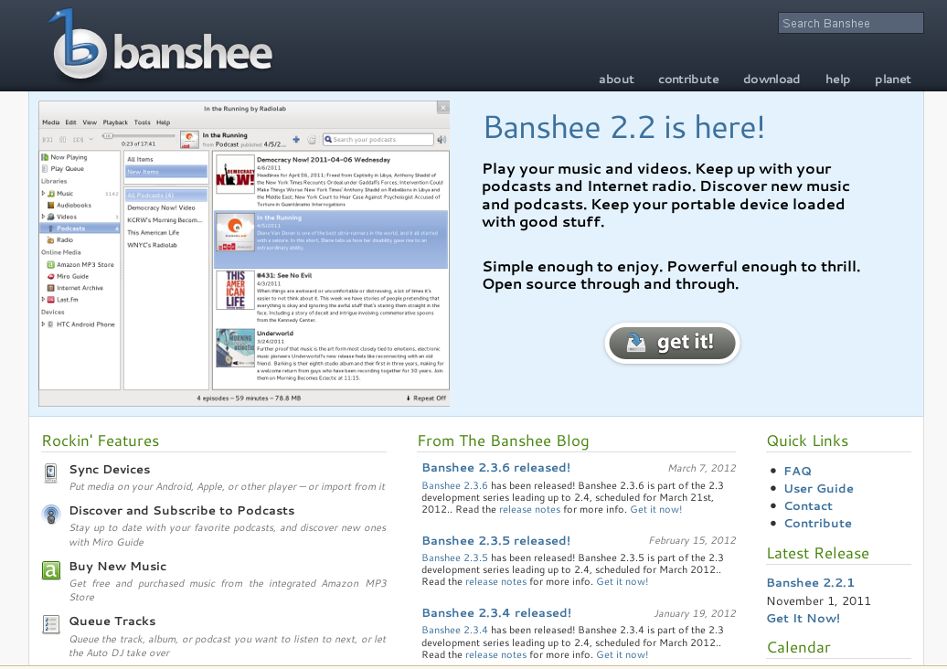

Slide 8
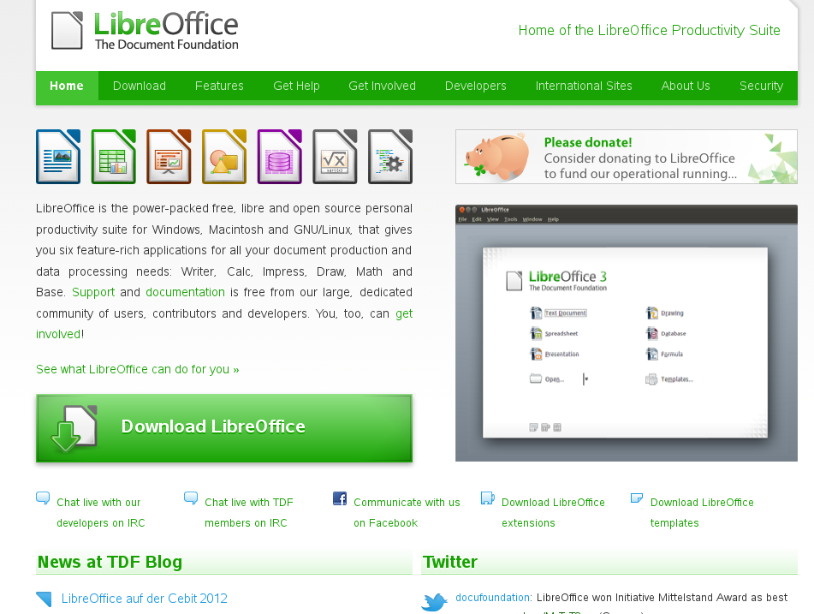

Slide 9
Security
System Security Services Daemon
openSSH with Cryptographic Hardware Acceleration
PAM Configuration

Slide 10
Maintain update
Bugs fix. Most fixes in sp1 and some L3 fixes added to sp2.
https://build.suse.de/project/show?project=SUSE:SLE-11-SP2:Update:Test
Networkmanager, zypper, xorg, xrdp, gdm and the etc....

Slide 11
Some version updates
Default Filesystem (ReiserFS to ext3) – since sle11
Samba 3.4.3
Python 2.6.0
Perl 5.10
Ruby 1.87

Slide 12
Answer

