Slide 1
Linux Desktop Overview
David Liang <dliang@suse.com>

Slide 2
Since init 5
/etc/init.d/rc5.d S50xdm/K50xdm
– xdm
- /etc/sysconfig/displaymanager
  - /etc/sysconfig/windowmanager – no use
Systemd
another story

Slide 3
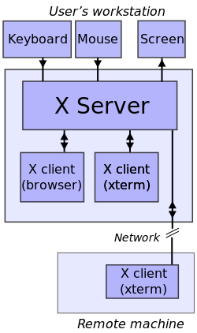
X client Server
export ip:display
xhost +
ssh -X

Slide 4
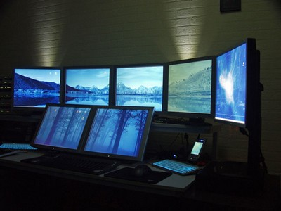
One Xserver, multiply screens
Projector
Fake screen
rdp

Slide 5
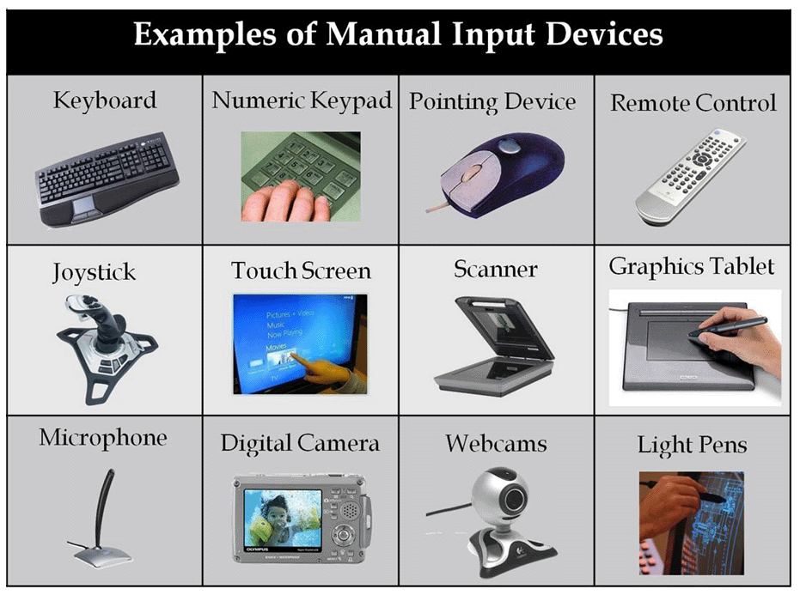

Slide 6
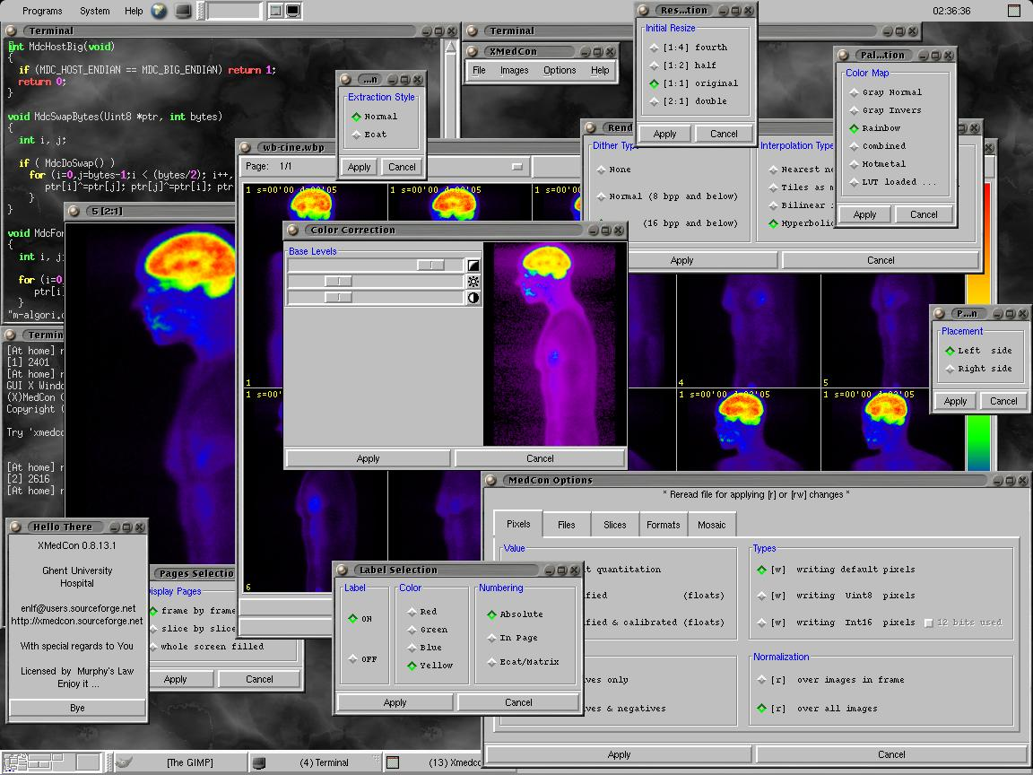
Lots of running apps?
Window manager
Alt-tab
Workspace
Panel
Applet/extensions
Notify/data..
Menu
App list

Slide 7
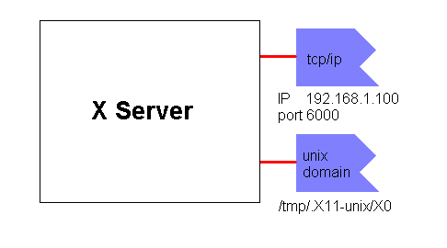
Multiply X servers
How to start a new X
Xorg :1
Display = Port - 6000

Slide 8
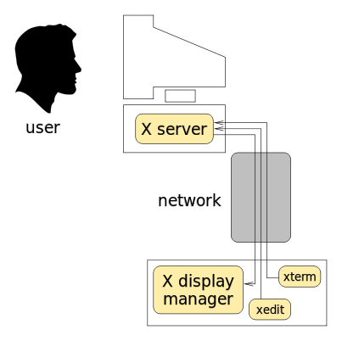
display manager
b

Slide 9
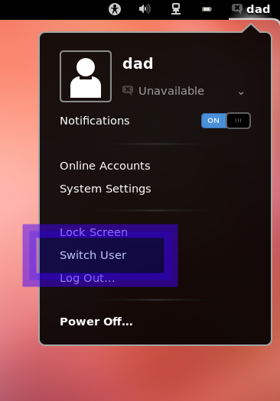
Main functions of display manager
start a new display
close an old display
find the exist display

Slide 10
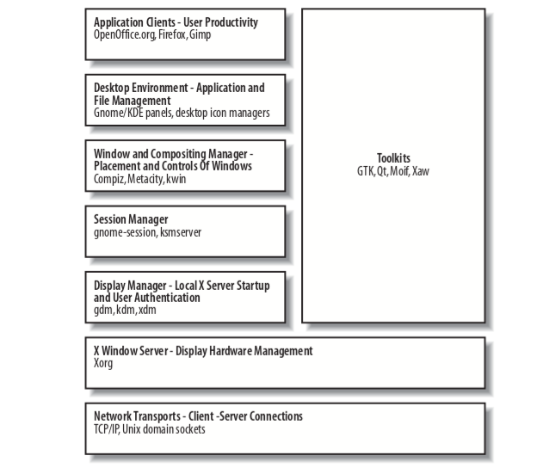
http://www.freedesktop.org/wiki/Software/systemd/logind/

