Slide 1
Biostatistics Example Figures
University of Dallas
Inimary Toby, PhD

Slide 2
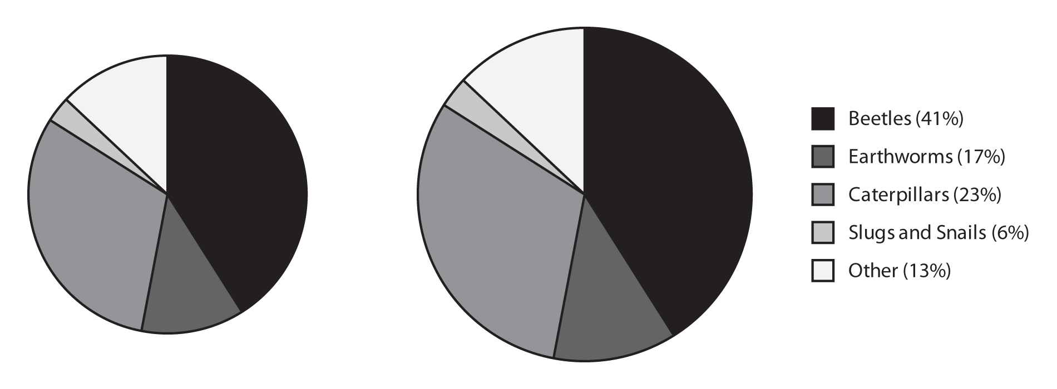
Figure 1
Percentage of each food type in the diet of two hedgehogs. The size of the circle indicates the total amount of food in the stomach.

Slide 3
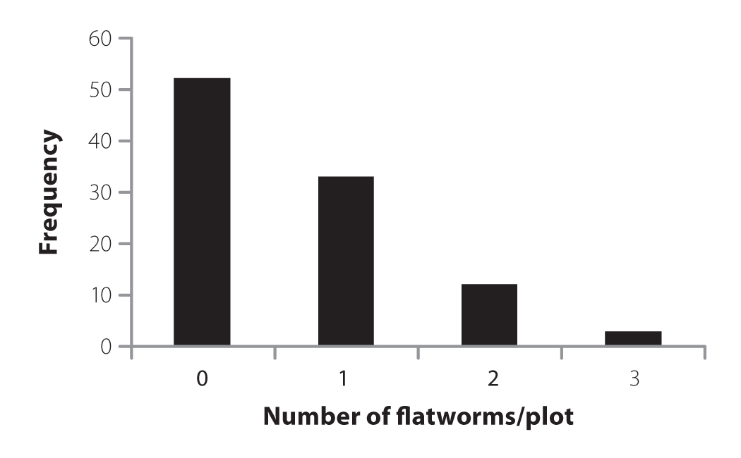
Figure 2
The abundance of terrestrial flatworms in 100 surveyed plots.

Slide 4
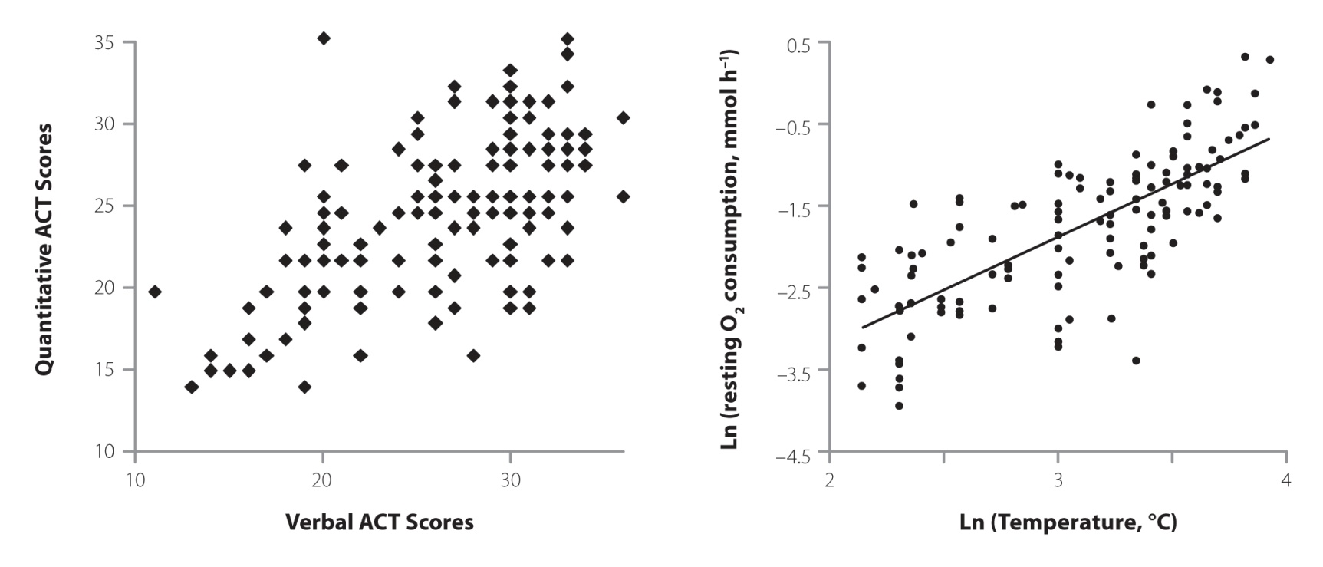
Figure 3
(A) The relationship between verbal ACT scores and quantitative ACT scores (imaginary data).
(B) Log/log plot with fitted least squared regression line demonstrating the relationship between resting metabolic rate and temperature in teleost fish.
Data from Clarke and Johnston, 1999. Journal of Animal Ecology 68:897.

Slide 5
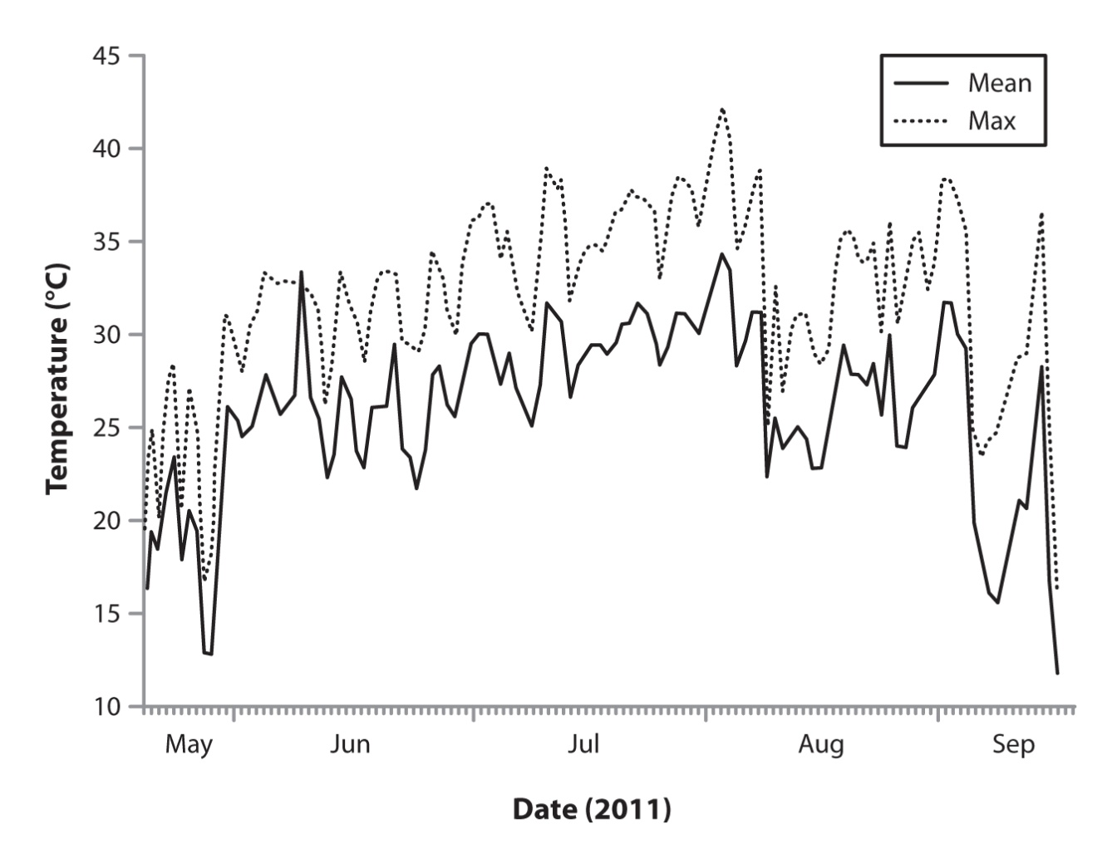
Figure 4
Example of a time-series graph. Air temperatures from 2011 from Springfield, Missouri (daily average and daily maximum). Data from the National Weather Service, graph prepared by K. Reynolds.

