Slide 1

NovaMed Solutions: Sales Performance Analysis and Reporting
Ini Tom
POD LUNA

Slide 2

BUSINESS PROBLEMS
Develop Overall Sales Metrics – Calculate key sales indicators such as quantity sold, cost of goods sold (COGS), revenue, profit, and profit margin.
Compare Monthly Performance – Implement a Profit month-over-month comparison for revenue and Profit
Identify Top 5 & Bottom 5 Drugs –Rank drugs dynamically based on revenue, profit, and sales volume, with percentage contributions.
Analyze Customer Performance – Identify top and underperforming customers based on sales metrics and contributions.
Create Interactive Visualizations – Develop dynamic charts and slicers to allow users to explore sales performance by different dimensions.
Sales Analysis

Slide 3
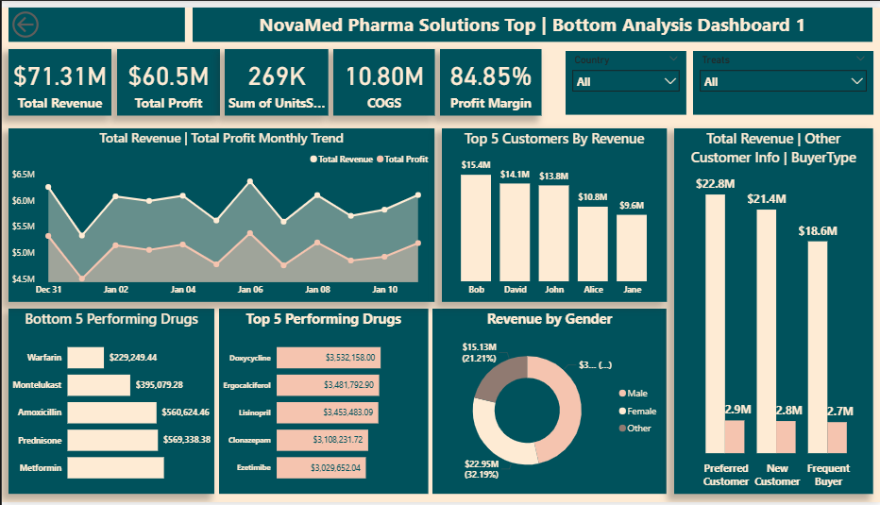
Dashboard 1

Slide 4
Dashboard 2
Analyze Customer Demographics – Generate insights into customer distribution based on age, gender, and buyer type.
Calculate Average Revenue per Customer – Determine the average revenue generated per customer segment.
Visualize Revenue Distribution – Display revenue breakdown by country and customer type.
Revenue by Gender & Age – Provide insights into purchasing trends based on demographic segments.
Geographical Insights – Highlight revenue share from the top two countries using maps or heatmaps.
Customer Analysis

Slide 5
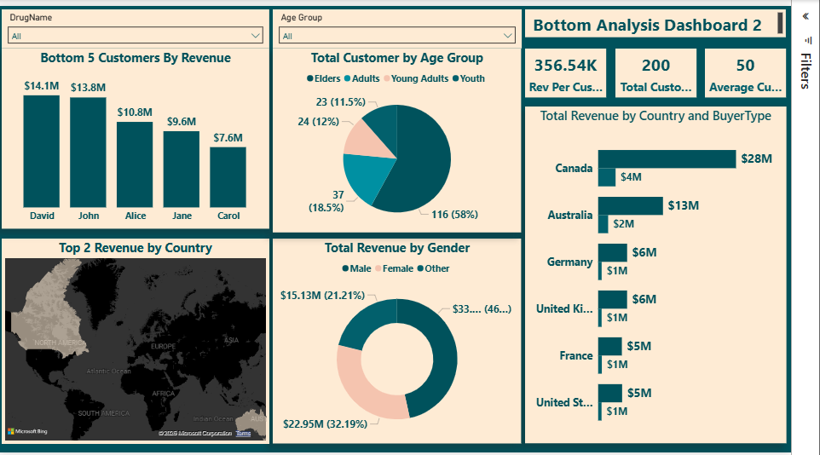
Dashboard 2

Slide 6

Revenue and profit move together consistently showing costs are stable and predictable
Revenue is high in January then drops bi-monthly until July
July and September sales peak and remain stable toward end of the year
Suggestions:
Investigate the reason for the bi-monthly peaks and dips –potential seasonality
Focus on drugs that bring in the most revenue during peak seasons to ensure adequate supply
Monthly Trends

Slide 7
Product Performance
Top Performing Drugs:
Doxycycline, Ergocalciferol, Lisinopril (~$3.5M each)
Clonazepam ($3.1M)
Ezetimibe ($3.0M)
Balanced revenue across top products.
Underperforming Drugs:
Warfarin ($229K)
Montelukast ($395K)
Amoxicillin, Prednisone, Metformin (~$560K–600K)
Suggestions:
Investigate potential pricing or demand issues for underperforming drugs
Consider revamping marketing strategies for underperforming drugs

Slide 8

Customer Performance
Over 80% of buyers are Sellers with less than 15% are Users
Revenue is evenly distributed across various Buyer Types:
Preferred Customers: $23M
New Customers: $21M
Frequent Buyers: $19M
Suggestions:
Preferred customers bring in the most revenue, so implement a plan that focuses on converting customers New Customers and Frequent Buyers to Preferred Customers.
Implement discounts or incentives for larger customers and optimized pricing for Preferred Customers

Slide 9
Geographical Performance
Country Revenue:
Canada: $32M (revenue more than doubles other countries)
Australia: $15M
Germany / UK: ~$7M each
France / USA: ~$6M each
Suggestions:
Determine if other markets are emerging or underperforming.
Investigate Canada and Australia’s marketing strategies to implement into other regions.
Other regions could focus on obtaining more Sellers to increase revenue.
All regions should develop a plan to increase the number of Buyer users.

Slide 10

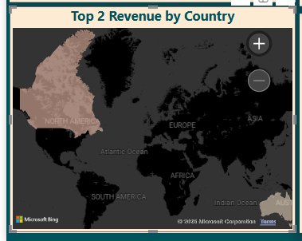
Top two contributing countries
Canada and Australia bring in the most revenue
Suggestions:
It is risky to depend on two regions to bring in the majority of revenue
Expand business in Europe and US to diversify revenue

Slide 11
Customer Demographics
Gender Distribution
Male: 47%
Female: 32.5%
Other: 20.5%
Suggestions:
Segment marketing campaigns by gender preferences
Determine if “Other” category is intentional or due to inconclusive reporting or categorization issues

Slide 12
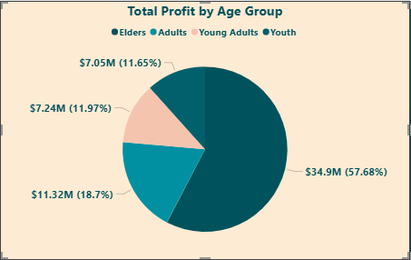
Customer Spending Behavior
Average customer age is 50 however,
Highest spending group are 18–24-year-olds from the UK & Germany
Highest spending group in Australia are 25–34-year-olds
50 plus group dominate other countries.
Suggestions:
Look into why the 35-44 age group in the US does not bring in any revenue
Investigate which medications are most popular and when customers purchase them to ensure they are in stock and potentially decrease bi-monthly dips

Slide 13
Key Suggestions
Expand top 3 drugs and focus on increasing revenue for other top performing drugs
Improve or phase out bottom performers
Implement targeting marketing to increase buyer volume for Users
Focus on transitioning New Customers and Frequent Buyers to Preferred Customers
Smooth bi-monthly dips with promotions or supply planning
Grow US, France & UK regions to reduce dependency on Canada
Target specific spending groups that bring in the most revenue for each country
It is important to focus on implanting a new customer growth strategy

Slide 14
Key Points
Strengths
Exceptionally high profit margin
Diversified top-performing products
Stable cost structure
NovaMed Solutions has a loyal customer base with 100% return rate
High Revenue per customer (356.55K)
Diverse age-base spending patterns in various regions
Risks
Possible over-reliance on seasonal peaks
Huge difference between User and Seller groups
Only two countries bring in the majority of revenue
100% repeat rate could mean lack of focus on new customer acquisition
Potential underperformance in US & France

Slide 15

Thank you

