Slide 1
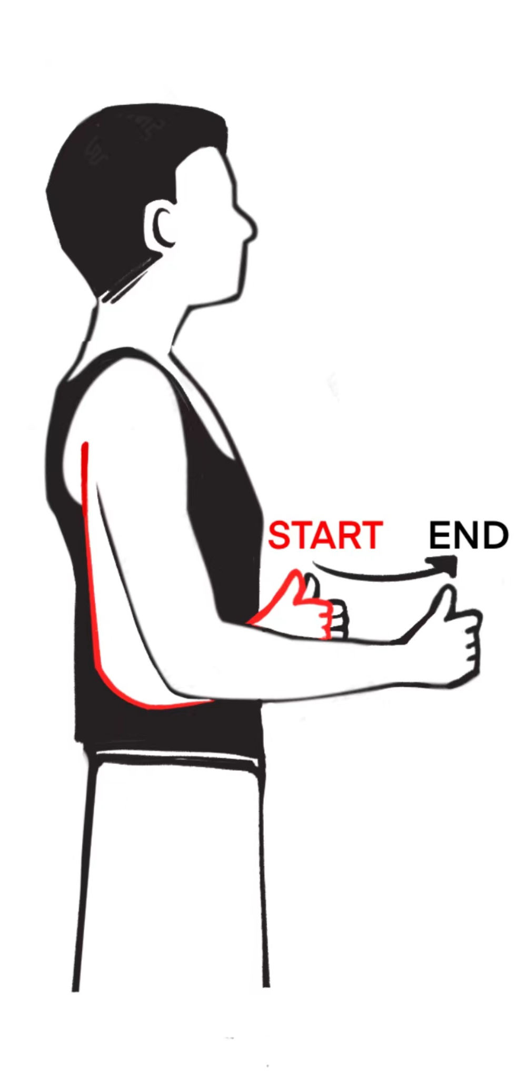




Gesture Recognition
Gesture Segmentation
Point Clouds
Capture
t
Noise
Canceling
GesIDNet
Gesture
. . .
User
Identification
mmWave
Radar
t+s
Data Augmentation
Inference Stage
Training Stage
GesIDNet
User

Slide 2












$$x_{p}$$
$$x_{0}$$
Predictor
Tier classifications probability & relative scores
Architectures
Attributes
(for each architecture)
Linear projection
1
$$x_{α}$$
Matrix N
Flops
Matrix n-1
2
Transform
Flatten
MSA
FFN
…
Params
Matrix 3
. . .
Matrix 2
. . .
. . .
Encoder
. . .
Matrix1
Node
Operations
Matrix 1
N
…
$$L_{1}$$
one batch of sampled networks
Update Tier Embedding
Bucket 1
2
1
4
3
5
K
V
MSA
Linear
Softmax
Labels
2
$$P_{1}$$
0
Flops
FFN
$$P_{2}$$
0
Flops
MSA
Q
3
$$P_{3}$$
Distributions
. . .
1
Params
Params
$$P_{4}$$
0
Node operations
Decoder
4
$$P_{5}$$
0
Node operations
Embedding 1
Distribution 1
z
Tier 1-5
5
$$L_{2}$$
$z_{1}$- $z_{5}$
Update Distributions

