Slide 1





IMAGE CLASSIFICATION
Eye Disease Classification
https://github.com/hardiantots/EyeDiseaseClassification
Hardianto Tandi Seno
Future ML Engineer

Slide 2
CONTENT
1
About Image Classification
2
Workflow In Pytorch
3
Deploying in Streamlit
4
Challenge & Conclusion
Hardianto Tandi Seno
Future ML Engineer

Slide 3

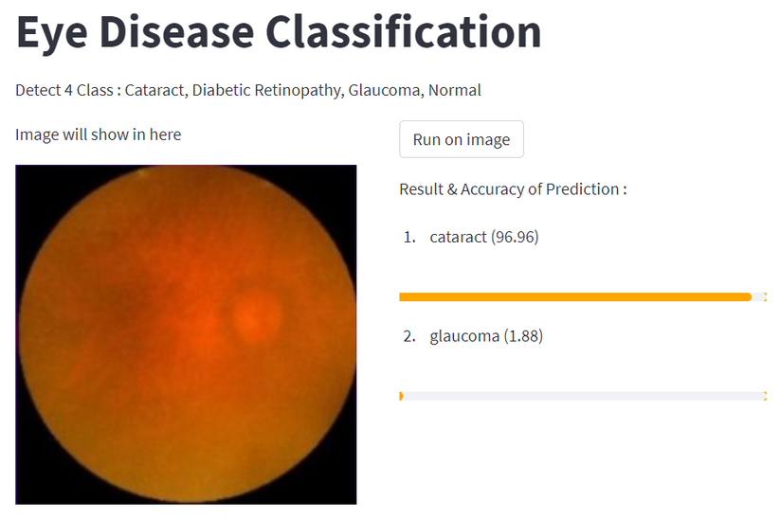

ABOUT IMAGE CLASSIFICATION
Image classification is a supervised learning problem, in which define a set of target classes (objects to identify in an image), and train a model to recognize them using labeled sample photos.

Slide 4
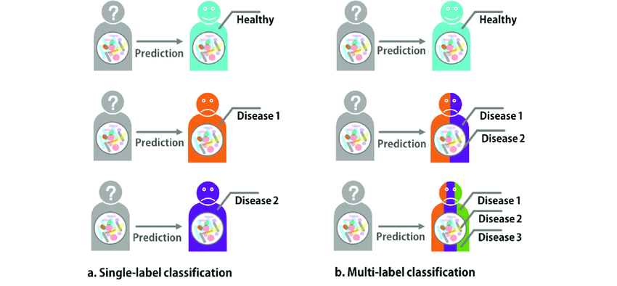
ABOUT IMAGE CLASSIFICATION
Image classification is divided into two types, namely Single-label Classification (only detects one object in the image, that using in this project) & Multi-label Classification (can detect more than one object in the image)

Slide 5
Prepare the Datasets
Prepare model to be used
Train & Evaluation model
Plot the Accuracy, Train & Validation Loss
Test result of training model
Save the model
WORKFLOW
IN PYTORCH
For Complete Process :
https://github.com/hardiantots/EyeDiseaseClassification/blob/main/ClassificationEyeDisease.ipynb

Slide 6


Prepare the datasets
Fetch dataset from kaggle
https://www.kaggle.com/datasets/gunavenkatdoddi/eye-diseases-classification
Labelling, processing, divide the Image Dataset into train, val, & loss in Roboflow
https://universe.roboflow.com/eye-disease/eyedisease-1/model/1

Slide 7
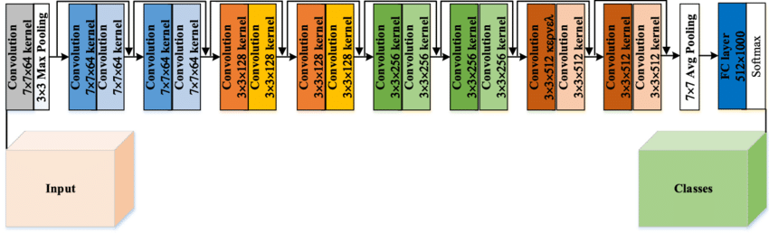
Prepare model to be used
ResNet-18
ResNet-18 is a Convolutional Neural Network that is trained on more than a million images from the ImageNet database. There are 18 layers present in its architecture. It is very useful and efficient in image classification. Modifications were made to the output layer which was changed to 4 because there were only 4 classes in the dataset

Slide 8
Train & Evaluation Model
In the process of train & evaluation model, there are several important things that need to be known :
Loss Function : Cross Entropy Loss
Optimizer : SGD (Stochastic Gradient Descent)
Epoch (Iteration) : 60
Learning Rate : 0.0004

Slide 9

Plot the Accuracy, Train & Validation Loss
Final result from training the model :
Train Loss = 0.064
Train Accuracy = 98.562%
Validation Loss = 0.217
Validation Accuracy = 92.326%

Slide 10
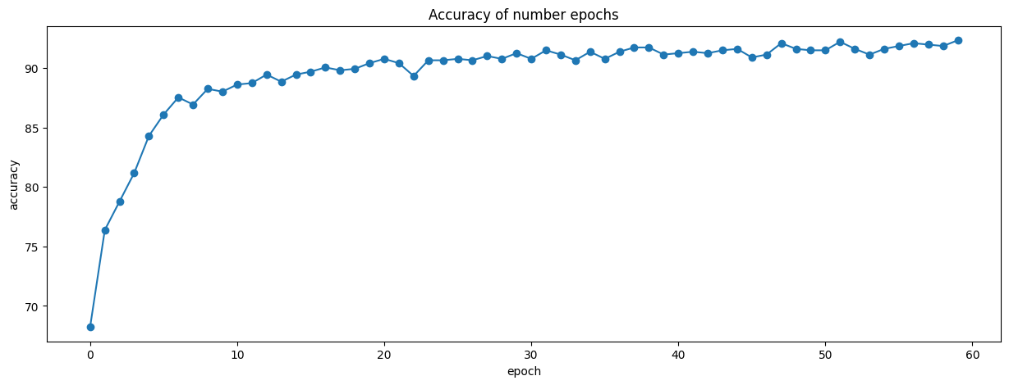
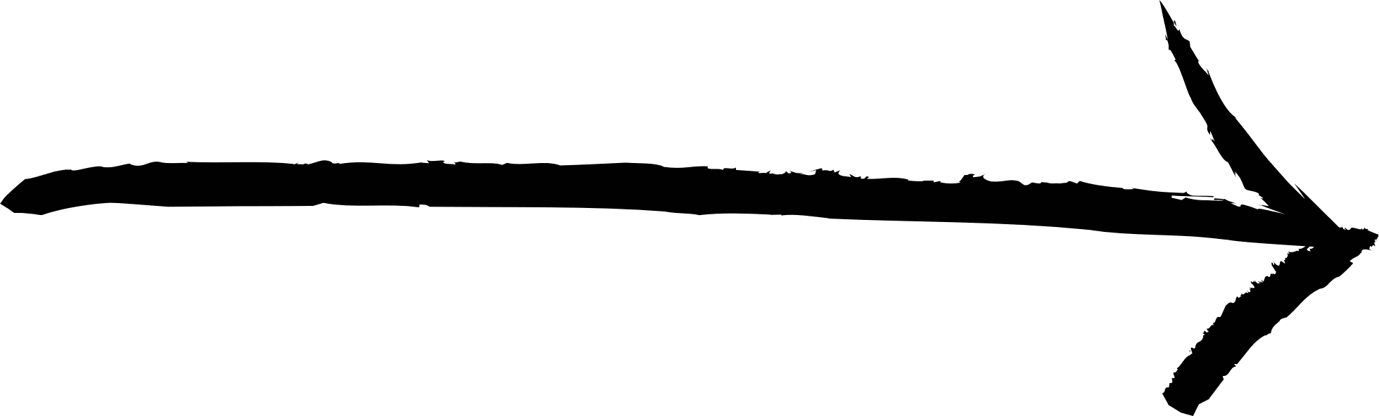
Reach about 92%
Graph of Accuracy from training model
(Using Validation Accuracy value for Accuracy Model)

Slide 11
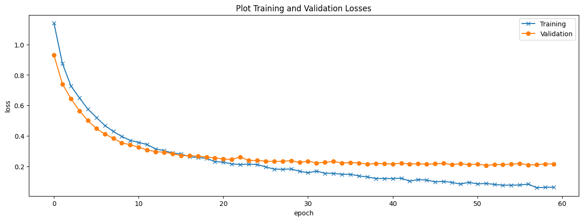
Graph of Training & Validation Loss from training model
(From epoch 20, validation loss did not experience a significant decrease, even tended to stabilize around 0.2)

Slide 12
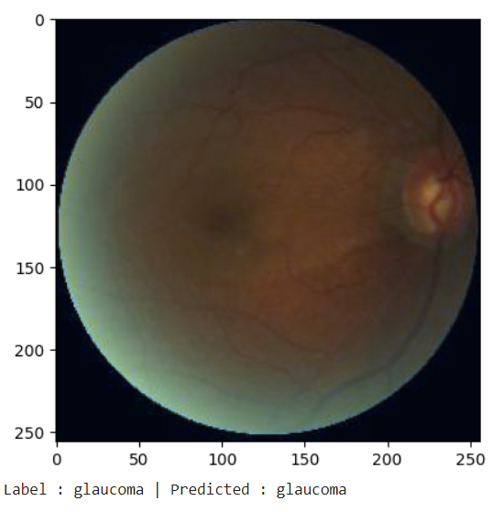
Test result of training model
The model has been able to predict the object in the image correctly
*although the accuracy is already high, it does not rule out the possibility of errors in the classification

Slide 13
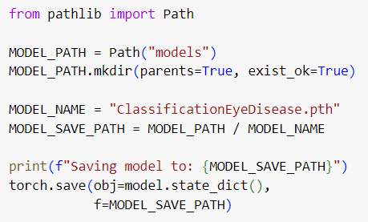
Save the model
The model parameters that have been trained, which include learnable weights and biases, are saved to be loaded when entering the deploy process with streamlit

Slide 14
DEPLOYING IN STREAMLIT

Slide 15
Load the model parameter for make sure that trained model is used to classify Eye Disease on Streamlit
LOAD MODEL
After load the model, we can code for make classification app via streamlit and then deploy it to streamlit cloud
DEPLOY ON STREAMLIT

Slide 16
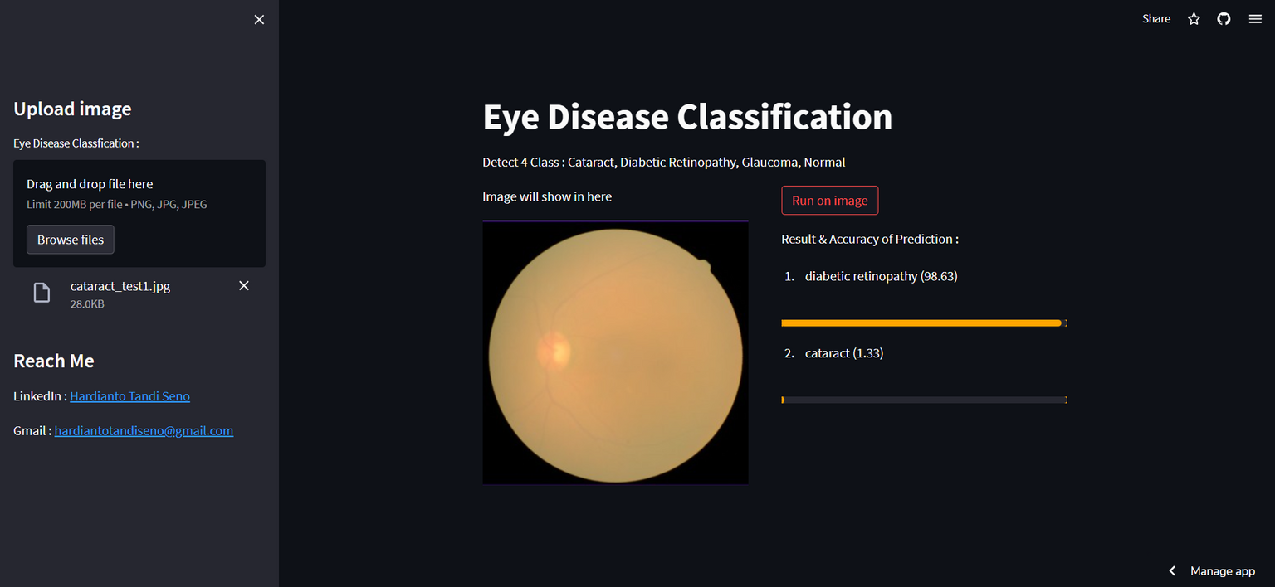
DEPLOYMENT RESULT ON STREAMLIT
Link Deployment : https://eyediseaseclassificationhts.streamlit.app
When testing the model on Streamlit, it turns out that 1 of the 6 images in the testimg folder is misclassified. This can happen maybe because the image can be seen as a model that is more similar to another class than the original class

Slide 17
CHALLENGES
CONCLUSION

Slide 18
CHALLENGES
Looking for the right dataset for the project :
Dataset is crucial for the Image Classification process. This is because the diversity of the dataset obtained will affect the accuracy of the model itself and the ability to classify images outside of the dataset provided
Choosing an inaccurate dataset from existing sources (e.g. roboflow) will in fact affect the model training process. I'm having a validation loss case that doesn't go down. I've been trying to tweak the model structure that I designed myself, up to replacing the model with ResNet-18. Besides that, I tried to find a good optimizer, epoch and learning rate for the modeling process, but the accuracy obtained was difficult to reach 80% and the validation loss did not decrease either.
Finally, after searching the dataset on kaggle and processing the dataset on roboflow, my problem was solved.

Slide 19
CHALLENGES
Deployment Process on Streamlit :
When the modeling problem has been completed, another problem arises, namely an error that occurs when deploying the project to streamlit cloud.
The problem that arises is that there are several modules that are not available in Streamlit, so I have to find a way to be able to provide these modules to the Streamlit cloud.
Also, there are some things that are different when we run streamlit on local device and run streamlit on the cloud provided, so we need to adjust our existing code according to where streamlit is run.

Slide 20
CONCLUSION
From the various stages that I have done, there are several conclusions that I can get :
Image classification is very dependent on the diversity and amount in the image dataset, the less diversity & number of datasets, it will be difficult to provide accurate classification predictions if images are used outside of the dataset provided.
The model used will also affect the accuracy and loss results.
Even though the accuracy during the model training process is high, it is not certain that it can classify all the images given correctly even though the chance of error is also small.

Slide 21


THANK YOU
Hardianto Tandi Seno
hardiantotandiseno@gmail.com
Hardianto Tandi Seno
Future ML Engineer

