Slide 1
TNSDC-Generative AI
Heart Disease Prediction
Presented by : Iniyan.M,
au2115211040854,
Pre-Final Year Student,
Computer Science and Engineering,
Panimalar Institute of Technology.

Slide 2

OUTLINE
Problem Statement
Proposed Solution
System Approach
Algorithm
Result
Conclusion
References

Slide 3
PROBLEM STATEMENT
Develop a Heart Disease Prediction system using machine learning techniques implemented in Python and deployed using Flask framework. The goal is to create a predictive model capable of accurately diagnosing the presence of heart disease based on various clinical parameters. The system should take inputs such as age, sex, chest pain type, resting blood pressure, cholesterol levels, fasting blood sugar, resting electrocardiographic results, maximum heart rate achieved, exercise induced angina, ST depression induced by exercise relative to rest, slope of the peak exercise ST segment, number of major vessels colored by fluoroscopy, and thallium stress test result. The model should then classify the likelihood of heart disease presence. The deployed web application should provide a user-friendly interface where users can input their data and receive an immediate prediction regarding their heart disease status. The system should aim for high accuracy, sensitivity, and specificity to ensure reliable predictions and assist healthcare professionals in early diagnosis and treatment of heart disease.

Slide 4
PROPOSED SOLUTION
The proposed solution involves building a Heart Disease Prediction system using machine learning algorithms in Python, leveraging libraries such as Scikit-learn, Pandas, and NumPy for data preprocessing, model training, and evaluation. The dataset, containing clinical parameters of individuals, will be utilized to train various classification algorithms like logistic regression, decision trees, random forests, and support vector machines to identify patterns indicative of heart disease presence. Hyperparameter tuning and cross-validation techniques will be employed to optimize model performance and prevent overfitting. Once the best-performing model is selected, a Flask web application will be developed to deploy the model. The application will provide a user-friendly interface where users can input their data, which will then be processed by the deployed model to predict the likelihood of heart disease presence. The system will prioritize accuracy, sensitivity, and specificity to ensure reliable predictions and assist healthcare professionals in timely diagnosis and intervention for individuals at risk of heart disease. Additionally, the system will be designed for scalability and maintainability to accommodate future updates and enhancements.

Slide 5
SYSTEM APPROACH
Hardware:
CPU: The system requires a CPU with sufficient processing power to handle the computational demands of training and inference. A multi-core processor, preferably with a clock speed of at least 2 GHz or higher, is recommended.
Memory: A minimum of 8 GB RAM is recommended for smooth operation, especially during model training, where large datasets are processed. More RAM may be required for handling larger datasets or concurrent user requests.

Slide 6
SYSTEM APPROACH – CONT.
Software:
Python: The system is built using Python programming language
PyTorch: PyTorch, a machine learning library, is utilized for implementing the Convolutional Neural Network (GAN) architecture. PyTorch provides efficient tensor computation with GPU acceleration, facilitating faster model training and inference.
NumPy: NumPy is a fundamental package for scientific computing in Python, essential for handling multidimensional arrays and mathematical operations. It is used extensively for data preprocessing, manipulation, and numerical computations within the GAN model.
TorchVision: TorchVision, a PyTorch library, provides datasets, transforms, and utilities for computer vision tasks. It is used for loading and preprocessing handwritten digit image datasets, facilitating seamless integration with the GAN model for training and evaluation.

Slide 7

ALGORITHM
1. Data Collection and Preprocessing:
Gather a dataset containing clinical parameters such as age, sex, chest pain type, blood pressure, cholesterol levels, etc., along with the corresponding heart disease labels.
Preprocess the data by handling missing values, encoding categorical variables, and scaling numerical features.
2. Exploratory Data Analysis (EDA):
Conduct exploratory data analysis to understand the distribution of features, identify correlations, and gain insights into the dataset.
Visualize the data using plots such as histograms, box plots, and correlation matrices to explore relationships between variables.
3. Feature Selection:
Perform feature selection techniques such as correlation analysis, feature importance ranking, or dimensionality reduction methods to identify the most relevant features for predicting heart disease.

Slide 8
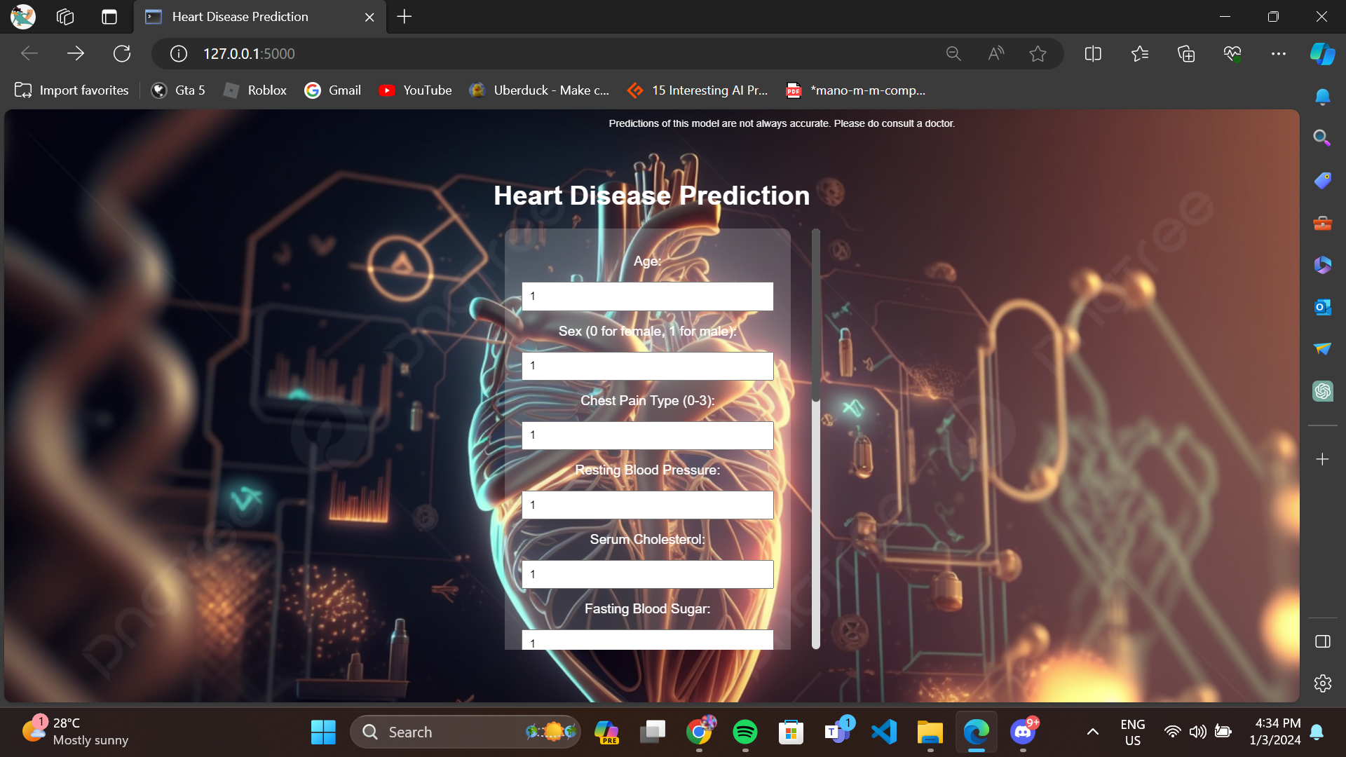
RESULT
Figure 1

Slide 9
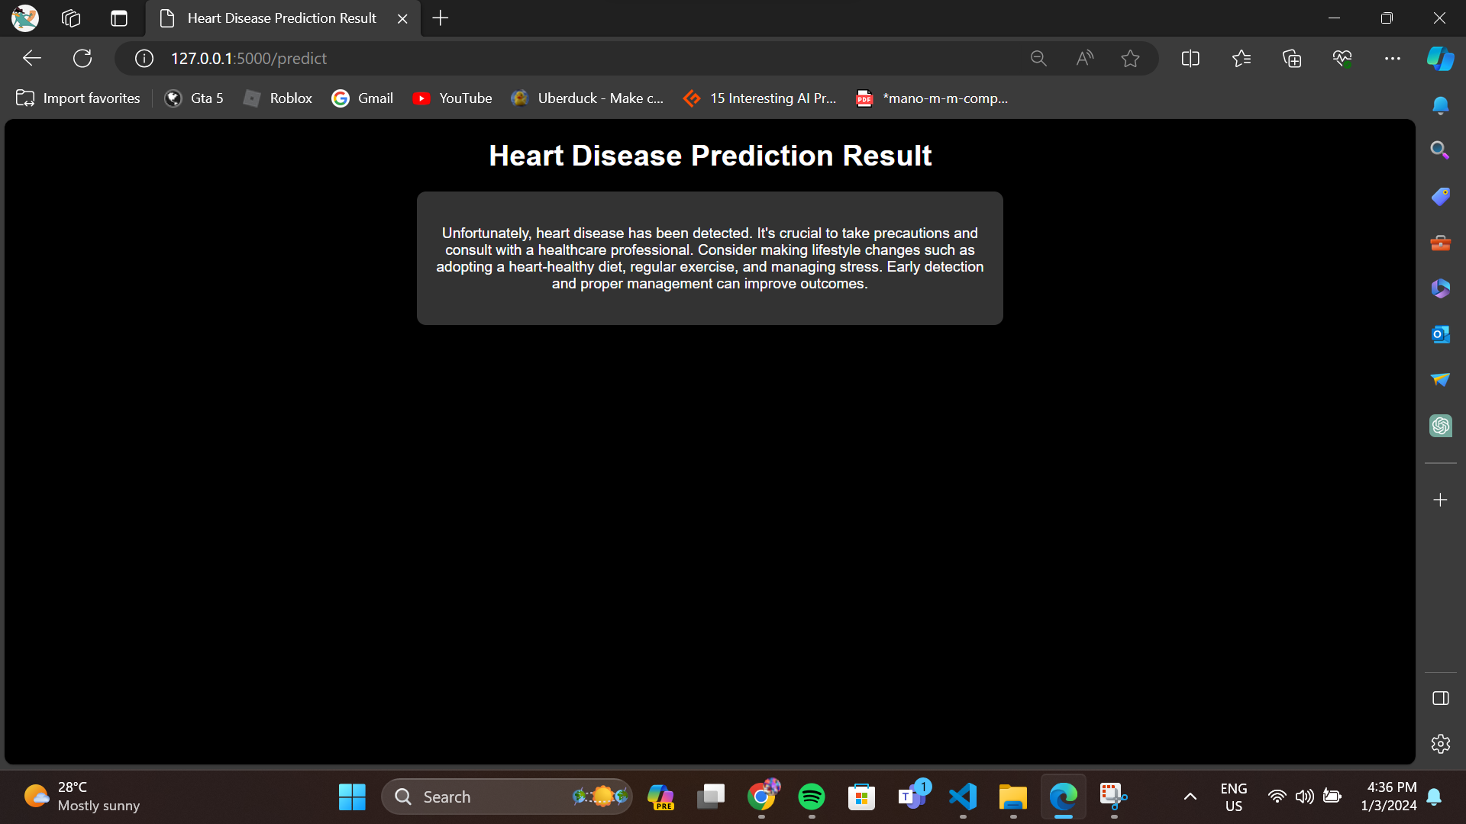
RESULT
Figure 2

Slide 10
Conclusion
In summary, the Heart Disease Prediction system utilizes machine learning and Flask to offer a user-friendly interface for diagnosing heart disease based on clinical parameters. It aims for high accuracy and reliability, aiding healthcare professionals in early diagnosis and treatment planning. This system empowers individuals to manage their cardiovascular health proactively, potentially reducing the burden of heart disease in the population.

Slide 11
REFERENCES
Tensorflow: https://www.tensorflow.org/
Numpy: https://numpy.org/
PyTorch: https://pytorch.org/

