Slide 1

EEE 321L PROJECT PRESENTATION
Open-Ended Project on
Digital Filter Design
Presented by:
Injamamul Haque Sourov (Id: 1820170)
Faiyaz Ahmed (Id: 1820545)
Department of Electrical & Electronic Engineering
INDEPENDENT UNIVERSITY, BANGLADESH
Course Instructor: Ms. Saila Ishrat Annie

Slide 2
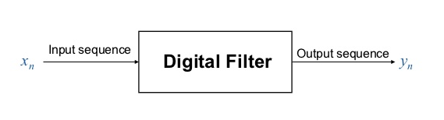
Digital Filters
Select certain frequencies while rejecting others
LTI System defined by
Impulse response h(n)
System function coefficients
Classified by:
Frequency Selection
Design
Duration

Slide 3
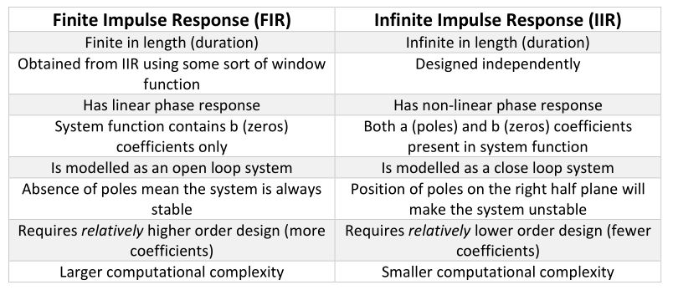
FIR versus IIR

Slide 4
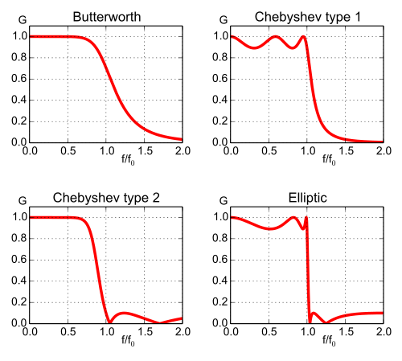
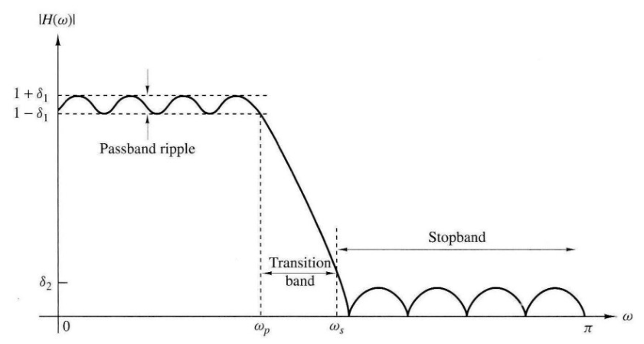
Chosing Filter Type

Slide 5
ECG Signals
Time domain representations
Contaminated ECG signal
Clean ECG signal

Slide 6
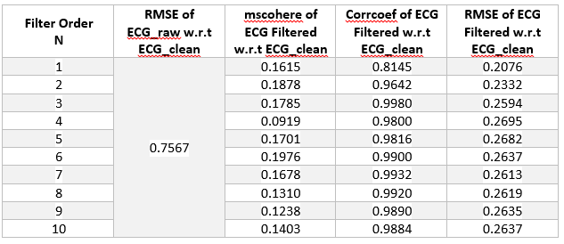
Order of Filter
Optimum order N = 3
High Magnitude Squared Coherence
Highest Correlation Coefficient
Low Root Mean Squared Error

Slide 7
Signal Comparision
Filtered Output slightly resembles the Clean ECG
Peaks and troughs do appear in the same sequence
Possible reason: Noise frequency lies withing the signal bandwidth

Slide 8
Frequency Spectrum (PSD)

Slide 9
Selected MATLAB Codes
% performance
msc= mean(mscohere(clean,ECG_clean));
corr= det(corrcoef(clean,ECG_clean));
rmse= sqrt(mean((ECG_clean - clean).^2));
rmse2= sqrt(mean((ECG_clean - ECG_raw).^2));
% Butterworth
fc = 80;
fs = 5000;
N = 3;
Wn = fc/(fs/2); % freq in rad/sample
[b,a] = butter(N, Wn);
%filter signal
clean = filter(b,a,z);
% remove any dc offset
m = mean(ECG_raw);
x = ECG_raw - m;
% PSD
PSD_r= pwelch(ECG_raw);
PSD_c= pwelch(ECG_clean);
PSD= pwelch(clean);
% 50hz notch filter (fc/(fs/2)
[b,a] = butter(3,[0.0196 0.0204],'stop');
z = filter(b,a,x);

Slide 10
Discussions
Filter order chosen based on
highest correlation coefficient
High MS Coherence and Low RMSE
PSD → BW approximately equal for filtered and clean signals
Peaks and troughs appear at roughly same sequence
Notch filter stop-band 49Hz - 51Hz, 6th order
Lowpass cutoff frequency = 80Hz

Slide 11
References
Milchevski A., Gusev M. (2018) Performance Evaluation of FIR and IIR Filtering of ECG Signals. In: Stojanov G., Kulakov A. (eds) ICT Innovations 2016. ICT Innovations 2016. Advances in Intelligent Systems and Computing, vol 665. Springer, Cham.
https://www.mathworks.com/help/signal/ref/butter.html#d122e8874
http://ocw.utm.my/file.php/134/M12_-_IIR_Filter_Design.pdf
https://www.mathworks.com/help/signal/ref/periodogram.html#d122e110165
http://www.brainkart.com/article/Difference-Between-FIR-Filter-and-IIR-Filter_13039/
https://www.mathworks.com/help/signal/ref/butter.html

