Slide 1
Search Engine Optimization (SEO)

Slide 2
Topic Outline Class-1
What is SEO?
How Search Engines Work?
SEO Building Blocks..
Major function of SEO
What is keyword and different types of keywords
Google keyword planner tool overview
Keyword mix
Google operators
Summary and Conclusion

Slide 3
Definition of Search Engine Optimization
"Natural," or "organic," search engine optimization (SEO) is designing, writing, and HTML-coding a Web site to maximize the chance its pages will appear at the top of spider-based search engine results for selected keywords and phrases
Organic Listings: Listings that search engines do not sell (unlike paid listings)
Functions of search engine-
1-crawling
2-indexing
3-search

Slide 4
Indexing
Indexing- It is the process of submitting your website pages in Google’s database so that webpages can be found on SERP.
Google webmasters tool
By links
Auto crawling by Google (web server)
Indexing process---
Crawling (frequency of crawling by google MG)
Main program(evaluation the webpages on the bases of keywords, car, reviews-back links)
Database
Index or partial indexing
NB: Who check whether your site is indexed or how many pages of your site is indexed in google “site:domain.com”

Slide 5
Defining Success (Context)
Search-Friendly (SEO)
  High ranking
  Terms and conditions set by search engines (Google, Yahoo, MSN Search)
User-Friendly
  Site must satisfy the needs of visitors
  Profitable for site owner

Slide 6
What is keyword and different types of keywords
Types of keywords-(what should be our keywords and shortlist keywords for which we want to rank-Nike shoes example)
Primary—Buy shoes online
Secondary---what kind of shoes, formal or casual
Long tail/phrase-”how to loose your girlfriend in 5 mins”
Short tail keyword “
high searched (“Amir khan” “buy shoes, nike shoes, shoes)
low searched “rajender rawat”
high competitive (quantity, quality)
low competitive (quantity, quality)
Seasonal (IPL, FIFA World cup)
Misspelled (roger Federer, roger federrer)
Money (buy shoes, buy iPhone 5-easy to convert into sale)
Broad match, exact match and phase match

Slide 7
Keyword tools
Keyword tools
Google keyword planner tool
Word tracker
Longtailpro

Slide 8
Keyword research process Class-2
Search-Exercise
Categorization-on the basic of similarity
Analysis
Selection
Quantity competition-
-no of result displayed by
SERP
Quality competition-
Page rank
Domain age
Domain authority
Page authority
No: of back links
Quality of backlinks

Slide 9
Keyword research process
ANALYSIS
No: of searches (top ranking with decent amount of traffic)
Relevancy- (how close the keyword match with your biz)
Competition-(what is competition for this KW)
Frequency –(how frequent the KW appears in SERP)
Monetary value (Buy shoes on line)
Google trends (current search for KW if the searches are dying)google.com/trends.
Exercise: Write down 10 keywords relevant to your organization, using the Google Keyword Tool at https://adwords.google.com/o/KeywordTool to analyze each keyword. Next to each keyword write down
a.) how competitive the word is,
b.) the number of global monthly searches for that keyword, and
c.) the number of local monthly searches.

Slide 10
How to do SEO?
--- On page (optimizing website content)
  Keywords Placement
  Meta tags creation
  Content optimization
  Internal linking
  Google webmasters tool
  Creating sitemap
  Uploading sitemap
--- Off page (increasing visibility and building backlinks)

Slide 11
How to do SEO?
On Page SEO-
Keywords Placement
  Title tags --Title- (words 65-75)
    buy branded shoes online in India
    buy branded shoes
    buy shoes
    buy shoes in India
    buy shoes online
    buy branded shoes online
    buy branded shoes in India
    shoes in India
    Shoes online in India
Notes:
Main program evaluates on the bases of keywords, example : Mahatma Gandhi, aamir khan.. Firefox plugin: MOJ bar, SEO status page rank…
Online shopping India domain-home page
WPTD.com to check which WordPress theme
Advertising agency
http://xyz.com
(advertising agency, advertising company, advertising agency in Delhi)
mag
news
http://xyz.com/services
(print advertising agency, online adv.. company, best online advertising agency in Delhi)
http://xyz.com/print-services
(print advertising agency, best print agency, print company in Delhi)
magazine
newspaper

Slide 12
How to do SEO?
Meta tags
  Meta Description- (135-165)
  Online Shopping Store in India for Branded Shoes, Clothing; Accessories for Men and Women. Cash on Delivery, END OF SEASON SALE, Free Shipping, 30 day returns
  Buy Nike Shoes for Men online in India. Select from the wide range of Nike Men Shoes at Jabong.com. ✔ Free Shipping ✔ COD ✔ 30 Days Return

Slide 13
How to do SEO?
Headings (H1, H2, H3----- H6)
  H1= HEADING
  H2= HEADING
  H3= HEADING
    Keyword- “narendra modi career”
    All you want to know about narendra modi
    <h1>Narendra modi career highlights- Everything answered.</h1>
Text-content
Domain name
    abccompany.com
    abcadvertisingagency.com

Slide 14
How to do SEO?
URL
URL (Uniform resource locator) Address of any given webpage, URL optimization- adding keywords to your URL
  http://myntra.com/134/abc/xyz.html
  http://myntra.com/shoes/puma/men.html
Anchor text link
  Anchor text link- Add link on our “keywords”… and not on words like “click here”
  <a href=”http://wikipedia.org/wiki/customers”> customers </a> <a href= “destination URL” > keyword </a>
  example-
  Click here to know more
  Click here to read about “customers”

Slide 15
How to do SEO?
Alt tag
  Alt Tags, alternate text. Is a way to tell SE what an image is all about….
  Keyword is “Honda Jazz interiors”
  ALT Tag Examples-
  Honda car
  Image shows Honda Jazz car Interiors
  IN WordPress
Sitemap-
Sitemap.html- is for user
Sitemap.xml- is for robots
Meta Robots.txt
Page layout update

Slide 16
How to do SEO?
Content Optimization: How You View Your Page
Share three websites you regularly visit and indicate what you feel are the strengths and weaknesses of each, noting how “user friendly” you feel they are. Are there common characteristics “good” websites share that you can apply to your own efforts?
Discussion: Consider the three scenarios below and discuss how you’d provide clarity and quality to each of the audience groups that are visiting the “Explore California” website for information: a.) a resident of California planning a one-day backpacking trip near her home; b.) a father in Massachusetts planning a two-week vacation in California for a family of four; c.) an international visitor from Japan interested in cycling across the state.
Exercise: Search one keyword using a search engine of your choice, and then identify take one keyword and search in google analysis the result at number 1 position and 20th position and write as many characteristics about about each website as you can easily identify.

Slide 17
How to do SEO?
Content Optimization---CONTENT IS KING
  Content Quantity (50 words less it should be at least 1000)-marketing on wiki
  Content Quality
  Content variety(images, video, infographics, downloaded pdf, table and graph)
  Content readability
    Contrast/color
    Points
    Small paragraphs
  Blog
    Subdomain-- Subdomain- http://blog.xyz.com
    Directory-- Directory- http://xyz.com/blog
  Internal links, xyz.com to xyz.com/abc
  External links, xyz.com to 123.com/abc should be for good sites only
  Keyword density, 1.5%- 2.5%

Slide 18
How to do SEO?
  Internal links, xyz.com to xyz.com/abc
  External links, xyz.com to 123.com/abc should be for good sites only
  Keyword density, 1.5%- 2.5%
Assignment-
Write 600 words on keyword- “benefits of digital marketing”

Slide 19
Off page SEO?
1). Directory listing
-- travel directory
2). Blogging for back linking
--Google operators
-- iPhone 5 -Facebook, -twitter, -LinkedIn, -Pinterest
3). webmaster tool
--sitemap--https://www.xml-sitemaps.com/
4. google local

Slide 20
Off page SEO?
1. Social Networking Sites
Social Networking is bigger than ever these days! Sometimes known as “Online Reputation Management”, getting involved with social media sites is the fundamental step with which you begin to advertise, market and build your online reputation within your niche.
You need to sign up to the most popular social networking sites, such as; Facebook, LinkedIn, Twitter, Google+, etc., and create yourself a profile of your own. This allows you to extend your online network of contacts, to connect and interact with your friends, to share things with each other, and most importantly promote your website/blog and help build your online reputation.

Slide 21
Off page SEO?
2. Blogging
Blogging is one of the best ways to promote your website online! By writing a blog for your website, you give a reason for visitors to keep returning to your site and keep up to date with your latest posts. It also helps search engines to crawl your site more frequently, as they have to update your latest blog post entries, which ultimately helps you rank higher in search engine results pages (SERPs).
You need to produce and include lots of unique content for your blog, such as; Infographics, Top Lists, How To…Tutorials, Viral Videos, etc. Try to remember to be clear and concise in
what you are trying to convey to your readers within your blog posts, don’t waffle.
To help you promote your blog, submit it to niche blog directories and blog search engines. (See below)
If you’re not very good at writing content for your blog, then you could always hire a guest blogger for your blog and ask him/her to write precise and unique content so that your blog can gain more credit from a search engine point of view.

Slide 22
Off page SEO?
3. Blog Marketing
Post comments on other blogs within the same niche as yours, which allow you to add a link in the comments section. These links can then be crawled by search engines, helping to point them towards your site. These blogs are commonly referred to as "Do-Follow” Blogs (Just like ours, where you can comment below!).
4. Forum Marketing
Find forums online that are related to your sites niche and get involved within that community. Reply to threads, answer peoples questions, offer advice, etc. This all helps to build up your reputation as someone who is an expert within that niche. Try to use “Do-Follow” Forums so that you can include a link to your site within your signature, which helps search engines crawl your site.

Slide 23
Off page SEO?
5. Search Engine Submission
Search engines will eventually find your site online, but that can take a while. To speed everything up, you should submit your website to the most popular search engines like Google, Yahoo, Bing, etc.
6. Directory Submission
Many people may say that directory submission is dead! I believe that it isn’t as you are increasing the likely hood of people seeing your website. It is purely based on how effectively we are selecting those directories and how efficiently we are choosing the category for submission. You could submit to general directories, but for maximum effect, you are better off submitting to niche directories. Of course, I agree that it gives quite delayed results, but it is worth doing it.

Slide 24
Off page SEO?
7. Social Bookmarking
Social Bookmarking is another great way of promoting your website. Submit your latest blog posts and pages to the most popular bookmarking sites, like StumbleUpon, Digg, Delicious, Reedit, etc. Search engines really like these types of sites because the content on these sites is updated very frequently.
You should be very careful while doing this and you must properly handle the tags which are very essential to broadcast your news on a wide area network. This may increase your website traffic based on how effectively you have participated.
8. Link Baiting
Link baiting is another popular way of promoting your site. If you produce a really popular unique post for your site, then other people may want to link to it. Perhaps you have copied/published another website’s content on your site, don’t forget to place their website link as a reference. Do it for others and, if your content is trustworthy, let others do it for you. This is another way to increase your link popularity.

Slide 25
Off page SEO?
9. Photo Sharing
If you have used any of your own photos or images on your site, then you can share then on many of the major photo sharing websites like Flickr, Picasa, Photo Bucket, etc. Other people will be able to see them and comment on them, hopefully following a link to your site.
10. Video Marketing
Just like photo sharing, if you have any videos that you have used on your site, then you can submit them to sites like; YouTube, Vimeo, etc. allowing people to find your content in other ways.
11. Business Reviews
Write reviews about others businesses or ask your friends/clients to write a review of your business in major business review sites like RateitAll, Shvoong, Kaboodle, Stylefeeder, etc.

Slide 26
Off page SEO?
12. Local Listings
Depending on your site’s niche, you might find that listing in local directories may be useful. You may have a website promoting your local business, therefore instead of going global and facing huge competition, listing your website locally, so that search engines can easily view your website and fetch the content, will be much better. This will help you to reach a targeted audience. Submit your website to sites like; Google Local, Maps, Yahoo Local, Yellow Pages, etc.
13. Article Submission
If you write your articles yourself, then you can submit them to popular article directory sites like; Ezine, Go Articles, Now Public, etc. This can help drive traffic to your site, whilst you can also gain some links to your site from other people (though it’s usually a slower process).

Slide 27
Off page SEO?
14. Social Shopping Network
If you run an e-commerce website, then a good strategy for advertising and branding your products for free is to submit then to online shopping networks. By submitting your products to sites like; Google Product Search, Yahoo Online Shopping, MSN Online Shopping, and other major social shopping network sites like Kaboodle, Style Feeder, etc. then you increase the likelihood of people finding the products that you are selling.
15. Answer Questions
You can actively participate in answering questions on sites like Yahoo Answers. By answering and asking relevant questions on your site niche, you help to build up your reputation as someone that is an expert in your chosen field. You can place a link to your website in the source section if necessary so that people can easily find your site. If you don’t spam, this is another great way to increase your link popularity.

Slide 28
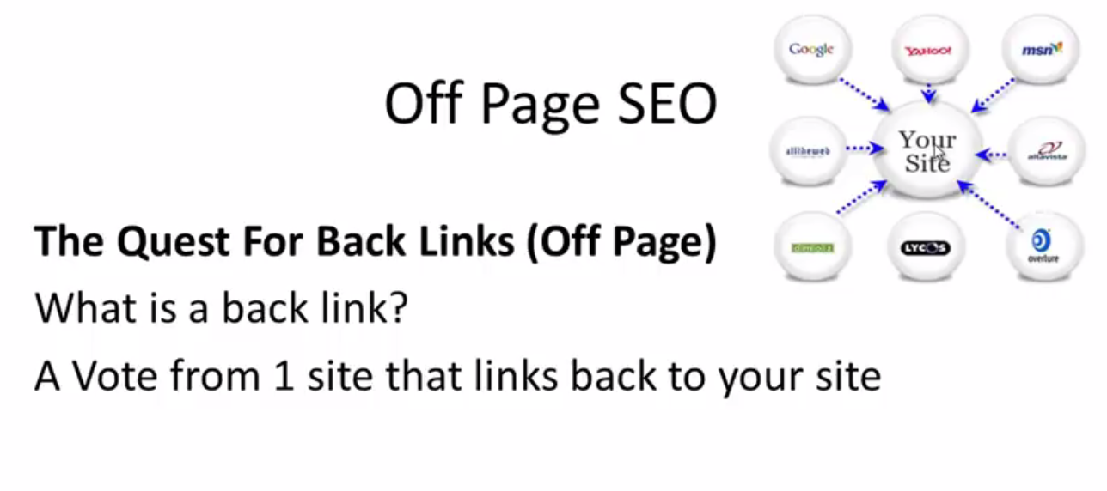

Slide 29
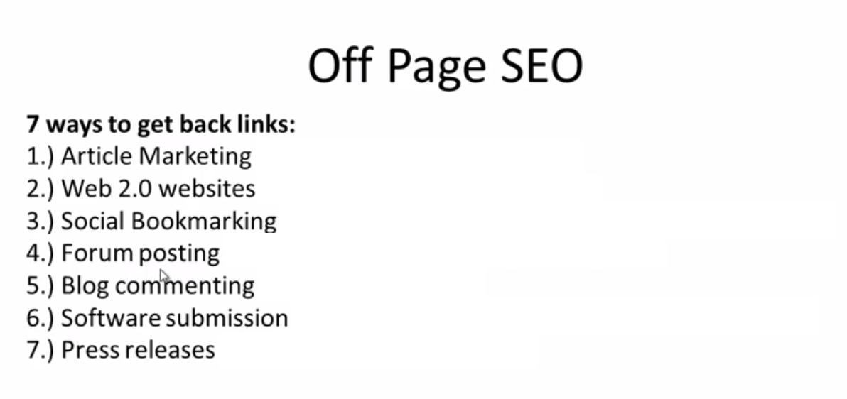

Slide 30
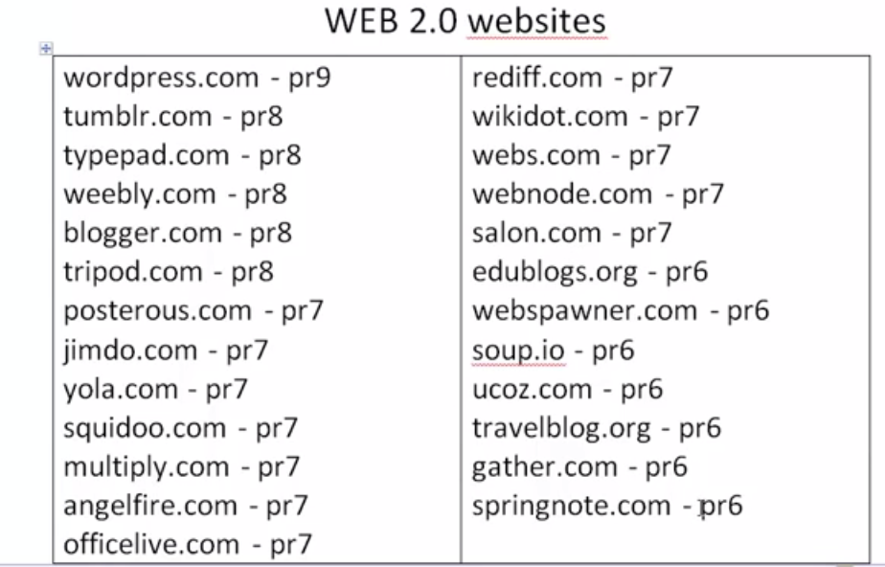

Slide 31
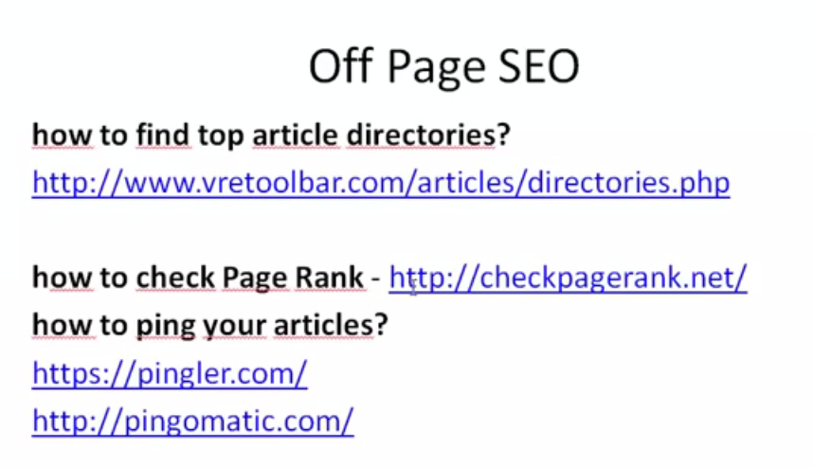

Slide 32
Robots Meta tags
You can force the search engine to ignore the ODP information by including a robots meta tag. If the search engine (in this case, Yahoo!) displays information about your site taken from the Yahoo! Directory instead of your description meta tag, you can force it to ignore the directory information by including a robots meta tag like this:
<meta name="robots" content="noodp" />.
<meta name="robots" content="noydir" />.
The "NOODP" robots meta tag is fully supported by Google, Yahoo!, and MSN.

Slide 33
Robots Meta tags
If you only have the problem with Google, you can use this:
<meta name="googlebot" content="noodp" />.
If you only have the problem with Yahoo!, you can use this:
<meta name="slurp" content="noydir" />
If you only have the problem with MSN, you can use this:
<meta name="msnbot" content="noodp" />.
One of the most succinct methods is to use a single robots meta tag with multiple attributes separated by commas like this:
<meta name="robots" content="noodp,noydir" />
payment page no index:
<meta name="robots" content="noindex">

Slide 34
Robots Meta tags
If you want to block content from a specific search engine, you need to need to replace the value of robots with the name of the search engine spider. Some common
search engine spiders are:
<meta name="value" content="value">
googlebot – Google
googlebot-news – Google News
googlebot-image – Google Images
bingbot – Bing
teoma – Ask

Slide 35
Robots Meta tags
For reference, here is a list of the most common directives that are available to you:
all – No restrictions on indexing or linking
index – Show the page in search results and show a cached link in search results
noindex – Do not show the page in search results and do not show a cached link in search results
follow – Follow links on the page
nofollow – Do not follow links on the page
none – The same as using “noindex, nofollow”
noarchive – Do not show a cached link in search results

Slide 36
Robots Meta tags
nocache – Do not show a cached link in search results
nosnippet – Do not show a snippet for the page in search results
noodp – Do not use the meta data from the Open Directory Project for titles or snippets for this page
noydir – Do not use the meta data from the Yahoo! Directory for titles or snippets for this page
notranslate – Do not offer translation for the page in search results
noimageindex – Do not index images from this page
unavailable_after: [RFC-850 date/time] – Do not show the page in search results after a date and time specified in the RFC 850 format

Slide 37
Robots Meta tags
A few of these directives are redundant too.
<meta name=”robots” content=”all”>,
for example, will give the same result as
<meta name=”robots” content=”index, follow”>.
And there is no point using either of those meta tags since search engines will index content and follow links by default anyway.

Slide 38
Off page SEO?
WHAT IS PAGE RANK- Score given by Google to a web page on a scale of 0-10. 10 being highest.
Page rank depends on-
Age of domain name
No: of back links
Quality of back links
Link juice
Quality of content (on page seo)
Domain authority(1-100)
Page authority

Slide 39
Off page SEO?
Domain authority-
page rank
back links (quantity and quality)
Traffic
Age of the domain
Page authority
Types of links
Inbound
Outbound

Slide 40
Off page SEO?
Follow and no follow links
<a rel= “no follow” href=http://xyz.com> anchor text </a>
<meta name=”robots” content= “no follow”/>
Types of link building-
One way
Two way (reciprocal)
Three way
A.com → b.com
A.com → ←b.com
A.com ←b.com

Slide 41
Off page SEO?
LINK BUILDING TECHNIQUES
Low hanging fruits (1st month)
Content
Black-hat techniques
Google algorithm update
Panda- Content quantity and quality
Penguin- Quality of backlinks

Slide 42
Off page SEO?
Low quality backlinks
Non-relevant content
Footer links
Keywords as anchor text (70-30)
Link farms
New domains (6 months old)
Backlinks of backlink page
Links from comments on blogs
Too many profile links
80-20 rule in link building (20% links for home page and 80% links for other webpages)

Slide 43
Off page SEO?
What not to do in link building?
No non-relevant back links, only get links from relevant content and webpages
Do not buy links
No link farms
Do not go for too many web 2.0 links
Do not use same content more than once
Do not go only for follow backlinks`
Do not go only for keywords match anchor text links
Not too many profile links
Try to get links from different IP addresses or web servers
Try to give multiple external links rather than giving just 1 link to your money site
Try not to give links in footer and add them between the content/text
Do not build too many/hundreds of back links over night

Slide 44
Off page SEO?
Low hanging fruits(1st month of SEO)
Directory submission(only in top)
Niche directory submission (all)
Article Submission
video submission (3-4 submission in 1 month)
profile creation (do not build backlinks…… spamy)
web 2.0 properties (build credibility, at least 3000 words and minimum 2 months old.. then give link)
press release submission (once every month…. With NEWS)
blog directory submission (only in top directories.. just once)
eBook directory submission (only in top directories….. 2 links- website, download here)

Slide 45
Off page SEO?
Low hanging fruits(1st month of SEO)
blog comments/Forums discussions (only on related blogs and with contextual meaning full text….)
article submission (1 every month, only on top website and use different URL for link)
infographic submission (convert articles into infographics and post)
Social bookmarking (only for visibility…. Blog articles infographics, articles, eBooks can be bookmarked, bookmarking should be done from different accounts)

Slide 46
Off page SEO?
LINK BUILDING VIA CONTENT (2nd month of SEO)
Free stuff
Guest blogging
Paid blogs
EBook, Video, Demo, Whitepaper (Research Paper), Case study, Trial Versions,
1- Free stuff-
Create a survey - Then giveaway the results for free and help others in your niche. Ask questions people want to know the answers to, so that they will pass on the information via links.
Create how to videos - Teach people how to use your products, or how to be better at their jobs. Give them the type of insights they'd usually have to pay for and they'll thank you for it. We giveaway how to guides that we could charge for, simply to build brand awareness.

Slide 47
Off page SEO?
Build an amazing infographic - Spend the time to make a great looking infographic that presents key information on your niche. Make it fun to view, and post it on infographic sharing sites for a link back.
Write a whitepaper - Give it away rather than charging for the results, but ask people to tweet about the whitepaper so they can get it. Here's how the Clockwork Pirate does it.
Make a Top 10 list - Then link to everyone in the list and give them a badge to display on their own website. You're giving them links and exposure for free, but if they are proud of the achievement they'll link back.

Slide 48
Off page SEO?
Guest blogging
Steps-
Finding your niche blog that accepts guest post
Checking quality of blog
Dropping email
Correspondence
Writing post
Getting link
Checking live webpage
Finding blogs- find blogs via Google search
Guest Post “niche”
Write for us “niche”
“Niche” submit guest post
“Niche” submit a post
“Niche” guest blogging
“Niche” guest blogger
Use Google operators for searching

Slide 49
Off page SEO?
The following table lists the search operators that work with each Google search service. Click on an operator to jump to its description — or, to read about all of the operators, simply scroll down and read all of this page.
Search Service | Search Operators
Web Search | allinanchor:, allintext:, allintitle:, allinurl:, cache:, define:, filetype:, id:, inanchor:, info:, intext:, intitle:, inurl:, link:, related:, site:
Image Search | allintitle:, allinurl:, filetype:, inurl:, intitle:, site:
Groups | allintext:, allintitle:, author:, group:, insubject:, intext:, intitle:
Directory | allintext:, allintitle:, allinurl:, ext:, filetype:, intext:, intitle:, inurl:
News | allintext:, allintitle:, allinurl:, intext:, intitle:, inurl:, location:, source:
Product Search | allintext:, allintitle:
allinurl:"guest blog" +"travel"

Slide 50
Off page SEO?
Blackhat techniques for link building-
Old Domains (How to do/leverage an old domain which already has a credibility in the eyes of Google)
Content farming (content spinning)
Old domains
Change your DNS asap and add content
Domain should be hosted on different IP address
Wait for 1 month at least before you give backlink and 6 months if it is a new domain
Give multiple links on the page where you give link of your money site

