Slide 1

Final Project Structural Topic Modeling on News Headlines
InJoo Kim
CSCI S-89B Introduction to Natural Language Processing
Fall 2025
Harvard Extension School

Slide 2
Motivation / Problem Statement
Why this project?
Digital media produces overwhelming volumes of news headlines.
Headlines are extremely short → limited context → hard to classify manually.
Need an automated, scalable method to uncover meaningful themes.
Why STM?
Incorporates metadata (e.g., publish date).
Discovers both topics and how they change over time.
More flexible and interpretable than LDA for real-world news data.
Key challenge: headlines are extremely short → sparse context → traditional classifiers struggle

Slide 3
Project Goals
This project aims to:
Identify latent topics within large-scale headline data.
Characterize topics using FREX and probability-based word lists.
Examine how topic prevalence shifts across time.
Provide a reproducible STM workflow using R Markdown.

Slide 4
Dataset Overview
Dataset: Kaggle News Headlines (≈150k–200k)
Includes:
headline — short text string
publish_date — metadata for temporal analysis
Characteristics:
Very short (5–12 words)
High frequency of named entities
Strong temporal signals

Slide 5
Preprocessing Pipeline
Steps:
Convert to lowercase
Remove punctuation and non-alphabetic characters
Tokenize using quanteda
Remove English stopwords
Build Document-Term Matrix (DTM)
Convert DTM into STM’s documents, vocab, meta format
Output: Clean, sparse representation suitable for STM.
Key design choice:
Aggressive preprocessing was required due to extreme sparsity of headlines.

Slide 6
What is STM? (Theory Overview)
Structural Topic Modeling (STM):
Unsupervised method for discovering latent topics.
Extends LDA by modeling topic prevalence with metadata.
Uses a logistic-normal prior for flexibility.
Advantages:
Captures how topics change over time.
More interpretable via FREX words.
Designed for social science datasets like news.

Slide 7
Model Configuration
STM Parameters:
Number of topics: K = 10
Prevalence formula: ~ publish_date
Iterations: 75 EM iterations
Initialization: spectral
Seed set for reproducibility
Goal: Balanced interpretability + distinct topic separation.
K was selected to balance interpretability and topic separation rather than maximizing likelihood.

Slide 8
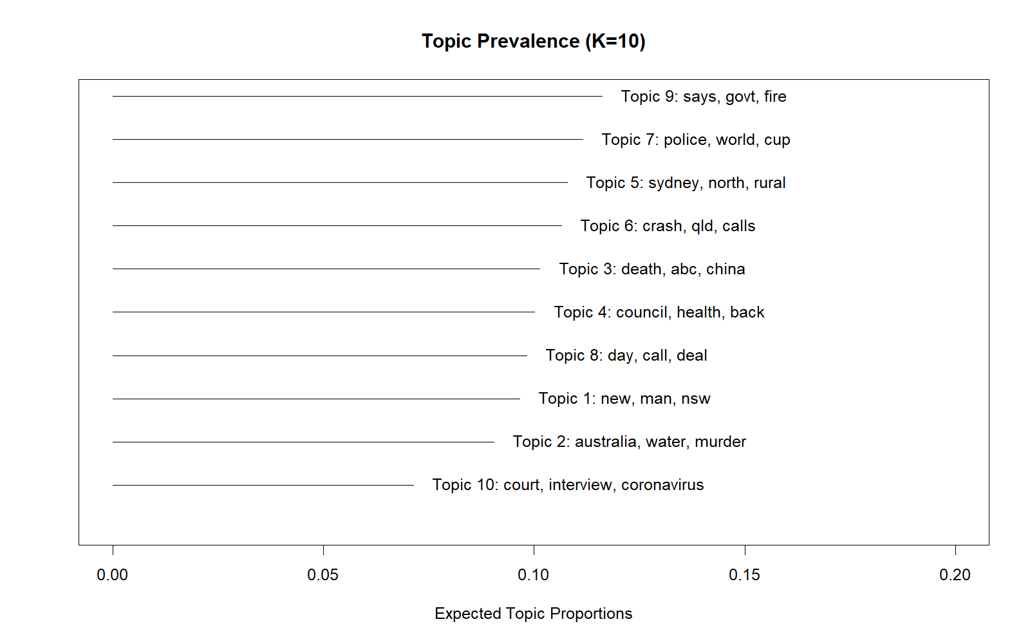
Topic Summary (Main Result)
STM discovered 10 coherent topics:
U.S. politics and elections
Business and economic news
Crime and law enforcement
Politics & Public Policy
Technology and innovation
Legal/judicial issues
Public health and COVID
Climate and environmental events
Sports
International affairs
Entertainment and culture

Slide 9
Topic Prevalence Across Corpus
Key observations:
Politics, crime, and economy dominate the news cycle.
Tech and global affairs appear consistently but less frequently.
Sports and entertainment topics are lower but still coherent.
Interpretation: reflects real-world editorial prioritization.

Slide 10
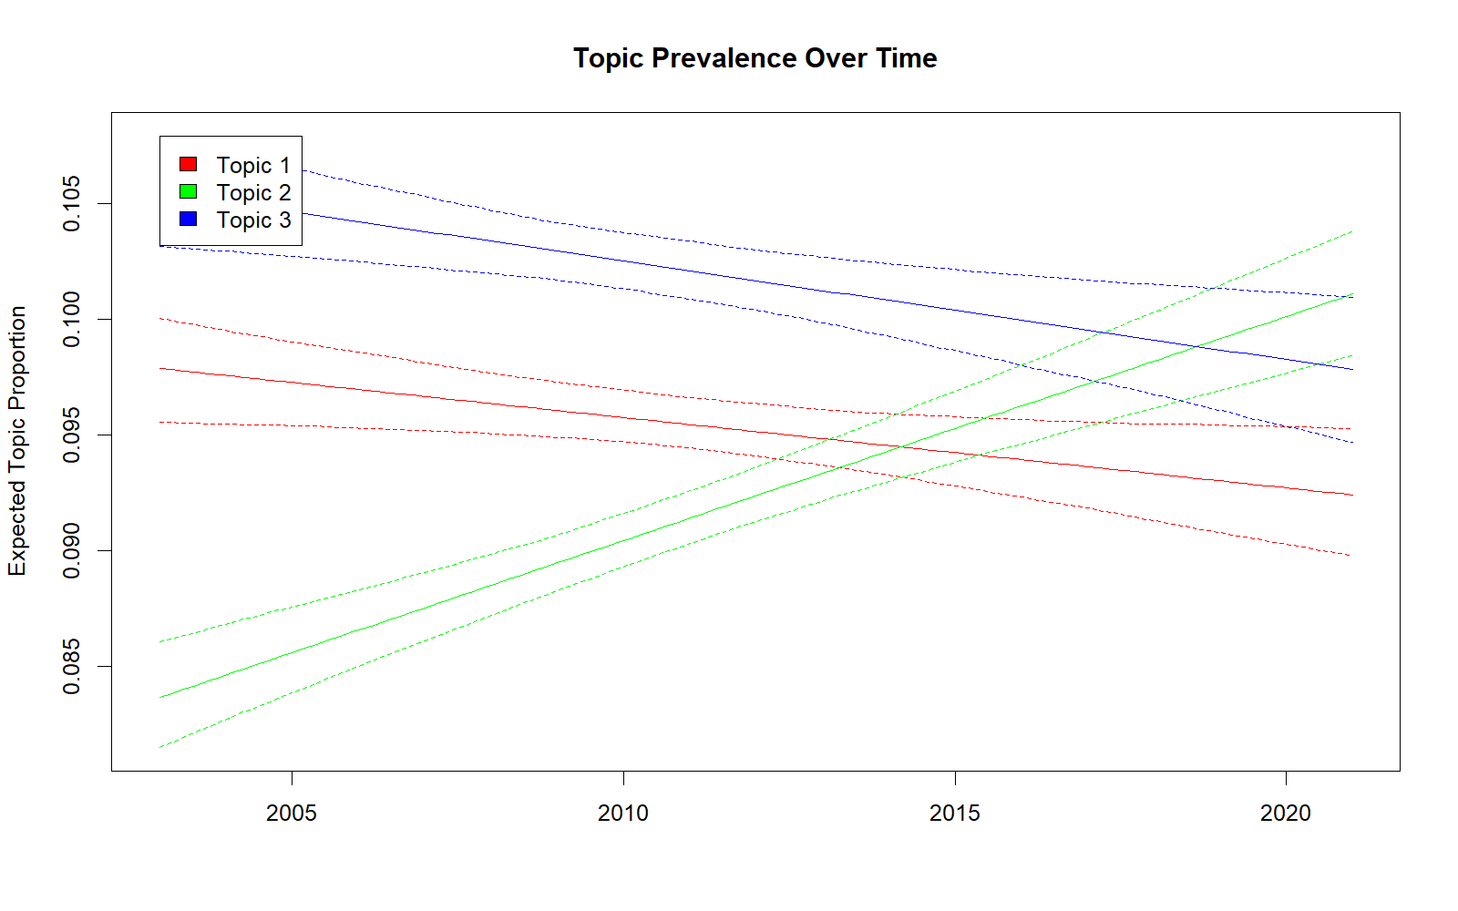
Temporal Trends (STM Covariate Effects)
Temporal effects reveal:
Political topics spike during election cycles.
Health topics surge sharply during COVID.
Economic topics fluctuate with major financial events.
Climate topics show clear seasonal patterns.
Insight: STM captures real-world event cycles via metadata.
These temporal patterns align closely with real-world events, validating the model’s external plausibility.

Slide 11
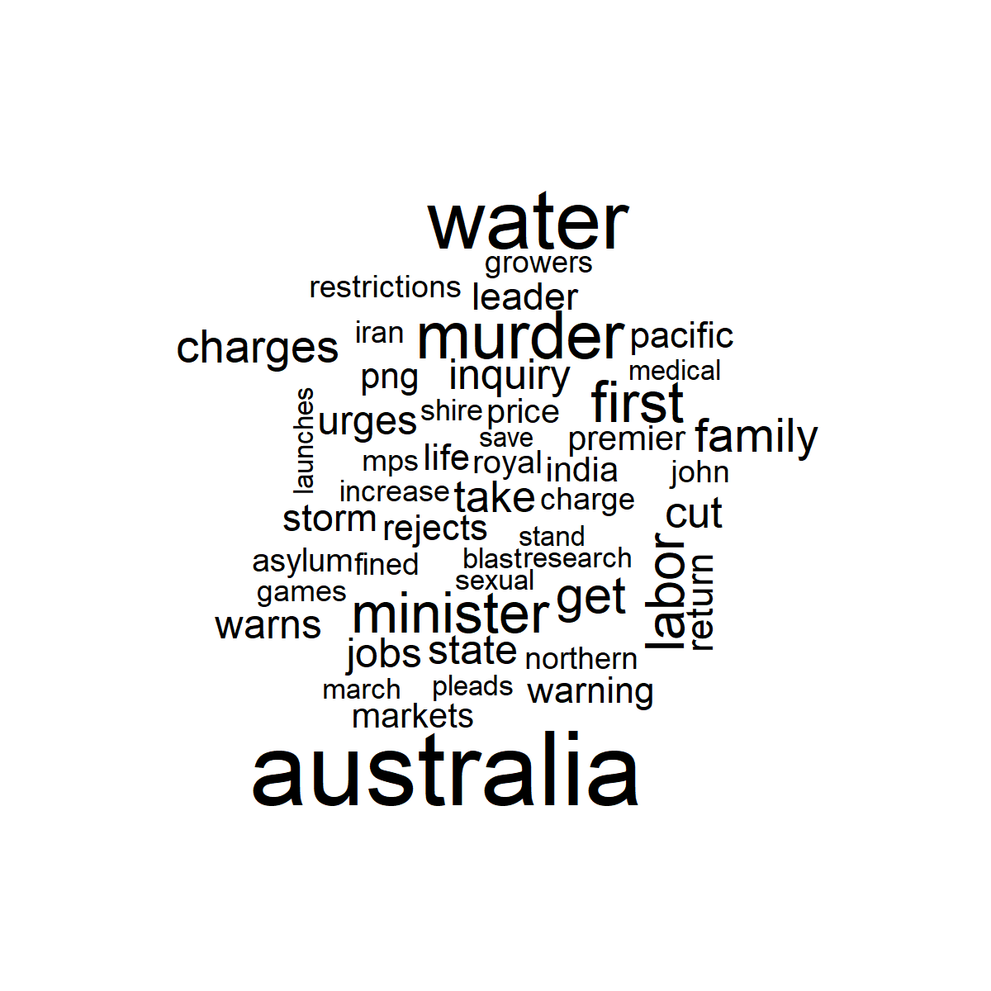
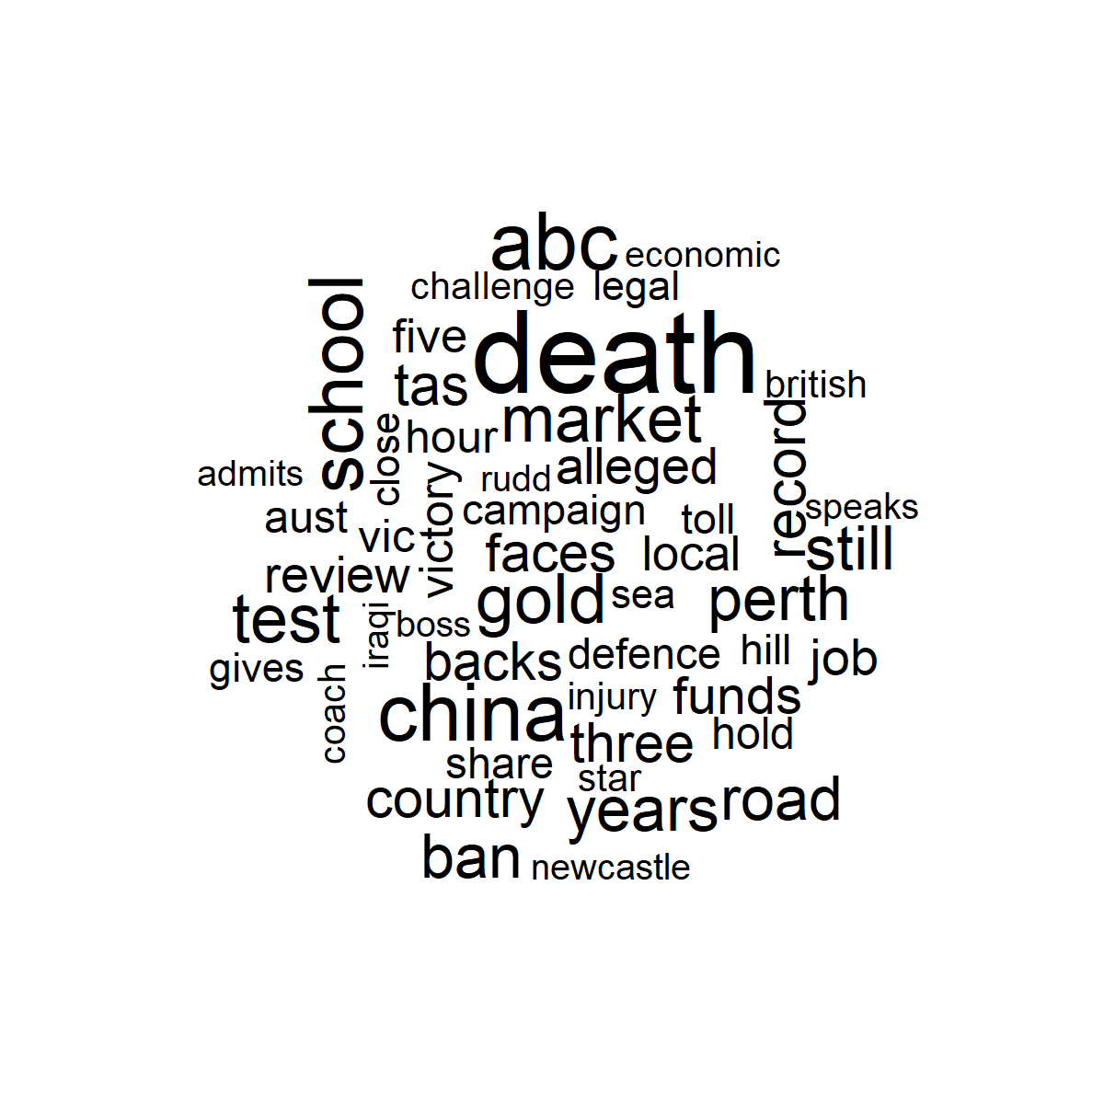
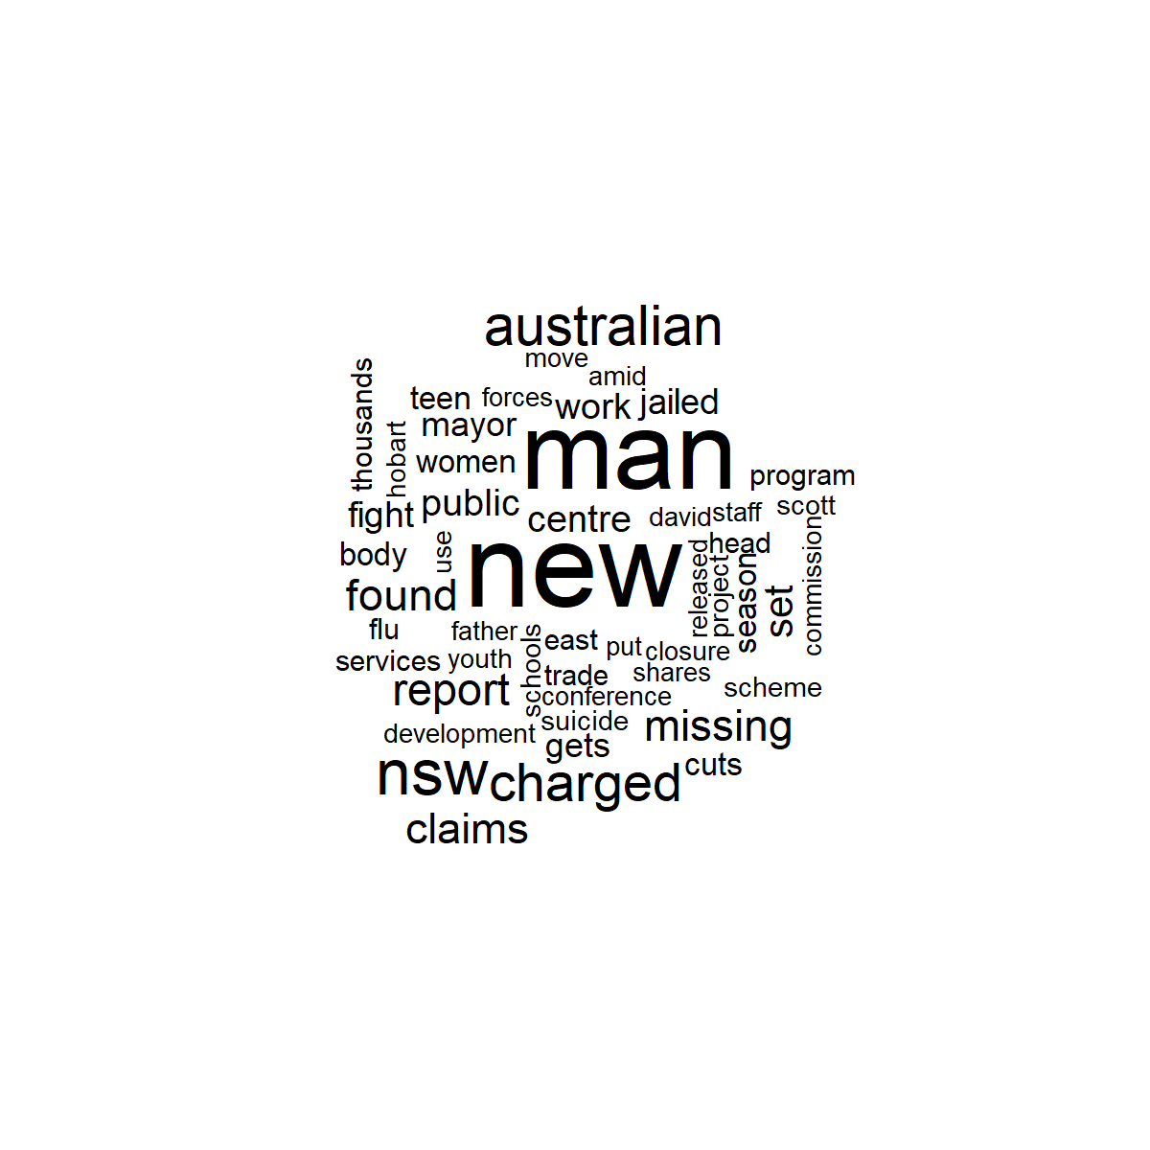
Word Cloud Visualization
Purpose: intuitive representation of high-probability terms.
Examples:
Politics topic: trump, election, vote, poll, campaign
Crime topic: police, shooting, arrest, suspect
Tech topic: google, apple, ai, launch
Helps: quickly validate topic interpretability.

Slide 12
Topic Quality Evaluation
Evaluation metrics:
Semantic coherence (word co-occurrence strength)
Exclusivity (topic-specific vs shared terms)
Findings:
Politics, crime, and economy = highest coherence.
Entertainment / sports = lower exclusivity due to shared vocabulary.
K=10 achieves a good balance.

Slide 13
What Worked / What Didn’t
Worked well:
STM handled metadata effectively.
Clear, interpretable topics emerged.
Temporal trends aligned with real-world events.
R Markdown workflow ensured reproducibility.
Challenges:
Headlines are extremely short → sparse context.
Named entities dominated some topics.
Selecting K required trial and error.
STM proved especially effective when metadata carries meaningful signal.

Slide 14
Lessons Learned
Metadata-aware models (STM) outperform basic LDA for news data.
Preprocessing quality directly impacts topic interpretability.
Visualizations (summary plots, word clouds) are essential.
Reproducible workflows simplify debugging and iteration.
Overall: STM is highly suitable for short-text trend analysis.

Slide 15
Final Slide + Video Link
Thank you!
Video Presentation: https://www.youtube.com/watch?v=eERADNFa528
Code & Report Available in Final Submission ZIP
Metadata-aware models (STM) outperform basic LDA for news data.
Preprocessing quality directly impacts topic interpretability.
Visualizations (summary plots, word clouds) are essential.
Reproducible workflows simplify debugging and iteration.
Overall: STM is highly suitable for short-text trend analysis.

