Slide 1
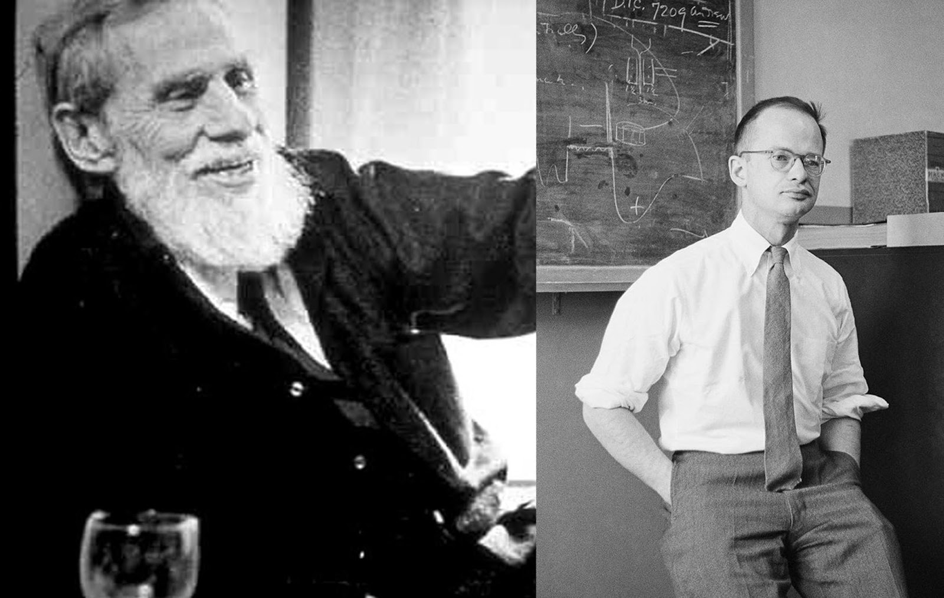
1943: described the first artificial neural networks
Warren McCulloch
Walter Pitts

Slide 2
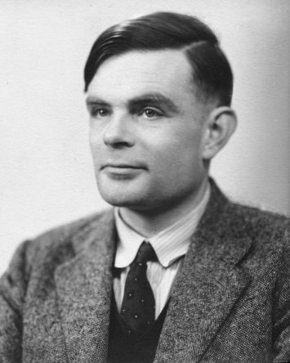
1948-50: wrote probably the first computer chess program (although never got it running on a computer)
1950: proposed the Turing Test as a test of general-purpose computer intelligence
Also well known for his work in foundational computer science (Turing machines), and helping to crack the German Enigma code during WW2
Alan Turing

Slide 3
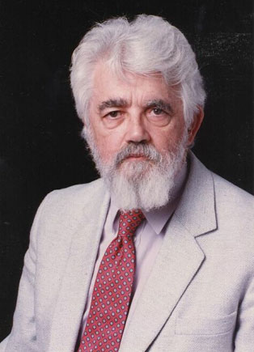
1955: coined the term Artificial Intelligence
1958: designed the LISP programming language (used in many early symbolic AI programs)
Involved in much foundational AI research, in particular applications of logic
John McCarthy

Slide 4
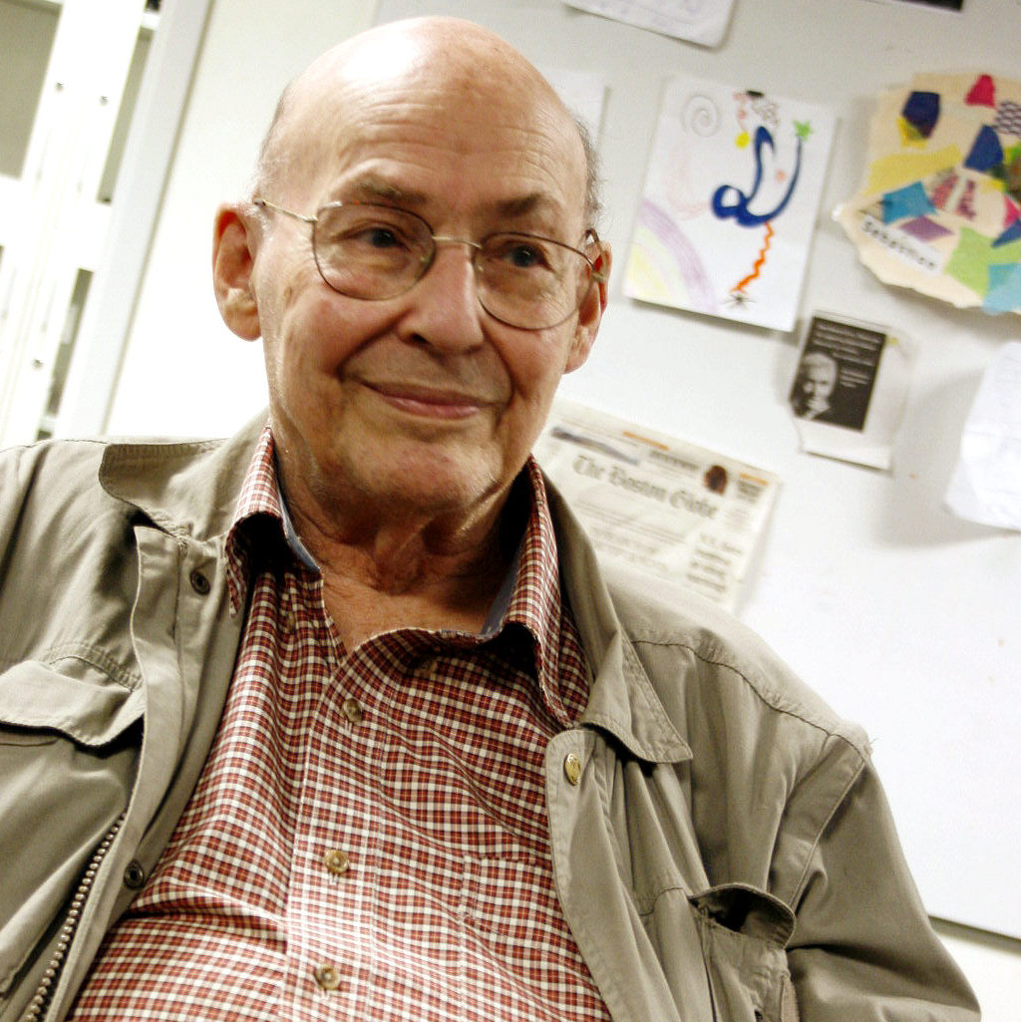
1951: created the first randomly wired neural net learning machine (hardware)
1969: with Seymour Papert, wrote the influential book Perceptrons that showed fundamental limitations of early neural nets
Along with John McCarthy, one of the major leaders of early AI work

Slide 5
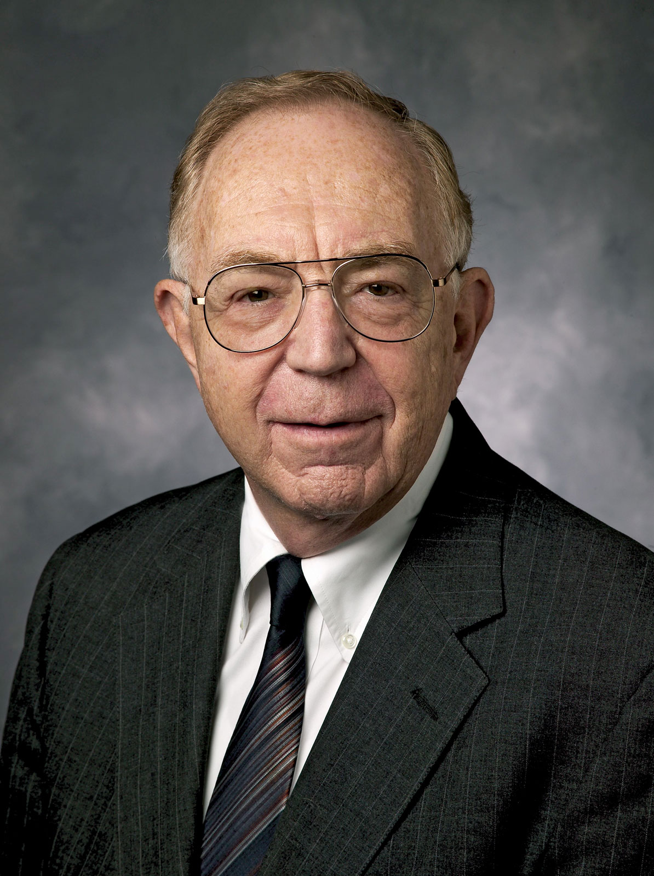
1965 – onwards: helped create the influential expert system Dendral (for identifying unknown organic molecules), and other expert systems
Proponent of heuristics and rule-based AI
1980s: expert-system shells for adding rule-based AI to programs were available
Edward Feigenbaum

Slide 6
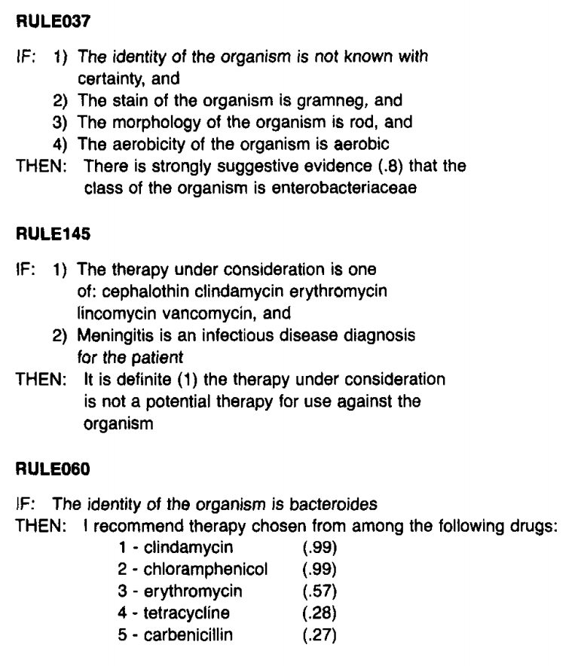
Examples of heuristic rules from the MYCIN expert system

Slide 7
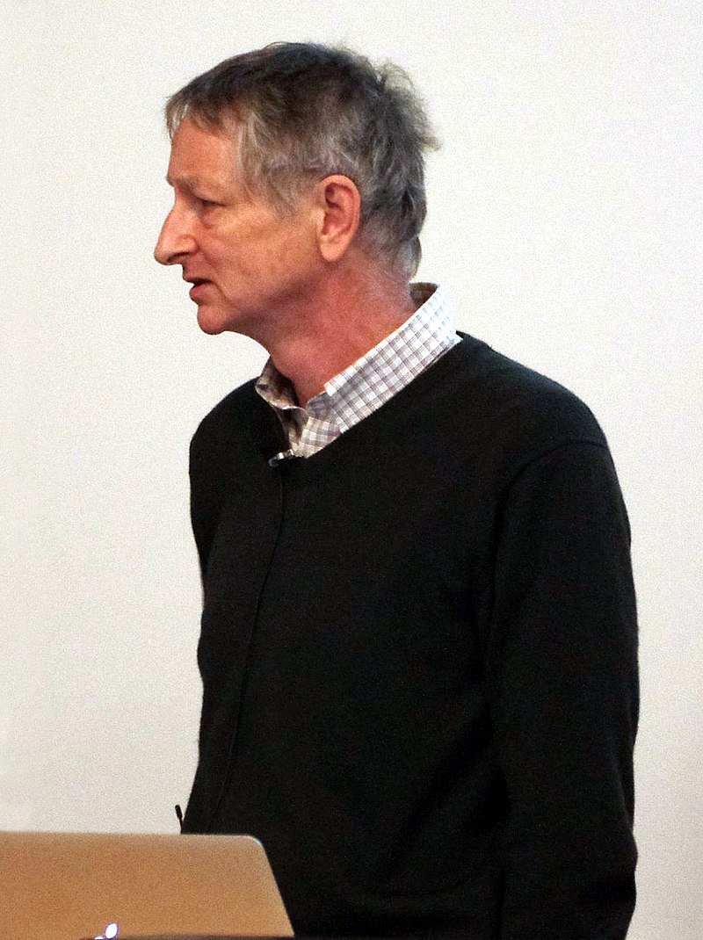
1978 - onwards: one of a small group of enthusiastic neural net researchers
Involved in a lot of fundamental modern work on neural nets
2011 - onwards: major success with neural net model, achieving best performance in applications such as image recognition and speech understanding
Geoffrey Hinton

