Slide 1
S4965918
Edoardo Vassallo
Sequential Prediction
and Reinforcement
Learning
Final Project

Slide 2
Assignment: SP Proposal 5
Consider a finite state Markov chain, with transition matrix P.
Using one long trajectory of length T, estimate the conditional expected state:
from any starting state x, by using:
Monte-Carlo estimation of the empirical conditional expectation
Kernel VAR (with p = 1).
Compare the accuracies of the two methods.

Slide 3


Montecarlo

Slide 4


Kernel VAR
Given p = 1, we rewrite our trajectory as:
Where:
Gaussian
Kernel

Slide 5
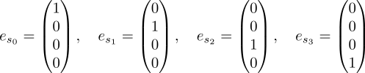
State Representation
To properly exploit VAR, we need to represent our states as vectors. We choose to use One-Hot Encoding.

Slide 6


Impact of 1HE
Only two distances are possible between 1H encoded vectors:
This simplifies the gaussian kernel to:

Slide 7



Influence of Sigma
If σ→0, the kernel behaves like Kronecker’s Delta:
Similar to Montecarlo

Slide 8

Influence of Sigma
If σ→+∞, the kernel becomes filled with 1s. This means that every state carries the same information.
It can be proved that:
A global average

Slide 9
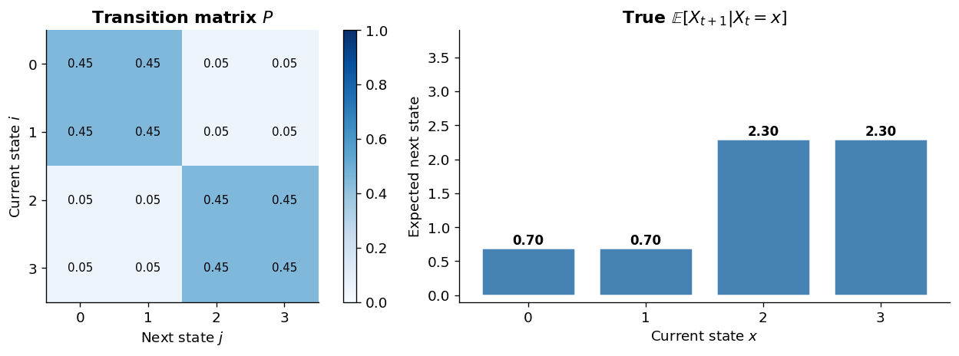
Experiments
We test a “clustered” matrix

Slide 10
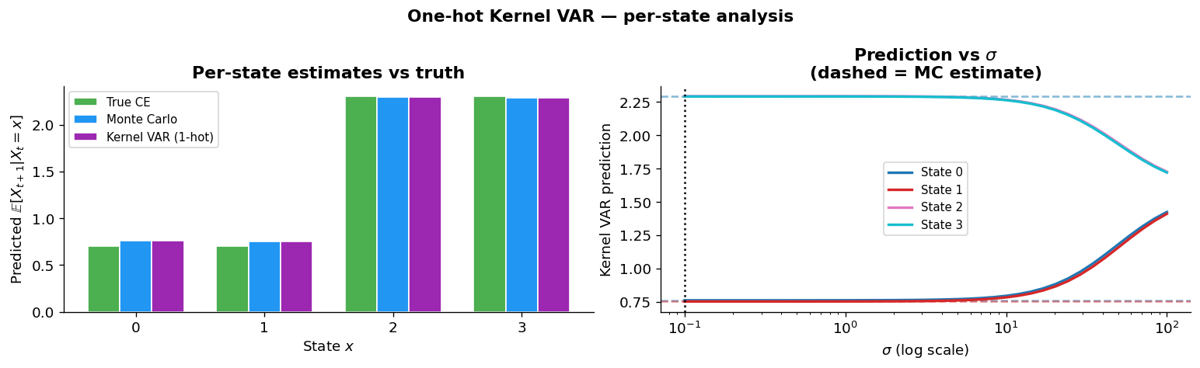
Experiments

Slide 11
Experiments

