Slide 1
NLP/S&DAI
TakeThemOut: A dialogue driven stealth game
Edoardo Vassallo

Slide 2
Creative Project
Difficulty: Not Specified

Slide 3
Development of a stealth game which makes use of VesNA-Pro for agents’ mind design and Intent-based chatbots for natural language interactions, to improve enemy instances’ characterization and hence player’s immersion
Proposal Summary:

Slide 4
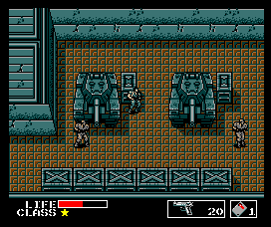
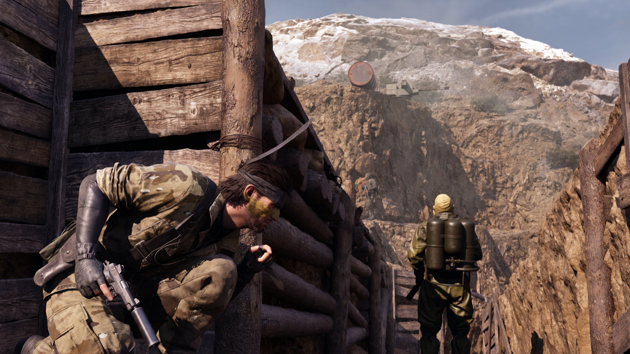
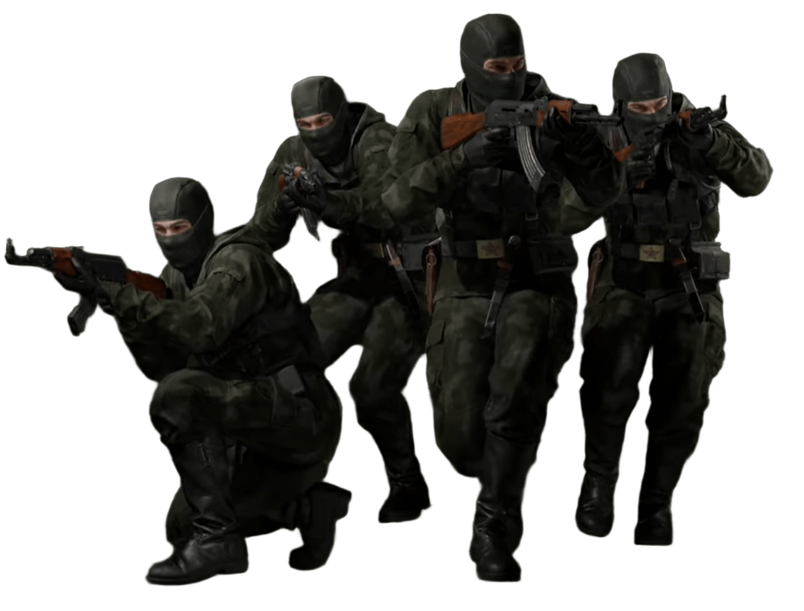

Project Motivation
Uneven Evolution
Metal Gear (1987)
Metal Gear Solid Δ (2025)

Slide 5
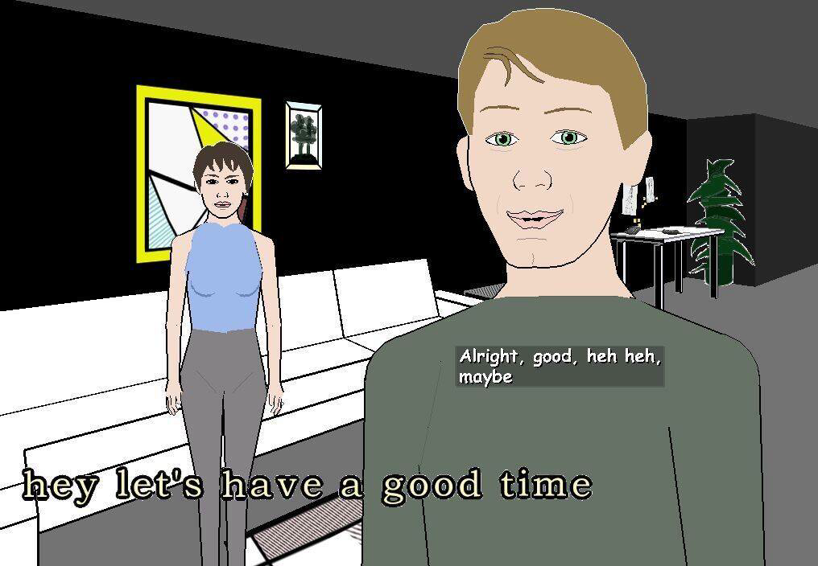
How Do We Improve Instance Characterization?
Method 1:
Temper Based Behaviour
Method 2:
Natural Language Interactions
If Shy:
Hide
…
If Aggressive:
Attack
…
If Scared:
Run Away
…
Else:
Default Behaviour
…
Façade (2005)

Slide 6
Project Overview

Slide 7
Technologies Used
Godot Engine – Environment and agent bodies design
VEsNA-Pro – Agents’ minds design
Rasa – Agents’ chatbots design

Slide 8
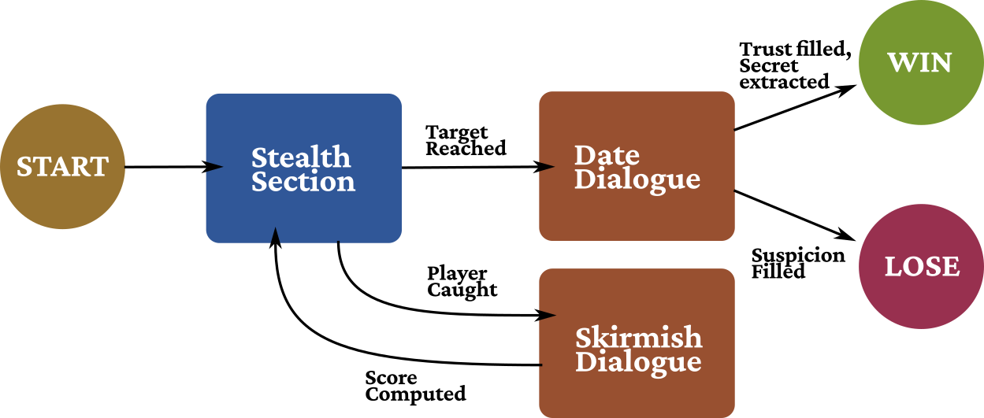
Game Loop
Schema detailing the different phases of the game, and the transitions between them.

Slide 9
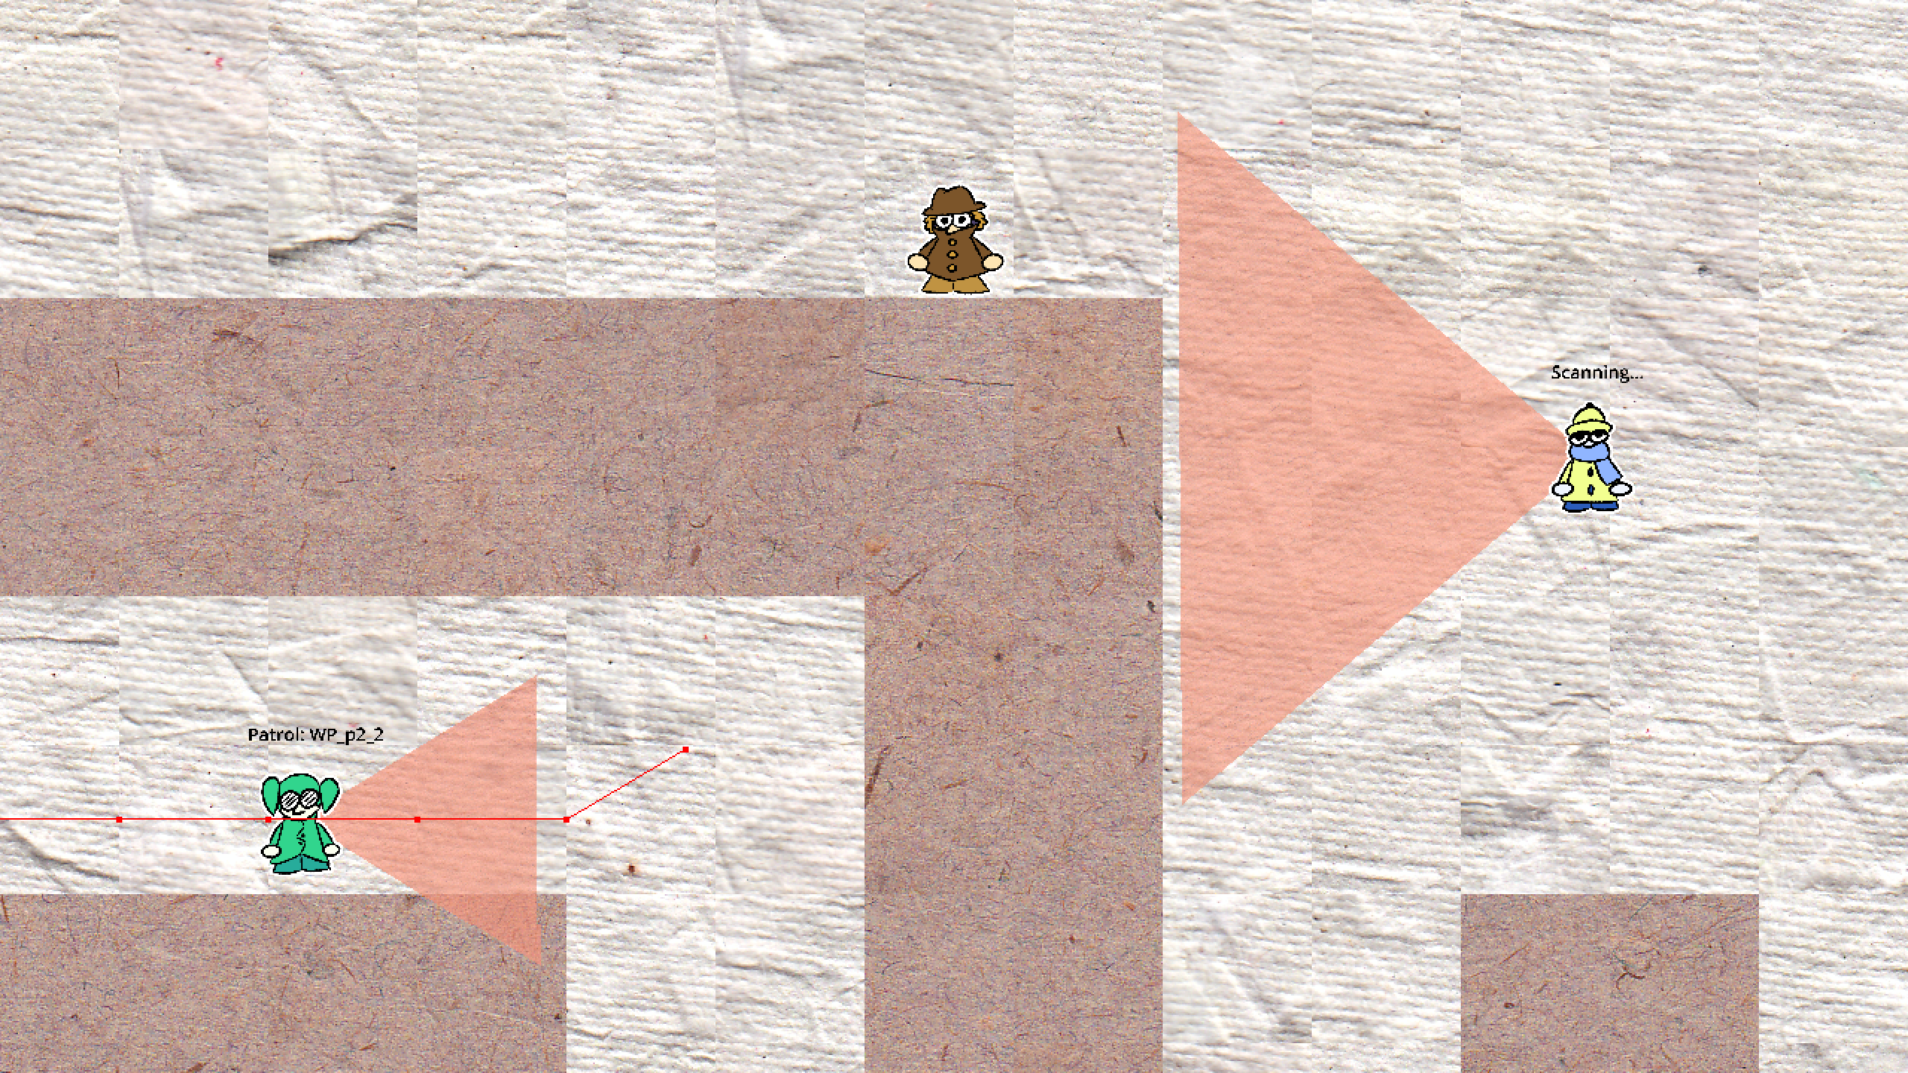
Stealth Section
Screenshot of the Stealth Section

Slide 10
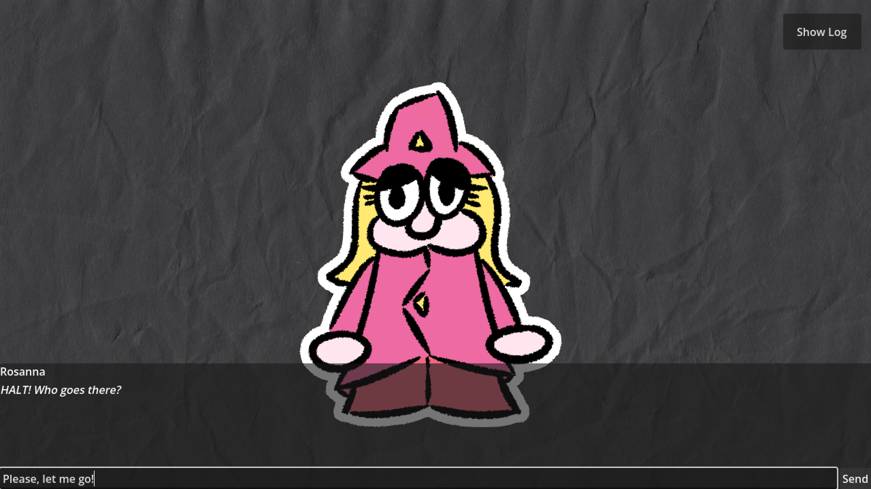
Skirmish Dialogue
Screenshot of the Skirmish Dialogue Section

Slide 11
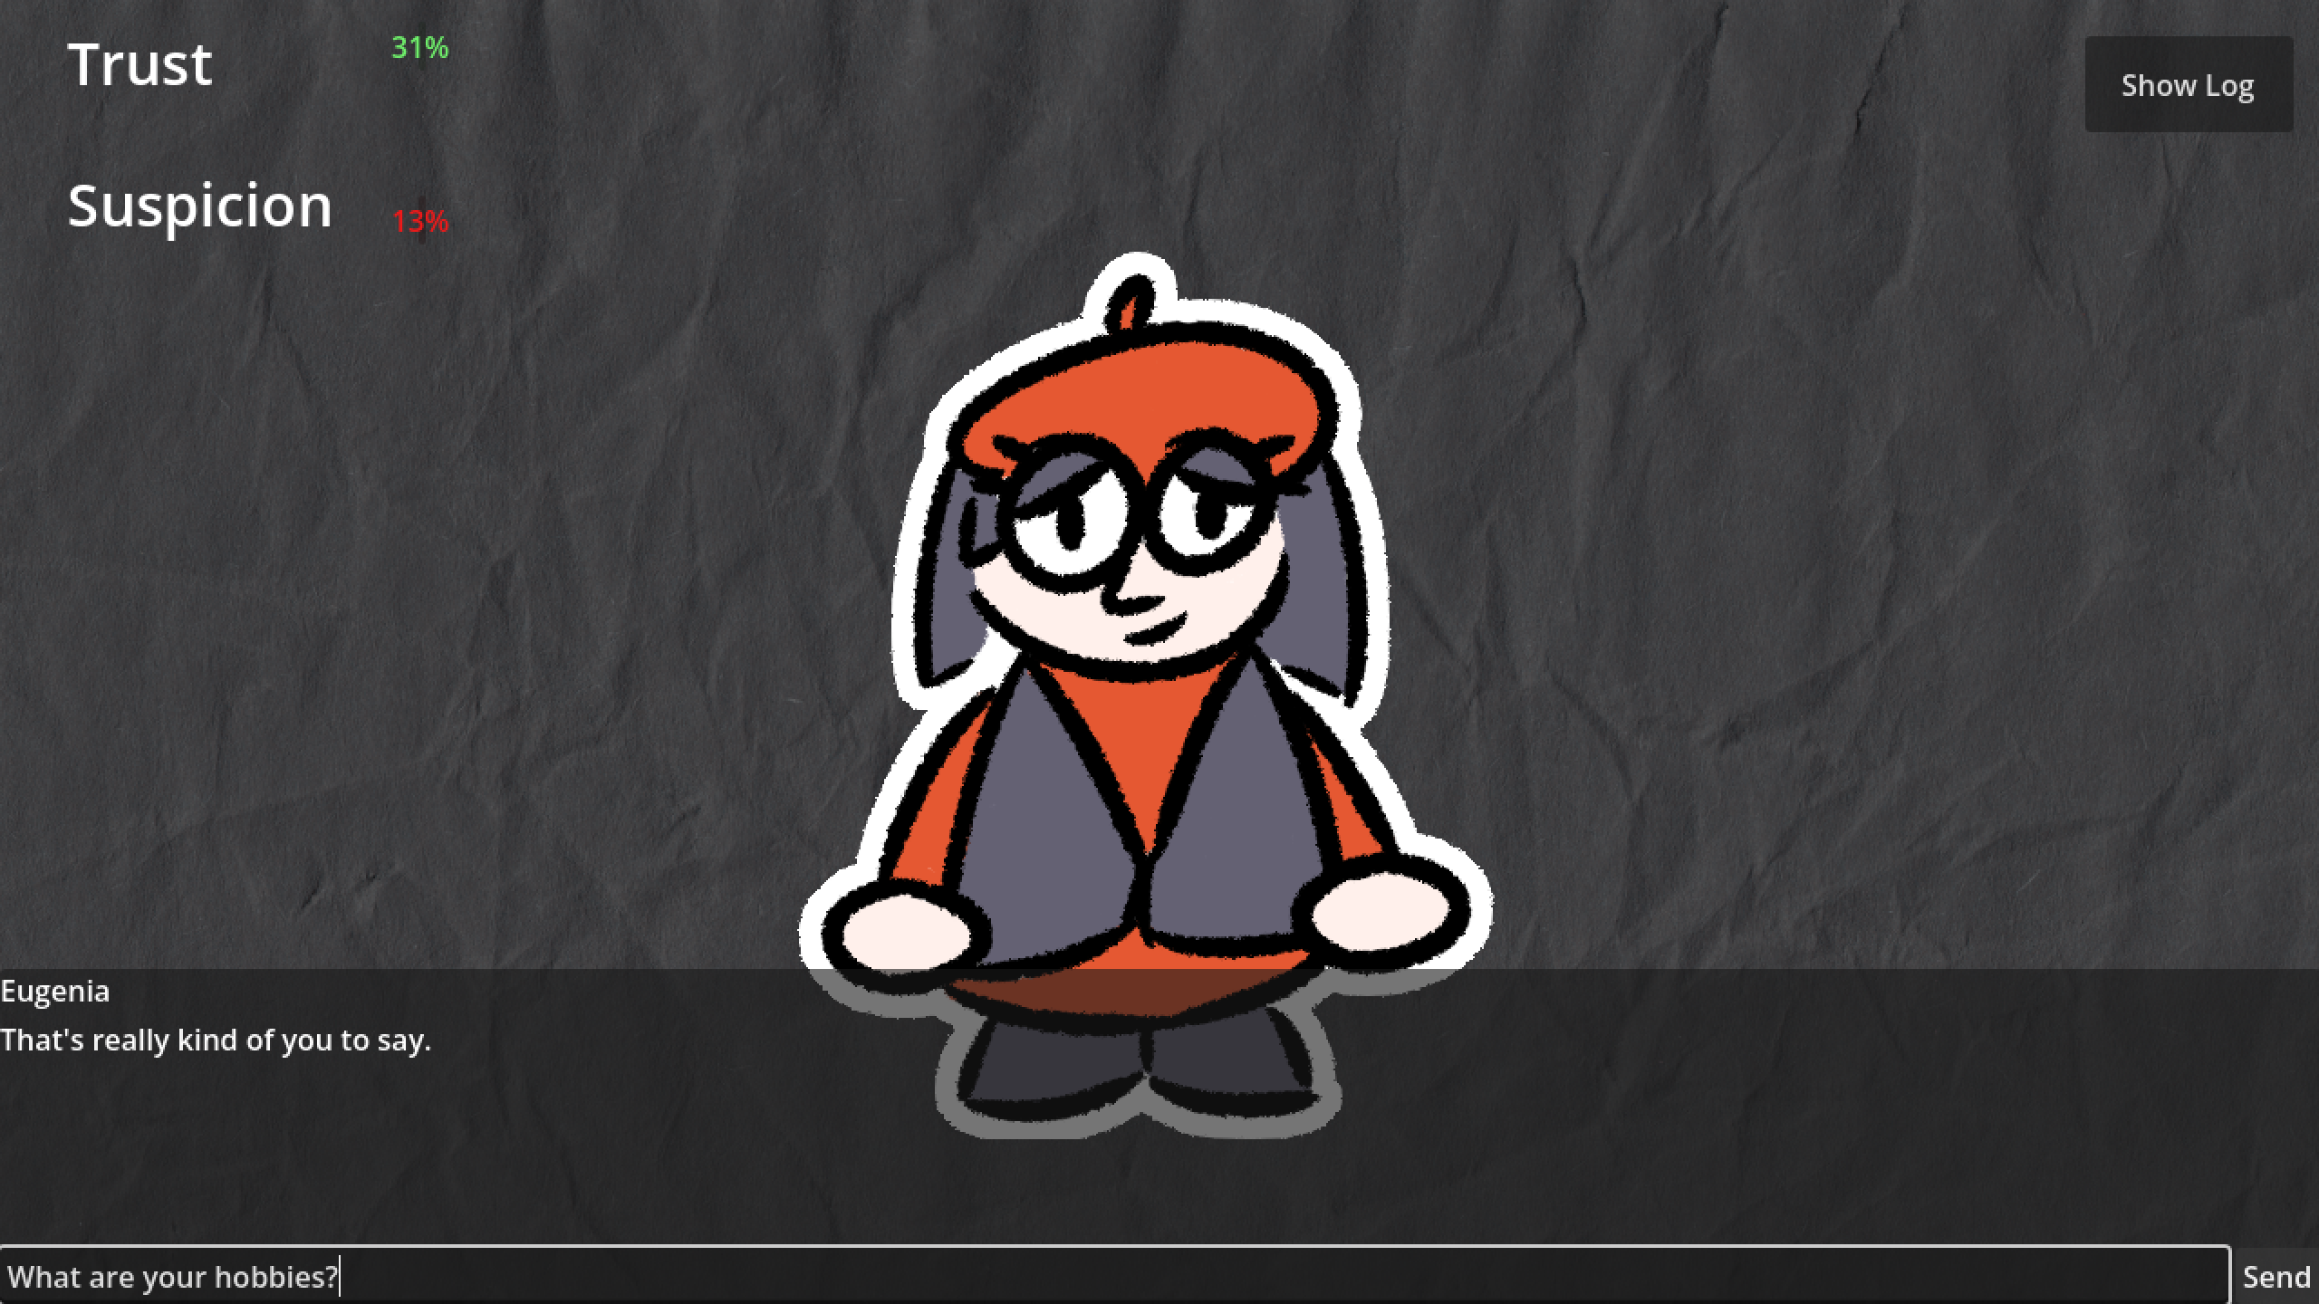
Date Dialogue
Screenshot of the Date Dialogue Section

Slide 12
Reasoning Design

Slide 13
Mind-Body Relationship
The bodies of the agents have been designed as State Machines
The mind is able to transition between the body’s states and modify directly its parameters. Communication between agents happens at the mind’s level
When met with complex events, the body notifies the mind and moves to an Idle state, waiting for its input.

Slide 14
Why Choose A State Machine Approach?

Slide 15



Agent Types
Three types of agents were developed:
Sentry
Patrol
Captain

Slide 16
Agent Types
Sentries
Sentries stand still and alternate between a set of view points. If they spot the player, they alert eventual allies nearby
Two body states:
Scan
Alert

Slide 17


Sentries
Example
The sentry starts in the Scan state, and alternates between two viewpoints
Bodies
Sentry
Mind
Ally
Sentry
Player
Scan

Slide 18
Sentries
Example
The sentry spots the player. The body notifies the mind and goes to the Idle state
Bodies
Sentry
Mind
Ally
Received notification saying Player has been spotted!
Sentry
Player
!
Idle

Slide 19
Sentries
Example
The mind sends the command to move to the Alert state. The body searches for allies nearby, and sends a list to the mind.
Bodies
Sentry
Mind
Ally
Send command to move to Alert.
---
Received list of allies nearby
Sentry
Player
?
Alert

Slide 20
Sentries
Example
The mind notifies its allies. When the alert time is over, the body notifies the mind and moves to Idle.
Bodies
Sentry
Mind
!
Ally
Notify allies
---
Received notification saying Alert time is over.
Sentry
Player
Idle

Slide 21
Sentries
Example
The mind can command to transition back to the Patrol State, closing the loop.
Bodies
Sentry
Mind
Ally
Send command to move to Scan.
Sentry
Player
Scan

Slide 22
Agent Types
Patrols
Patrols move in the maze. When they see the player, they try to catch him, following him even after losing sight. They answer to alerts from Sentries and Captains
Four body states:
Patrol
Chase
Track
Investigate

Slide 23
Patrols
Patrol State
“I’m navigating to point WP1”
WP1
Could also be a coordinate or Agent position

Slide 24
Patrols
Chase State
Player
“I’m moving towards the Player”

Slide 25
Patrols
Track State
Player
“I’m following the player’s trail”
2
4
1
3

Slide 26
Patrols
Investigate State
R3
“I’m patrolling X random points nearby”
4
R1
R2

Slide 27
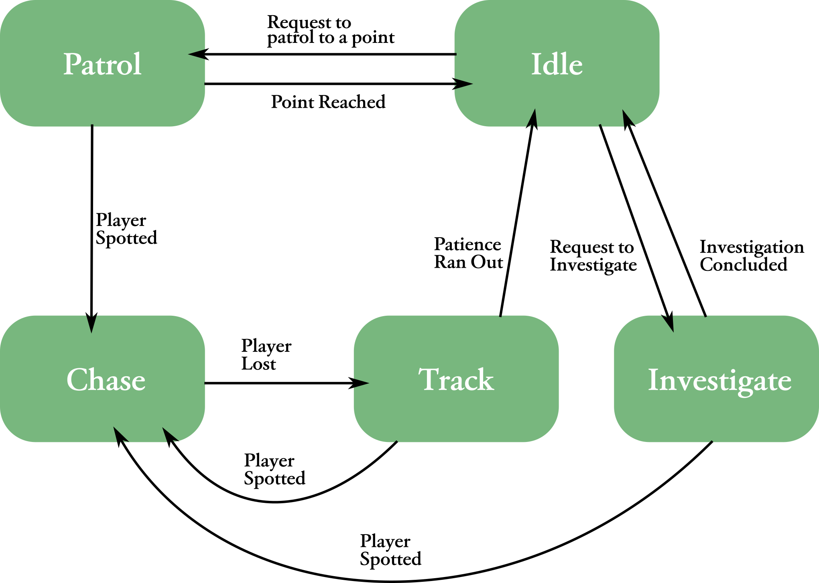
Patrols
Body Transitions

Slide 28
Patrols
Messenger System
Player
“I’ll follow the player, go alert the nearest captain”
2
4
1
3
Ally
A “Super-State” implemented on the mind’s level

Slide 29
Agent Types
Captains
Captains behave similarly to Patrols but add coordination and communication. They patrol between the last player’s sighting locations and alert allies when they spot the player.

Slide 30
Captains
Patrol Computation
When deciding where to move next, the captain asks other agents for the last player sighting
Bodies
Captain
Mind
Ask allies for last player sighting

Slide 31
Captains
Patrol Computation
The allies reply. The captain will move to the average point reported.
Bodies
Captain
Mind
“I saw them in L1”
Received position L1 and L2
---
Send command to Patrol to A1
“I saw them in L2”
L2
A1
L1

Slide 32
Captains
Chase Alert
When the player is spotted, all available allies are alerted
Bodies
Captain
Mind
!
Received notification saying Player has been spotted!
Alerting allies
L2
Player
A1
!
L1

Slide 33
Adding Temper

Slide 34
Temper Components
The minds do not choose their plans based only on beliefs and enevironment events, but also based on personality and mood traits

Slide 35
Traits
The two personality traits are:
Aggressiveness
Laziness
The two mood traits are:
Fear: influenced by encounters with the player
Sympathy: influenced by natural language interactions

Slide 36
Example
Sentry
Default plan:
Send last recorded position
Captain asks for player’s last sighting
Sympathetic plan:
Lie and send nothing

Slide 37
Example
Patrol
Aggressive plan:
Wait for 0.5 seconds, move to next waypoint
Waypoint reached
Default plan:
Wait for 6 seconds, move to next waypoint
Lazy plan:
Wait for 12 seconds, move to next waypoint

Slide 38
Example
Captain
Aggressive + Fear plan:
Do not alert allies, chase alone
Player Spotted
Default plan:
Alert allies, start chasing the player
Lazy + Sympathetic plan:
Directly ignore the player

Slide 39
Chatbot Design

Slide 40
Natural Language Interactions
The player is able to interact with a subset of the agents through natural language in the Skirmish and Date scenes
The agents’ dialogue have been implemented through Rasa intent-based chatbots

Slide 41
Why Choose Intent-based
Chatbots?

Slide 42
Natural Language Interactions
Two bots were developed, one for each scene, sharing the intent detection pipeline, but with different intents and action scripts

Slide 43
Skirmish Bot
Intents
The Skirmish Bot is able to detect the following intents:
Flattery, example: ”You’re clearly the best guard here”
Aggression, example: ”Don’t you dare touch me”
Logic, example: ”My badge is valid for this sector”
Pity, example: ”Please have mercy on me”
Bribe, example: ”I can pay you off to look the other way”

Slide 44
Skirmish Bot
Input Analysis
Based on the player’s input, the chatbot first detects its intent and then its sentiment score using Python’s VADER library.
Based on the current agent personality, a sympathy score is computed, and an answer is selected. The former is passed to the relative agent’s mind

Slide 45
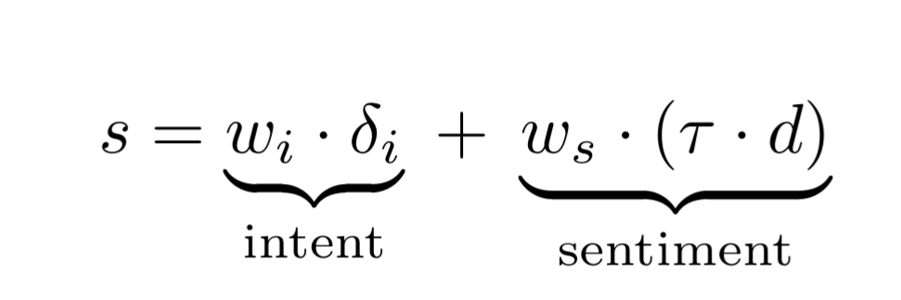
Skirmish Bot
Example Personalities
Instance | Flattery | Bribe | Logic | Aggression | Pity | Sentiment
Rosanna | +1.0 | +0.5 | +0.2 | -1 | -0.5 | Positive
Susanna | +0.2 | -0.5 | +0.9 | -1 | +0.8 | Positive
Polyanna | -0.8 | -0.5 | -0.2 | +0.4 | +0.7 | Negative
Marianna | +0.6 | +0.2 | -0.6 | -0.5 | -0.8 | Positive

Slide 46
Date Bot
Intents
The Date Bot is able to detect the following intents:
Compliment, example: ”I really like your dress”
Curiosity, example: ”What are your hobbies?”
Talking About Oneself, example: ”I’m thinking about changing careers”
Toxicity, example: ”I really can’t stand this conversation”
Asking the Objective, example: ”Tell me the name of the target”

Slide 47
Date Bot
Input Analysis
The bot keeps track of two values, a Trust score and a Suspicion Score. Based on the player’s input and the previous two, the chatbot detetcs the current input and computes new updated scores.
If Suspicion maxes out, the player loses the game.
If Trust is high and Supicion low enough, the player can ask for the objective and receive an answer, winning the game.

Slide 48
Date Bot
Example Scores
Intent | Cold Phase (T < 30) |  | Warm Phase (T < 50) |  | Close Phase (T > 50)
 | ΔT | ΔS | ΔT | ΔS | ΔT | ΔS
Compliment | +10 | +13 | +6 | +11 | +2 | +9
Curiosity | +2 | +3 | +6 | +3 | +10 | 0
Talking about Self | +2 | -3 | +6 | -6 | +10 | -3
Toxicity | -9 | -2 | -13 | -5 | -20 | -9
Ask Objective | -15 | +20 | -9 | +13 | +2 | +7

Slide 49
Integration and Testing

Slide 50
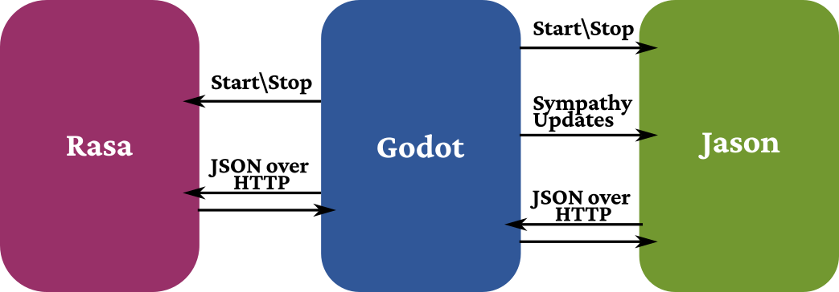
System Integration
Simple schema summarizing communications between the main three system components

Slide 51
Testing
The system was developed on an Arch Linux machine, and tested on both Linux and Windows based machines.
Issues were found with initialization and startup of Jason and Rasa on the latter system.

Slide 52
Issues
Besides the previous, the following issues were detected:
Agent could often get stuck in the maze. This is a problem strictly related to Godot’s navigation system
Chatbots often failed to generalize and detect the correct intent on complex sentences. This is related to the quality and quantity of its training data.

Slide 53
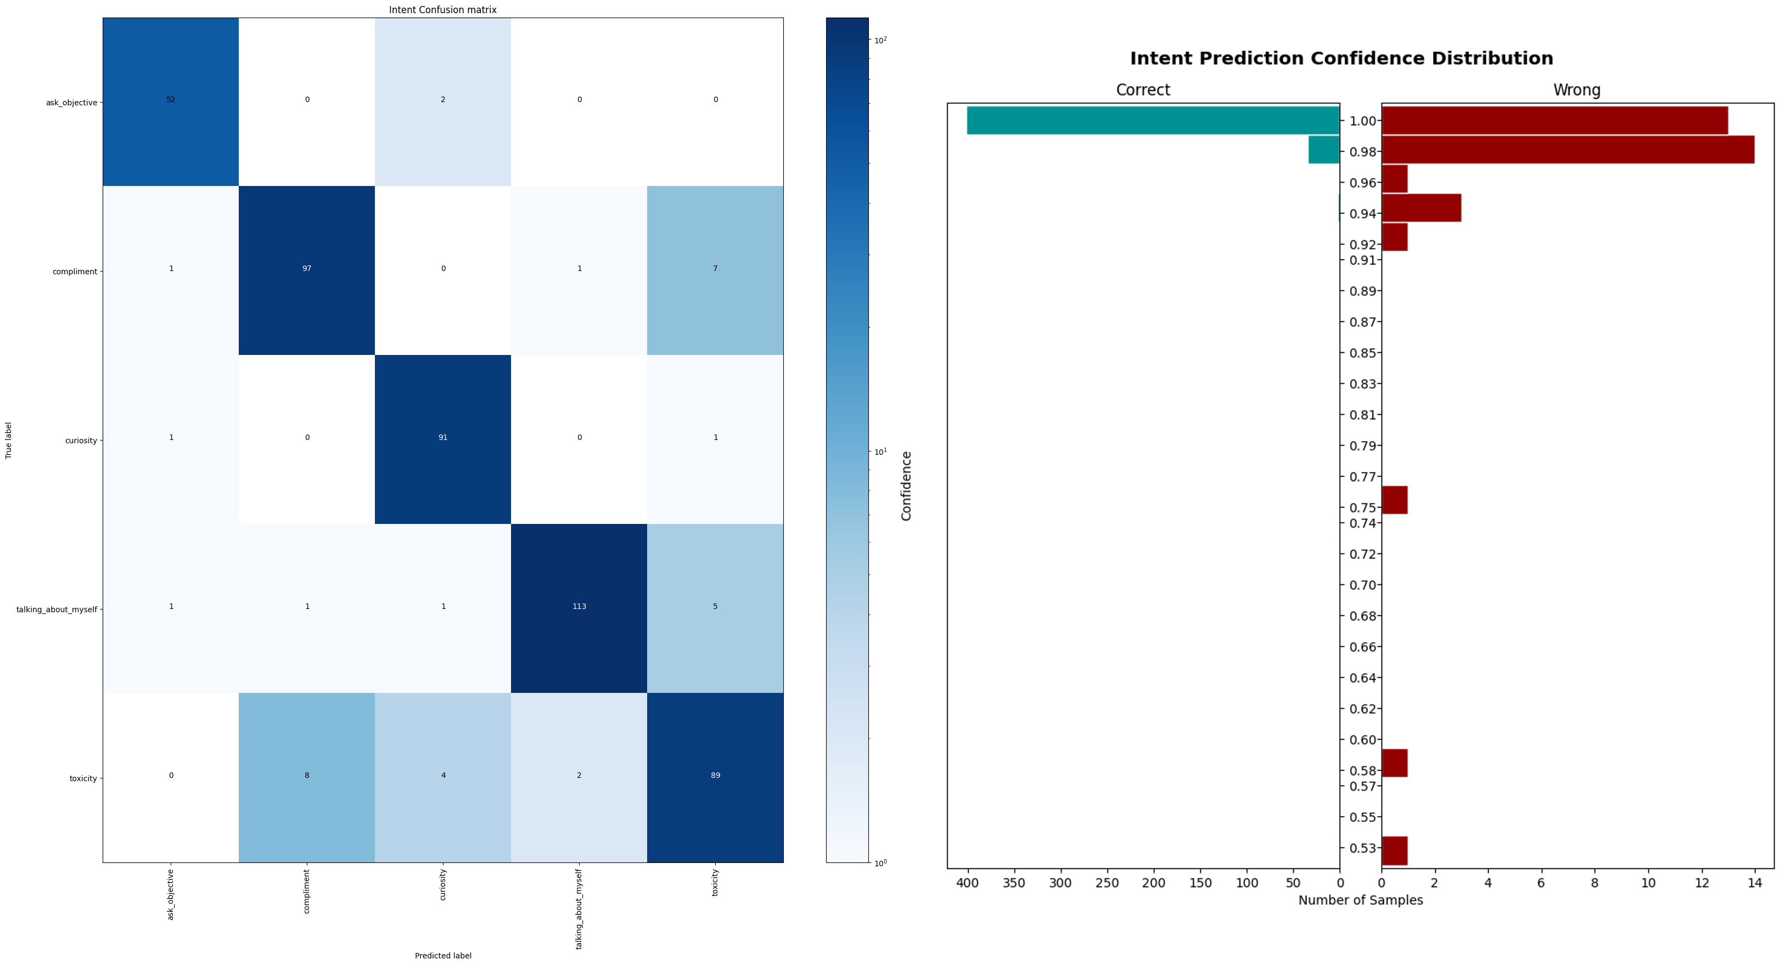
Issues
Crossvalidation Results (Date chatbot)

Slide 54
Final Remarks

