Slide 1
Air Quality Visuals
With MongoDB
MongoDB tool exploration
Kevin Liao
Big Data Tools & Techniques
2024

Slide 2
Goals
Explore Visuals with MongoDB
Get more comfortable with cloud based utilities instead of self hosted tools
  Technology constantly changes, should learn on IaaS/SaaS more
Not spend money

Slide 3
Steps
Obtain Data: https://www.kaggle.com/datasets/threnjen/40-years-of-air-quality-index-from-the-epa-daily/data
Cut/Clean Data
  Too large for Free Atlas (reduce data)
  awk -F ',' ' ($2 >= "1980-01-01" && $2 <= "2011-12-31") {next} {print} ' aqi_daily_1980_to_2021.csv > aqi_daily_2011_to_2021.csv
Register a MongoAtlas account
  https://cloud.mongodb.com
Download MongoDB Compass (Client Interface)
  https://www.mongodb.com/try/download/compass
Connect Compass with Atlas
  Configure Compass to connect to your MongoDB Atlas cluster using your cluster credentials.
Familiarize with MongoDB Atlas Charts

Slide 4
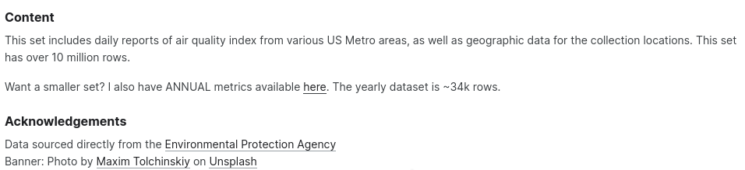
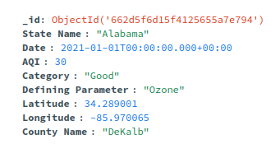
Data

Slide 5
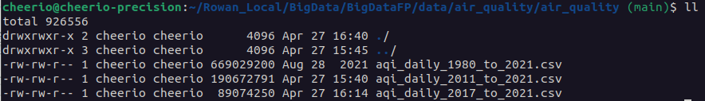
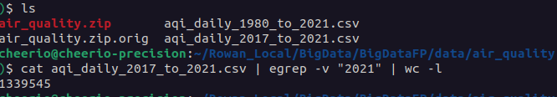
Cut Data
Limited to 500 Mb
Had to cut daily data from 10 million records from 1980-2021 to 1.37 million records 2017-2021
awk -F ',' ' ($2 >= "1980-01-01" && $2 = "2016-12-31") {next} {print} ' $input_file > $output_file

Slide 6



MongoDB
Local
MongoDB Compass
  Mongos GUI Desktop Utility
MongoDB Atlas
  Mongos online SaaS
  Billing structure like Azure
MongoDB Charts
  Online SaaS visualization tools like Tableau
  Free tier limits
Cloud

Slide 7
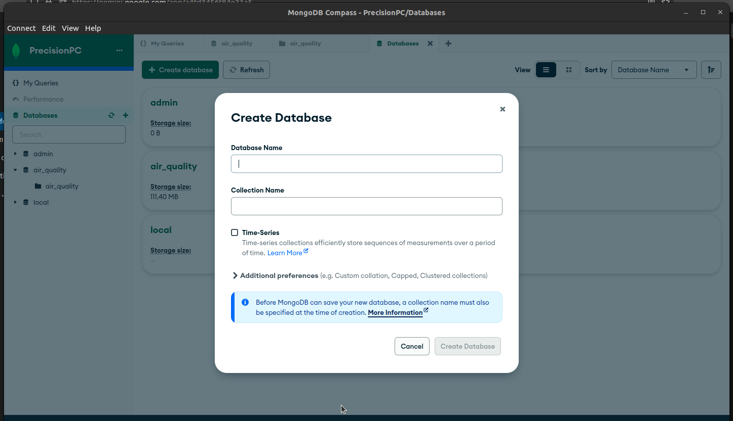
Import Data w/ MongoDB Compass

Slide 8
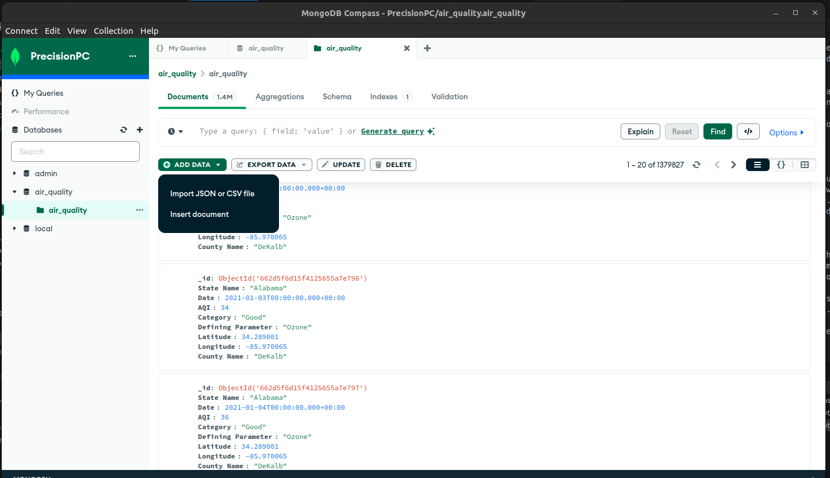
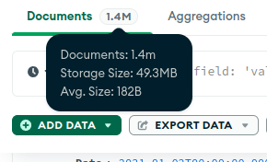
Import Data w/ MongoDB Compass

Slide 9
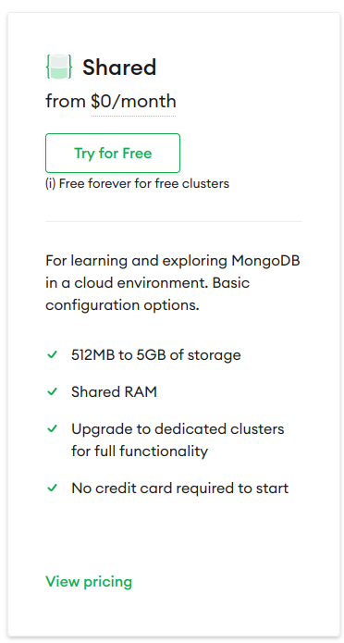
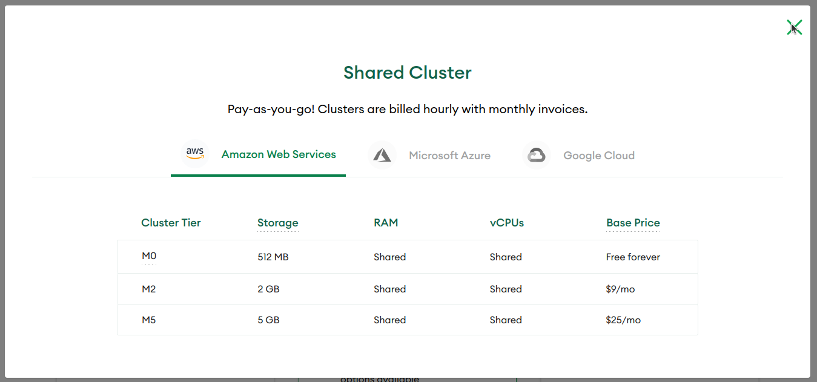
MongoDB Atlas Free Tier
https://www.mongodb.com/pricing

Slide 10
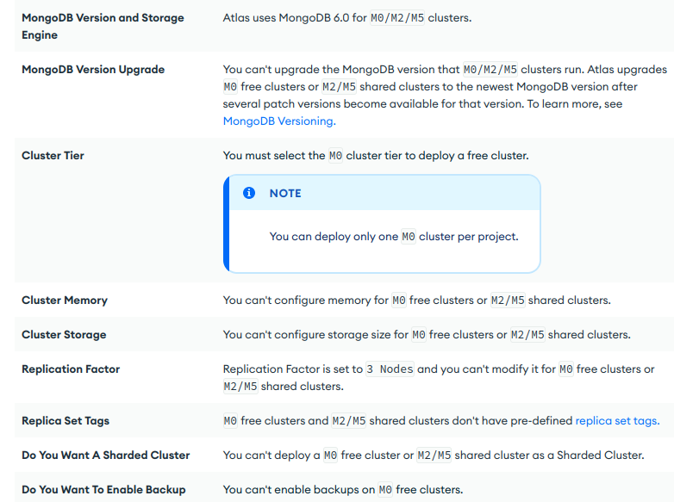
MongoDB Atlas Free Tier
https://www.mongodb.com/docs/atlas/reference/free-shared-limitations/

Slide 11
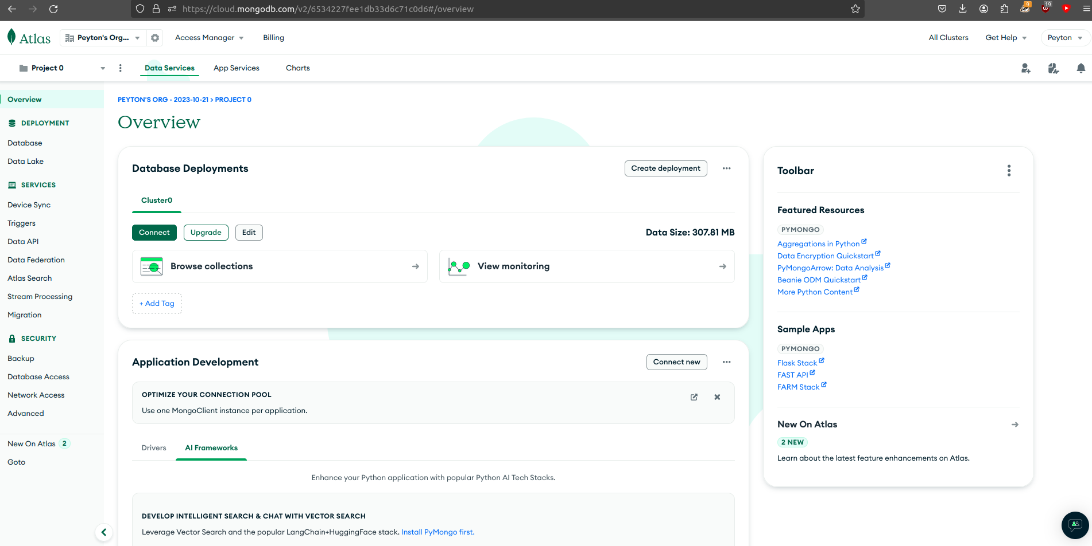
MongoDB Atlas

Slide 12
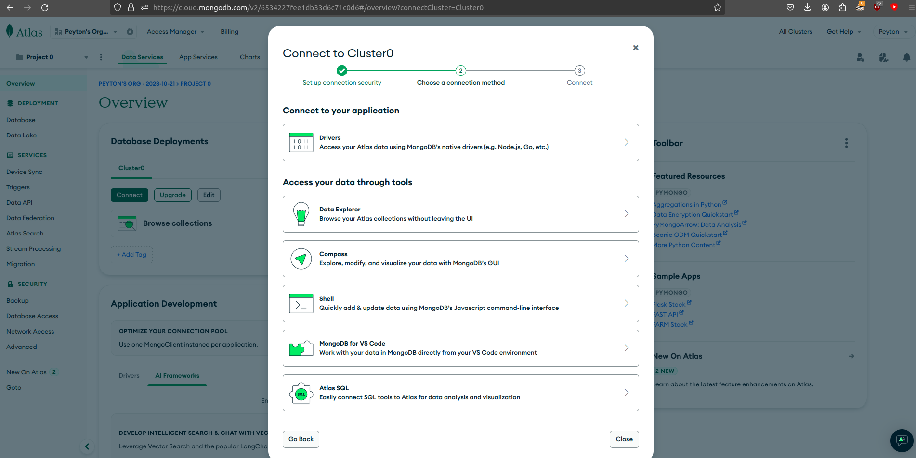
Connecting Compass to Atlas

Slide 13
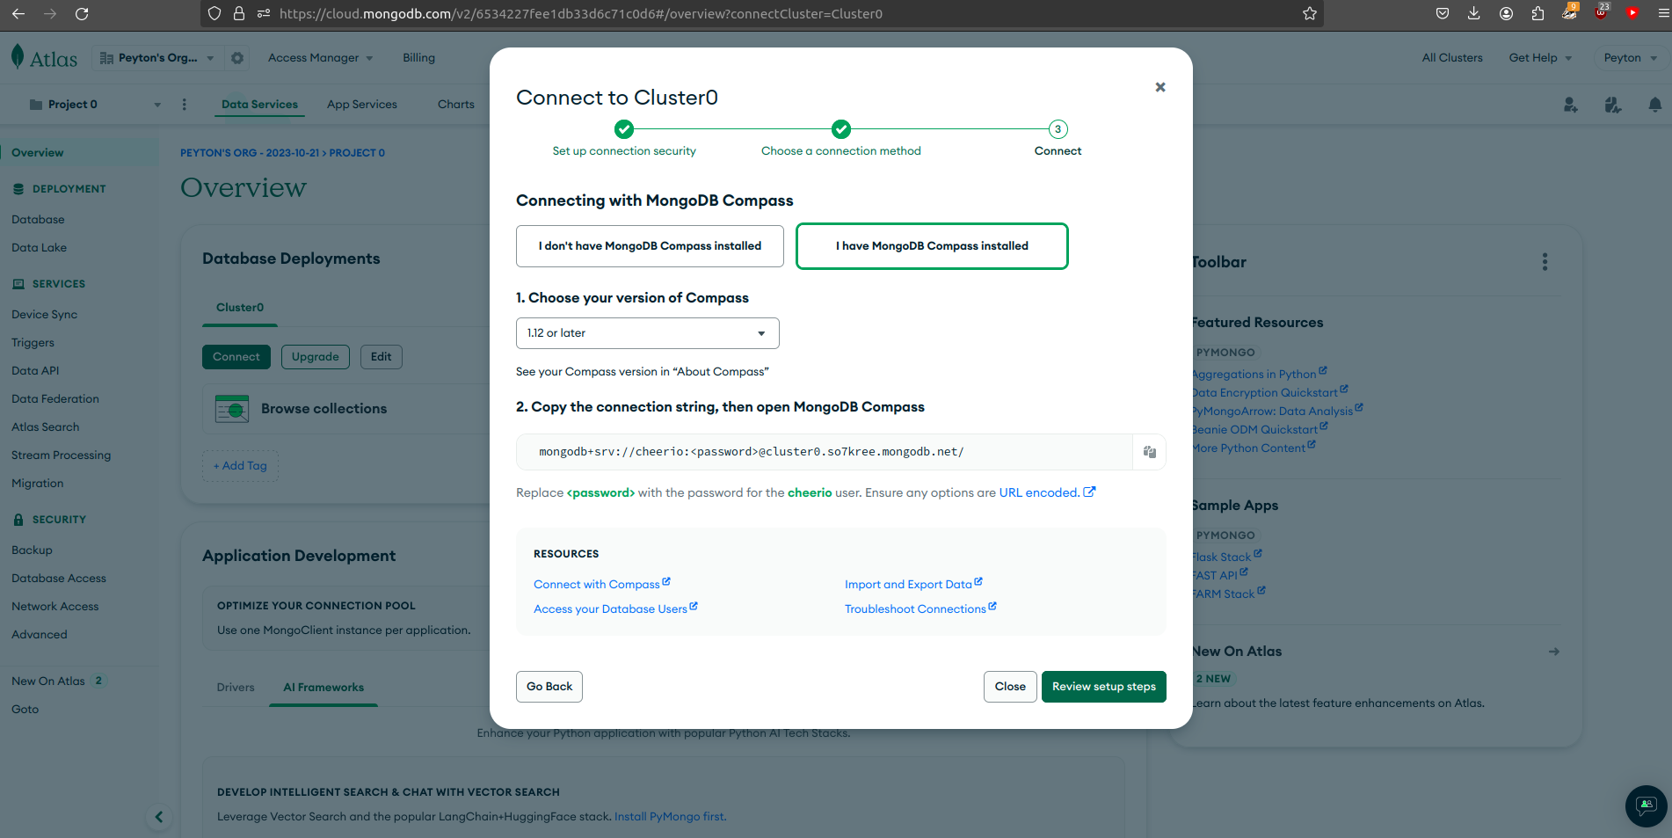
Connecting Compass to Atlas

Slide 14
Connecting Compass to Atlas

Slide 15
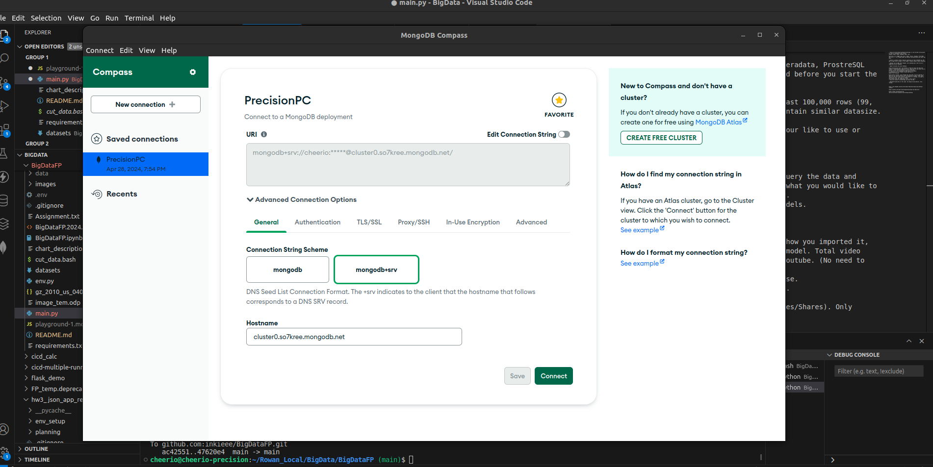
MongoDB Compass Connection

Slide 16
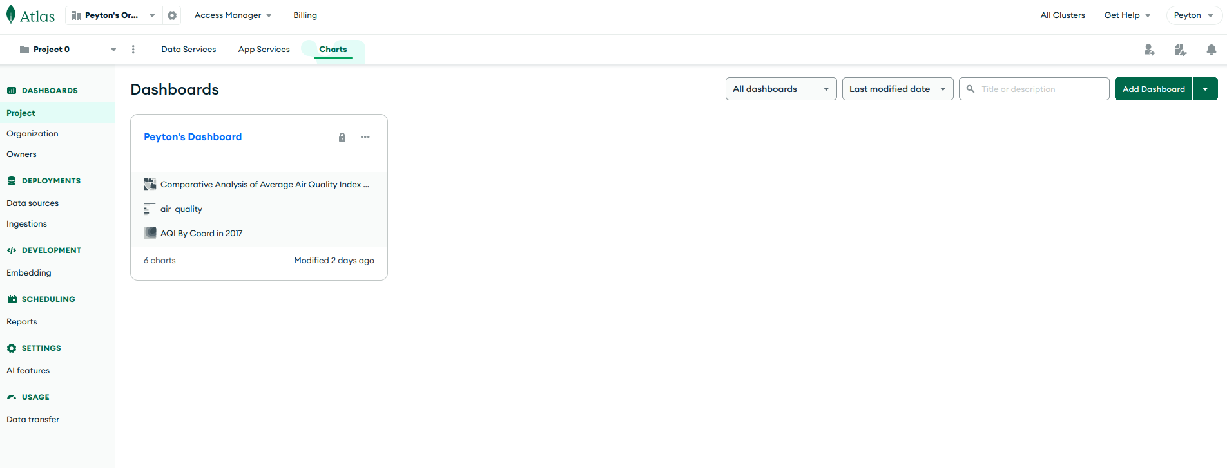
MongoDB Charts

Slide 17
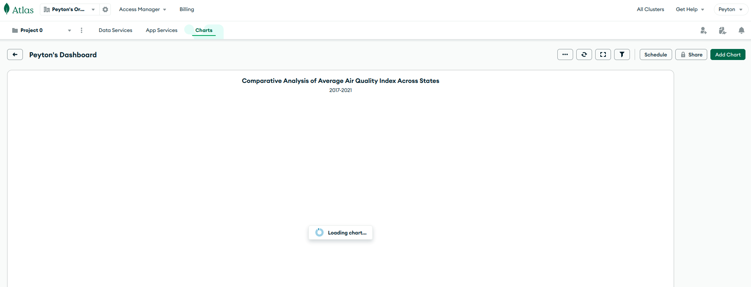
MongoDB Charts

Slide 18
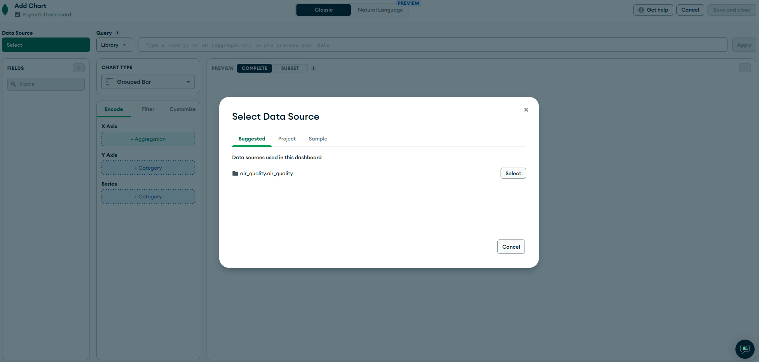
MongoDB Atlas Charts

Slide 19
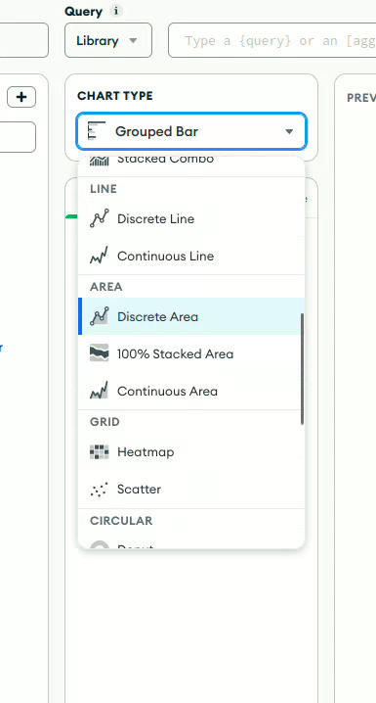
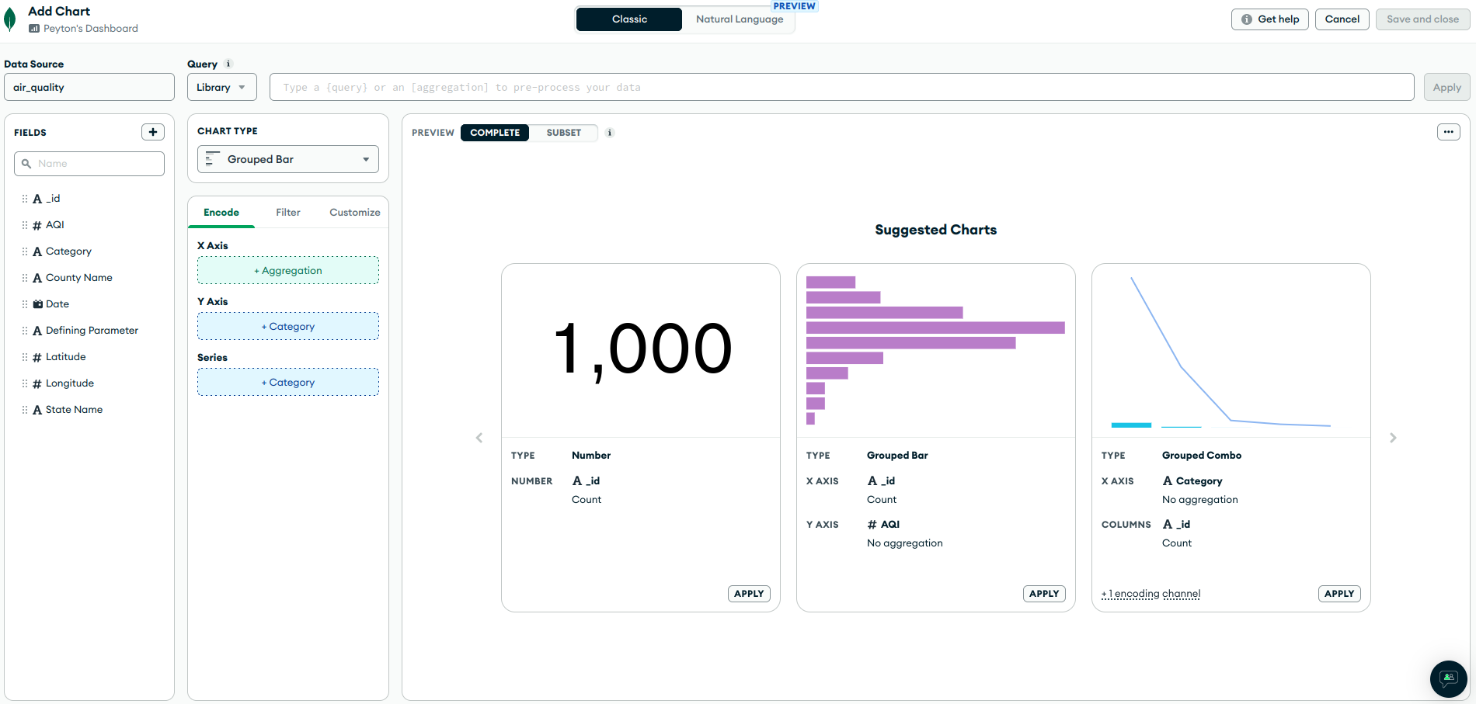
MongoDB Atlas Charts

Slide 20
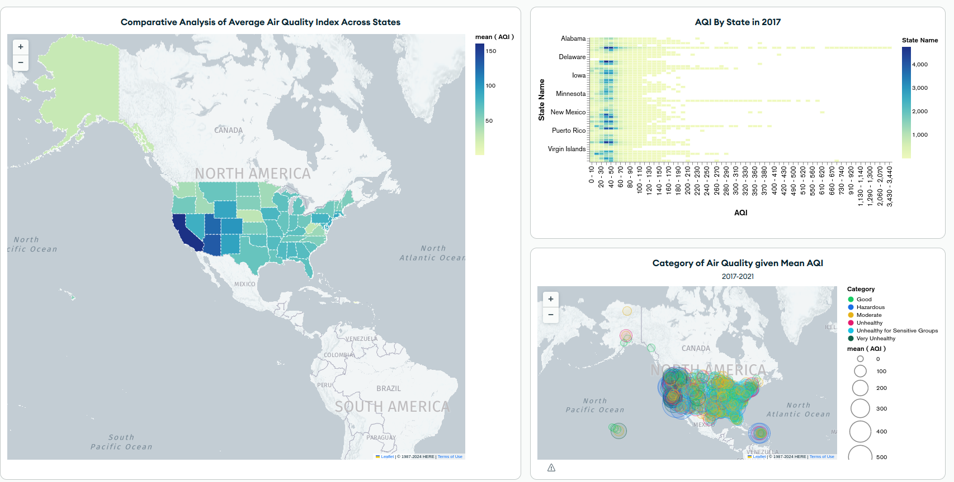
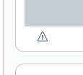
MongoDB Chart Limitations

Slide 21
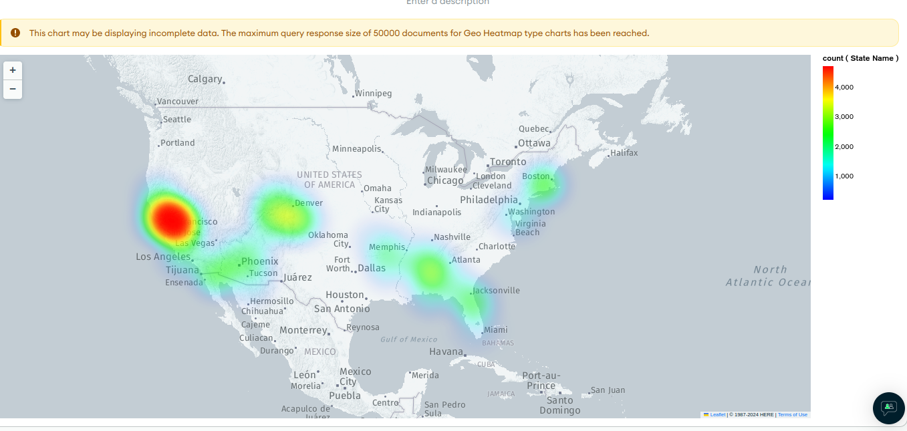
MongoDB Chart Limitations

Slide 22
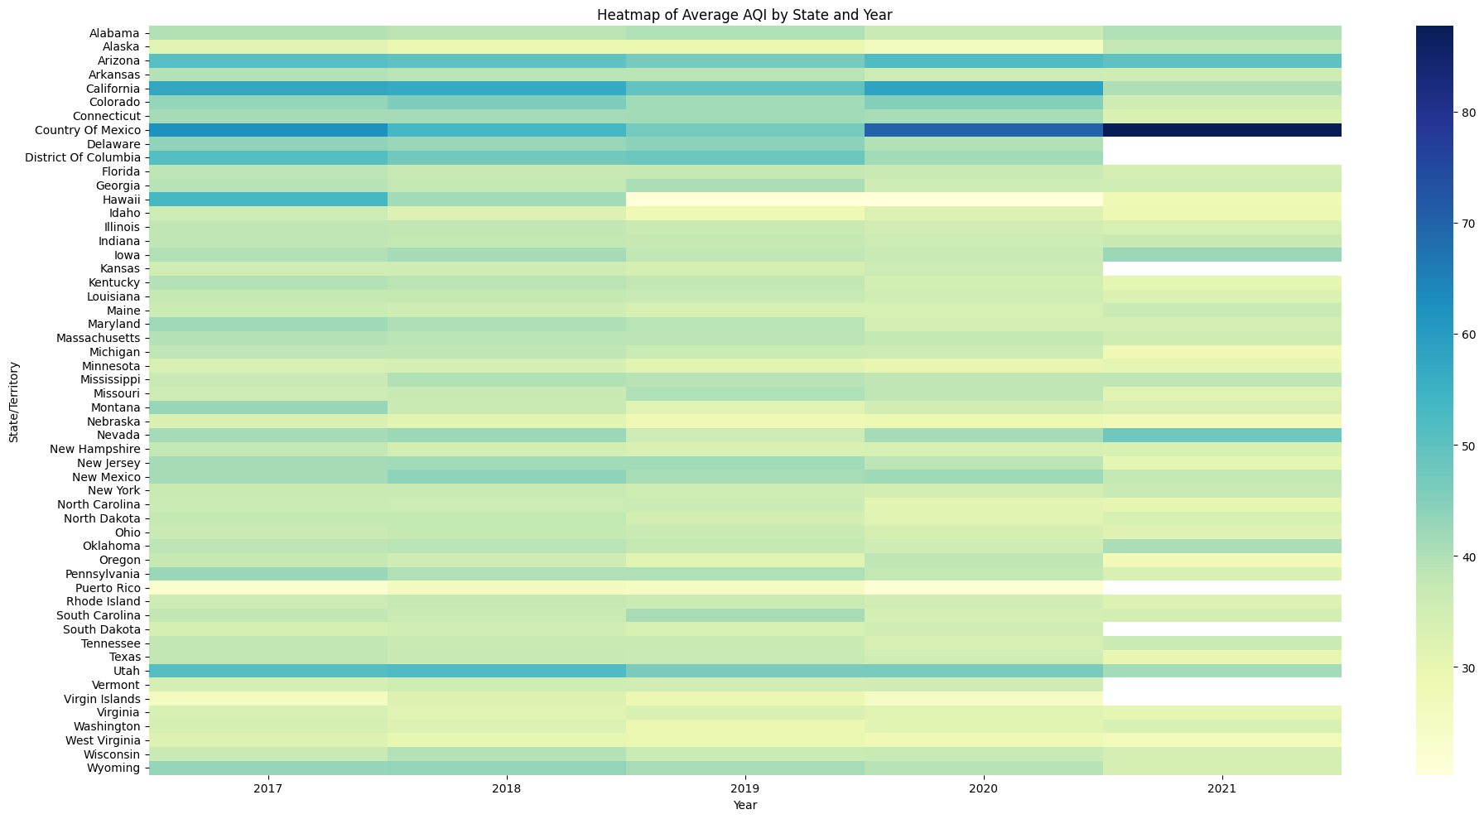
Visual/Model 1

Slide 23
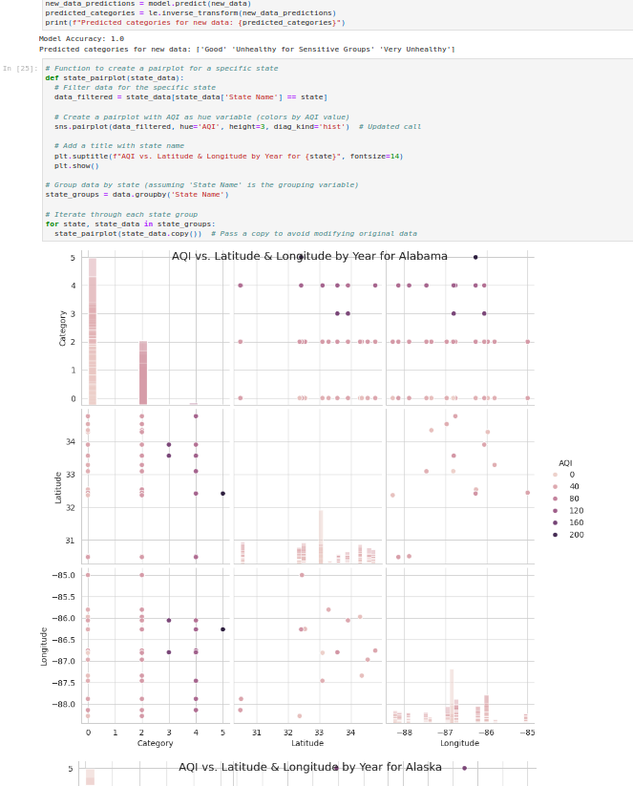
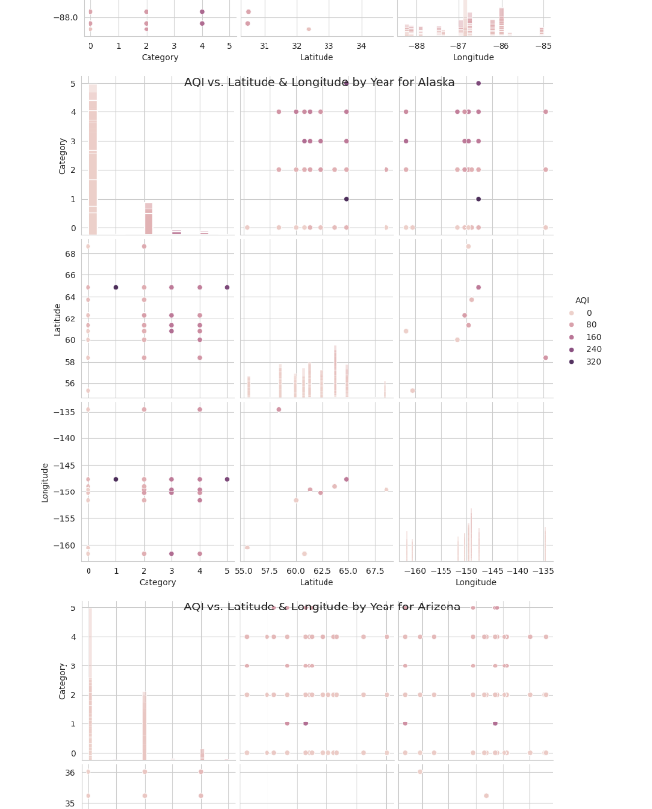

Slide 24
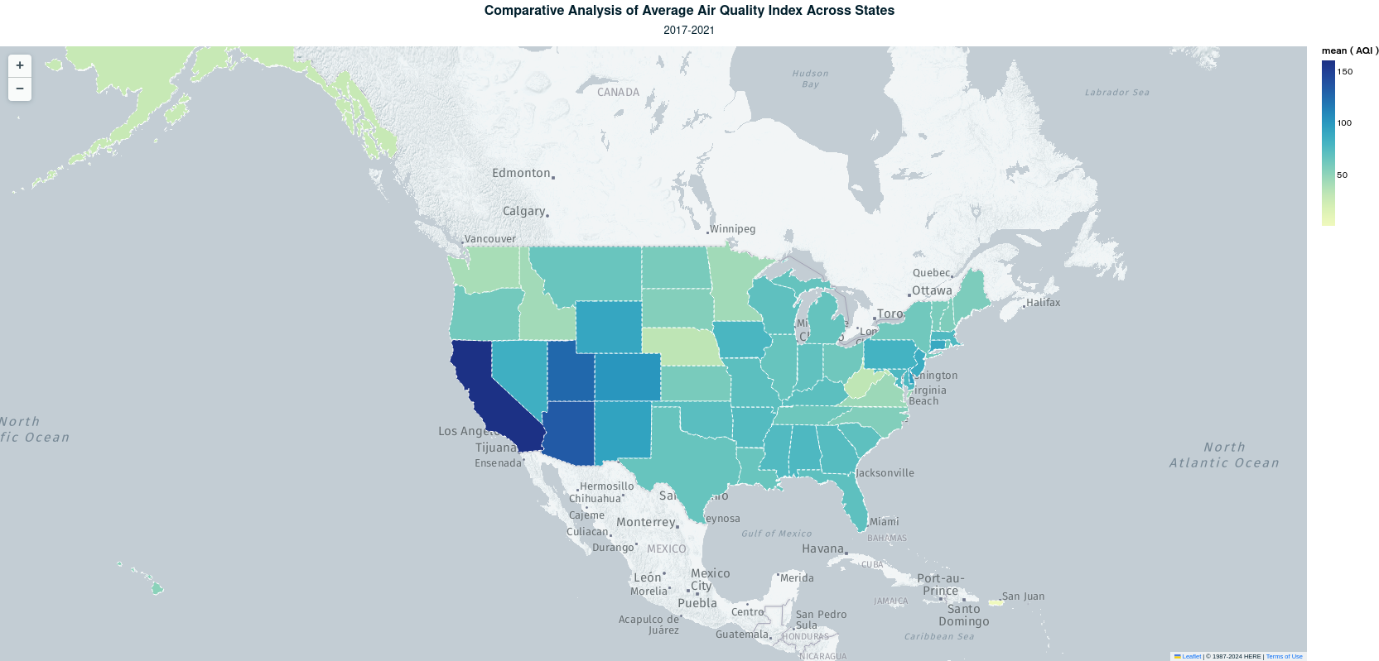
Visual/Model 1

Slide 25
Visual/Model 1

Slide 26
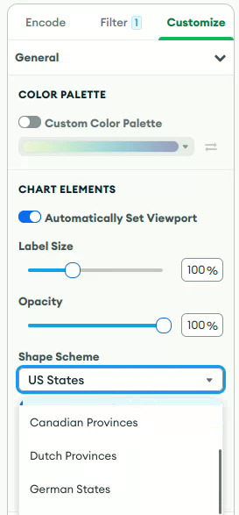
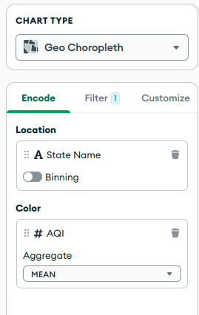
Visual/Model 1

Slide 27
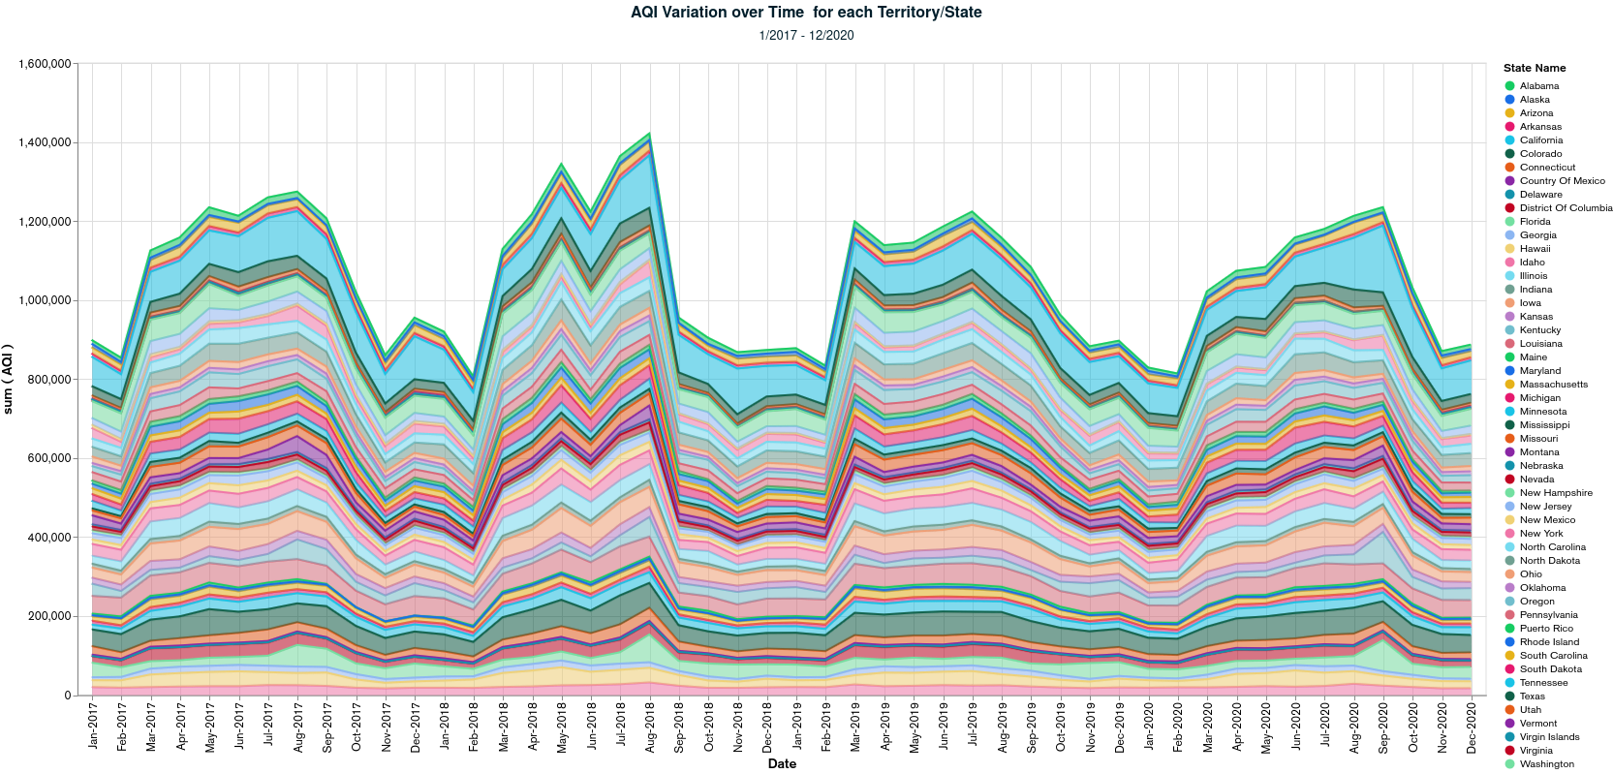
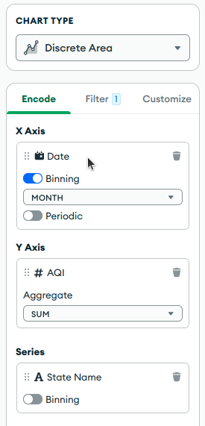
Visual/Model 3

Slide 28
Visual/Model 3

Slide 29
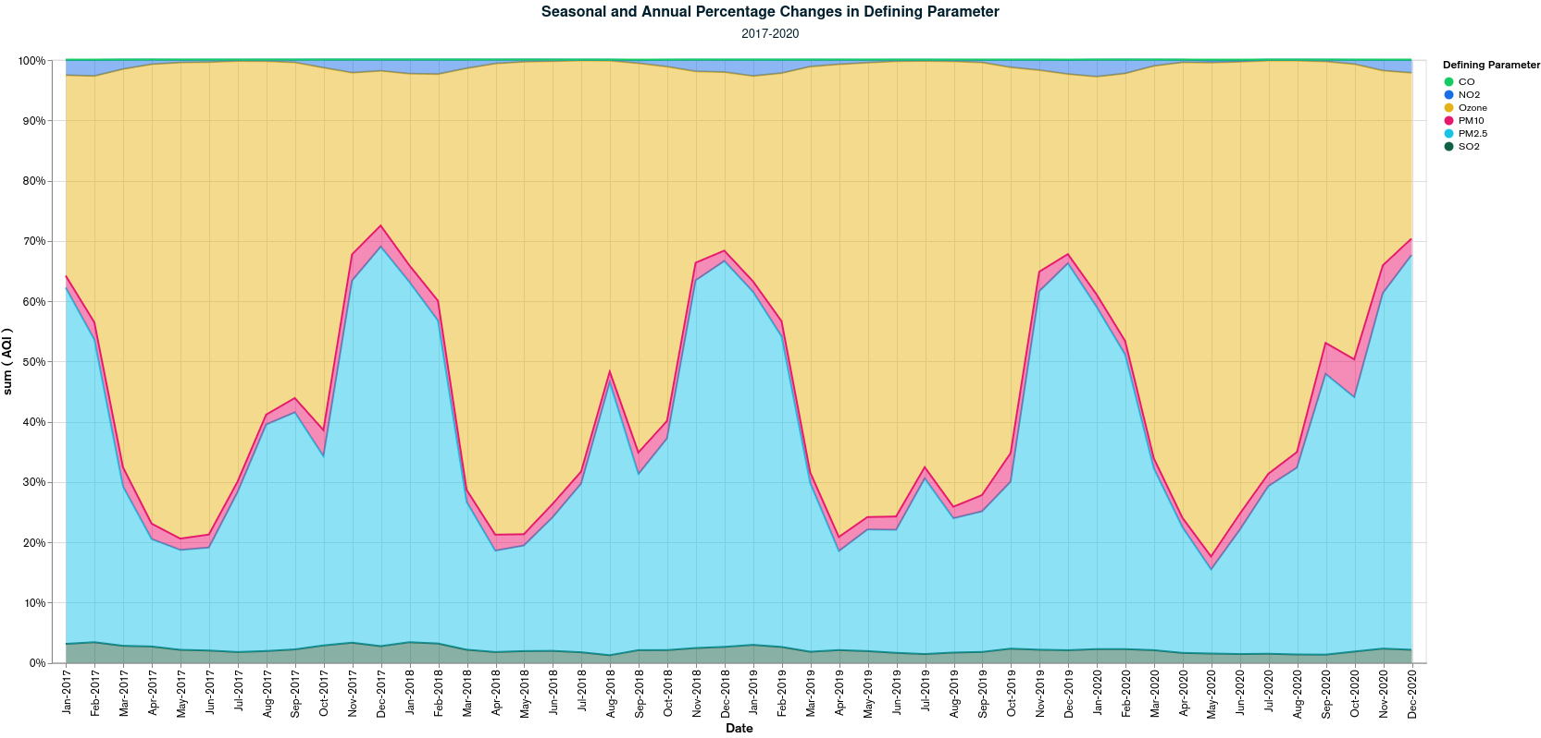
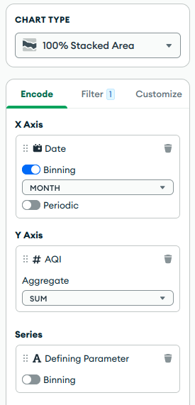
Visual/Model 2

Slide 30
Visual/Model 2

Slide 31
Github Repository
https://github.com/inkieee/BigDataFP

Slide 32
Like/Dislike
Liked
  Exposure to a lot of different tools
  CICD
  Distributed HA concepts
  Various DB types
  Example git repos
Disliked
  Required using up free trials to complete assignments
  Couldn’t download gitbook easily

Slide 33
Thanks!

Slide 34
Following slides here for posterity

Slide 35
GitHub Limitations

Slide 36
GitHub Limitations
“Additionally, had some issues with uploading document data into github for free for too large file sizes.”

Slide 37
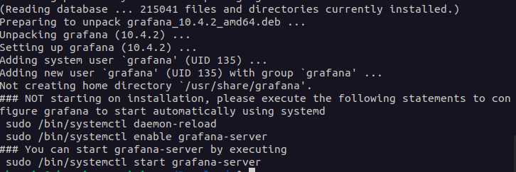
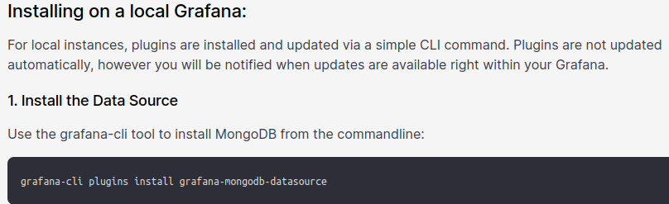
Grafana Attempt
Enterprise only

Slide 38
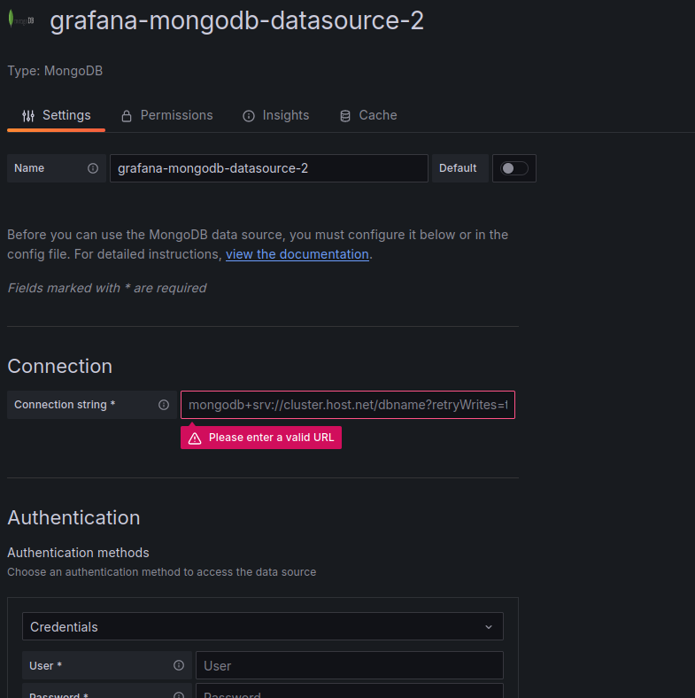
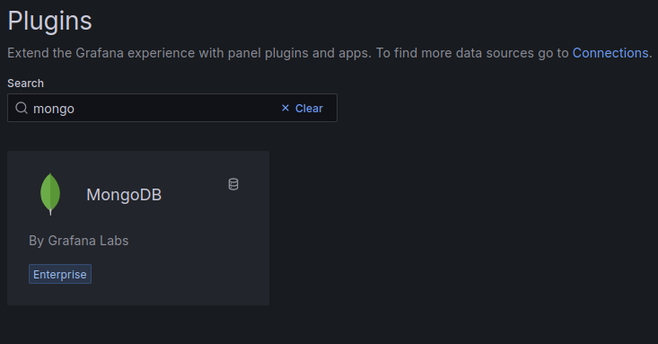
Mongo w/ Grafana
Looks exactly like free self hosted :v

Slide 39
Grafana Attempt
“
Initial project attempts included Grafana and Tableau, all of which were new tools to me, which I encountered other issues. For example Grafana requires a mongodb-plugin that is only available to Enterprise accounts of grafana, even when hosted locally from your machine, the plugin verifies against some enterprise key and if incorrect, will not allow mongodb connections. You can use the online Grafana SaaS service which also has it's own payment structure like Azure or MongoAtlas, but also requires an enterprise key. You can use a free trial for 2 weeks though.
”

Slide 40
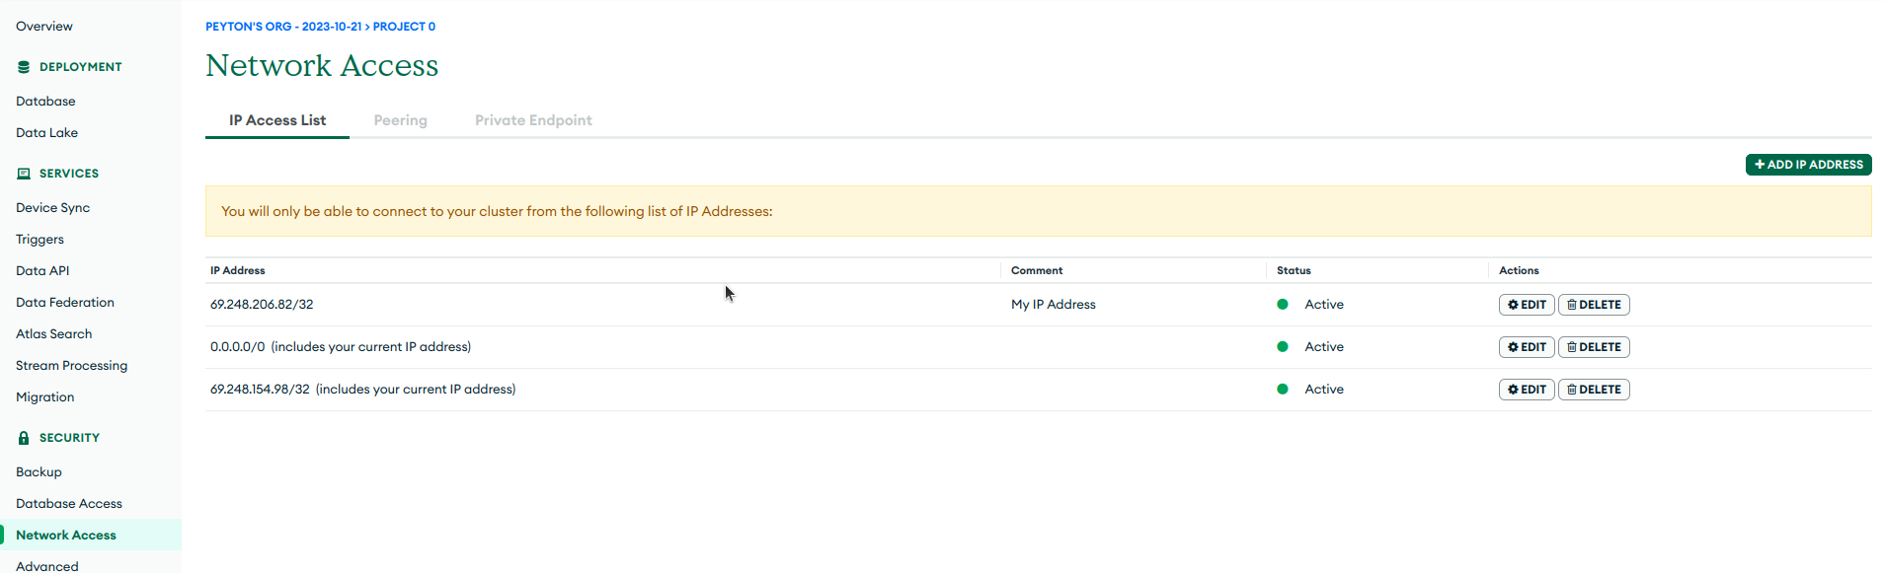
Mongo w/ Grafana

Slide 41
Mongo w/ Grafana
“
Being hosted on Grafana servers though, we do have to modify our MongoDB network connection profile to be open to the internet (0.0.0.0 netmask 0) which allows all connections (including from grafana IPs).”

Slide 42
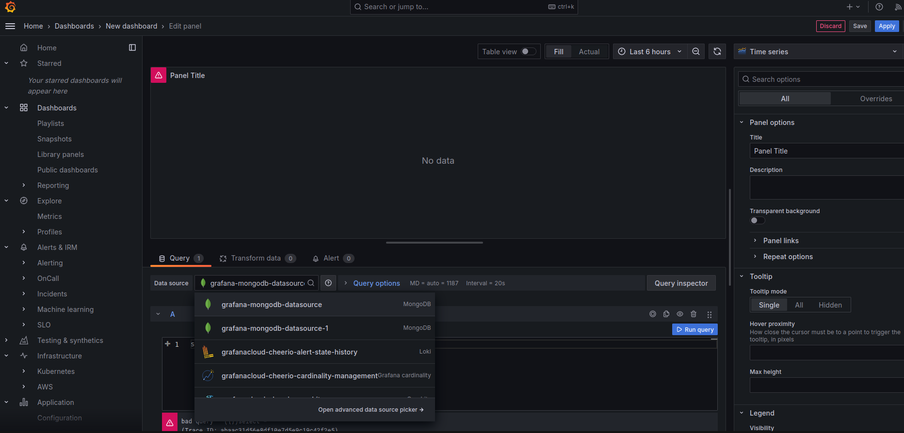
Grafana issues w/ Cloud

Slide 43
Grafana issues w/ Cloud
“
Annoyingly I had issues with generating queries of any type and decided not to invest too much time on something that would expire in 2 weeks anyway.
“

