Slide 1

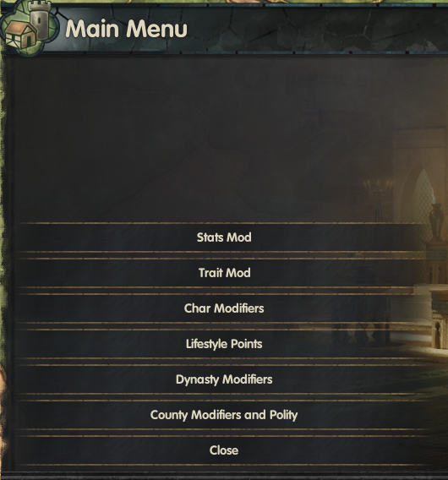
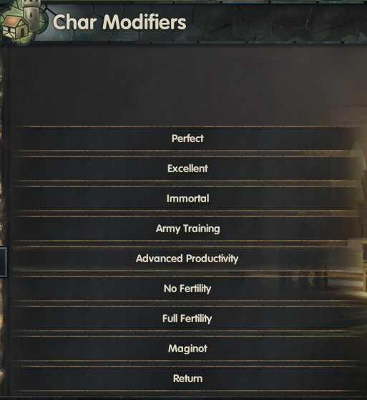
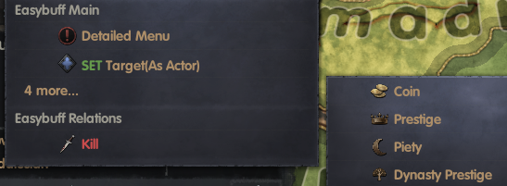
Easy Buff
for CK3
9.12update: Take specific title
Updated for v1.1

Slide 2
Chinese Font Cu Yuan
方正粗圆字体
for CK3

