Slide 1
Analyzing spatial data to find the best neighborhoods for the establishment of a new Italian Restaurant in New York City.
Applied Data Science Capstone
IBM Data Science Professional Certificate

Slide 3
Part 1: Problem Description
The first Italian restaurants in New York, date back to the 1860s. New York has a history when it
comes to Italian food and restaraunts, with a plethora of immigrants from Italy having been established
there and having brought their culture as well as cousine.
So it is fair to say that anyone wishing to establish a new Italian restaurant, will have to deal with a lot
of already existant competition on this specific field.
Using the Foursquare API, we will be able to eliminate many competitors, simply by finding the top
rated restaurants. Finally we will be able to visually find neighbourhoods far away from these
restaurants, that are potential places.

Slide 4
Part 2: Data We Need
Longitude and Latitude Data:
We will need geo-locational information about all the neighborhoods in New York
Feature Data:
We will need venue information for each neighborhood from the Foursquare API.
We will need ratings of the Italian restaurants in that we find.

Slide 5
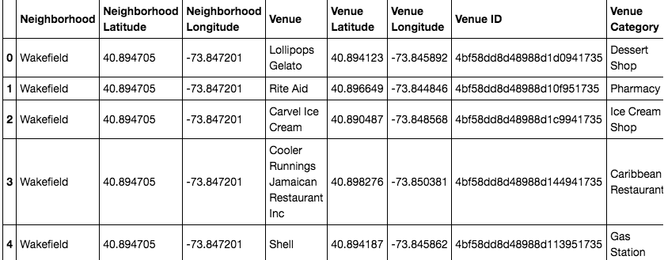

Slide 6
Foursquare API
Connecting to Foursquare and Retrieving Locational Data for Each Venue in Every Neighborhood
After finding the list of neighborhoods, we then connect to the Foursquare API to gather information about venues for neighborhood. For each neighborhood, we have chosen the radius to be 100 meter. We also make use of the API as we them gather rating information about Italian restaurants.

Slide 7
Data Preprocessing
Processing the Retrieved Data and Creating a DataFrame for All the Venues in New York
When the data is completely gathered, we will perform processing on that raw data to find our desirable features. That is our coordinates for each venue and Neighborhood, the category of the venue, it’s ID, and the rating score it has gotten.

Slide 8
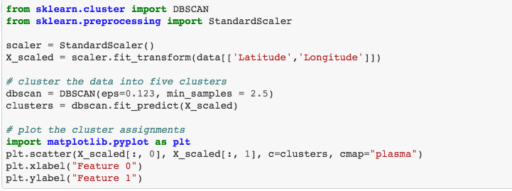
Main Article
Part 4: Applying one of Machine Learning Techniques (DBSCAN)

Slide 9
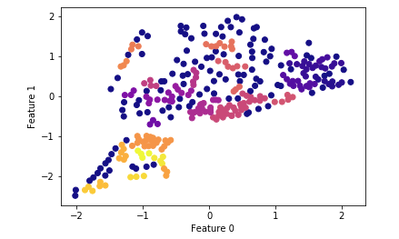
Clustering

Slide 10
Conclusion:
From the findings of the analysis we can provide the business man with information as to which neighbourhood is a possible candidate for building an Italian restaurant. We come to this conclusion as we can see from the final plot that the clusters form very close to the marks on the map that are the top rated restaurants.

Slide 11
Thank you for your time.

