Slide 1
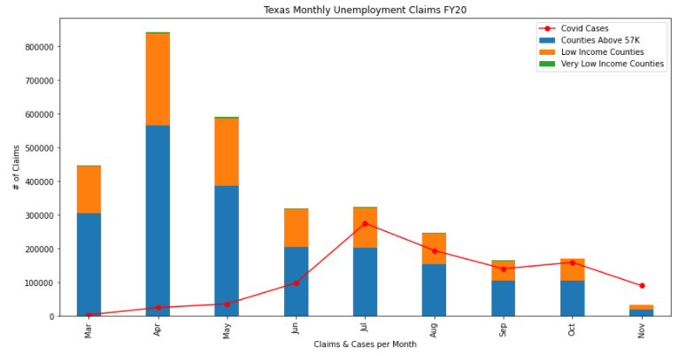
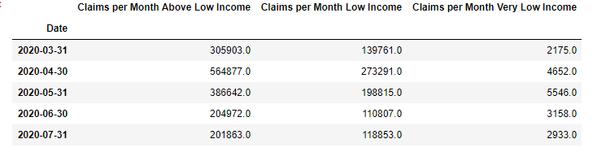
Data Analysis

Slide 2
Data Analysis
More unemployment claims made by those living in non-low-income counties (% of population low income vs not is this relative?)
Family of 4 household income can make up to $43,236 and still qualify for SNAP assistance
Spike in April could be due to March 19 state-wide lockdown order
Family of 4 household income can make up to $43,236 and still qualify for SNAP assistance

