Slide 1




The Affect of Covid-19 on Low Income Communities
October 1, 2020

Slide 2

Team Members
Jazlyn Mazick
Michael Rivera
Miguel Padilla
Niguel Williams

Slide 3
Hypothesis: Blah

Slide 4
Focus of Analysis
What was the affect of Covid-19 on low-income communities vs. the rest of the targeted population?
Was there any affect on unemployment claims during the Covid-19 Pandemic?
Is there any correlation between different urbanized categories as a result of Covid-19?

Slide 5
Sources
Covid-19 Dataset (County Level Confirmed – Latest Overall Numbers)
https://data.world/associatedpress/johns-hopkins-coronavirus-case-tracker/workspace/file?filename=1_county_level_confirmed_cases.csv
Covid-19 Dataset (County Level Cases & Deaths Timeseries)
https://data.world/associatedpress/johns-hopkins-coronavirus-case-tracker/workspace/file?filename=2_cases_and_deaths_by_county_timeseries.csv
Texas Counties: Median Household Income
https://txcip.org/tac/census/morecountyinfo.php?MORE=1013
Texas Weekly Claims by County
https://www.twc.texas.gov/files/agency/weekly-claims-by-county-twc.xlsx

Slide 6
Definitions

Slide 7
Data Cleanup and Explorations
I used the ‘datetime’ python library to clean up all my dates and make them look pretty
My ‘Aha! Moment’: unix dates work just like common date formats under the hood. Computers understand numbers, so numeric dates make sense.
My 1st headache with this set: I couldn’t understand the dates. They looked liked mumbo jumbo, until I converted them
I resolved this by using the python library ‘datetime’ and specifically by coding the following
Print(datetime.utcfromtimestamp(“1284101485”).strftime(‘%Y-%m-%d %H:%M:%S’)
Also converted dates from ‘Object’ data-type to ‘float64’ numeric data-type:
>>> df['Date of Publication'] = pd.to_numeric(extr) >>> df['Date of Publication'].dtype dtype('float64')

Slide 8
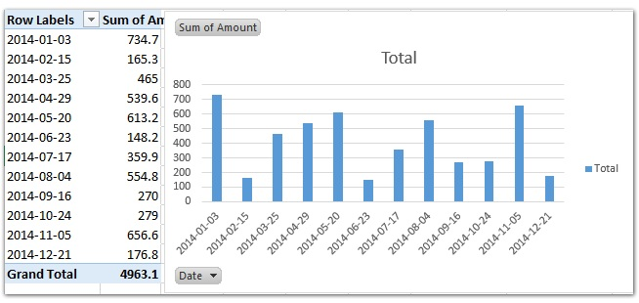
Data Cleanup and Explorations Continued
A look at the really important dates

Slide 9
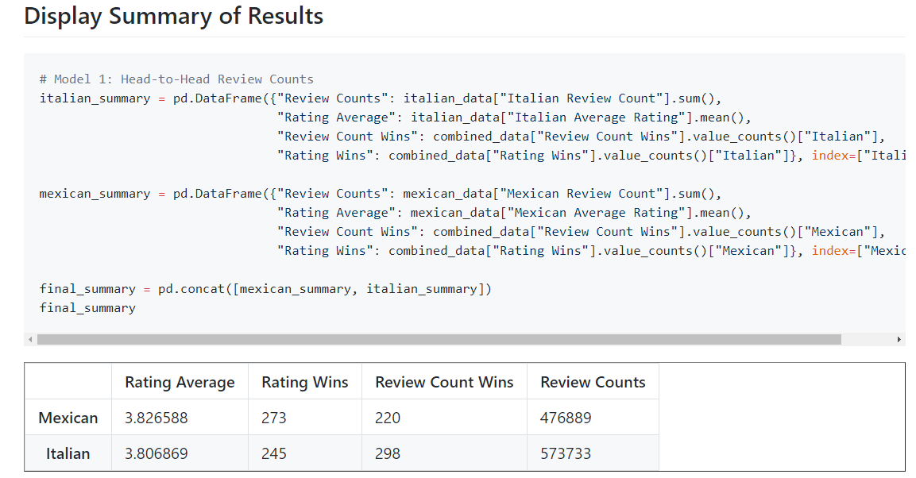
Data Analysis

Slide 10
Discussion
I found that there are some really important dates in this dataset. I didn’t expect to find this truth. The data initially led me to believe that all unix dates are just numbers, but now I realize they have a deeper meaning.

Slide 11
Post Mortem
I had a hard time dealing with unix datetimes. Couldn’t understand them at first.
I fixed that problem by converting the dates to a readable format, using python.
I really wished that we had many more years of dates in this dataset
Additional years would have shed more light on blahblahblah

Slide 12
Questions?

