Slide 1




The Affect of Covid-19 on Low Income Communities
October 1, 2020

Slide 2

Team Members
Jazlyn Mazick
Michael Rivera
Miguel Padilla
Niguel Williams

Slide 3
Project Proposal

Slide 4
Hypothesis: Blah

Slide 5
Focus of Analysis
What was the affect of Covid-19 on low-income communities vs. the rest of the targeted population?
Was there any affect on unemployment claims during the Covid-19 Pandemic?
How did COVID-19 affect different types of urbanization categories?

Slide 6
Sources
Covid-19 Dataset (County Level Confirmed – Latest Overall Numbers)
https://data.world/associatedpress/johns-hopkins-coronavirus-case-tracker/workspace/file?filename=1_county_level_confirmed_cases.csv
Covid-19 Dataset (County Level Cases & Deaths Timeseries)
https://data.world/associatedpress/johns-hopkins-coronavirus-case-tracker/workspace/file?filename=2_cases_and_deaths_by_county_timeseries.csv
Texas Counties: Median Household Income
https://txcip.org/tac/census/morecountyinfo.php?MORE=1013
Texas Weekly Claims by County
https://www.twc.texas.gov/files/agency/weekly-claims-by-county-twc.xlsx

Slide 7
Definitions
Timeseries

Slide 8
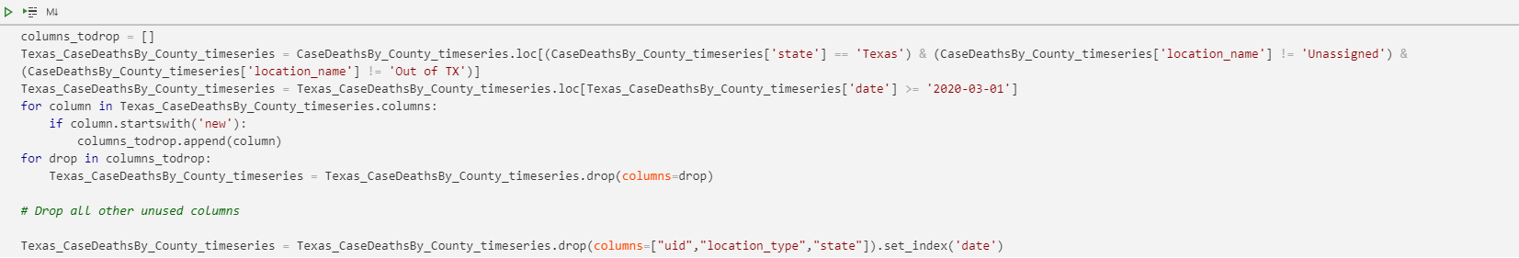
Data Cleansing
Looping through to remove unused columns
Selecting all rows based on end of month date
Cleaning and Transforming
Filtering dataset by State

Slide 9
Data Exploration and Wrangling
Divide and Conquer(Creating categorical DataFrames)

Slide 10
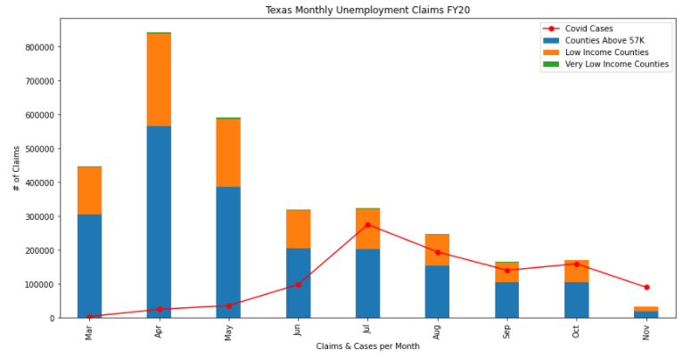
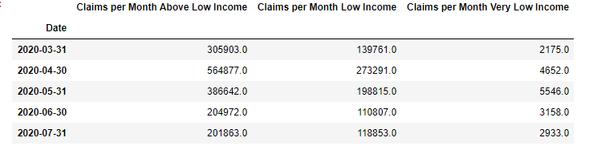
Data Analysis (Unemployment and Covid-19)
DataFrame View of Data

Slide 11
Data Analysis (Unemployment and Covid-19) - Continued
More unemployment claims made by those living in non-low-income counties (% of population low-income vs not is this relative?)
Family of 4 household income can make up to $43,236 and still qualify for SNAP assistance
Spike in April could be due to March 19 state-wide lockdown order
Family of 4 household income can make up to $43,236 and still qualify for SNAP assistance

Slide 12
Data Analysis – Income Categories and COVID-19
Low income communities had the highest prevalence of COVID-19
COVID cases spiked in July
Income categories and unemployment claims
Very low income communities had the least reported cases of COVID-19

Slide 13
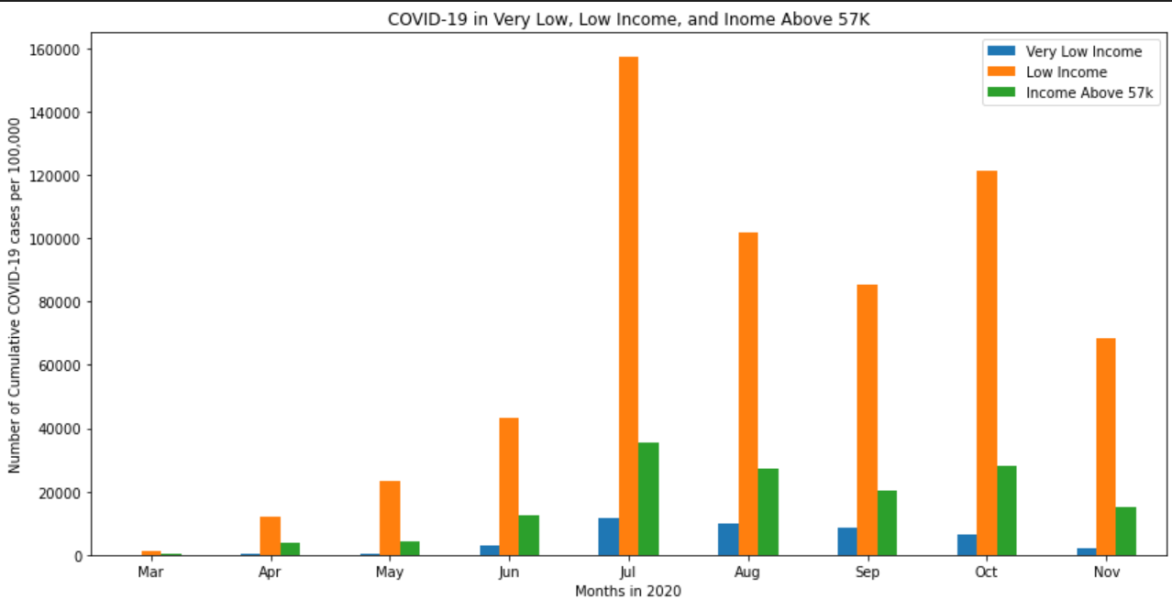
Data Analysis – Income Categories and COVID-19
Notes:
Pertaining to our question of how did covid-19 affect low income communities
We separated 254 counties in Texas by income category. *see definitions* this visualization shows that counties with primarily low income communities had the highest cumulative reported cases of covid-19 per 100,000. there are a multitude of factors that contribute to

Slide 14
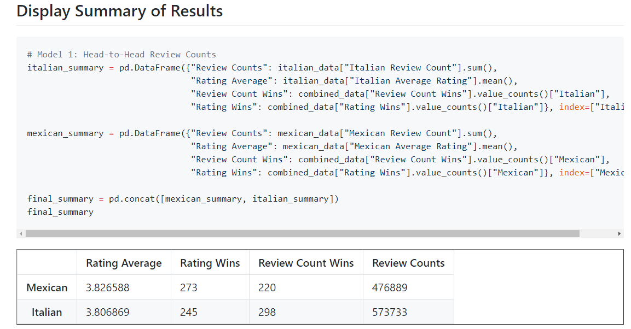
Data Analysis

Slide 15
Post Mortem
I had a hard time dealing with unix datetimes. Couldn’t understand them at first.
I fixed that problem by converting the dates to a readable format, using python.
I really wished that we had many more years of dates in this dataset
Additional years would have shed more light on blahblahblah

Slide 16
Questions?

