Slide 1

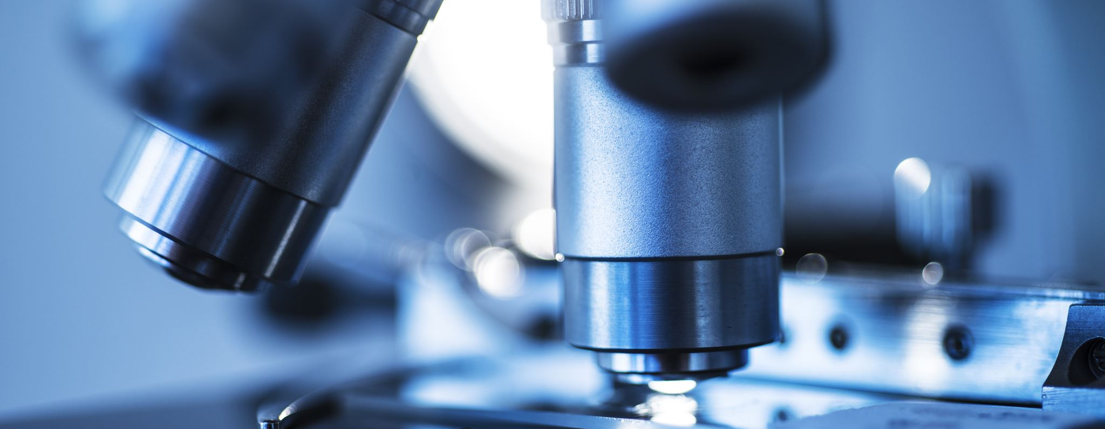


My Ridiculous Title Slide
By Joe Do and Sally Smith
October 1, 2020

Slide 2
Participants

Slide 3
Hypothesis: Blah
My main message to you:
Question 1 because blah
Question 2 because double blah
I answered both questions
Q1: blah^2
Q2: blah^3
Here is what I found overall:
Blah is boring

Slide 4
My Questions more in Depth
Q1: blahblahblahblahblahblah, blahblahblahb blahblahblahblahblahblah, blahblahblah emoji data, found at Facebook API
Q2: blahblahblahblahblahblah, blahblahblahb blahblahblahblahblahblah, blahblahblah tweets data, found on Twitter API
A surprising insight I found: BLAH!

Slide 5
Sources

Slide 6
Definitions

Slide 7
Data Cleanup and Explorations
I used the ‘datetime’ python library to clean up all my dates and make them look pretty
My ‘Aha! Moment’: unix dates work just like common date formats under the hood. Computers understand numbers, so numeric dates make sense.
My 1st headache with this set: I couldn’t understand the dates. They looked liked mumbo jumbo, until I converted them
I resolved this by using the python library ‘datetime’ and specifically by coding the following
Print(datetime.utcfromtimestamp(“1284101485”).strftime(‘%Y-%m-%d %H:%M:%S’)
Also converted dates from ‘Object’ data-type to ‘float64’ numeric data-type:
>>> df['Date of Publication'] = pd.to_numeric(extr) >>> df['Date of Publication'].dtype dtype('float64')

Slide 8
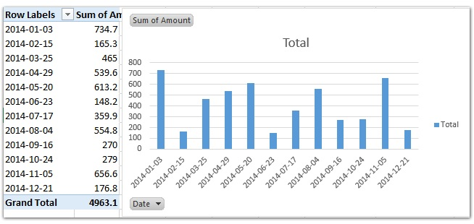
Data Cleanup and Explorations Continued
A look at the really important dates

Slide 9
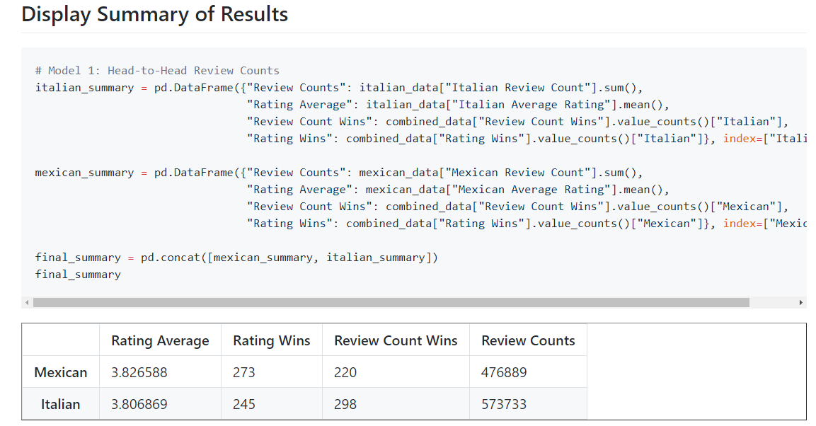
Data Analysis

Slide 10
Discussion
I found that there are some really important dates in this dataset. I didn’t expect to find this truth. The data initially led me to believe that all unix dates are just numbers, but now I realize they have a deeper meaning.

Slide 11
Post Mortem
I had a hard time dealing with unix datetimes. Couldn’t understand them at first.
I fixed that problem by converting the dates to a readable format, using python.
I really wished that we had many more years of dates in this dataset
Additional years would have shed more light on blahblahblah

Slide 12
Questions

