Slide 1
Data Analysis
More unemployment claims for the higher income counties
Spike in April
Unemployment cases fall for one group and rise for another

Slide 2
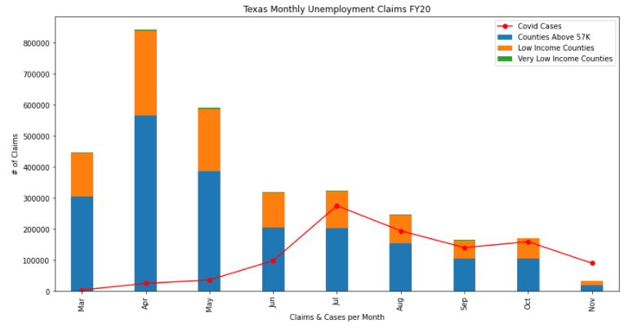
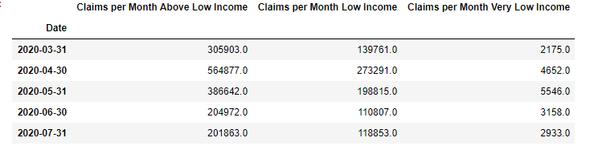
Data Analysis

Slide 3
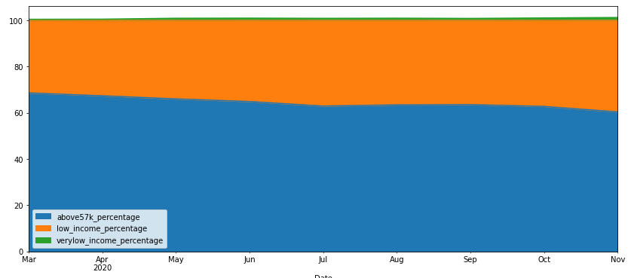
Data Analysis – Unemployment Claims by County Category

