Slide 1
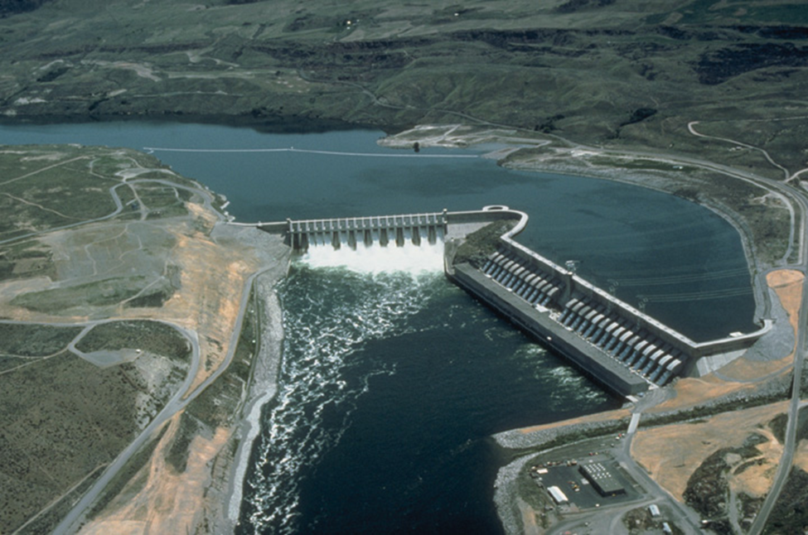







Water Power Peer Review
  Effects of
  Climate Change on Federal Hydropower
Michael J. Sale
M.J. Sale & Associates / ORNL
Wartburg, TN
11-3-2011
Notes:
[Principal Investigators: please use this template for your project presentation at the Peer Review Meeting, October 19-21, 2010. Your project’s accomplishments and progress are the primary focus of Review.
Do not include any information that is copyrighted, proprietary, or confidential in your presentation. Presentations and review results may be made public after the review. Please submit a .PPT file]

Slide 2
Purpose, Objectives, & Integration
Section 9505 of the SECURE Water Act required DOE to report to Congress on climate change effects at federal hydropower facilities
  Analyze the effects on water supplies for hydropower and power sales from Power Marketing Administrations (PMAs)
  First Report due in 2011, then every 5 years thereafter
  DOE to lead, in consultation with PMAs, USGS, NOAA, and states, as well as Corps and Reclamation
  Include recommendations from PMA administrators
  The “9505 Assessment” will enable better understanding of the future of the federal portion of the U.S. hydropower portfolio; it will also build new working relations with PMAs on hydropower issues.
Notes:
[Describe the challenges, barriers, knowledge gaps, or problems that this project addresses]
[Describe how solving this problem relates to the Program’s mission and objectives]
[If this project is a subtask of a larger, multi-part project, describe how this task’s results will be integrated with the results of the other tasks]

Slide 3
Challenges with the Assessment
How to structure short-term, limited-budget project to look at 132 federal projects?
  Three federal dams owners, four PMAs, plus USGS, NOAA, and state agencies
  One consistent, nationwide analysis required
How to organize complex climate science for application to hydropower community not familiar with it?
How to maximize use of existing information from both climate science and hydropower arenas?
  Use “best available scientific information”
How to communicate results to Congress and non-technical audiences?
  PMAs and their customers
Notes:
1. Identify the most important challenges faced during this reporting period and their impacts on technical accomplishments and progress.
2. Describe the approaches to resolving any issues or challenges faced during this reporting period

Slide 4
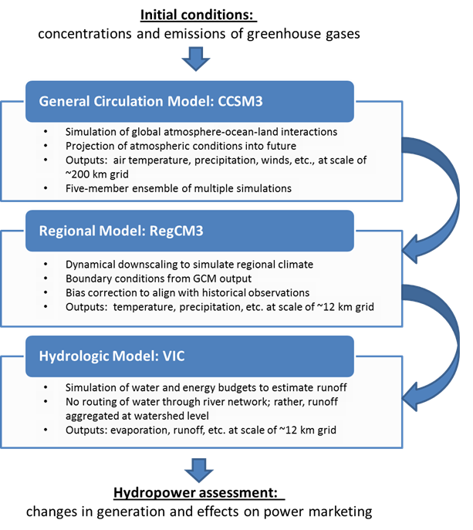
Technical Approach
Define regions of analysis
Describe existing power systems, including hydrologic sensitivity
Review climate change research and assessments
Design analysis approach that is consistent across regions
Work with existing data and on-going activities
Consult with USGS, NOAA, state agencies, plus Corps and Reclamation, to obtain best-available scientific data

Slide 5
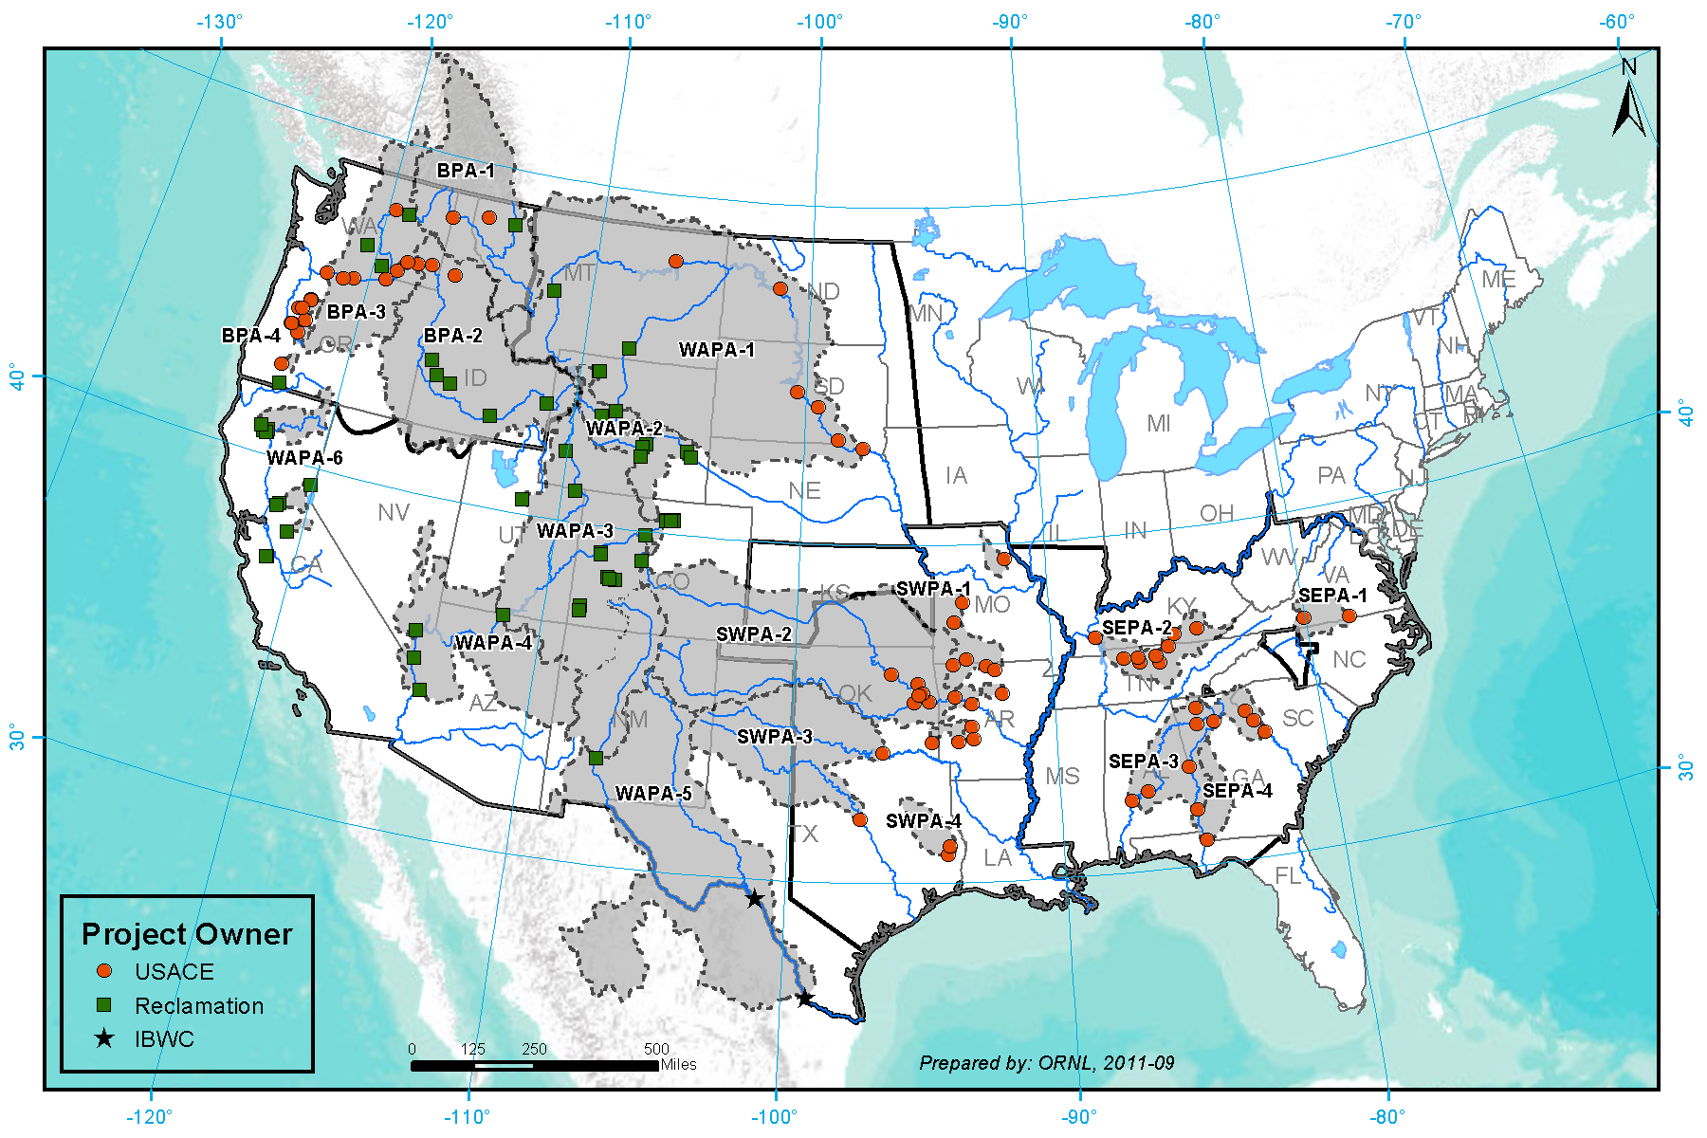
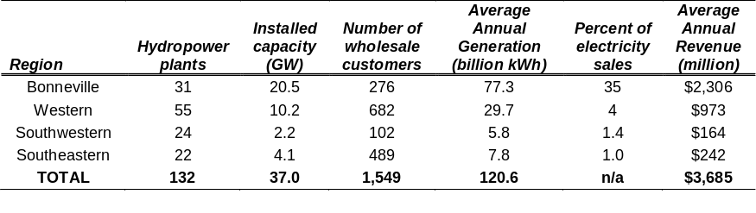
Projects, Regions, and Areas

Slide 6
Plan, Schedule, & Budget
Schedule:
Initiation date -- November 2010 (authorization and funding in place at ORNL)
Completion date -- September 30, 2011
  Initial consultations with PMAs started September 2010 and are continuing
  First draft Assessment Report completed and reviewed by PMAs in June 2011
  Technical review of Assessment Report conducted in August 2011
  Two drafts of Report to Congress completed in August 2011
  3rd draft of Report to Congress delivered to DOE-HQ on Sept. 28, 2011
  Final revised draft of Assessment Report completed on Sept. 30, 2011
Budget:
$449K expended as of September 30, 2011 (slightly under budget)
$51K (10%) carried over into FY12 to cover technical support during the DOE concurrence review
Budget History
FY2009 |  | FY2010 |  | FY2011
DOE | Cost-share | DOE | Cost-share | DOE | Cost-share
$0 | $0 | $500,000 | $0 | $0 | $0

Slide 7
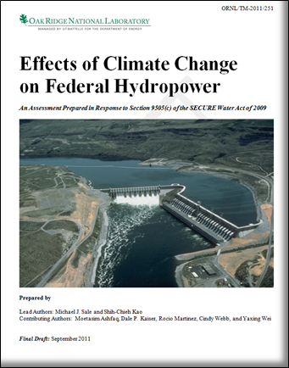
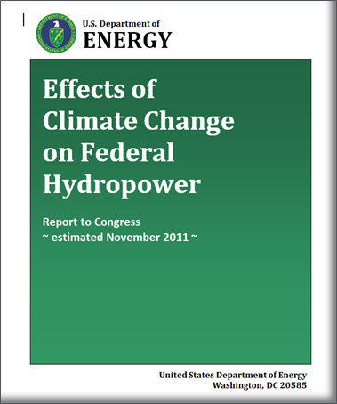
9505 deliverables
Two main products:
9505 Assessment Report
  ORNL/TM to be released concurrent with delivery of Report to Congress
  ~150 pages, including front material and eight appendices
9505 Report to Congress
  20-page summary of the Assessment Report, including recommendations from PMA Administrators
  To be delivered to Congress after DOE concurrence review is complete, before the end of CY11?

Slide 8
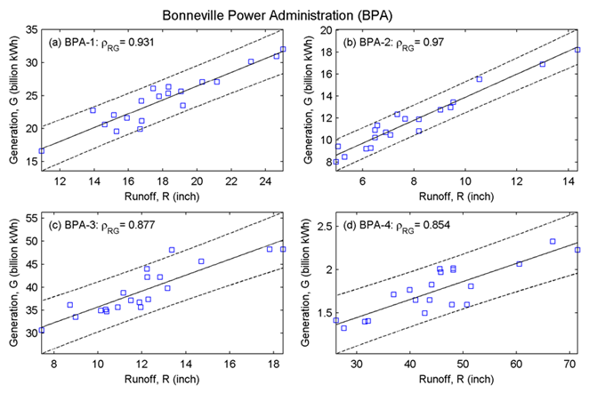
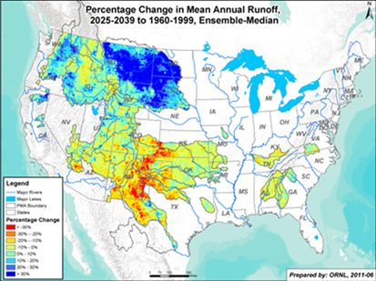
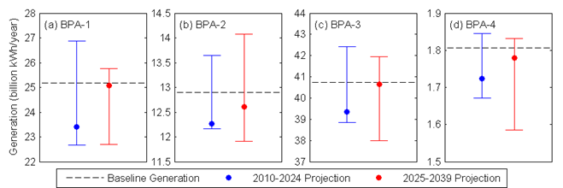
Accomplishments
Assembled a comprehensive database describing federal projects, power outputs, and climate variables
For first time, quantified the sensitivity of federal hydropower generation to water availability (runoff from upstream watersheds) on a nationwide basis
Assembled state-of-the-art models to project hydropower-relevant climate variables into the future
Estimated future climate change impacts to federal hydropower and completed an rigorous technical review to ensure the quality and defensibility of the assessment
1
2
3

Slide 9
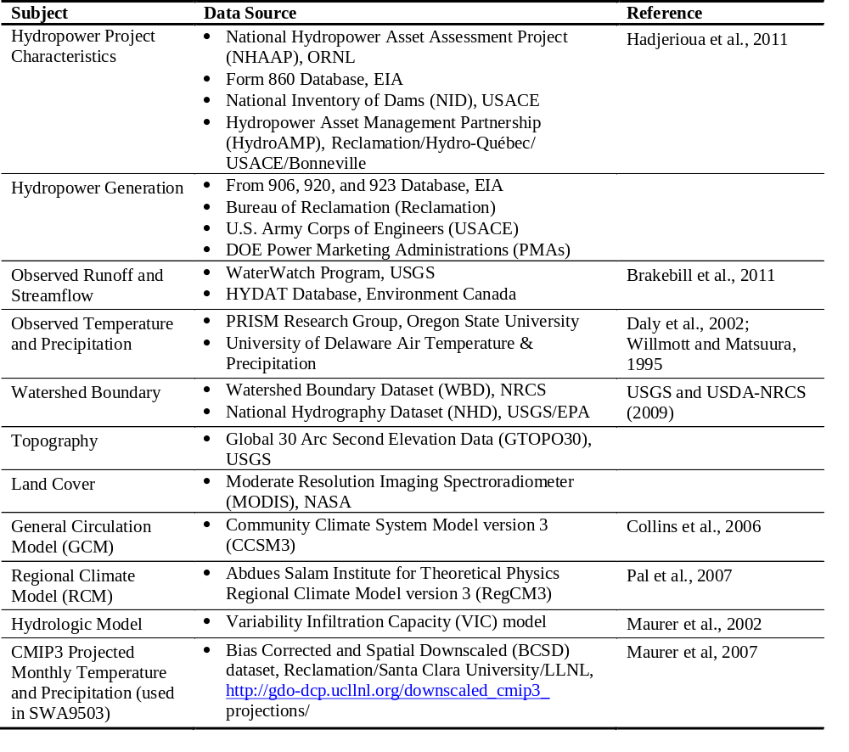
Integrated Database
A wide range of data types and sources where used
Observational
Data
Model
Outputs

Slide 10
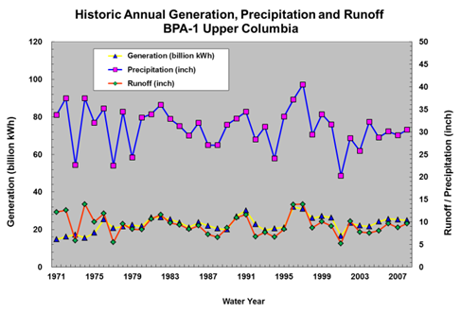
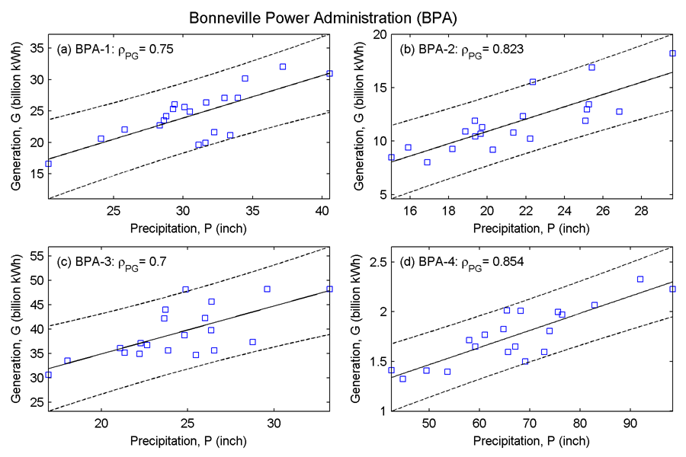
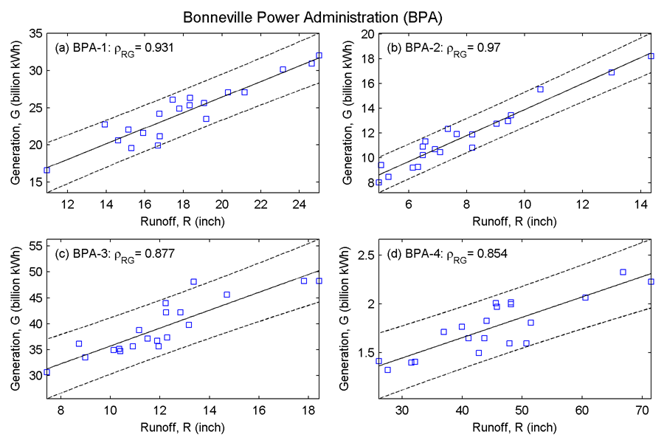
Existing hydropower systems
Hydropower generation is highly variable year-to-year
Annual runoff is a good predictor of annual generation
In some areas, multi-year runoff is a better predictor of generation

Slide 11
Climate modeling
Used existing model data where possible
Global modeling with GCM
  CCSM3 developed by NCAR with support from NSF and DOE
  One emission scenario, A1b (moderate)
  Five-member ensemble
Regional modeling to increase resolution
  Regional Climate Model version 3 (RegCM3) from International Center for Theoretical Physics
  Dynamical downscaling
  Bias correction to PRISM T and P data (1960 to 1999)
Hydrologic modeling of water and energy balances
  Variable Infiltration Capacity (VIC) model from U. Washington
  No routing; rather, runoff aggregated over upstream watershed
  Bias correction to USGS WaterWatch runoff data (1960-1999)
  End product = daily runoff on ~12 km grid from 1870 to 2099

Slide 12
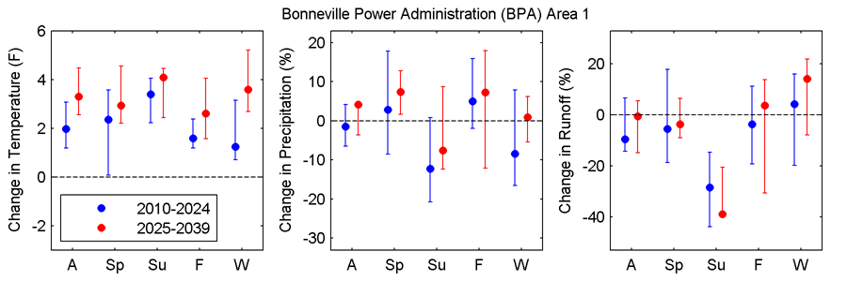
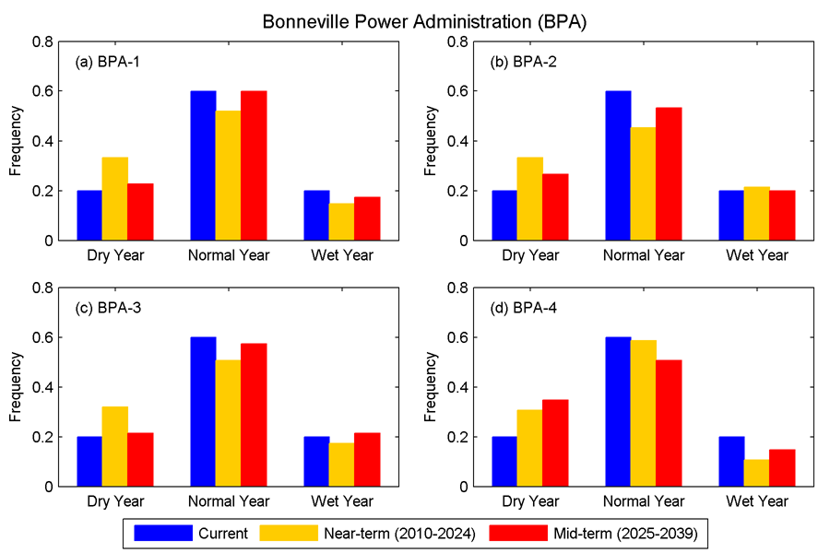
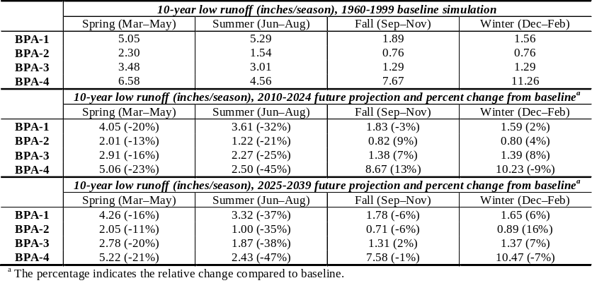
Projections of climate and power
Results for near-term and mid-term periods, and for 18 areas, annual and seasonal basis
Air temperature, precipitation, and runoff
Frequency of water year types
Intensity of critical low-flow periods
Change in annual hydropower generation

Slide 13
Major Findings
Assessment methods and data
  Success: defensible projections can be made with existing information
  Limitations: shorter-term and project-specific impacts not addressed in this first 9505 assessment
Direct effects of climate change on federal hydropower
  For next 30 years, range of effects to hydropower similar to variability of generation over past 20 years
  Longer-term trends in hydrology will pose greater challenges (published work by others)
Indirect effects of climate change
  Not modeled in 9505 assessment but real nevertheless
  Examples: climate impacts on fish habitat and on demand for power
Capability of federal PMAs to manage risks
  Contracting mechanisms in place to mitigate energy shortfalls and to share burden
Interactions with other pressures on water resources
  Neither hydropower nor climate are isolated issues – they must be dealt with in more integrated assessment and planning

Slide 14
Next Steps
Current Activities for FY2012
  Complete the DOE Concurrence process (HQ lead with ORNL support) and deliver 9505 Report to Congress
  Work with PMAs and other federal agencies to communicate results (e.g., organize HydroVision panel)
Preparing for future assessments
  Congress authorized 9505 assessments every five years
  Recommendations from Assessment Report:
    Maintain and improve databases
    Develop better modeling of climate and projects
    Integrate climate assessment with other water resources management issues
    Study interactions among federal and nonfederal power systems
    Engage with other agencies and stakeholders on climate issues (e.g., Federal Climate Change and Water Working Group)
Notes:
1. Explain project plans for the rest of FY12 and/or to project completion; discuss remaining barriers that the project plans to address, and list upcoming milestones and deliverables.
2. Discuss possible next steps and their impacts; describe tasks that could be added or expanded; describe potential opportunities for future research and development suggested by project results.

Slide 15
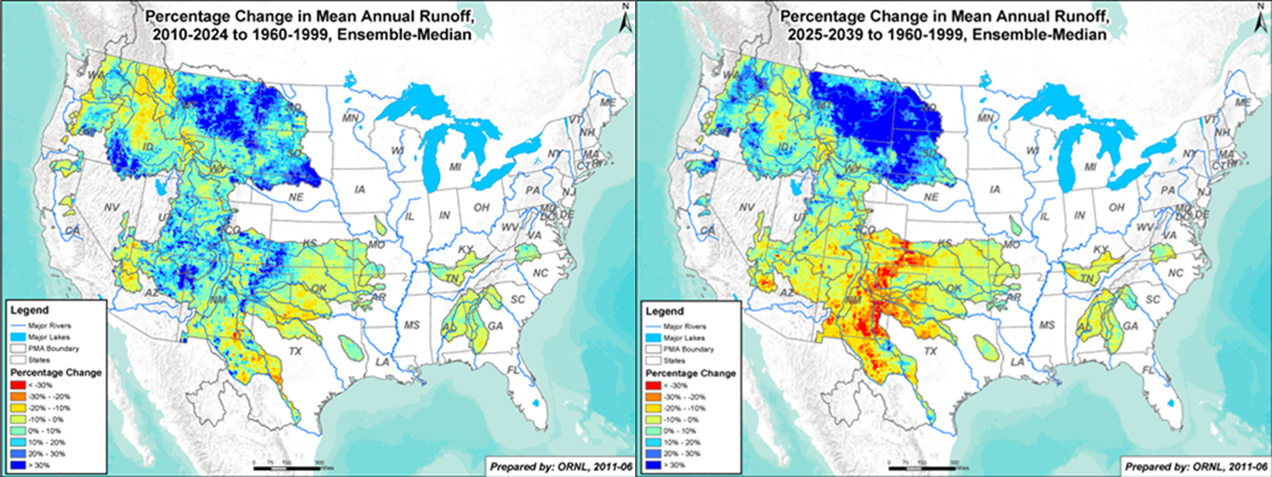
Additional Slides
BACKUP SLIDES
Notes:
The following slides are for information purposes only

Slide 16
SECURE Water Act of 2009
“SECURE Water” = Science and Engineering to Comprehensively Understand and Responsibly Enhance Water
Section 9501. Findings
Section 9502. Definitions
Section 9503. Reclamation Climate Change and Water Program
      Reclamation’s Report to Congress
Section 9504. Water Management Improvement
Section 9505. Hydroelectric Power Assessment
      * This DOE report *
Section 9506. Climate Change and Water Intragovernmental Panel
      USGS’s Report to Congress
Section 9507. Water Data Management by the U.S. Geological Survey
Section 9508. National Water Availability and Use Assessment Program
Section 9509. Research Agreement Authority
Section 9510. Effect

Slide 17
SECURE Water Act Section 9505
Duty of Secretary of Energy- The Secretary of Energy, in consultation with the Administrator of each Federal Power Marketing Administration, shall assess each effect of, and risk resulting from, global climate change with respect to water supplies that are required for the generation of hydroelectric power at each Federal water project that is applicable to a Federal Power Marketing Administration.
(b) Access to Appropriate Data-
(1) IN GENERAL- In carrying out each assessment under subsection (a), the Secretary of Energy shall consult with the United States Geological Survey, the National Oceanic and Atmospheric Administration, the program, and each appropriate State water resource agency, to ensure that the Secretary of Energy has access to the best available scientific information with respect to presently observed impacts and projected future impacts of global climate change on water supplies that are used to produce hydroelectric power.
(2) ACCESS TO DATA FOR CERTAIN ASSESSMENTS- In carrying out each assessment under subsection (a), with respect to the Bonneville Power Administration and the Western Area Power Administration, the Secretary of Energy shall consult with the Commissioner to access data and other information that--
(A) is collected by the Commissioner; and
(B) the Secretary of Energy determines to be necessary for the conduct of the assessment.

Slide 18
SECURE Water Act Section 9505 (cont.)
(c) Report- Not later than 2 years after the date of enactment of this Act, and every 5 years thereafter, the Secretary of Energy shall submit to the appropriate committees of Congress a report that describes--
(1) each effect of, and risk resulting from, global climate change with respect to--
(A) water supplies used for hydroelectric power generation; and
(B) power supplies marketed by each Federal Power Marketing Administration, pursuant to--
(i) long-term power contracts;
(ii) contingent capacity contracts; and
(iii) short-term sales; and
(2) each recommendation of the Administrator of each Federal Power Marketing Administration relating to any change in any operation or contracting practice of each Federal Power Marketing Administration to address each effect and risk described in paragraph (1), including the use of purchased power to meet long-term commitments of each Federal Power Marketing Administration.

Slide 19
SECURE Water Act Section 9505 (cont.)
(d) Authority- The Secretary of Energy may enter into contracts, grants, or other agreements with appropriate entities to carry out this section.
(e) Costs-
(1) NONREIMBURSABLE- Any costs incurred by the Secretary of Energy in carrying out this section shall be nonreimbursable.
(2) PMA COSTS- Each Federal Power Marketing Administration shall incur costs in carrying out this section only to the extent that appropriated funds are provided by the Secretary of Energy for that purpose.
(f) Authorization of Appropriations- There are authorized to be appropriated such sums as are necessary to carry out this section for each of fiscal years 2009 through 2023, to remain available until expended.

Slide 20
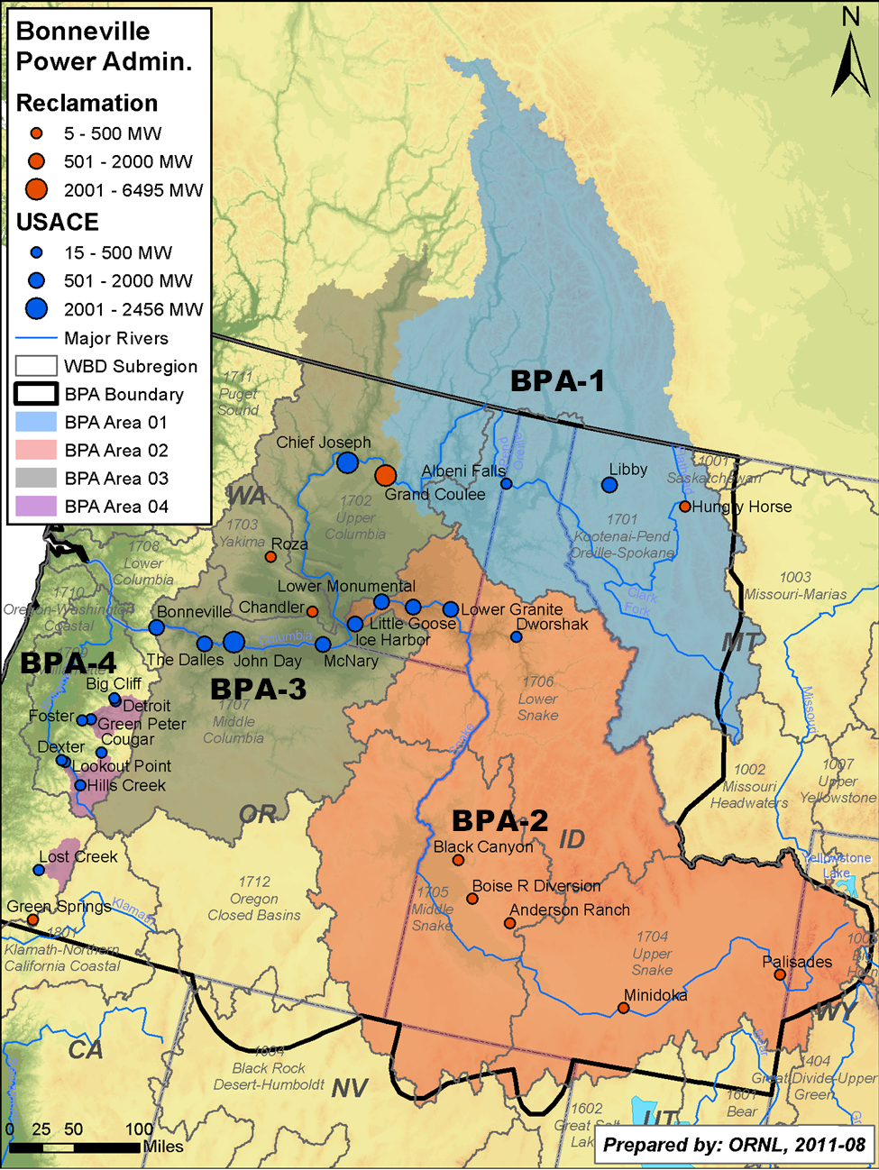
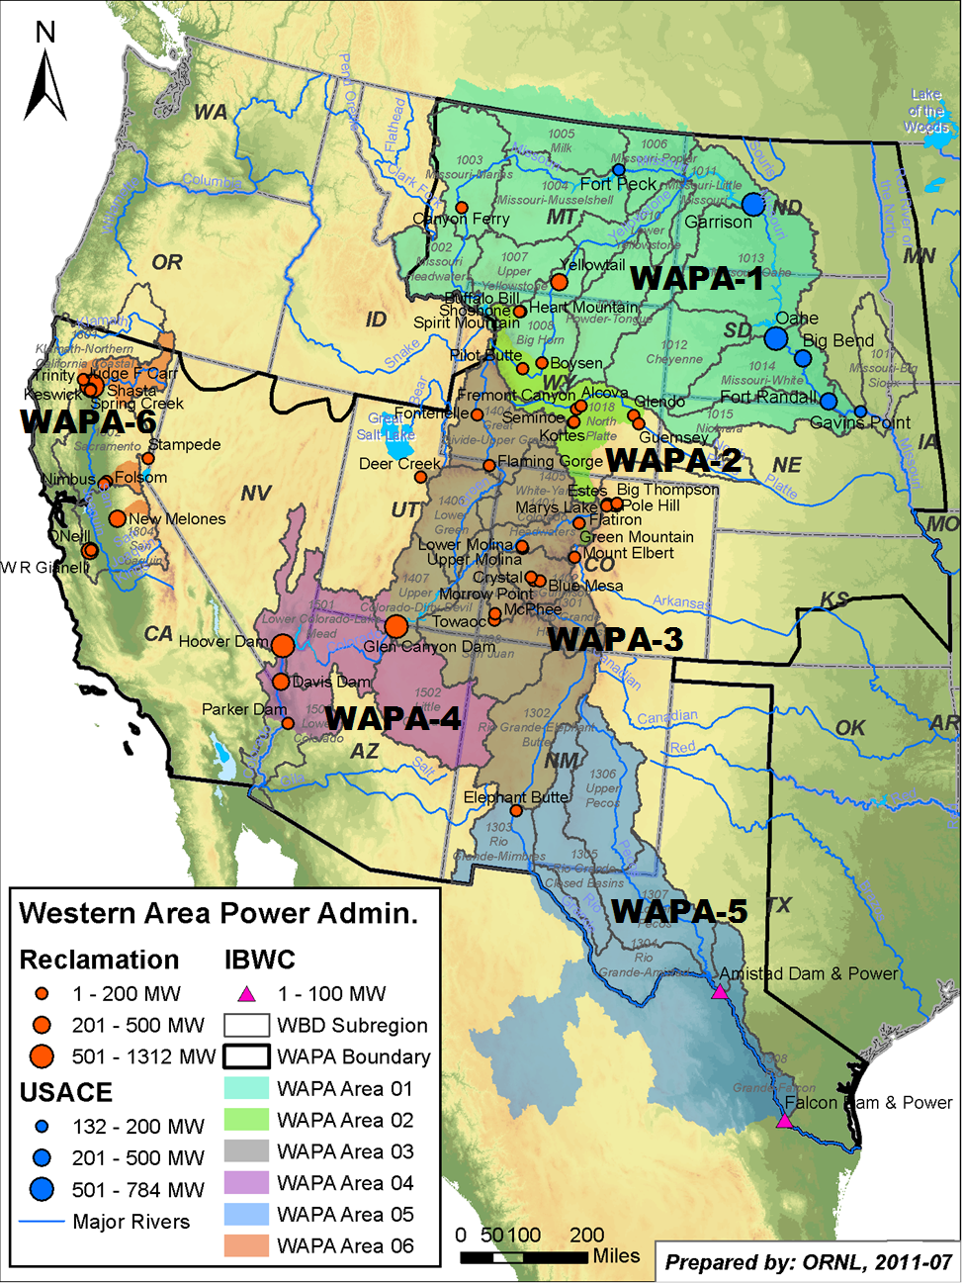
Regions and assessment areas

Slide 21
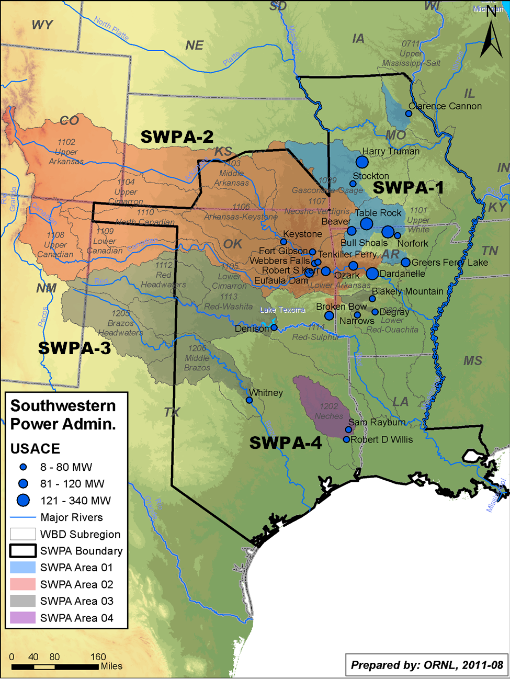
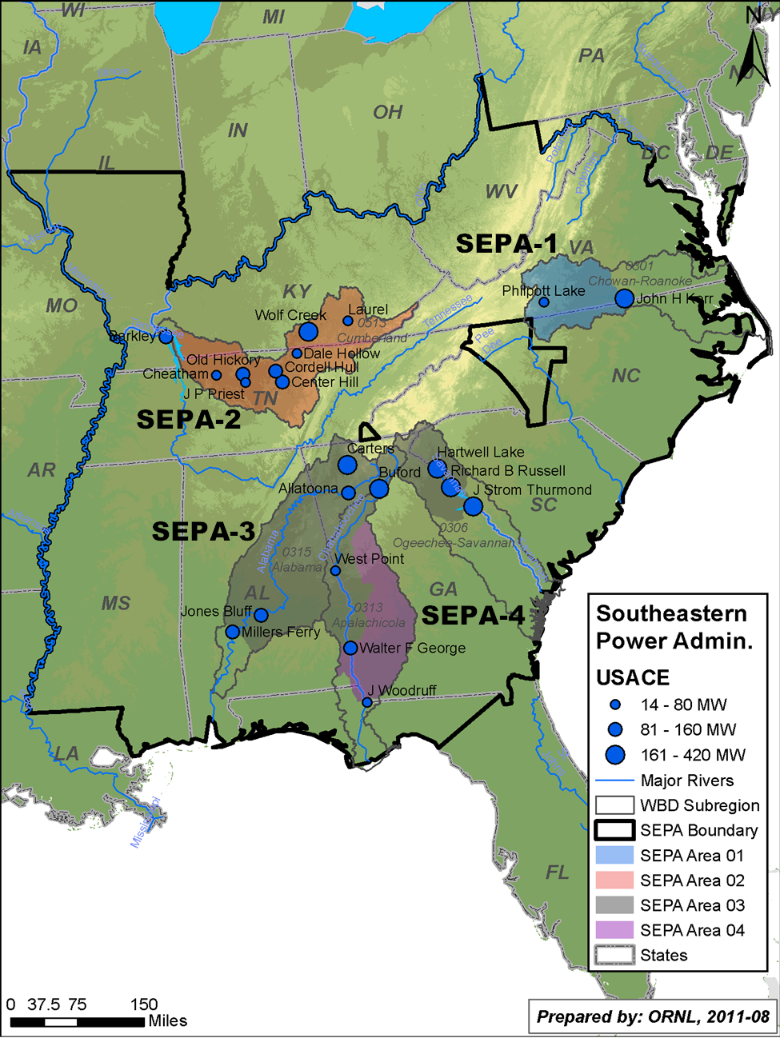
Regions and assessment areas

Slide 22
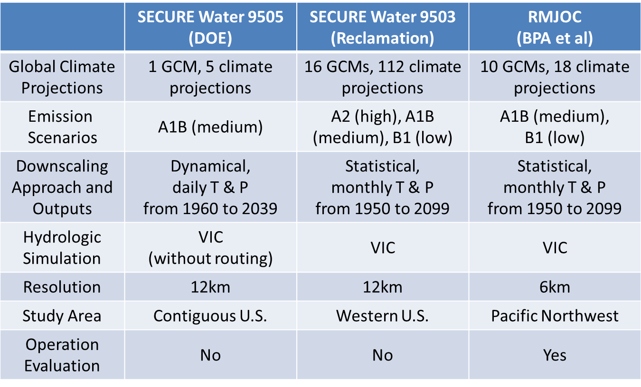
Comparison to other studies

